Slide 2
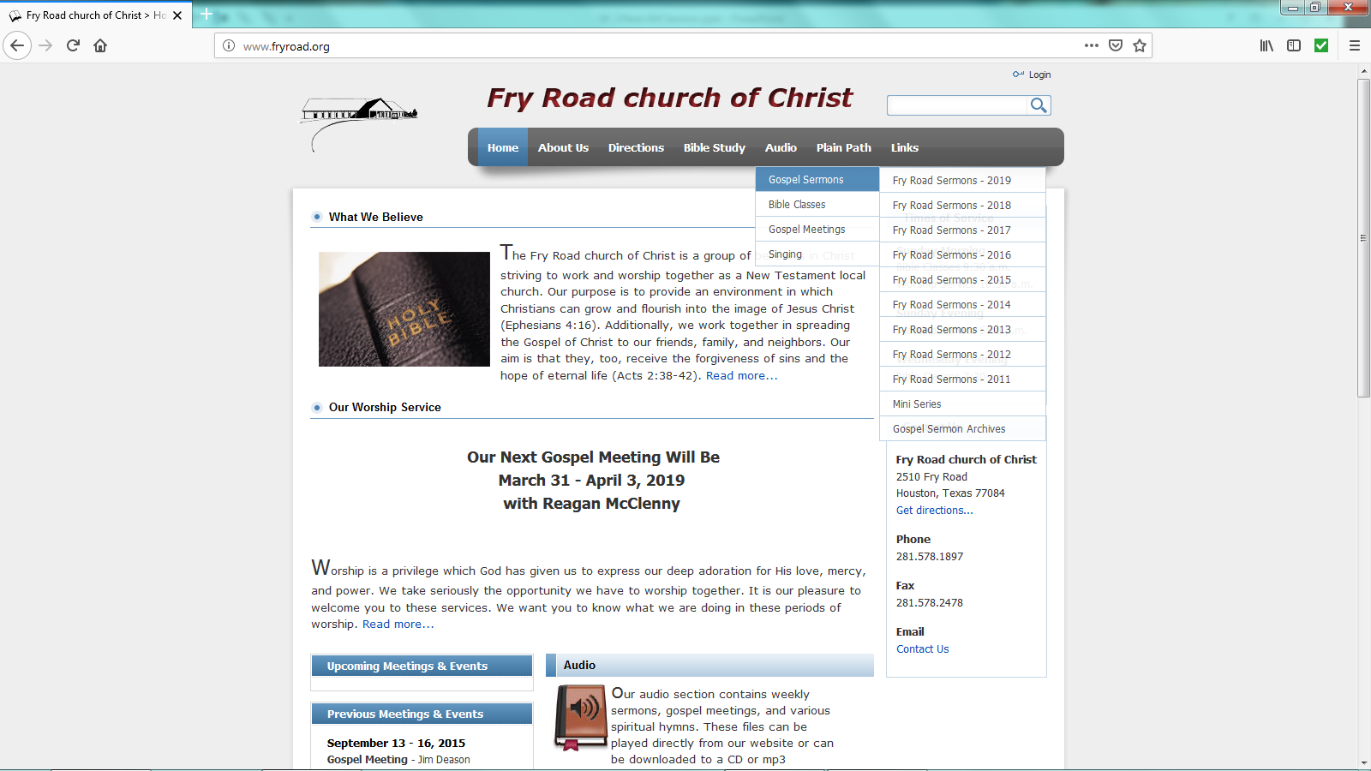
www.fryroad.org

Slide 3
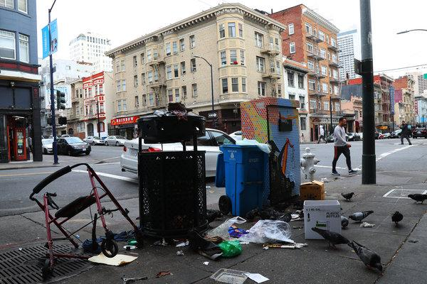
This World
Is Not
My Home

Slide 4
This World Is Not My Home
Three questions worth asking:
If the world isn’t our home, then what is?
How might the world become our home?
Which home really is worth it?

Slide 5
Compartmentalization:
Spiritual
Values
(Devotion)
Church
Recreation
Diet
Medical
Friends

Slide 6
Spiritual Values
(Devotion)

Slide 7
Spiritual Values
(Devotion)
Church
Politics
Recreation
Diet
Medical
Friends

Slide 8
Compartmentalization:
Spiritual
Values
(Devotion)
Church
Recreation
Diet
Medical
Friends

Slide 9
This World Is Not My Home
Three questions worth asking:
If the world isn’t our home, then what is?
How might the world become our home?
Which home really is worth it?

