Slide 2
John 5
¹² And through the hands of the apostles many signs and wonders were done among the people. And they were all with one accord in Solomon’s Porch. ¹³ Yet none of the rest dared join them, but the people esteemed them highly. ¹⁴ And believers were increasingly added to the Lord, multitudes of both men and women, ¹⁵ so that they brought the sick out into the streets and laid them on beds and couches, that at least the shadow of Peter passing by might fall on some of them. ¹⁶ Also a multitude gathered from the surrounding cities to Jerusalem, bringing sick people and those who were tormented by unclean spirits, and they were all healed.

Slide 3
John 5
¹² And through the hands of the apostles many signs and wonders were done among the people. And they were all with one accord in Solomon’s Porch. ¹³ Yet none of the rest dared join them, but the people esteemed them highly. ¹⁴ And believers were increasingly added to the Lord, multitudes of both men and women, ¹⁵ so that they brought the sick out into the streets and laid them on beds and couches, that at least the shadow of Peter passing by might fall on some of them. ¹⁶ Also a multitude gathered from the surrounding cities to Jerusalem, bringing sick people and those who were tormented by unclean spirits, and they were all healed.

Slide 4
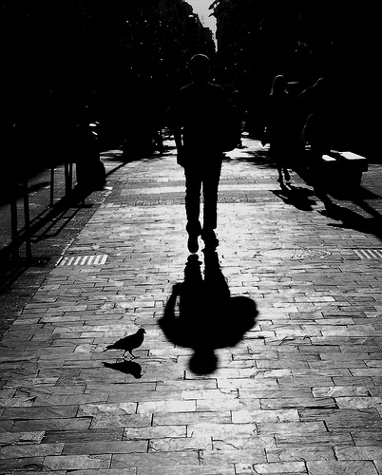
Me and
My Shadow

Slide 5
Casting Shadows
We all cast a shadow, sometimes a long one.
We have no idea whom our shadow may touch.
We may cast a good shadow or a bad shadow.
We must all give thought to the shadow we cast.

