Slide 1
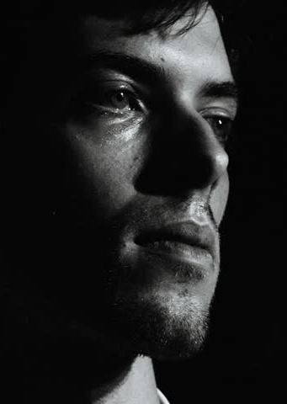
Repentance
For the Rest of Us....
Notes:
* Not a lesson for two groups
1. Those who are self-righteous and, therefore, see no need for repentance in their life
2. Those who are truly righteous and never need to repent again
* As I said, this lesson is for neither of those groups … it is for the rest of us.

Slide 2
  Introduction
John preached repentance (Matthew 3:1-2)
Jesus preached repentance (Matthew 4:17, Luke 13:3)
It was part of the Limited Commission (Mark 6:12)
It was part of the Great Commission (Luke 24:46-47)
It was part of what was preached to the Jews on Pentecost (Acts 2:37-38)
It was part of what Paul preached to the Gentiles saying it must be done by every person in every place (Acts 17:30-31)
Notes:
We cannot escape the conclusion that repentance is a fundamental part of the Gospel of Jesus Christ; that it is a necessary part of salvation.
We need to be certain that we don’t skip it; we skip it to the destruction of our souls!

Slide 3
  Repentance
For the Rest of Us....
Recognition of Sin (2 Samuel 24:10; Acts 2:36-38; Acts 3:14-15, 19)
Remorse for Sin (2 Samuel 24:17; 2 Corinthians 7:9-10, I.E. Matthew 27:1-5)
Resolve to Change (Luke 15:17-18; Jonah 3:5-9; Cf. Matthew 12:39-41)
Reformed Conduct (Matthew 21:28-31; Jonah 3:10; Luke 3:7-9)
Restitution if Possible (Leviticus 6:1-7; Luke 19:8-9)
Notes:
We shall never repent of something we do not acknowledge we have done wrong.
Deep, abiding and heart-felt grief over the wrong we have done (not simply over having been caught, but of having done it) motivates us to true repentance.
A very personal, definitive choice that emanates from within our hearts.
Not just stopping — a lot of people stop doing bad things when they get too old, they get tired, or they get incarcerated — rather it is stopping because our will has been adjusted by the truth of God. A truly altered and amended way of living that continues. Not a temporary change, but a permanent one.
It is not always a possibility; but, when there has been a true change we try to make things right. (Matthew 7:12)

