Slide 1
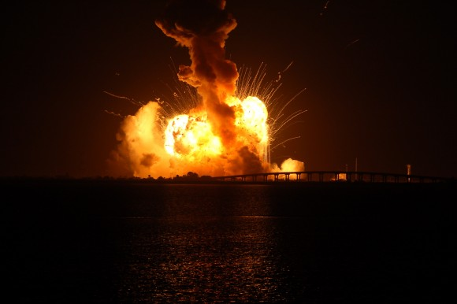
Failure to Launch
Why Some Never Seem to Get off the Ground Spiritually
Notes:
Like a rocket that never gets off the launching pad, some never become Christians, and some that do make no progress toward becoming what God wants them to become or doing what God wants them to accomplish. We must launch! Start by being born again. Develop your talents, and don’t let self-satisfatction, pride, or selfishness hinder you. Accept your position as priest. Allow God to accomplish His purpose for your life.

Slide 2
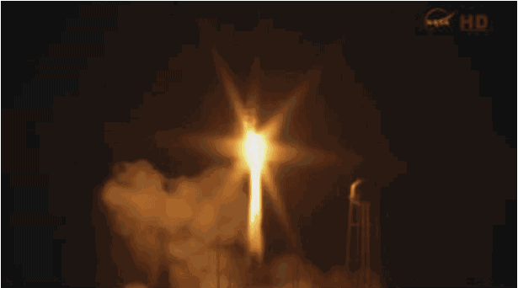
Failure to Launch
Why Some Never Seem to Get off the Ground Spiritually

Slide 3
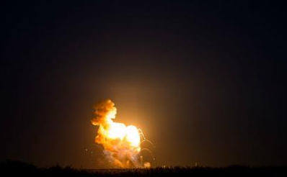
Failure to Launch
Why some never get off the ground spiritually
Some are never born again
You’ll never meet your potential as a child of God if you never become a child of God. (John 3:7)
A person must be willing to apply the teaching, training and encouragement that he has received (Proverbs 6:20-22; 15:32; 2 Timothy 3:14-15; Colossians 2:6-7)

Slide 4
Failure to Launch
Why some never get off the ground spiritually
Some never develop or use their talents
We must commit to using what God has given us (Luke 19:12-27)
But self-satisfaction stifles our drive to excel (2 Peter 1:5; Philippians 3:12-14)
And pride and selfishness prevent us from pursuing our potential (Jude 12; Judges 13-16; Proverbs 13:1)

Slide 5
Failure to Launch
Why some never get off the ground spiritually
Some never accept their mission as priests
Every Christian is part of a kingdom of priests. (Revelation 1:5-7; 5:10)
As priests, we proclaim God’s praises (1 Peter 2:9)
As priests, we teach God’s word (Malachi 2:7; Hebrews 5:12-14)
As priests, we offer sacrifices (Hebrews 13:15-16)

Slide 6
Get off the Ground!
Questions You Must Ask God
“What did You have in mind when You created me?”
“What do You want me to do with my life?”
“How high should I aim?”
“What potential lies within me?”
“What can You accomplish through me?”
Answers You Must Accept
To be like Jesus! (Romans 8:29)
Glorify Him! (Ephesians 1:11-12)
Out of this world! (Colossians 3:1-2)
God’s good works! (Ephesians 2:10)
More than you think! (Ephesians 3:20)

