Slide 1

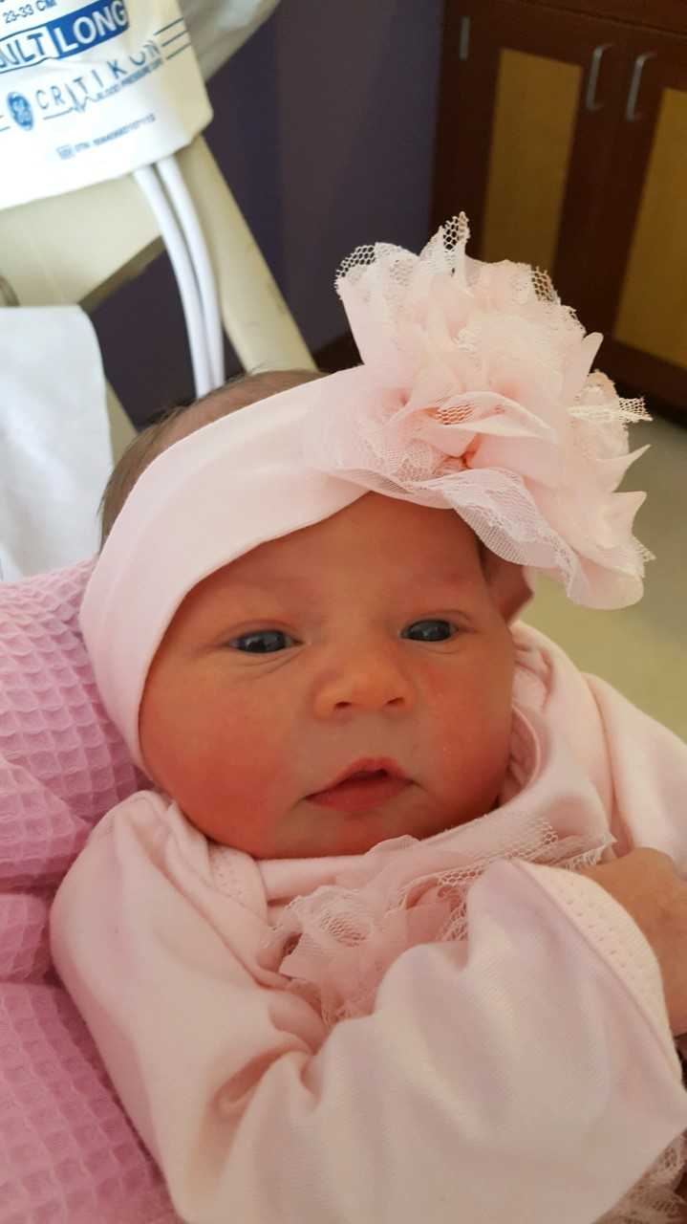
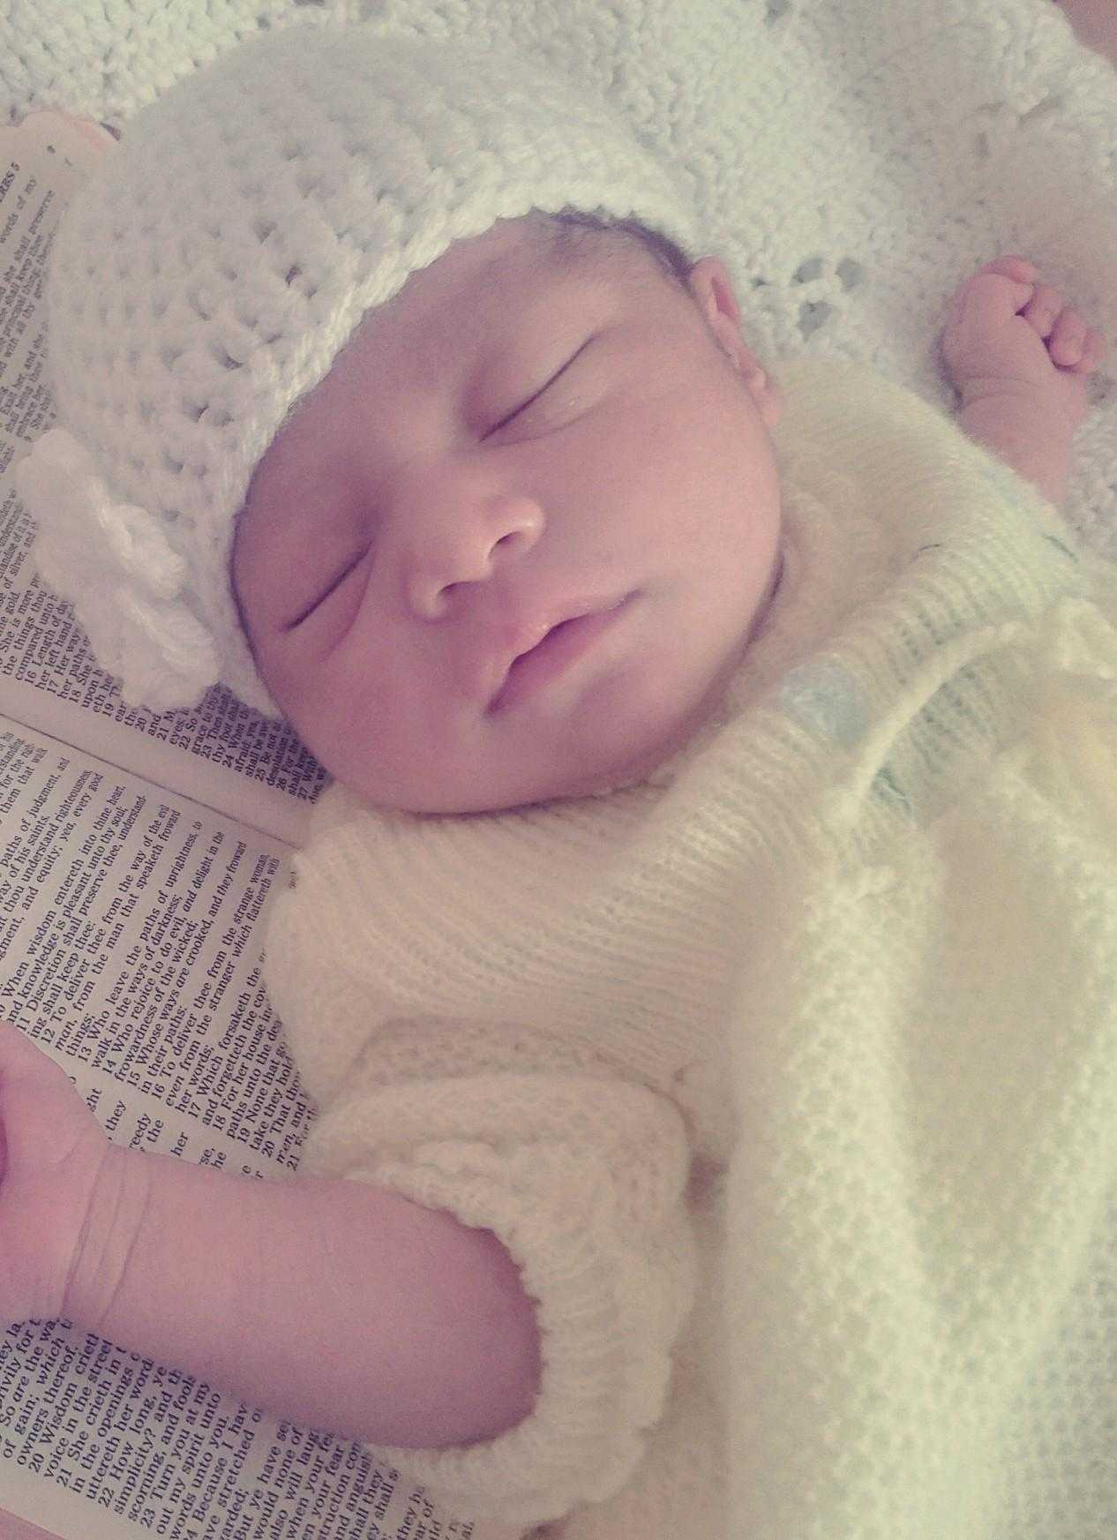

Slide 2
A new beginning…

Slide 3
…by Becoming a Christian
Hear the gospel
  Acts 18:8
Believe the gospel
  Mark 16:16, John 3:16
Repent of your sins
  Luke 13:3, Acts 2:38

Slide 4
…by Becoming a Christian
Make your confession
  Matthew 10:32-33, Romans 10:9-10
Be Baptized for the remission of your sins
  Mark 16:16, John 3:3, Romans 6:4
Becoming a Christian gives us a new life

Slide 5
…By Remaining Faithful
Revelation 2:9-10
Continue to Repent
  Matthew 4:17, Acts 8:22
Keep good communication with God
  1 Thessalonians 5:17
    “Pray without ceasing”
  Matthew 26:41

Slide 6
…By Remaining Faithful
Study to know the gospel
  2 Timothy 2:15, 2 Timothy 4:2
Coming to services
  Hebrews 10:22-25
Helping others
  Philippians 2:4, Galatians 6:2
By remaining faithful, we keep a clean soul

Slide 7
…by being restored
Luke 15:11-32
2 sons
  1 son remained obedient
  1 son wasted his riches with sin
”Prodigal son” returns home
  ²¹ And the son said to him, ‘Father, I have sinned against heaven and in your sight; I am no longer worthy to be called your son.’
the father rejoices
  ³² But we had to celebrate and rejoice, for this brother of yours was dead and has begun to live, and was lost and has been found.’”

Slide 8
…by being restored
The lost sheep
  Luke 15:1-7
The lost coin
  Luke 15:8-10
God rejoices over all of those who come back to him

Slide 10
God’s Plan of Salvation
Hear
  Acts 18:8
Believe
  John 3:16; Mark 16:16; Acts 16:31
Repent
  Matthew 4:17; Acts 2:38; Luke 13:3; Acts 8:22
Confess
  Matthew 10:32-33; Romans 10:9-10
Be Baptized
  Mark 16:14-20; John 3:3, 5-8; Romans 6:4; I Peter 3:21; Acts 2:38
Live a Faithful Life
  Revelation 2:10

