Slide 1
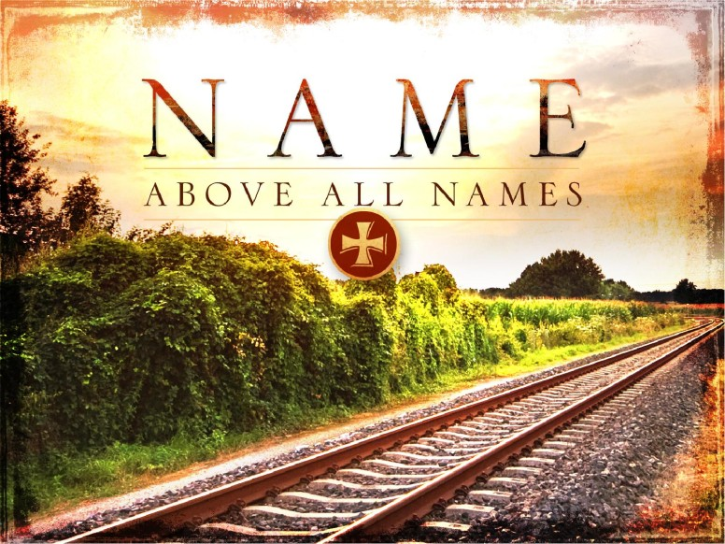

Slide 2
A Year End Look at
JESUS CHRIST
Acts 4:12 Heb. 12:1-3
O’neal church of Christ, Athens, Alabama “A Year End Look at Jesus Christ” Dec. 31, 2017

Slide 3
Hebrews 12:1-3
12 Wherefore seeing we also are compassed about with so great a cloud of witnesses, let us lay aside every weight, and the sin which doth so easily beset us, and let us run with patience the race that is set before us,
² Looking unto Jesus the author and finisher of our faith; who for the joy that was set before him endured the cross, despising the shame, and is set down at the right hand of the throne of God.
³ For consider him that endured such contradiction of sinners against himself, lest ye be wearied and faint in your minds

Slide 4
Heb. 1:1-3 7 things that show Jesus is King of Kings and Lord of
Lords.

Slide 5
1. Heb.1:2 . "Whom he hath appointed heir of all things ..."
2. Heb. 1:2 "Through whom also he made the worlds ...“
3. Heb. 1:3 “Who being the brightness (effulgence )of
his glory,
4. Heb. 1:3 "And the express image of his person (the
very image of his substance“)
5. Heb. 1:3 “And upholding all things by the word of
his power”
6. Heb. 1:3 “’When he had by himself purged our sins
(‘when he had made purification of sins’)
7. Heb. 1:3 “Sat down on the right hand of the Majesty
on high.”

Slide 6
This hymn offers three reasons why we should extol Jesus as our Lord and King.
I. Stanza 1 says that He is a glorious friend "Wonderful Jesus! glorious friend! He will be with me unto the end, Cheering, upholding, keeping me strong, Fearless and loyal, shielding from wrong." A. Jesus is truly a loyal friend of whom we never need fear that He will forsake us: Jn. 15.14 Ye are my friends, if ye do whatsoever I command you.
B. This is because He has promised to be be with us unto the end of the age: Matt. 28.20 C. As our Friend, He will help to keep us strong in the power of His might: Eph. 6.10 Finally, my brethren, be strong in the Lord, and in the power of his might.

Slide 7
II. Stanza 2 says that He shows us the way
"Wonderful Jesus! showing the way Into the blessed kingdom of day; Guiding my footsteps, holding control, Making me happy, keeping me whole.“
A. Jesus is the only way by which we can come to the Father:Jno.14:1
B. Thus, He is the way into the blessed kingdom of day and will abundantly supply us an entrance into that everlasting kingdom: 2 Pet. 1:11 For so an entrance shall be ministered unto you abundantly into the everlasting kingdom of our Lord and Saviour Jesus Christ. C. He guides our footsteps on the way to that kingdom by leaving us an example that we should follow Him: 1 Pet. 2.21 For even hereunto were ye called: because Christ also suffered for us, leaving us an example, that ye should follow his steps

Slide 8
III. Stanza 3 says that He will keep us all through the night
"Wonderful Jesus! all through the night He will enfold me, giving me light; Then when the morning breaks on the shore, This He will whisper, ‘Mine evermore.’“
A. The term "night" often represents times of sorrow and sadness: Ps. 91.5 Thou shalt not be afraid for the terror by night; nor for the arrow that flieth by day B. Jesus is the light that guides us through the darkness of this world: Jn.8:12 Then spake Jesus again unto them, saying, I am the light of the world: he that followeth me shall not walk in darkness, but shall have the light of life. C. His goal is to lead us to eternal life where the morning breaks on the shore: Ps. 30.5 For his anger endureth but a moment; in his favour is life: weeping may endure for a night, but joy cometh in the morning

Slide 9
CONCL.: The chorus then breaks forth with praise for Jesus as our King.
"Wonderful Jesus! Marvelous King! Ever His praise my spirit shall sing; When I behold His glorified face, How I shall praise His wonderful grace.“
As we think about all that Jesus our Lord and King has done, is doing, and will do for us, we are bound to sing praise to this "Wonderful Jesus.“ Let’s sing: #793

Slide 10
Many people have lived upon this earth.
So many lived by faith in the Son of God.
Though most follow the broad way, there
Are those who have entered in the narrow way.
Matt. 7:13-14 Enter ye in at the strait gate: for wide is the gate, and broad is the way, that leadeth to destruction, and many there be which go in thereat:
¹⁴ Because strait is the gate, and narrow is the way, which leadeth unto life, and few there be that find it.

Slide 11
Many have looked unto God by faith:
1. Abel. Heb 11:4
2. Enoch. Heb. 11:5
3. Noah. Heb. 11:7
4. Abraham. Heb. 11:8-10,12, 17-19
5. Sara. Heb. 11:11
6. Isaac. Heb. 11:20
7. Jacob. Heb. 11:21

Slide 12
8. Joseph. Heb. 11:22
9.Moses. Heb. 11:23-29
10.Joshua (N.N.) Heb. 11:30
11.Harlot Rahab. Heb. 11:31
12.Heb.11: 32 “and what shall I more say? For the time would fail Me to tell of Gedeon, Barak, Samson, Jephthae; of David, Samuel; And of the prophets…..who endured so much showing their Faith in God… And all were looking for Jesus to Come.
He came. He lived. He died. He was raised from the dead He Ascended back to the Father. He is our King today!

Slide 13
Hebrews 11:13-16¹³ These all died in faith, not having received the promises, but having seen them afar off, and were persuaded of them, and embraced them, and confessed that they were strangers and pilgrims on the earth.
¹⁴ For they that say such things declare plainly that they seek a country.
¹⁵ And truly, if they had been mindful of that country from whence they came out, they might have had opportunity to have returned.
¹⁶ But now they desire a better country,(so do we!) that is, an heavenly: wherefore God is not ashamed to be called their God: for he hath prepared for them a city.
(What a reunion There will be in that great city!)

Slide 14
A Year End Look,
Last day of 2017,
We look to Jesus

Slide 15
Isaiah 9:6 For unto us a child is born,
unto us a son is given: and the government
shall be upon his shoulder: and his name
shall be called Wonderful, Counsellor, The mighty God,
The everlasting Father, The Prince of Peace

Slide 16
Isa. 52:6-10 ⁶ Therefore my people shall know my name: therefore they shall know in that day that I am he that doth speak: behold, it is I.
⁷ How beautiful upon the mountains are the feet of him that bringeth good tidings, that publisheth peace; that bringeth good tidings of good, that publisheth salvation; that saith unto Zion, Thy God reigneth!
⁸ Thy watchmen shall lift up the voice; with the voice together shall they sing: for they shall see eye to eye, when the Lord shall bring again Zion.
⁹ Break forth into joy, sing together, ye waste places of Jerusalem: for the Lord hath comforted his people, he hath redeemed Jerusalem.
¹⁰ The Lord hath made bare his holy arm in the eyes of all the nations; and all the ends of the earth shall see the salvation of our God.

Slide 17
And on this December 31, 2017…
We Sing: WONDERFUL
Wonderful, wonderful,
Jesus is to me
Counselor, Prince of Peace,
Mighty God is He
Saving me, keeping me
From my sin and shame
Wonderful is my Redeemer
PRAISE HIS NAME. Let’s sing: 900

Slide 18
THE SAME. YESTERDAY, TODAY, AND FOREVER
Heb. 13:8 Jesus Christ the same yesterday,
And today, and for ever.
You can always count on Jesus!

Slide 19
HE IS THE AUTHOR OF our SALVATION…
Heb. 12:1-2

Slide 20
He tells us plainly how to live
acceptably with God
Heb. 11:6

Slide 21
His Promises to us will be kept.
Standing on the Promises of Christ my King!!
# 598 all 4 verses

Slide 22
2 Pet. 1:3-15
³ According as his divine power hath given unto us all things that pertain unto life and godliness, through the knowledge of him that hath called us to glory and virtue:
⁴ Whereby are given unto us exceeding great and precious promises: that by these ye might be partakers of the divine nature, having escaped the corruption that is in the world through lust.
⁵ And beside this, giving all diligence, add to your faith virtue; and to virtue knowledge;
⁶ And to knowledge temperance; and to temperance patience; and to patience godliness;
⁷ And to godliness brotherly kindness; and to brotherly kindness charity.

Slide 23
⁸ For if these things be in you, and abound, they make you that ye shall neither be barren nor unfruitful in the knowledge of our Lord Jesus Christ.
⁹ But he that lacketh these things is blind, and cannot see afar off, and hath forgotten that he was purged from his old sins.
¹⁰ Wherefore the rather, brethren, give diligence to make your calling and election sure: for if ye do these things, ye shall never fall:
¹¹ For so an entrance shall be ministered unto you abundantly into the everlasting kingdom of our Lord and Saviour Jesus Christ.
¹² Wherefore I will not be negligent to put you always in remembrance of these things, though ye know them, and be established in the present truth.

Slide 24
¹³ Yea, I think it meet, as long as I am in this tabernacle, to stir you up by putting you in remembrance;
¹⁴ Knowing that shortly I must put off this my tabernacle, even as our Lord Jesus Christ hath shewed me.
¹⁵ Moreover I will endeavour that ye may be able after my decease to have these things always in remembrance.

Slide 25
Jesus invites you to come to Him
This morning to be saved.
His plan is simple:
Hear Rom.10:17
Believe John 8:24
Repent. Acts 2:38
Confess Christ. Matt.10:32-33
Be baptized. Gal.3:27; Acts 22:16
Live faithfully to Him. If you haven’t, confess your faults and
Return to Him. I John 2:1-2

