Slide 1
A Brief History of myself and the work in Huntington, West Virginia

Slide 2
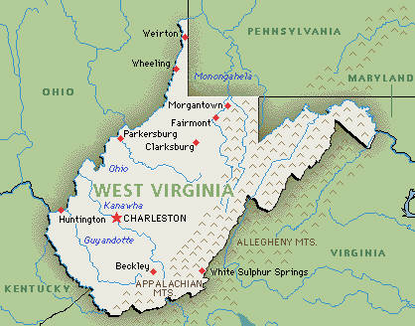

Slide 3


Slide 5
How to make Disciples
Matt 28:18-20
Make disciples – how? What is God wanting?
Count the costs: Luke 14:25-35 Unless you….. you cannot be my disciple!
Salt that has lost its taste is no longer any good.
Deut 4:2 “You shall not add to the word which I am commanding you, nor take away from it, that you may keep the commandments of the Lord your God which I command you.”

Slide 6
Graduated college in December 2001
1 Tim 6:17 “Instruct those who are rich in this present world not to be conceited or to fix their hope on the uncertainty of riches, but on God, who richly supplies us with all things to enjoy.”

Slide 7
Daniel 4:25 “that you be driven away from mankind and your dwelling place be with the beasts of the field, and you be given grass to eat like cattle and be drenched with the dew of heaven; and seven periods of time will pass over you, until you recognize that the most high is ruler over the realm of mankind and bestows it on whomever He wishes.”

Slide 9
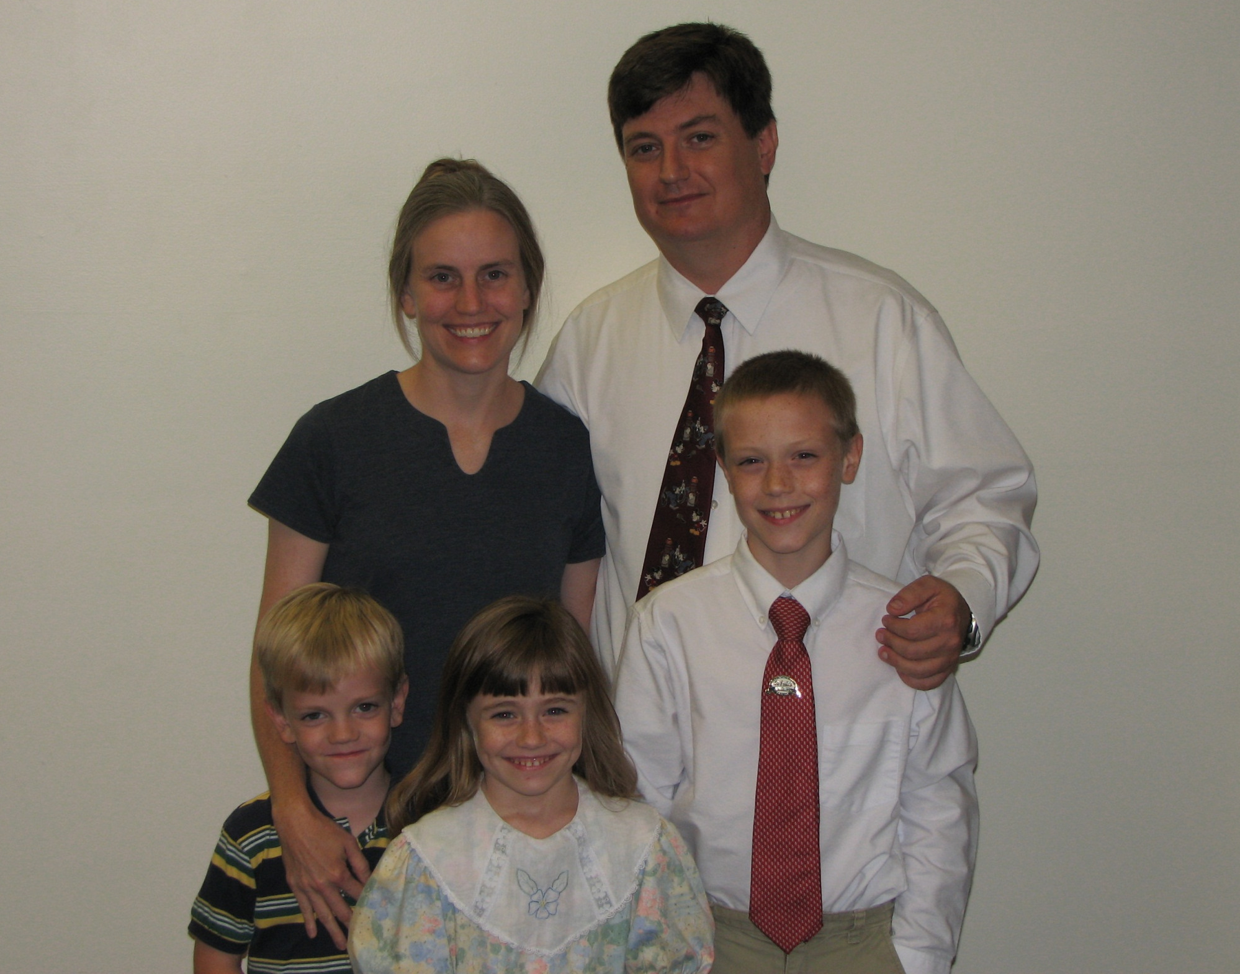

Slide 11
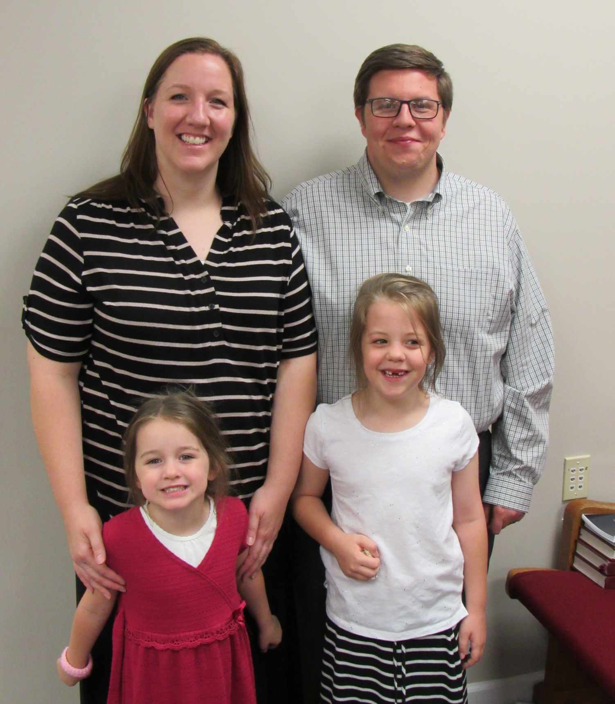

Slide 13
1 Tim 4:12 “Let no one look down on your youthfulness, but rather in speech, conduct, love, faith and purity, show yourself an example of those who believe.”
How can I help the kingdom?
How can I strengthen the work God wants done?
80 percent of the work done by 20 percent of the people.
Illustration of a cart

Slide 14
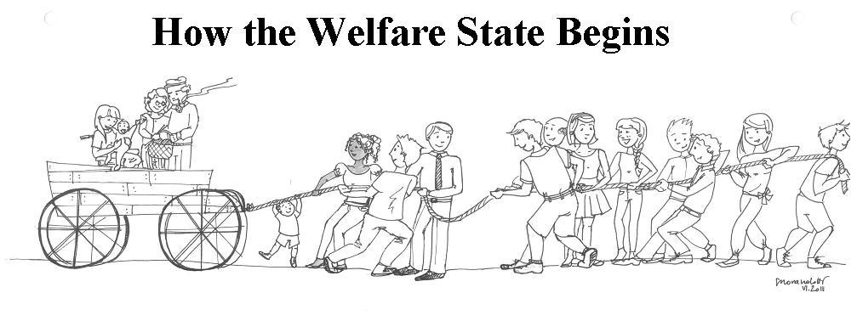

Slide 16
How to describe a church?
Psalm 133:1 “Behold, how good and how pleasant it is for brethren to dwell together in unity!”
Ex. Rev 2:1-7 the church at Ephesus.
Some 30 years after Paul wrote his epistle to them
Jesus mentions in Revelation 2 that they had endured and not grown weary – how they had not tolerated evil men, but…

Slide 17
How to describe a church?
They had left their first love, He admonished them to do the deeds they did at first or Jesus would remove their lampstand
The church is not brick and mortar. It is made up of individuals.
The individuals are made by the gospel. Shaped & molded by devotion to God’s word.
Romans 12:2 “And do not be conformed to this world, but be transformed by the renewing of your mind, that you may prove what is that good and acceptable and perfect will of God.”

Slide 18
How to describe a church?
They had left their first love, He admonished them to do the deeds they did at first or Jesus would remove their lampstand
The church is not brick and mortar. It is made up of individuals.
The individuals are made by the gospel. Shaped & molded by devotion to God’s word.
Romans 12:2 “And do not be conformed to this world, but be transformed by the renewing of your mind, that you may prove what is that good and acceptable and perfect will of God.”

Slide 19
How to describe a church?
The church in Huntington has 1st generation Christians.

Slide 20
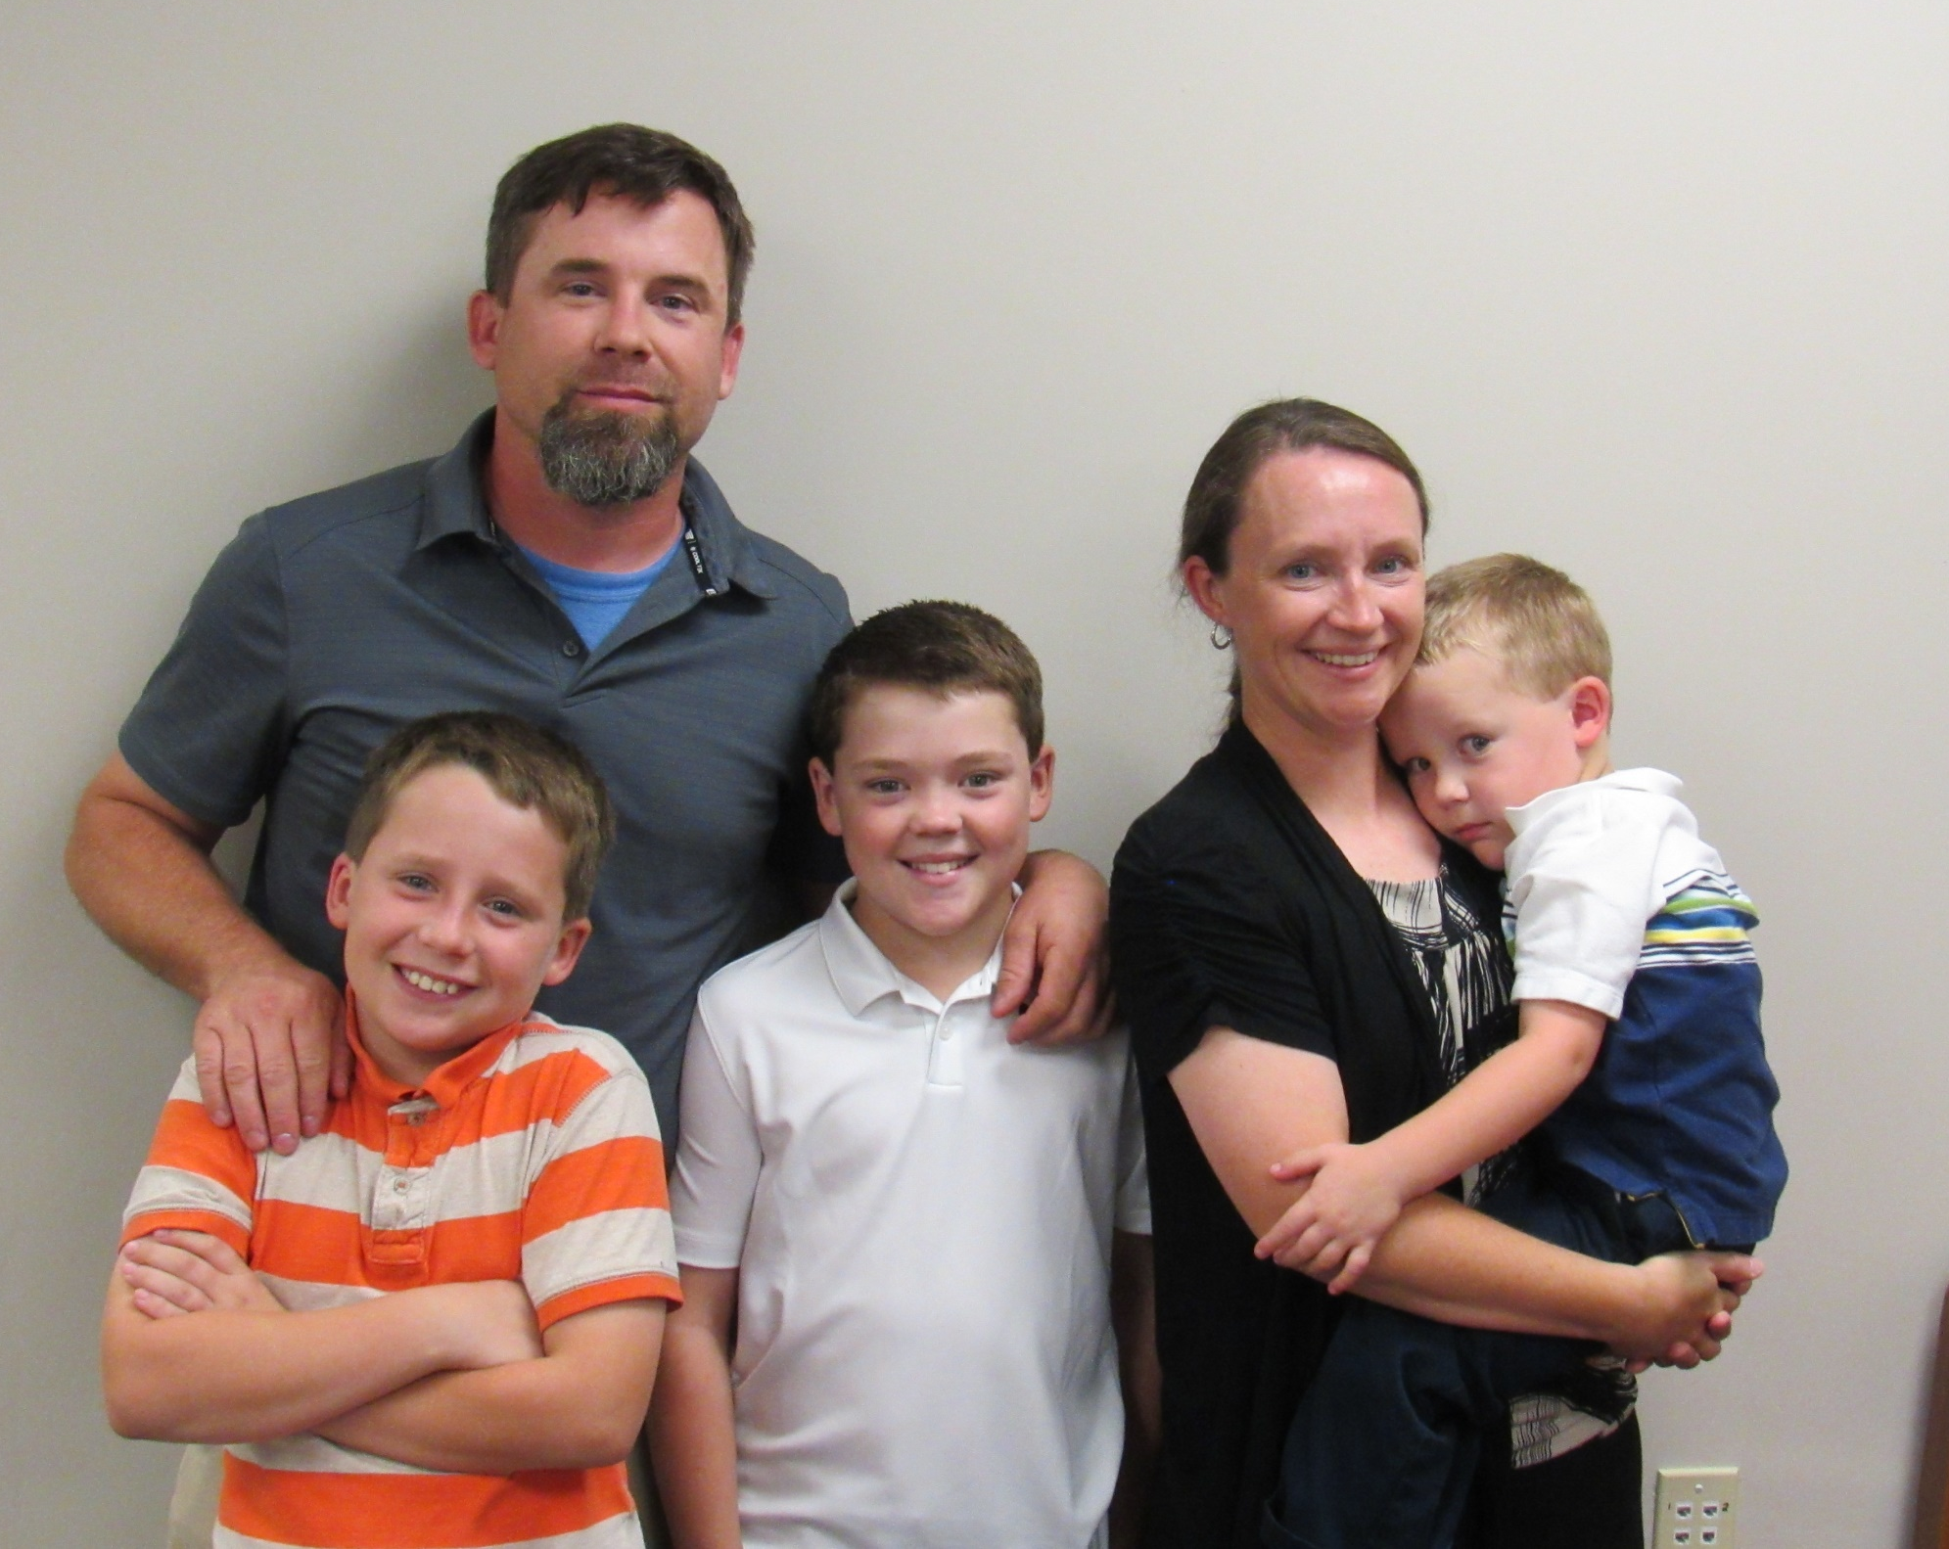

Slide 21
How to describe a church?
The church in Huntington has 1st generation Christians.
We have some who were raised by Christians but then went away from God when they were in college. Now they have repented and returned.
We have a mostly young group. I have come to value more the impact older Christians can have when they remain dedicated to God and help teach the young.

Slide 22
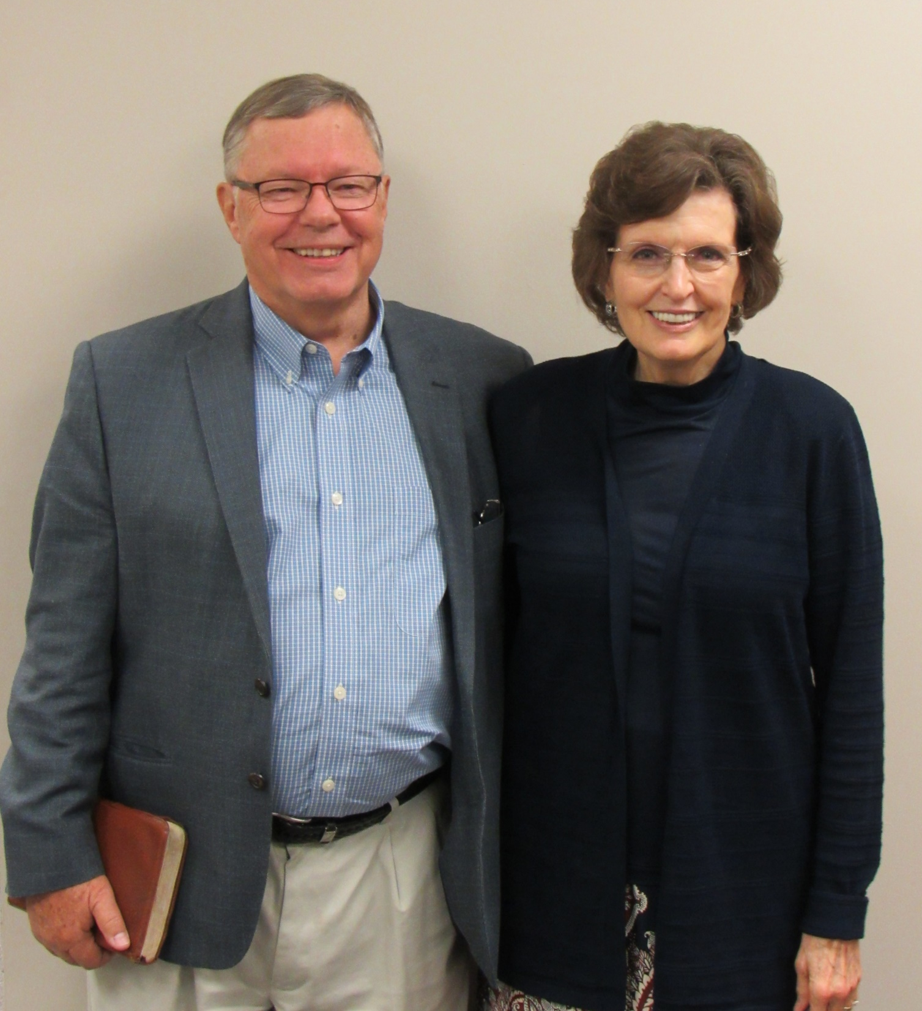

Slide 23
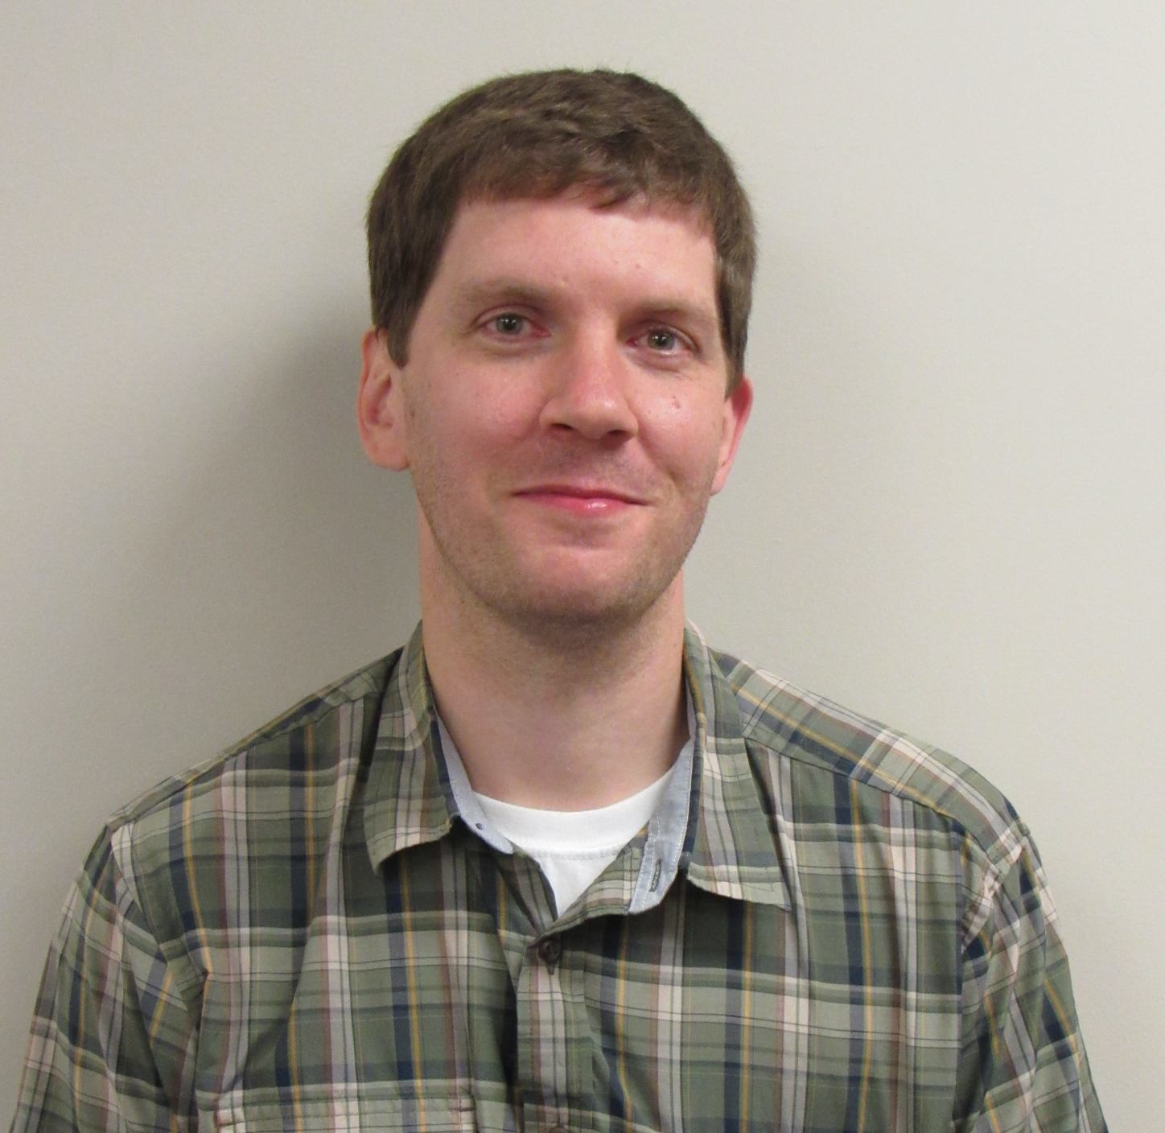

Slide 24
How to describe a church?
Romans 6:13 “And do not present your members as instruments of unrighteousness to sin, but present yourselves to God as being alive from the dead, and your members as instruments of righteousness to God.”

Slide 25
How to describe a church?
2 Tim 2:20-22 “Now in a large house there are not only gold and silver vessels, but also vessels of wood and of earthenware, and some to honor and some to dishonor. Therefore, if anyone cleanses himself from these things, he will be a vessel for honor, sanctified, useful to the Master, prepared for every good work. Now flee from youthful lusts and pursue righteousness, faith, love and peace with those who call on the Lord from a pure heart.”

Slide 26
How to describe a church?
2 Tim 2:20-22 “Now in a large house there are not only gold and silver vessels, but also vessels of wood and of earthenware, and some to honor and some to dishonor. Therefore, if anyone cleanses himself from these things, he will be a vessel for honor, sanctified, useful to the Master, prepared for every good work. Now flee from youthful lusts and pursue righteousness, faith, love and peace with those who call on the Lord from a pure heart.”

Slide 27
How to describe a church?
God wants me to be happy! No, not if that means trying to do what you think makes you happy.
God wants you to be holy (1 Thes 4:3-8).
How would someone describe your service in the kingdom?
Romans 12:4-10
Prov 16:3 “Commit your works to the Lord and your plans will be established.”

Slide 28
John 13:35 “By this all men will know that you are My disciples, if you have love for one another.”
1 Thes 4:9-11 “Now as to the love of the brethren, you have no need for anyone to write to you,…for indeed you do practice it toward all the brethren…But we urge you brethren, to excel still more,”

