Slide 1
Welcome
O’Neal 07-15-2018

Slide 2
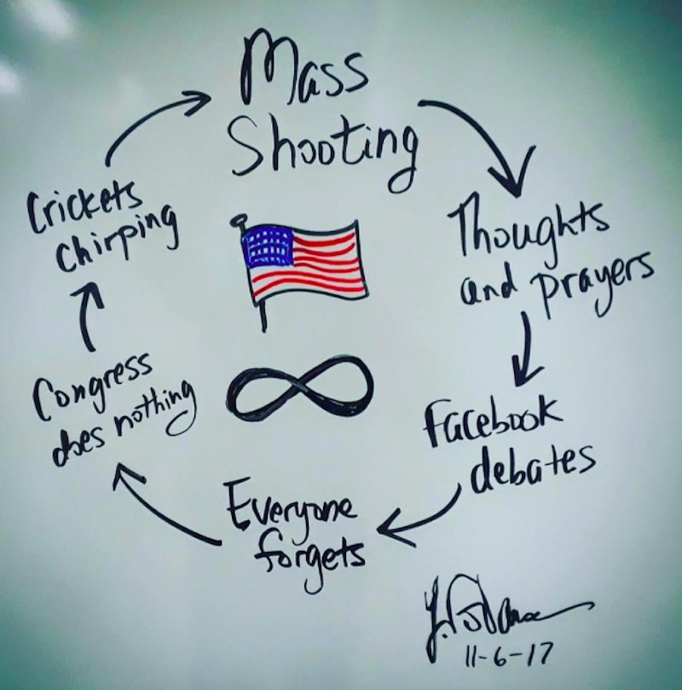

Slide 3
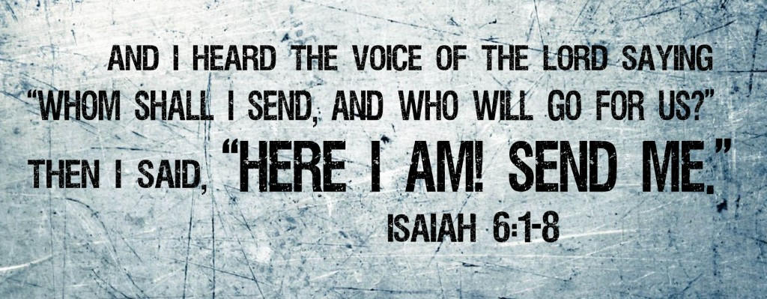

Slide 5
All You need is LOVE!

Slide 6

Love is all you need…
There's nothing you can do that can't be done
Nothing you can sing that can't be sung
Nothing you can say, but you can learn how to play the game
It's easy. Nothing you can make that can't be made
No one you can save that can't be saved
Nothing you can do, but you can learn how to be you in time
It's easy. All you need is love, love is all you need
There's nothing you can know that isn't known
Nothing you can see that isn't shown
There's nowhere you can be that isn't where you're meant to be. Love is all you need.

Slide 7
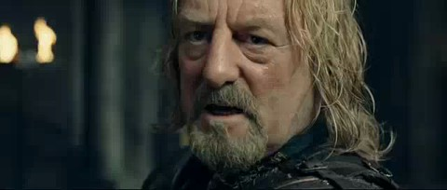
What’s the answer?
What can man do in the face of such reckless hate?

Slide 8
is love really all we need?

Slide 9

I Corinthians 13: 1-3
If I speak with the tongues of men and of angels, but do not have love, I have become a noisy gong or a clanging cymbal. If I have the gift of prophecy, and know all mysteries and all knowledge; and if I have all faith, so as to remove mountains, but do not have love, I am nothing. And if I give all my possessions to feed the poor, and if I surrender my body to be burned, but do not have love, it profits me nothing.

Slide 10


Slide 11
I Corinthians 13:4-8
Love is patient, love is kind and is not jealous; love does not brag and is not arrogant, does not act unbecomingly; it does not seek its own, is not provoked, does not take into account a wrong suffered, does not rejoice in unrighteousness, but rejoices with the truth; bears all things, believes all things, hopes all things, endures all things. Love never fails...

Slide 12
Love is patient

Slide 13
How patient is God?
But by His word the present heavens and earth are being reserved for fire, kept for the day of judgment and destruction of ungodly men.But do not let this one fact escape your notice, beloved, that with the Lord one day is like a thousand years, and a thousand years like one day. The Lord is not slow about His promise, as some count slowness, but is patient toward you, not wishing for any to perish but for all to come to repentance. I Peter 3:7-9

Slide 14


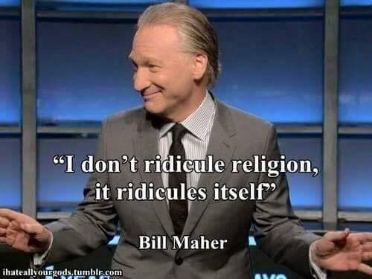
How patient is God?

Slide 15
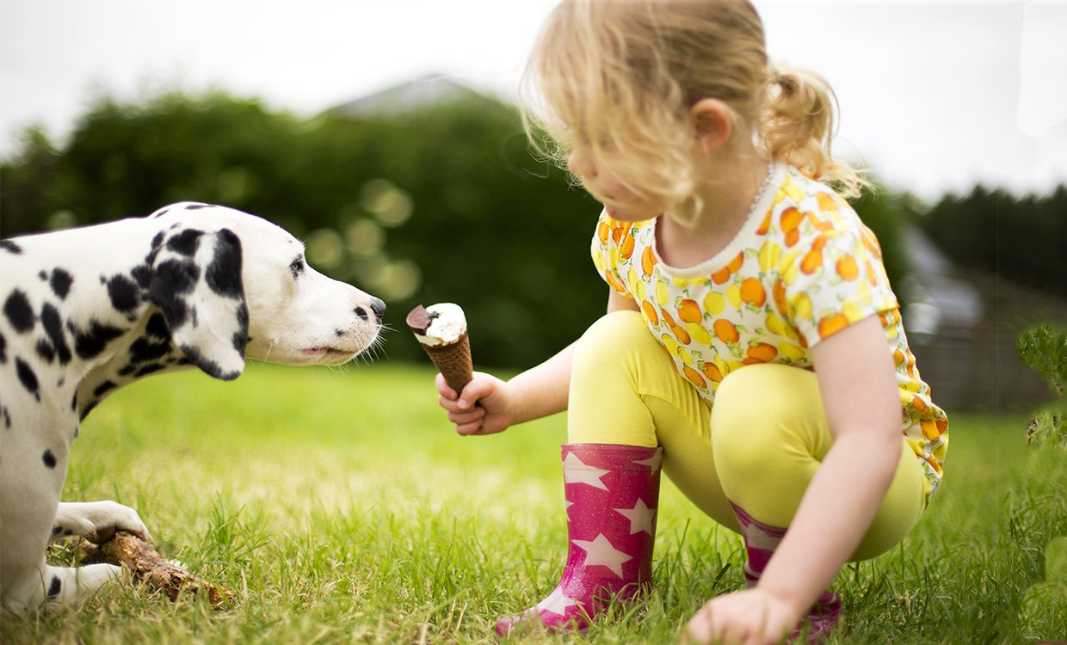

Love is kind

Slide 16
Love is kinder than the world knows!
He who withholds his rod hates his son,
But he who loves him disciplines him diligently. Proverbs 13:24
But for the cowardly and unbelieving and abominable and murderers and immoral persons and sorcerers and idolaters and all liars, their part will be in the lake that burns with fire and brimstone, which is the second death.” Revelation 21:8

Slide 17
Treat others the same way you want them to treat you. If you love those who love you, what credit is that to you? For even sinners love those who love them. If you do good to those who do good to you, what credit is that to you? For even sinners do the same.
Luke 6:31-33

Slide 18
On kindness hangs all the attributes of Love
Get rid of all bitterness, rage and anger, brawling and slander, along with every form of malice. Be kind and compassionate to one another, forgiving each other, just as in Christ God forgave you.
Ephesians 4:31-32

Slide 19
Kindness speaks the truth.
Therefore each of you must put off falsehood and speak truthfully to your neighbor, for we are all members of one body. “In your anger do not sin”: Do not let the sun go down while you are still angry, Ephesians 4:25-26
Get rid of all bitterness, rage and anger, brawling and slander, along with every form of malice. Be kind and compassionate to one another, forgiving each other, just as in Christ God forgave you. Ephesians 4:31-32

Slide 20
I Corinthians 13: 1-3
If I speak with the tongues of men and of angels, but do not have love, I have become a noisy gong or a clanging cymbal. If I have the gift of prophecy, and know all mysteries and all knowledge; and if I have all faith, so as to remove mountains, but do not have love, I am nothing. And if I give all my possessions to feed the poor, and if I surrender my body to be burned, but do not have love, it profits me nothing.

Slide 21
I Corinthians 13:4-8
Love is patient, love is kind and is not jealous; love does not brag and is not arrogant, does not act unbecomingly; it does not seek its own, is not provoked, does not take into account a wrong suffered, does not rejoice in unrighteousness, but rejoices with the truth; bears all things, believes all things, hopes all things, endures all things. Love never fails...

Slide 22
If we love Christ...We will be transformed into him
If you love me keep my commandments. John 14:15
I have been crucified with Christ; and it is no longer I who live, but Christ lives in me; and the life which I now live in the flesh I live by faith in the Son of God, who loved me and gave Himself up for me. Galatian 2:20
so that Christ may dwell in your hearts through faith; and that you, being rooted and grounded in love, may be able to comprehend with all the saints what is the breadth and length and height and depth, and to know the love of Christ which surpasses knowledge, that you may be filled up to all the fullness of God. Ephesians 3:17-19

Slide 23

Plain Love is not all you need but Christ love is!
104

Slide 24
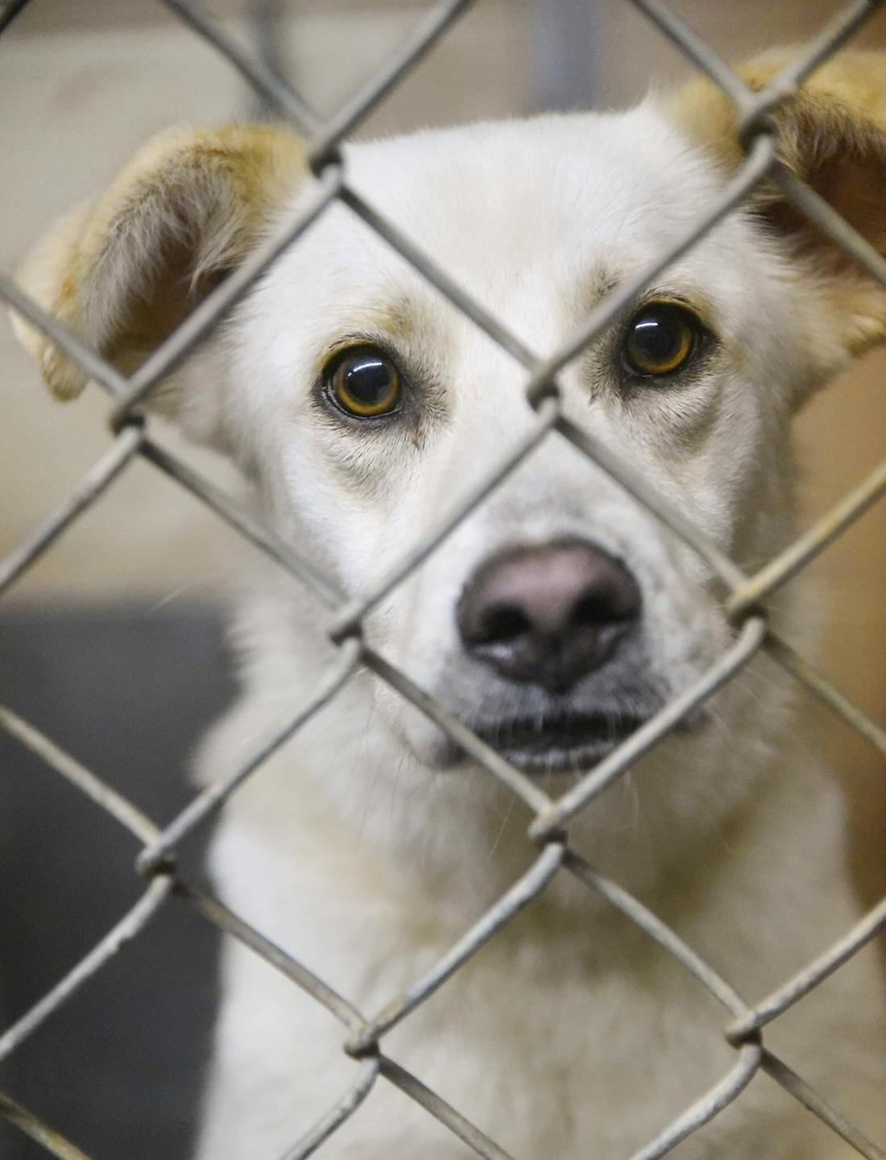
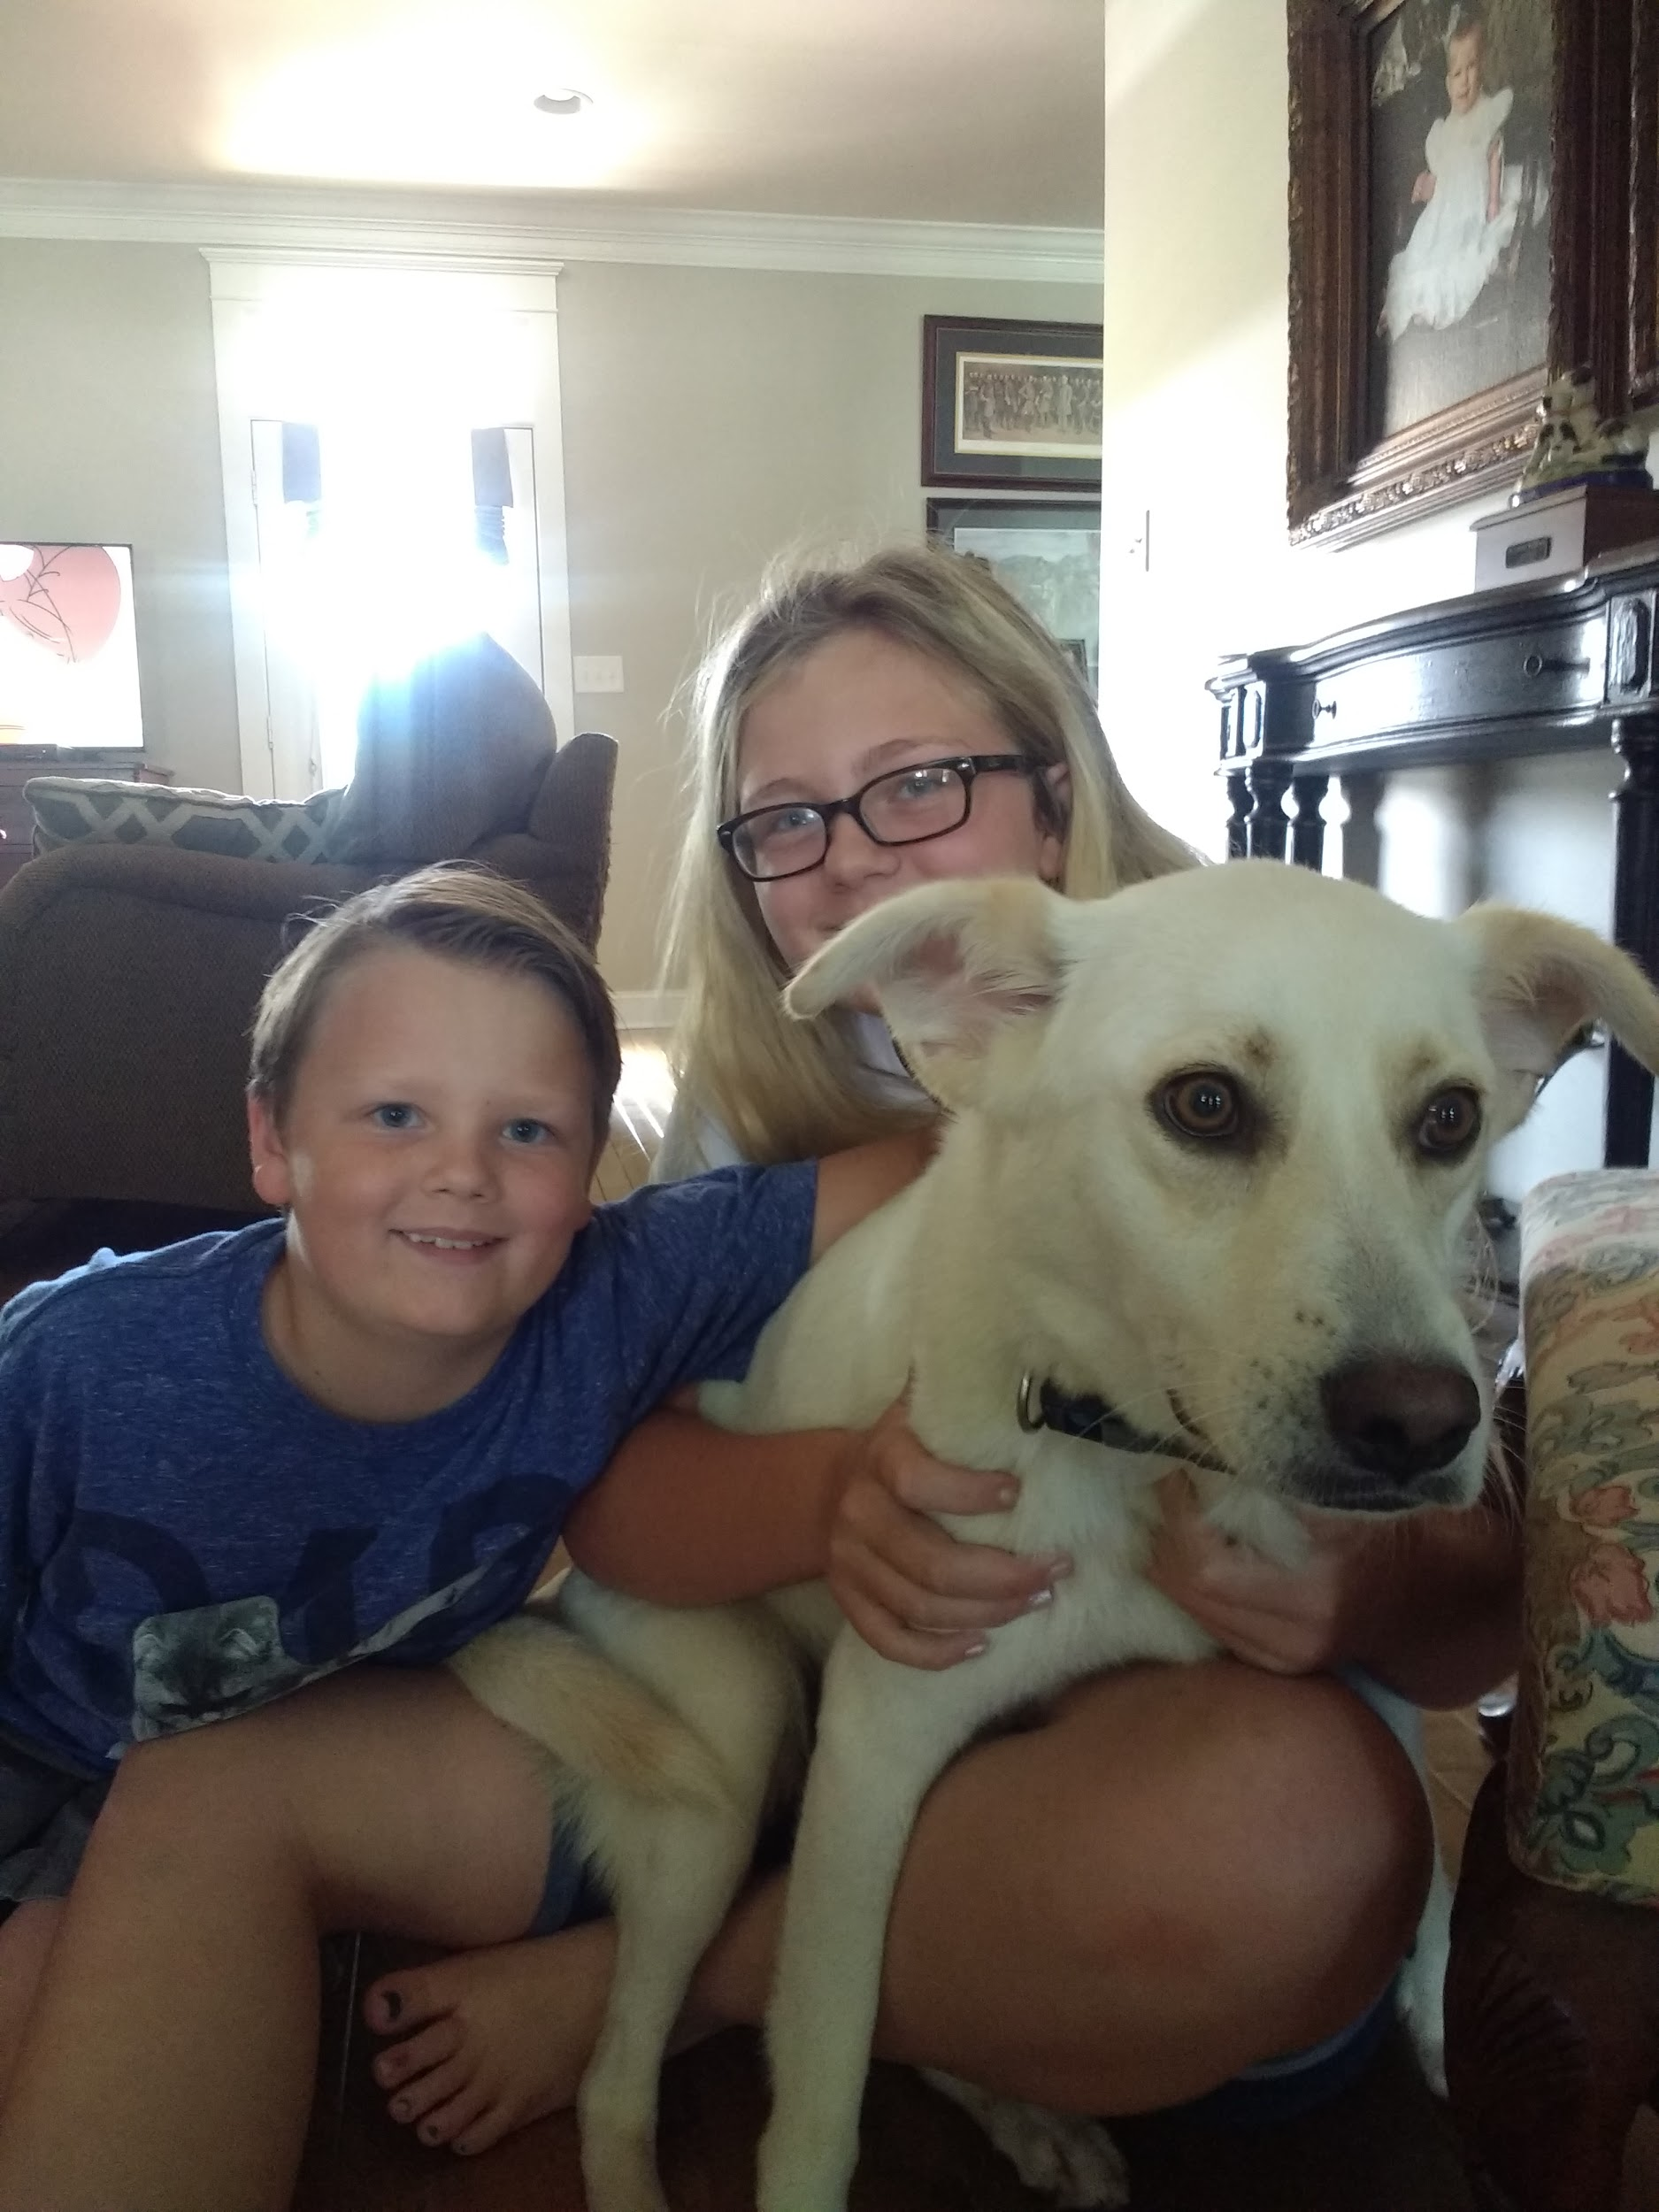
Love never fails

