Slide 1


Slide 2
Jesus' last words to his disciples - His Ascension
After Jesus said His last words to His disciples, He ascended into heaven.
“When he had led them out to the vicinity of Bethany, he lifted up his hands and blessed them. While he was blessing them, he left them and was taken up into heaven. Then they worshiped him and returned to Jerusalem with great joy. And they stayed continually at the temple, praising God” (Luke 24:50-53).

Slide 3
The Ascension
Of
Jesus Christ

Slide 4


Slide 5
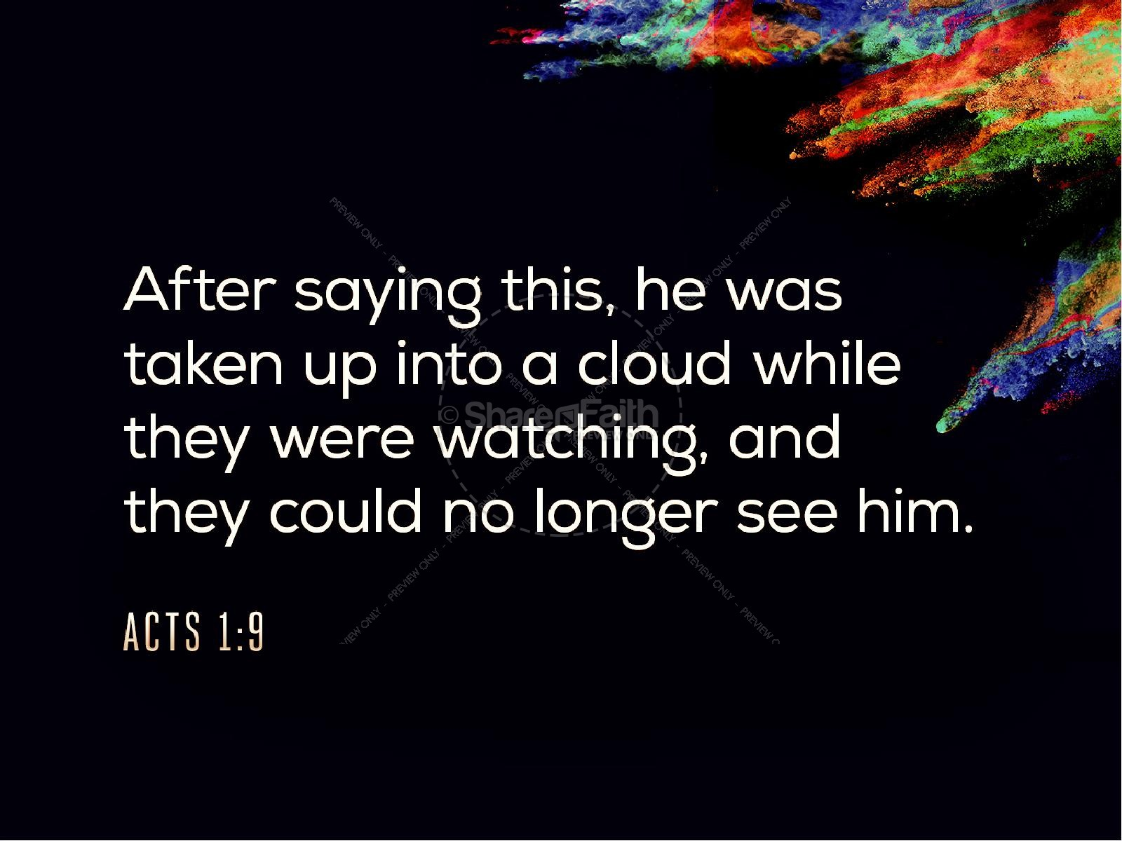

Slide 6


Slide 7
Acts 1:9-11
⁹ And when he had spoken these things, while they beheld, he was taken up; and a cloud received him out of their sight.
¹⁰ And while they looked stedfastly toward heaven as he went up, behold, two men stood by them in white apparel;
¹¹ Which also said, Ye men of Galilee, why stand ye gazing up into heaven? this same Jesus, which is taken up from you into heaven, shall so come in like manner as ye have seen him go into heaven.

Slide 8
Learning about the Ascension of
Jesus Christ

Slide 9
1 The former treatise have I made, O Theophilus, of all that Jesus began both to do and teach,
² Until the day in which he was taken up, after that he through the Holy Ghost had given commandments unto the apostles whom he had chosen:
³ To whom also he shewed himself alive after his passion by many infallible proofs, being seen of them forty days, and speaking of the things pertaining to the kingdom of God:
⁴ And, being assembled together with them, commanded them that they should not depart from Jerusalem, but wait for the promise of the Father, which, saith he, ye have heard of me.

Slide 10
⁵ For John truly baptized with water; but ye shall be baptized with the Holy Ghost not many days hence.
⁶ When they therefore were come together, they asked of him, saying, Lord, wilt thou at this time restore again the kingdom to Israel?
⁷ And he said unto them, It is not for you to know the times or the seasons, which the Father hath put in his own power.
⁸ But ye shall receive power, after that the Holy Ghost is come upon you: and ye shall be witnesses unto me both in Jerusalem, and in all Judaea, and in Samaria, and unto the uttermost part of the earth.

Slide 11
And when he had spoken these things

Slide 12
while they beheld
‘the disciples of Jesus’

Slide 13
he was taken up; and a cloud received him out of their sight
Mark states:
‘he was received up into Heaven and
Sat down at the right hand of God. Mark 16:19.

Slide 14
And the Hebrew writer states:
Hebrews 4:14¹⁴ Seeing then that we have a great high priest,that is passed into the heavens, Jesus the Son of God, let us hold fast our profession.
And Hebrews 1:3
³ Who being the brightness of his glory, and the express image of his person, and upholding all things by the word of his power, when he had by himself purged our sins, sat down on the right hand of the Majesty on high

Slide 15


Slide 16
¹⁰ And while they looked stedfastly toward
heaven as he went up
Remember what Jesus had
Said to them: John 6:62
⁶² What and if ye shall see the Son of man ascend up where he was before?

Slide 17
1 Timothy 3:16
¹⁶ And without controversy great is the mystery of godliness: God was manifest in the flesh, justified in the Spirit, seen of angels, preached unto the Gentiles, believed on in the world, received up into glory….
John 3:13 And no man hath ascended up to heaven, but he that came down from heaven, even the Son of man which is in heaven

Slide 18
Luke 24:50-53
⁵⁰ And he led them out as far as to Bethany, and he lifted up his hands, and blessed them.⁵¹ And it came to pass, while he blessed them, he was parted from them, and carried up into heaven.⁵² And they worshipped him, and returned to Jerusalem with great joy:⁵³ And were continually in the temple, praising and blessing God. Amen.
Look what Peter says:
1 Peter 3:22 Who is gone into heaven, and is on the right hand of God; angels and authorities and powers being made subject unto him

Slide 19
behold, two men stood by them in white apparel;
¹¹ Which also said:
We do not know who these two men
Were: They were men dressed in white
And could speak:

Slide 20
Which also said, Ye men of Galilee
Ephesians 4:8-10
⁸ Wherefore he saith, When he ascended up on high, he led captivity captive, and gave gifts unto men.
⁹ (Now that he ascended, what is it but that he also descended first into the lower parts of the earth?
¹⁰ He that descended is the same also that ascended up far above all heavens, that he might fill all things.)

Slide 21
why stand ye gazing up into heaven
It was time for them to get to work for the Lord!
Acts 7:55 (Stephen)
⁵⁵ But he, being full of the Holy Ghost, looked up stedfastly into heaven, and saw the glory of God, and Jesus standing on the right hand of God!

Slide 22
this same Jesus, which is taken up from you into heaven
A great promise that should
Motivate us all to be ready to
Meet Him!
God will not send someone else:
The same Jesus will come!

Slide 23
shall so come in like manner
As you have seen Him go into heaven!
John 14:28 ²⁸ Ye have heard how I said unto you, I go away, and come again unto you. If ye loved me, ye would rejoice, because I said, I go unto the Father: for my Father is greater than I
Matt.26:64 Jesus saith unto him, Thou hast said: nevertheless I say unto you, Hereafter shall ye see the Son of man sitting on the right hand of power, and coming in the clouds of heaven.

Slide 25
God’s people read about the Ascension of
Jesus Christ. We believe what the Bible says
About Jesus is true.
And thus we have the charge:
Mark 16:15-16; Matt. 28:18-20

Slide 27


Slide 28


Slide 29


