Slide 2
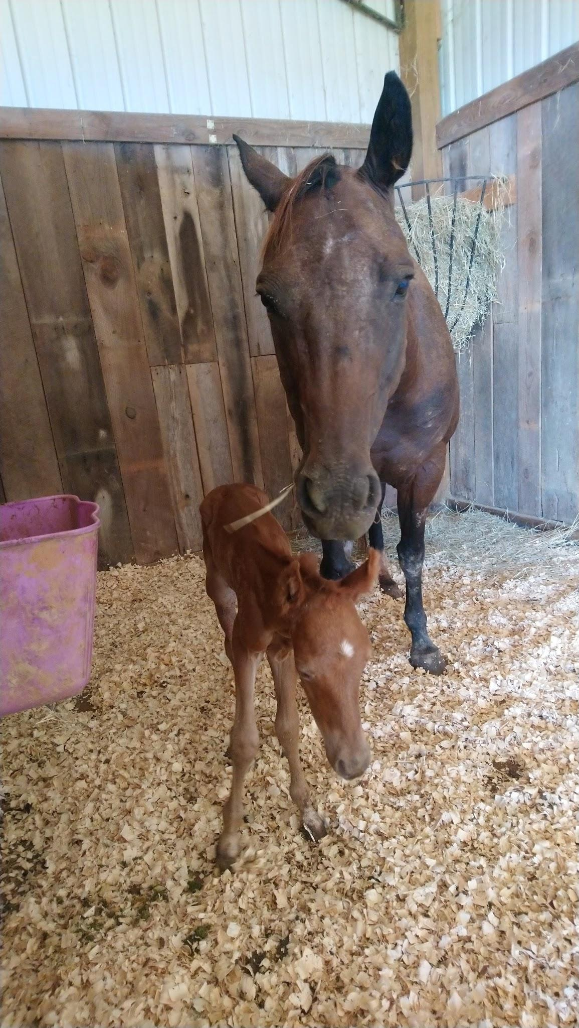
Surprise!!!
Sometimes God gives us things we haven't planned for!

Slide 3

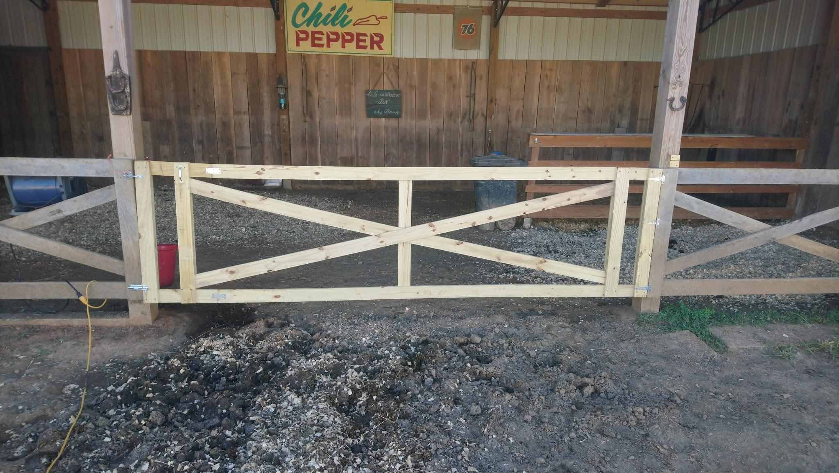
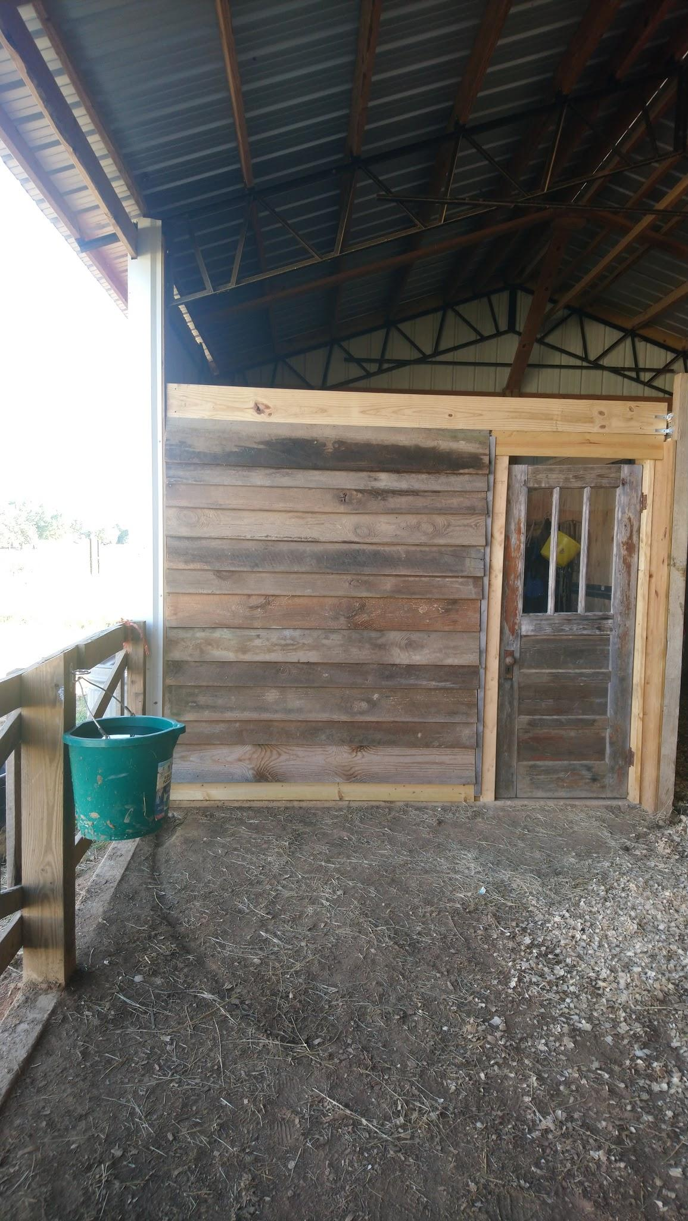

Slide 4
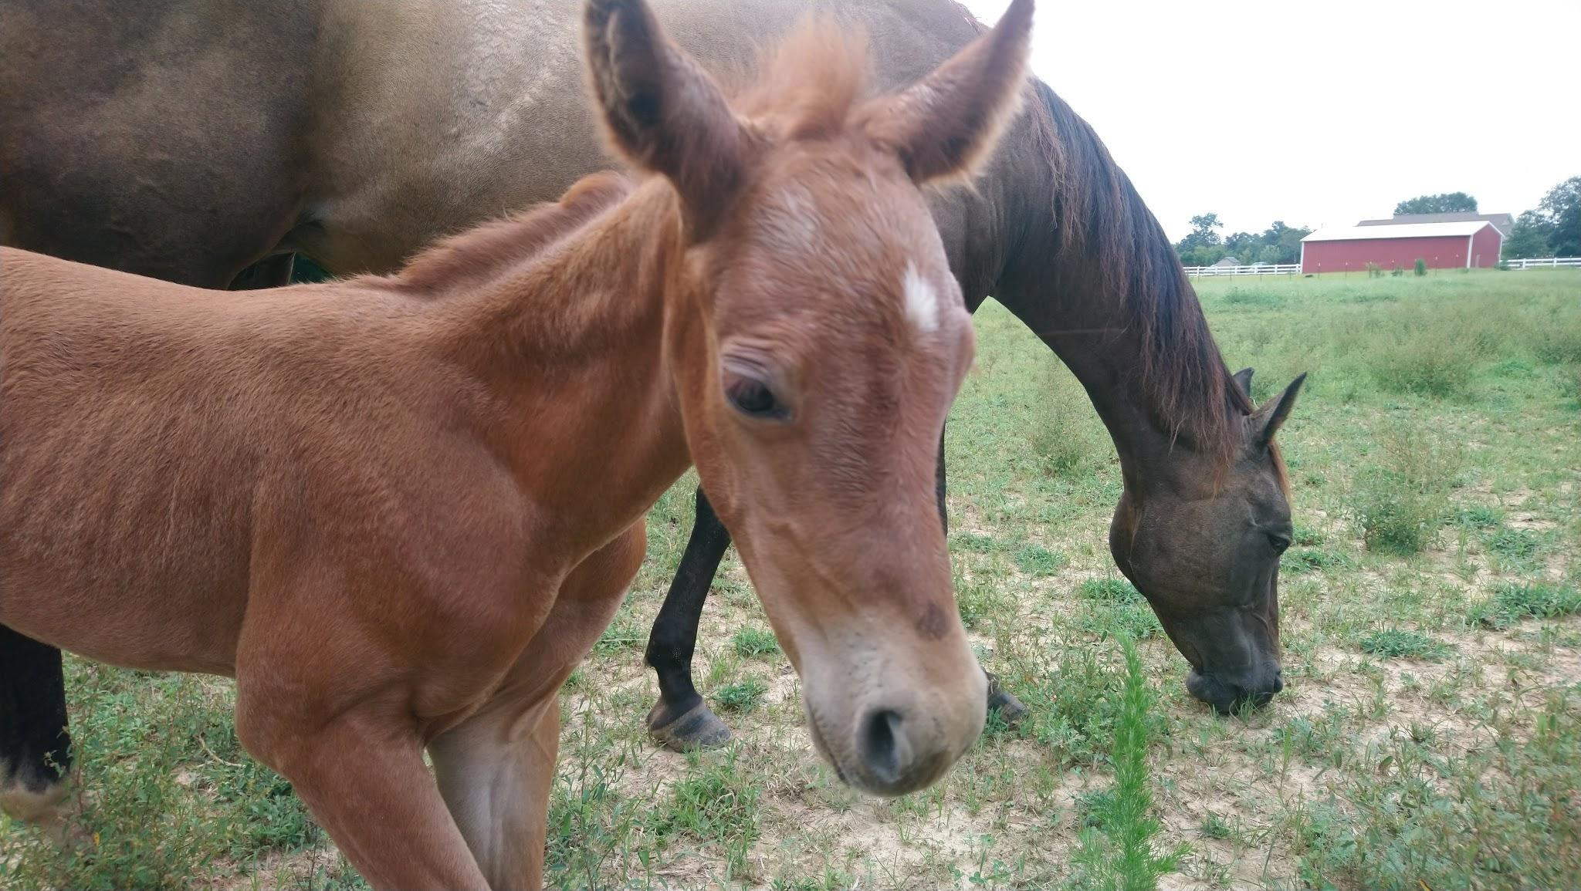

Slide 5
I had become comfortable. I was at ease… I was lazy.
3 years in the making

Slide 6
At Ease in Zion
Amos 6:1-8

Slide 7
Amos 6:1-3
Woe to those at ease in Zion, and those trusting in the mountain of Samaria, who are noted as leader of the nations. And the house of Israel came to them. Pass to Calneh, and see; and from there go to Hamath the great. Then go down to Gath of the Philistines. Are they better than these kingdoms, or their border greater than your border? You who put the evil day far away, and cause the seat of violence to come near;
These people were God’s chosen but had become comfortable.
He accuses all the nations around them for their unrighteousness.
And warns them that they are comfortable because they don’t see anything to worry about. They have forgotten.

Slide 8
Amos 6:4-8
who lie on beds of ivory, and those sprawling on their couches, and eat lambs out of the flock, and the calves out of the midst of the stall; who chant with the mouth of the harp; they invent instruments of music for themselves, like David; who drink wine in bowls, and anoint themselves with the best of oils; nor do they grieve for the breaking of Joseph! So now they shall go into exile with the first of the exiles. And the feast of those who stretch themselves shall cease. The Lord Jehovah has sworn by Himself, says Jehovah, the God of Hosts: I despise the glory of Jacob, and hate his palaces; and I will shut up the city and all its fullness.

Slide 9
Does the modern Church have anything in common with them?
So What… What’s wrong with being comfortable?

Slide 10
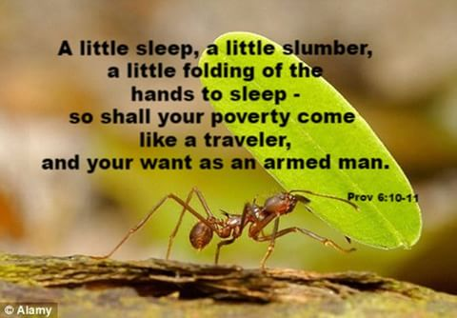

Slide 11

We stop trying
For by grace you are saved through faith, and that not of yourselves, it is the gift of God, not of works, lest anyone should boast. For we are His workmanship, created in Christ Jesus to good works, which God has before ordained that we should walk in them. Eph. 2:8-10
You were saved by faith in God, who treats us much better than we deserve. This is God's gift to you, and not anything you have done on your own. It isn't something you have earned, so there is nothing you can brag about.God planned for us to do good things and to live as he has always wanted us to live. That's why he sent Christ to make us what we are. (CEV)

Slide 12

When we stop trying we become lazy.
In everything, therefore, treat people the same way you want them to treat you, for this is the Law and the Prophets. Matthew 7:12

Slide 13

When Christians become lazy the world is worse for it.
“You are the salt of the earth; but if the salt has become tasteless, how can it be made salty again? It is no longer good for anything, except to be thrown out and trampled under foot by men. “You are the light of the world. A city set on a hill cannot be hidden; nor does anyone light a lamp and put it under a basket, but on the lampstand, and it gives light to all who are in the house. … Matthew 5:13-16

Slide 14
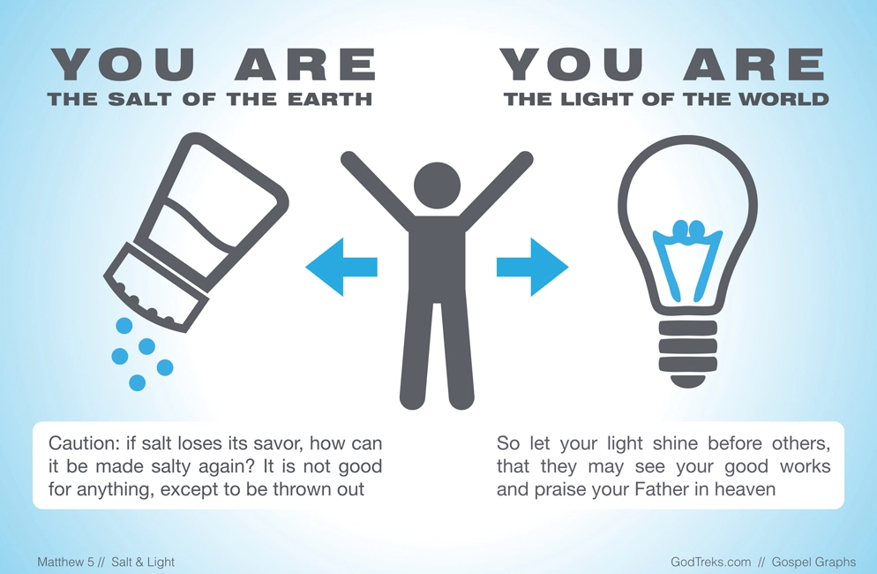

Slide 15
When we get too comfortable…
To the angel of the church in Laodicea write: The Amen, the faithful and true Witness, the Beginning of the creation of God, says this: “‘I know your deeds, that you are neither cold nor hot; I wish that you were cold or hot. So because you are lukewarm, and neither hot nor cold, I will spit you out of My mouth. Because you say, “I am rich, and have become wealthy, and have need of nothing,” and you do not know that you are wretched and miserable and poor and blind and naked, I advise you to buy from Me gold refined by fire so that you may become rich, and white garments so that you may clothe yourself, and that the shame of your nakedness will not be revealed; and eye salve to anoint your eyes so that you may see. Those whom I love, I reprove and discipline; therefore be zealous and repent.
Revelation 3: 14-19

Slide 16

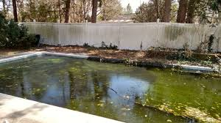

Slide 17
Stagnation = Forgetfulness

Slide 18

It’s easy to forget that there is more ...
… in reference to your former manner of life, you lay aside the old self, which is being corrupted in accordance with the lusts of deceit, and that you be renewed in the spirit of your mind, and put on the new self, which in the likeness of God has been created in righteousness and holiness of the truth. Ephesians 4:22-23
And He was saying to them all, “If anyone wishes to come after Me, he must deny himself, and take up his cross daily and follow Me. Luke 9:23

Slide 19
When we get too comfortable we tend to forget...
… it is appointed for men to die once and after this comes judgment, Hebrews 9: 27

Slide 20
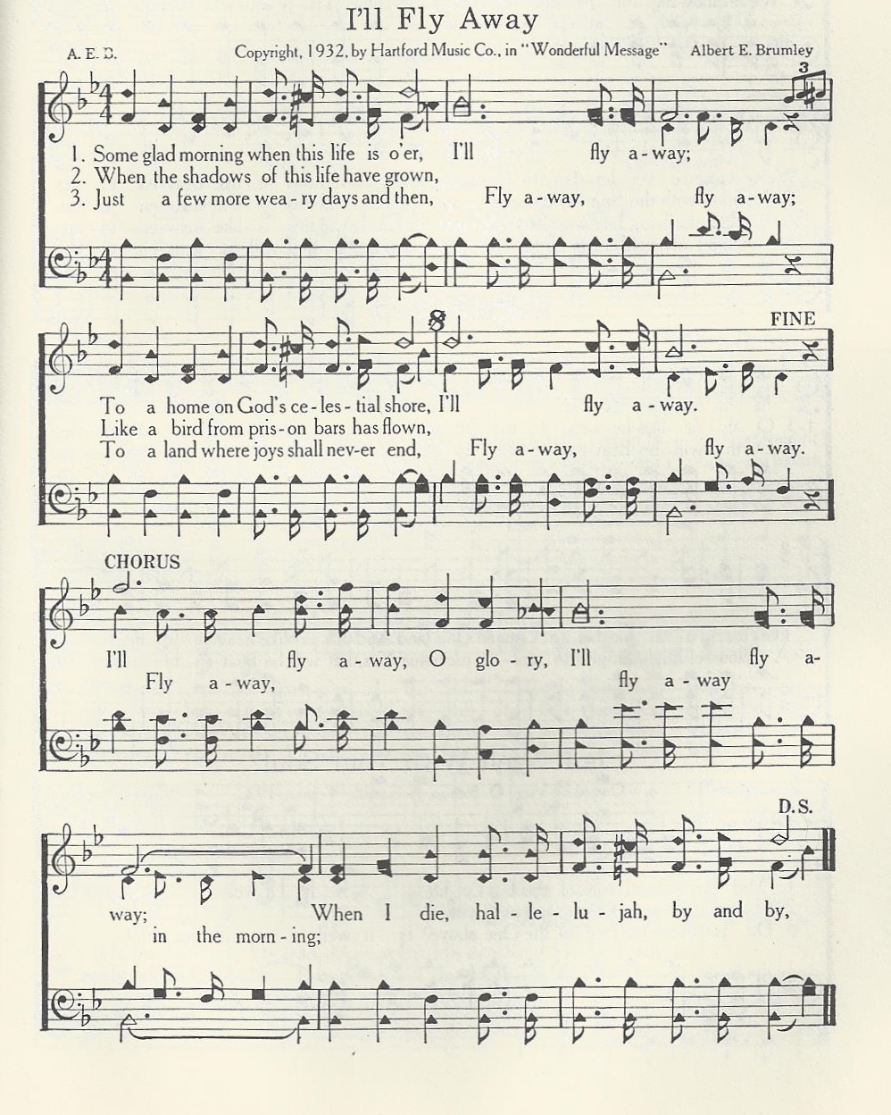
I’ll Fly away
Yet you do not know what your life will be like tomorrow. You are just a vapor that appears for a little while and then vanishes away. James 4: 14

Slide 21
