Slide 1
Life is….
Precious/beautiful
Wonderful
A bed of roses
The greatest thing God has given us
But a vapor (too short)
Too short to be unhappy
A journey of highs and lows that you learn and grow from along the way
A daily blessing
A gift from God
Family
An open book test
Jesus Christ
Knowing who is in control—my God
A crazy beautiful ride
Like a butterfly
A lesson
Not fair
An adventure
The hardest teacher
Full of ups and downs
Making preparations for eternity
Our chance to make a difference
Learning to put your trust and confidence in the Lord.
A journey…you choose where it leads. Choose carefully!
Only as good as your mindset
What you make it

Slide 2

Notes:
Attitude is the way you think or feel about someone or something.
How is your attitude tonight?

Slide 3
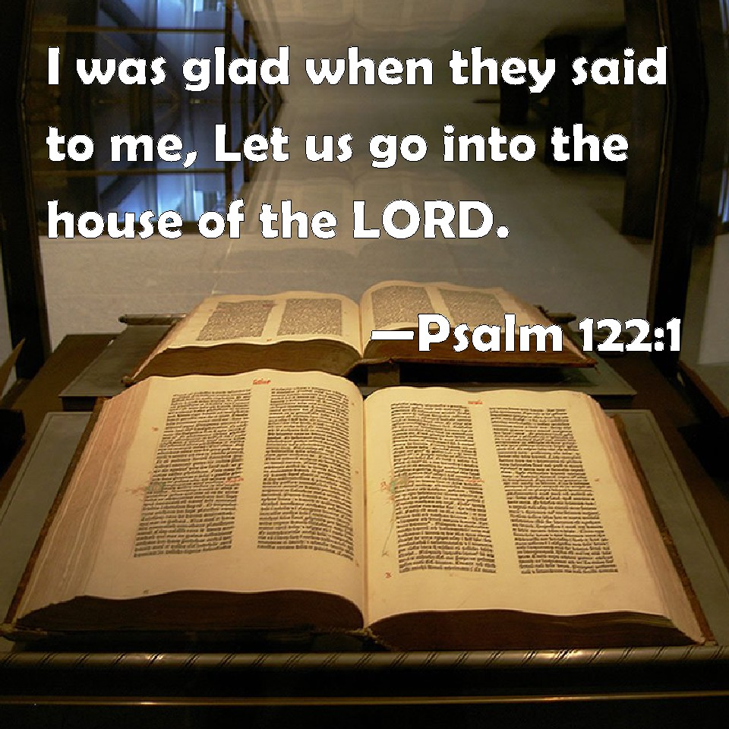

Slide 4

Notes:
How do you feel about God?
How do you feel about going to church?
How do you feel about forgiveness?
How do you feel about eternity?
Family?
Hatred?
People different than you?
Sin?

Slide 5

Proverbs 23:7
7 For as he thinketh in his heart, so is he:….

Slide 6
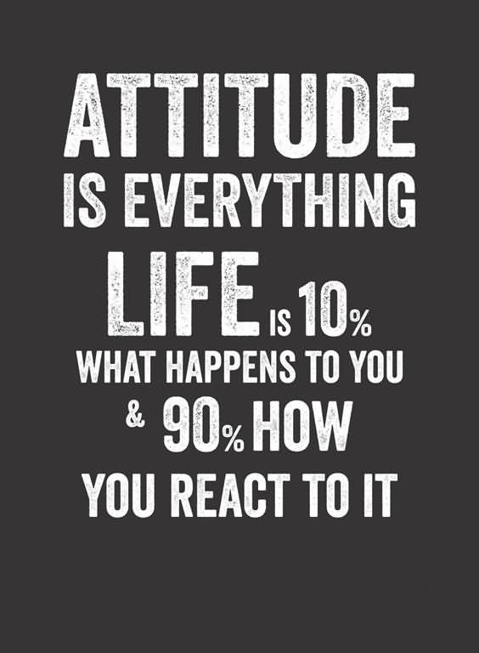

Notes:
Do you have a good attitude or a bad attitude toward life?

Slide 7

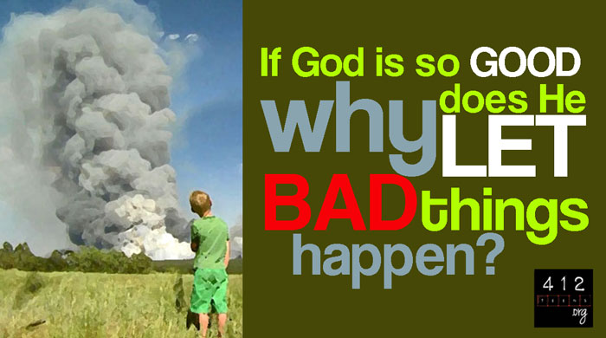

Slide 8
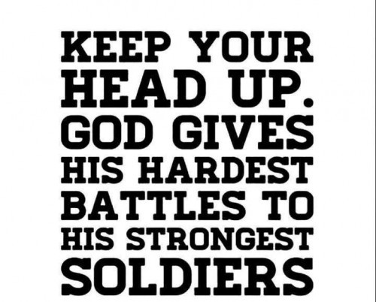


Slide 9
Philippians 1:27
27 Only let your conversation be as it becometh the gospel of Christ: that whether I come and see you, or else be absent, I may hear of your affairs, that ye stand fast in one spirit, with one mind striving together for the faith of the gospel;
Notes:
Writing from a prison cell in Rome, the apostle Paul wrote about the attitude a Christian should have: “Whatever happens, conduct yourselves in a manner worthy of the gospel of Christ” (Philippians 1:27). He’s telling us that no matter what unexpected disruptions, frustrations, or difficulties come our way, we are to respond with a Christ-like attitude.

Slide 10
Philippians 2:5
5 Let this mind be in you, which was also in Christ Jesus:
Notes:
Paul later writes, “Your attitude should be the same as that of Jesus Christ” (Philippians 2:5).

Slide 11
Ephesians 5:1
1 Be ye therefore followers of God, as dear children;
Notes:
He also encourages us in Ephesians 5:1 to be “imitators of Christ as dearly beloved children.”

Slide 12
Matthew 5:16
16 Let your light so shine before men, that they may see your good works, and glorify your Father which is in heaven.
Notes:
As children love to imitate what they see and repeat what they hear; we also are charged to imitate and model Christ’s behavior and to be clear reflections of the Lord (Matthew 5:16).

Slide 13
1 Peter 2:23
23 Who, when he was reviled, reviled not again; when he suffered, he threatened not; but committed himself to him that judgeth righteously:
Notes:
Jesus maintained a perfect attitude in every situation because He prayed about everything and worried about nothing.
We, too, should seek God’s guidance about every aspect of our lives and allow Him to work out His perfect will without interference.
Jesus’ attitude was never to become defensive, discouraged, or depressed because His goal was to please the Father rather than to achieve His own agenda.
In the midst of trials, He was patient.
In the midst of suffering, He was hopeful.
In the midst of blessing, He was humble.
Even in the midst of ridicule, abuse, and hostility, He “made no threats . . . and did not retaliate. Instead He entrusted Himself to Him who judges justly” (1 Peter 2:23).

Slide 14

Notes:
Sometimes my attitude isn’t what it needs to be. Sometimes I may develop a bad attitude. Others may also develop a bad attitude……
Towards their parents
Towards their kids
Towards a family member
Towards their job
Towards a coworker
Towards school/teacher/administrator
Towards the church/elder/deacon/preacher/member
Towards God

Slide 15
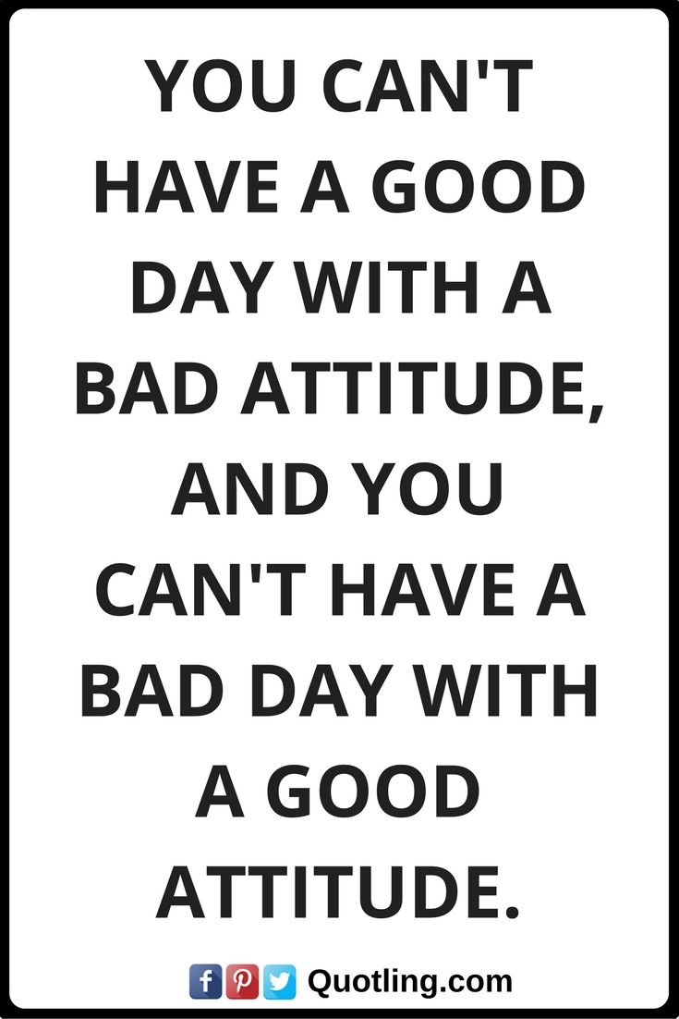

Good Attitudes Needed Today
Notes:
It’s sad, but sometimes members of the church can have the worst attitude. Our life is a reflection of our attitude. Without noticing it, we can come negative towards the life—towards everything.

Slide 16
Good Attitudes Needed Today
Philip’s Running
  So Philip ran to him, and heard him reading the prophet Isaiah, and said, "Do you understand what you are reading?" (Acts 8:30).
Running paid off:
  So he commanded the chariot to stand still. And both Philip and the eunuch went down into the water, and he baptized him (Acts 8:38).
Are we running to teach someone God’s Word today?

Slide 17
Good Attitudes Needed Today
Isaiah’s Willingness
  Also I heard the voice of the Lord, saying: "Whom shall I send, And who will go for Us?" Then I said, "Here am I! Send me." (Isaiah 6:8).
Are you involved in the Lord’s Work?
    Teaching Bible class?
    Visiting/Helping those who need help?
    Taking care of the building?
    Preparing to lead: elders, deacons, preachers, song leaders, etc.?

Slide 18
Good Attitudes Needed Today
Job’s Faith in God
  Though He slay me, yet will I trust Him… (Job 13:15).
Attitude based on life after death:
  If a man dies, shall he live again? All the days of my hard service I will wait, Till my change comes. (Job 14:14).
Job’s trust was rewarded:
  Now the LORD blessed the latter days of Job more than his beginning... (Job 42:12)

Slide 19
Good Attitudes Needed Today
Joshua’s Leading in the Home
  Now therefore, fear the LORD, serve Him in sincerity and in truth, and put away the gods which your fathers served on the other side of the River and in Egypt. Serve the LORD! (Josh. 24:14).
His attitude was contagious:
  And the people said to Joshua, "No, but we will serve the LORD!" (Josh. 24:21).
Each one must determine this for themselves.

Slide 20
Good Attitudes Needed Today
Stephen’s Boldness
  You stiff-necked and uncircumcised in heart and ears! You always resist the Holy Spirit; as your fathers did, so do you. (Acts 7:51).
Paul prayed for this same boldness:
  …And for me, that utterance may be given to me, that I may open my mouth boldly to make known the mystery of the gospel, 20 for which I am an ambassador in chains; that in it I may speak boldly, as I ought to speak (Eph. 6:19-20).
An attitude many religious people lack (Jn. 12:42).
Notes:
John 12:42
42 Nevertheless among the chief rulers also many believed on him; but because of the Pharisees they did not confess him, lest they should be put out of the synagogue:

Slide 21
Good Attitudes Needed Today
Paul’s Courage
  I can do all things through Christ who strengthens me (Phil. 4:13).
  “I can” – first step in success.
  “I can’t” – first step in failure.
Promise from the Lord – strength for every trying circumstance.
  Sickness, Death
  Persecution, Affliction
  Desertion

Slide 22
Good Attitudes Needed Today
Humble Spirit of those on Day of Pentecost:
  Now when they heard this, they were cut to the heart, and said to Peter and the rest of the apostles, “Men and brethren, what shall we do?” (Acts 2:37).
Humbly Obeyed the Lord’s Command:
  Then those who gladly received his word were baptized; and that day about three thousand souls were added to them (Acts 2:41).

Slide 23
Romans 12:2
2 And be not conformed to this world: but be ye transformed by the renewing of your mind, that ye may prove what is that good, and acceptable, and perfect, will of God.
Notes:
Finally, we must always keep in mind that God’s ultimate goal for His children is not our comfort, but the transformation of our minds into the attitude of godliness. He wants us to grow spiritually, to become like Christ. This doesn’t mean losing our personalities or becoming mindless clones. Christlikeness is all about transforming our minds. Again, Paul tells us,

Slide 24

How is your
Notes:
What’s your attitude about eternity? Are you ready?
If you are not a Christian, become one tonight by Believing, Repenting, Confessing, Being baptized for the remission of your sins to walk in a new life?
If you are a Christian, has your attitude been what God wants it to be?
Is it in need of improvements?
If you are subject to the Lord’s invitation, please come as we stand and sing.

