Slide 1
Bible Study

Slide 2
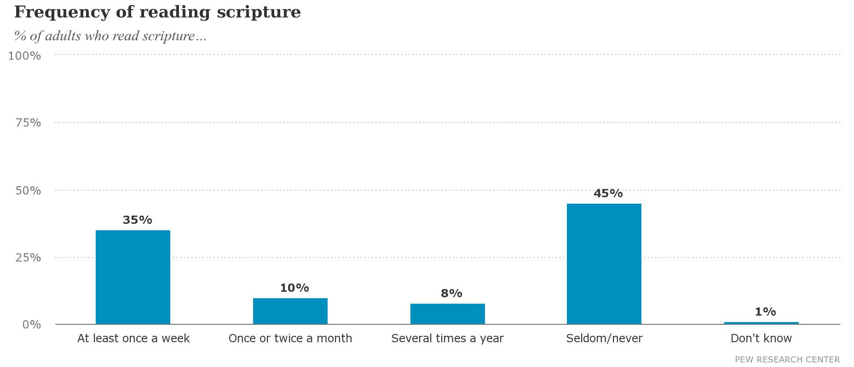

Slide 3
The Importance of Studying
Joshua 1:7-8
Matthew 22:23-33
Romans 10:17
“Faith comes by hearing, and hearing by the Word of God”
2 Timothy 2:14-15
2 Timothy 3:16-17
Hebrews 4:12-13
Revelation 1:1-3

Slide 4
Find your time
Designated time to study
Morning
Lunch break
Before bed
15 – 30 minutes
Create a weekly/monthly schedule

Slide 5
Study 1 book in-depth
Find a book to study all the way through
Understand “big picture” first
Study every aspect of book
5 Ws
Who, what, when, where, why
Reference with other books
Connect with the bigger picture of the Bible

Slide 6
Studying in context
Galatians 2:16
¹⁶ nevertheless knowing that a man is not justified by the works of the Law but through faith in Christ Jesus, even we have believed in Christ Jesus, so that we may be justified by faith in Christ and not by the works of the Law; since by the works of the Law no flesh will be justified.
John 3:16
¹⁶ “For God so loved the world, that He gave His only begotten Son, that whoever believes in Him shall not perish, but have eternal life.

Slide 7
Commentaries and Concordances
Confusion of certain passages/verses
Commentaries
Study Bibles
Websites
Sermons/lessons
Concordance
Reference
Hebrew and Greek translation

Slide 8
Ways to study
Read straight through/learn the “big picture”
Learn historical context
Concentrate on single topic
Study a certain character
Write it down
Listen to audio Bible
Bible trivia/apps
Bible studies

Slide 9
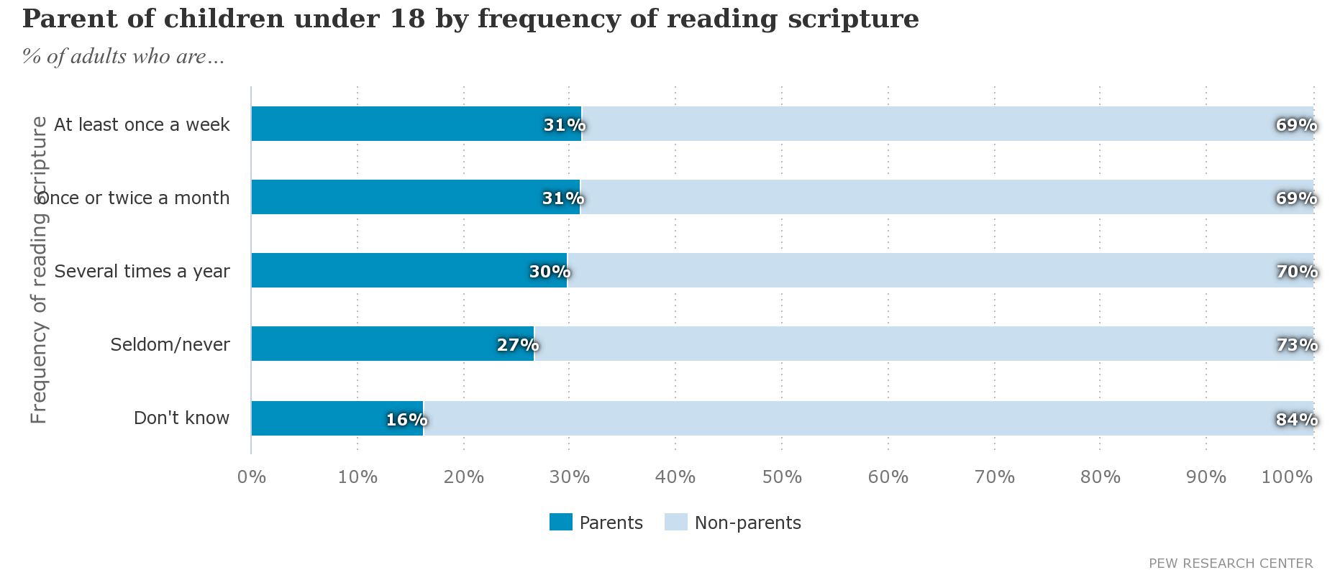

Slide 10
Teaching our Children
“Already Gone” – 2006
20,000 Adults and 2,000 teenagers
61% raised in church will disengage during 20s
What does that mean for our children?
Deuteronomy 6:4-9
Proverbs 22:6
Ephesians 6:1-4

Slide 11
Consequences of not studying
Being ignorant about Bible
Not understanding Bible class/sermons
No understanding of “big picture”
Not being able to understand certain books/passages
No/little understanding of major characters, prophets, apostles
Missing out on life’s lessons
Worshipping God in unacceptable way
Going to congregation that is not acceptable to God
Not knowing how to get to Heaven
Missing out on Heaven

Slide 12
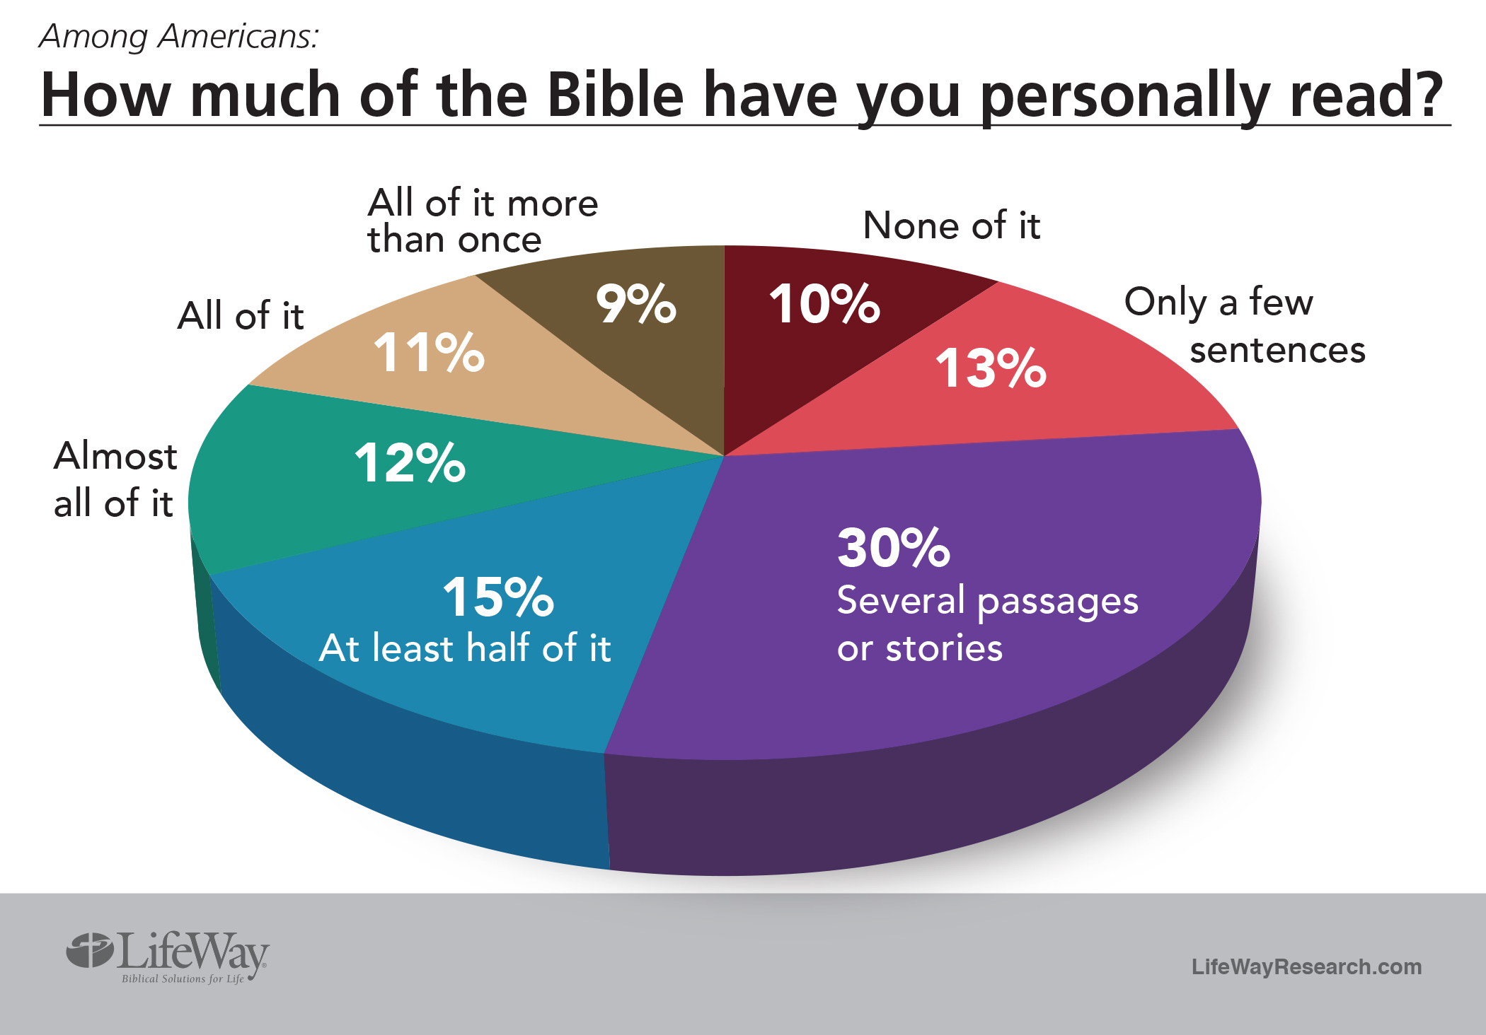

Slide 13
God’s Plan of Salvation
Hear
Matthew 7:24-27; Romans 10:17
Believe
John 3:16; Mark 16:16; Acts 16:31
Repent
Matthew 4:17; Acts 2:38; Luke 13:3; Acts 8:32
Confess
Matthew 10:32-33; Romans 10:9-10; Acts 8:36-37
Be Baptized
Mark 16:16; John 3:3, 5-8; Romans 6:4; I Peter 3:21; Acts 2:38
Live a Faithful Life
Revelation 2:10

