Slide 1
January series of sermons:
-Resolutions:
-Helping the poor:
-Personal Work:
-Visiting the sick:
-Bible Study:
-Bringing back the lost:
-Converting the lost:

Slide 2
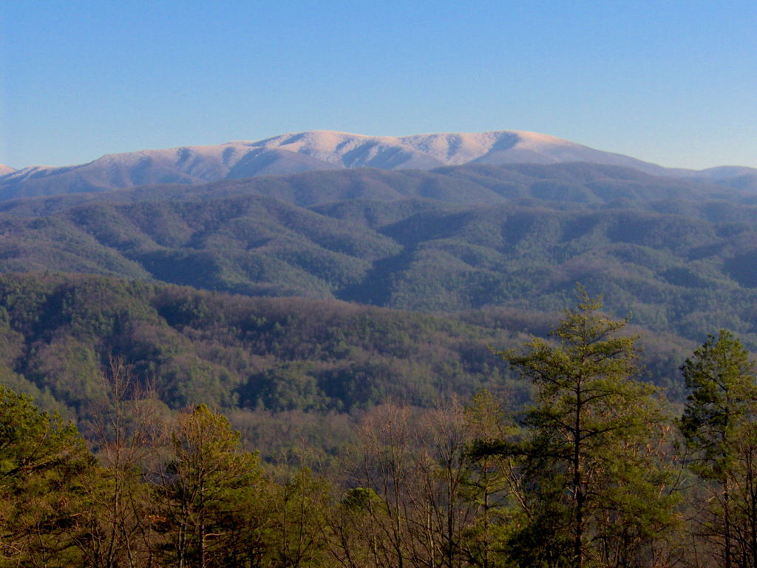

Slide 3
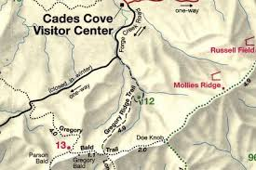
Gregory’s Bald
4,950 Feet
Over 2,900 elevation gain in less than 5 miles

Slide 4
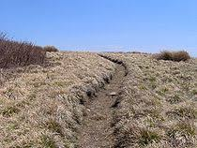
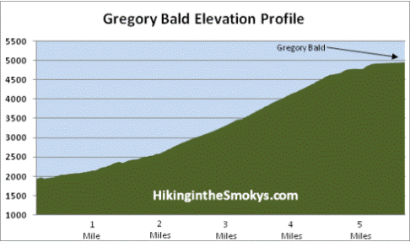

Slide 5
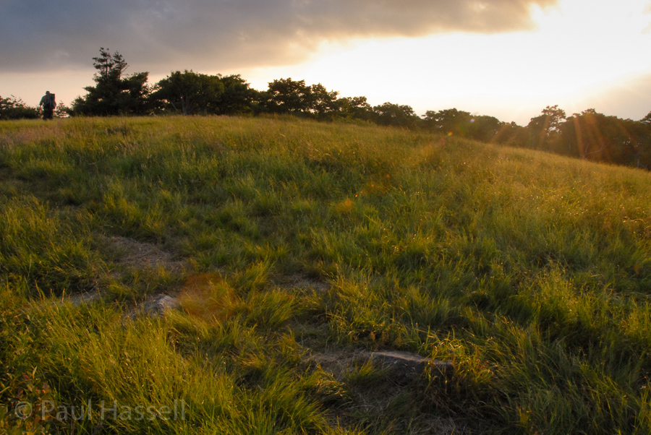

Slide 6
Bringing back the Lost
Luke 15:1-10

Slide 7
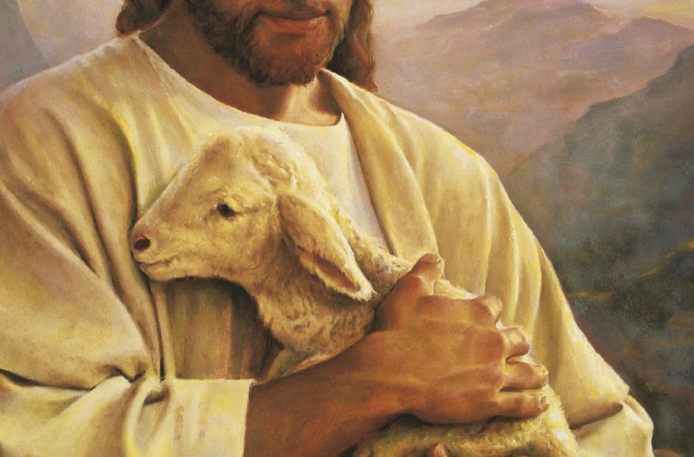
The Lost Sheep
So He told them this parable, saying, “What man among you, if he has a hundred sheep and has lost one of them, does not leave the ninety-nine in the open pasture and go after the one which is lost until he finds it? When he has found it, he lays it on his shoulders, rejoicing. And when he comes home, he calls together his friends and his neighbors, saying to them, ‘Rejoice with me, for I have found my sheep which was lost!’ I tell you that in the same way, there will be more joy in heaven over one sinner who repents than over ninety-nine righteous persons who need no repentance. Luke 15:3-7

Slide 8
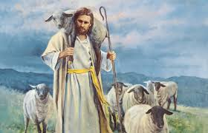
Who is a shepard?
For if I preach the gospel, I have nothing to boast of, for I am under compulsion; for woe is me if I do not preach the gospel. For if I do this voluntarily, I have a reward; but if against my will, I have a stewardship entrusted to me. What then is my reward? That, when I preach the gospel, I may offer the gospel without charge, so as not to make full use of my right in the gospel. I Corinthians 9:16-18

Slide 9
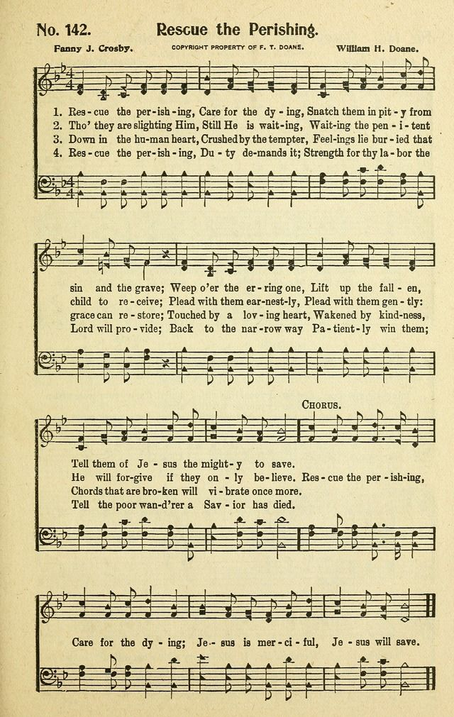
Rescue the perishing
When I say to the wicked, ‘You will surely die,’ and you do not warn him or speak out to warn the wicked from his wicked way that he may live, that wicked man shall die in his iniquity, but his blood I will require at your hand.
Ezekiel 3:18

Slide 10
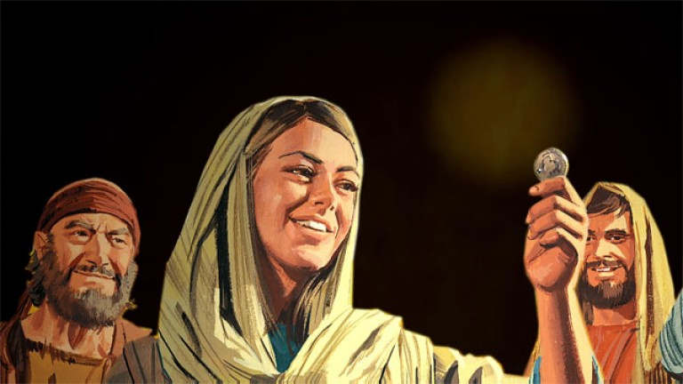
The Lost Coin
Or what woman, if she has ten silver coins and loses one coin, does not light a lamp and sweep the house and search carefully until she finds it? When she has found it, she calls together her friends and neighbors, saying, ‘Rejoice with me, for I have found the coin which I had lost!’ In the same way, I tell you, there is joy in the presence of the angels of God over one sinner who repents.” Luke 15:8-10

Slide 11
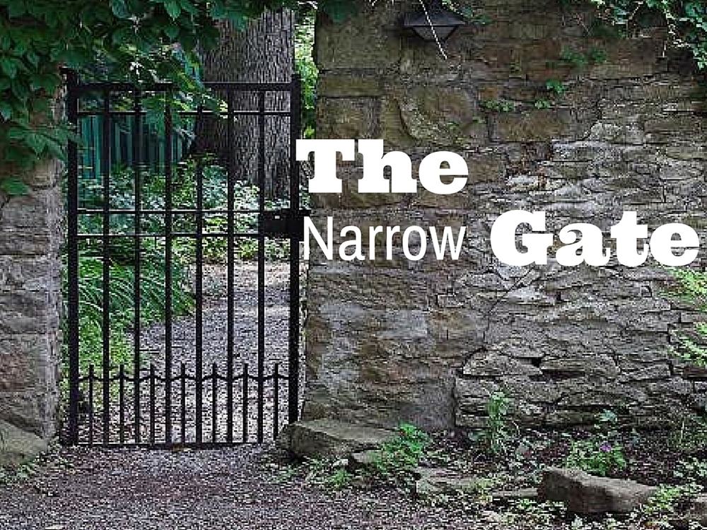
Getting off the right path can be easy.
-Enter through the narrow gate; for the gate is wide and the way is broad that leads to destruction, and there are many who enter through it. For the gate is small and the way is narrow that leads to life, and there are few who find it. Matthew 7:13-14
-for all have sinned and fall short of the glory of God, Romans 3:23

Slide 12

We live in a dark world
Ye are the light of the world. A city that is set on an hill cannot be hid.
Neither do men light a candle, and put it under a bushel, but on a candlestick; and it giveth light unto all that are in the house. Let your light so shine before men, that they may see your good works, and glorify your Father which is in heaven. Matthew 5:14-16 KJV

Slide 13
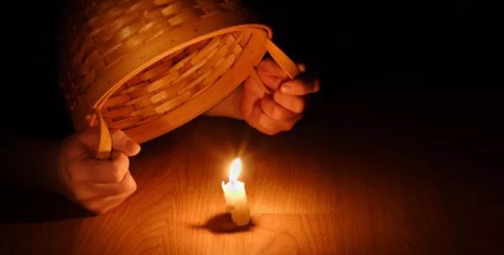
Hide it under a bushel? NO!

Slide 14
People are often looking for the light.
But an angel of the Lord spoke to Philip saying, “Get up and go south to the road that descends from Jerusalem to Gaza.” (This is a desert road.) So he got up and went; and there was an Ethiopian eunuch, a court official of Candace, queen of the Ethiopians, who was in charge of all her treasure; and he had come to Jerusalem to worship, and he was returning and sitting in his chariot, and was reading the prophet Isaiah. Then the Spirit said to Philip, “Go up and join this chariot.” Philip ran up and heard him reading Isaiah the prophet, and said, “Do you understand what you are reading?” And he said, “Well, how could I, unless someone guides me?” And he invited Philip to come up and sit with him.
Acts 8:26-31

Slide 15

We also, have to be salt.
You are the salt of the earth; but if the salt has become tasteless, how can it be made salty again? It is no longer good for anything, except to be thrown out and trampled under foot by men. Matthew 5:13

Slide 16


Slide 17
A sower went out to sow...
And He spoke many things to them in parables, saying, “Behold, the sower went out to sow; and as he sowed, some seeds fell beside the road, and the birds came and ate them up. Others fell on the rocky places, where they did not have much soil; and immediately they sprang up, because they had no depth of soil. But when the sun had risen, they were scorched; and because they had no root, they withered away. Others fell among the thorns, and the thorns came up and choked them out. And others fell on the good soil and *yielded a crop, some a hundredfold, some sixty, and some thirty. He who has ears, let him hear.” Matthew 13:3-9

Slide 18
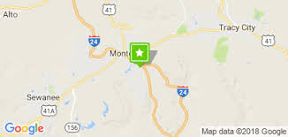
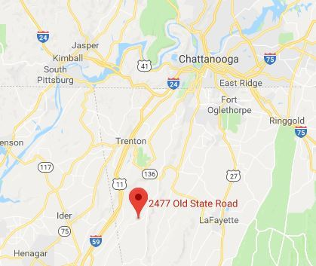

We’ve all been lost before...

Slide 19
It’s important how we bring the lost back?
Brethren, even if anyone is caught in any trespass, you who are spiritual, restore such a one in a spirit of gentleness; each one looking to yourself, so that you too will not be tempted. Bear one another’s burdens, and thereby fulfill the law of Christ. For if anyone thinks he is something when he is nothing, he deceives himself. Galatians 6:1-3

Slide 20
Sometimes we need a course correction.

Slide 21
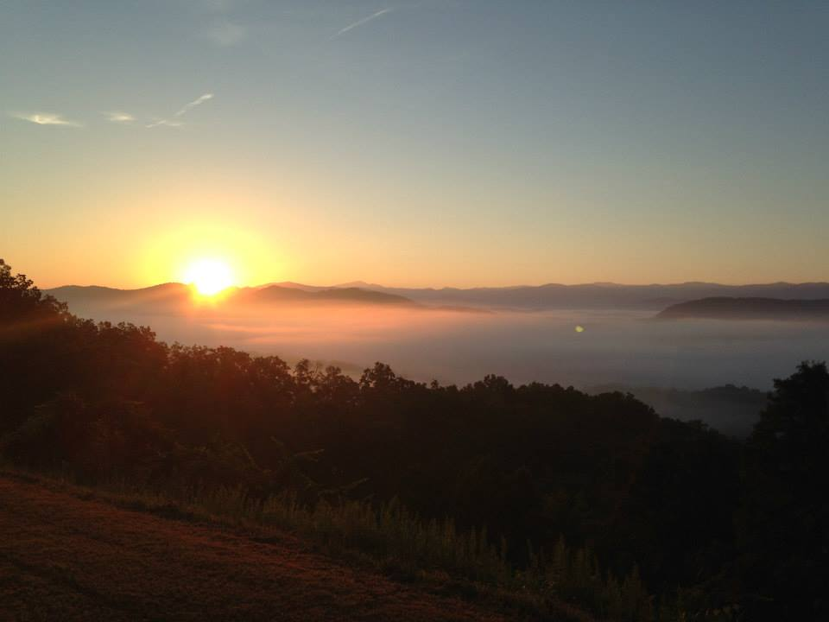
Going back to Gregory’s Bald

Slide 22
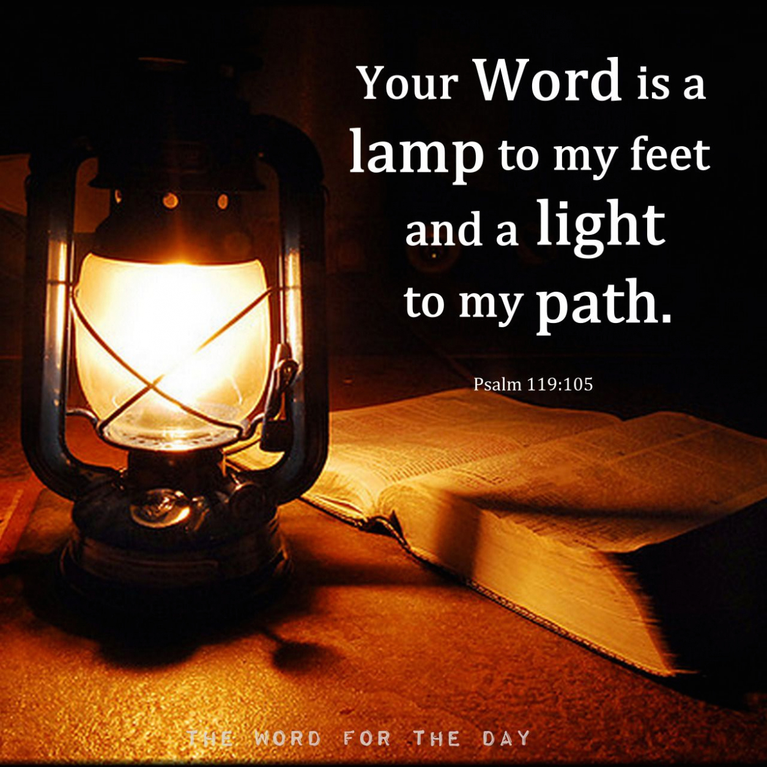
Thank you for your headlight. And thank you so much for your help! You are angels sent to help us. We would have never made it down without you. You guided us in the dark. Thanks!

Slide 23
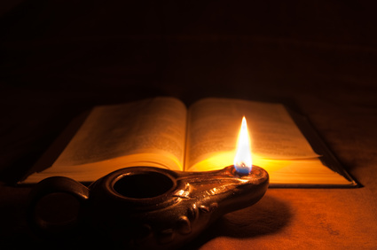
He loved me and you so
Do you think that I cannot appeal to My Father, and He will at once put at My disposal more than twelve legions of angels? How then will the Scriptures be fulfilled, which say that it must happen this way?” Matthew 26:53-54

