Slide 2

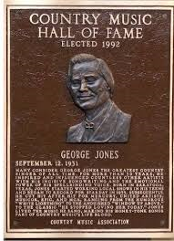
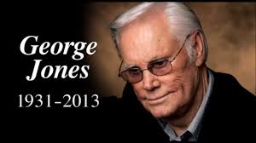
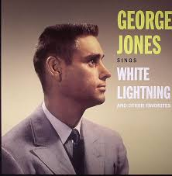
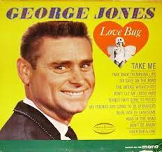
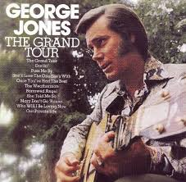

Slide 3
Choices
I've had choices Since the day that I was born There were voices That told me right from wrong If I had listened No I wouldn't be here today Living and dying With the choices I made

Slide 4
Choices: The Bibles common thread.
Genesis 3:1-6

Slide 5
We see choice from the start:
Now the serpent was more crafty than any of the wild animals the Lord God had made. He said to the woman, “Did God really say, ‘You must not eat from any tree in the garden’?” The woman said to the serpent, “We may eat fruit from the trees in the garden, but God did say, ‘You must not eat fruit from the tree that is in the middle of the garden, and you must not touch it, or you will die. You will not certainly die,” the serpent said to the woman. “For God knows that when you eat from it your eyes will be opened, and you will be like God, knowing good and evil.” When the woman saw that the fruit of the tree was good for food and pleasing to the eye, and also desirable for gaining wisdom, she took some and ate it. She also gave some to her husband, who was with her, and he ate it.

Slide 6
We see it in Abraham: Genesis 22:1-12
Now it came about after these things, that God tested Abraham, and said to him, “Abraham!” And he said, “Here I am.” He said, “Take now your son, your only son, whom you love, Isaac, and go to the land of Moriah, and offer him there as a burnt offering on one of the mountains of which I will tell you.” So Abraham rose early in the morning and saddled his donkey, and took two of his young men with him and Isaac his son; and he split wood for the burnt offering, and arose and went to the place of which God had told him. On the third day Abraham raised his eyes and saw the place from a distance. Abraham said to his young men, “Stay here with the donkey, and I and the lad will go over there; and we will worship and return to you.” Abraham took the wood of the burnt offering and laid it on Isaac his son, and he took in his hand the fire and the knife. So the two of them walked on together. Isaac spoke to Abraham his father and said, “My father!” And he said, “Here I am, my son.” And he said, “Behold, the fire and the wood, but where is the lamb for the burnt offering?” Abraham said, “God will provide for Himself the lamb for the burnt offering, my son.” So the two of them walked on together. Then they came to the place of which God had told him; and Abraham built the altar there and arranged the wood, and bound his son Isaac and laid him on the altar, on top of the wood. Abraham stretched out his hand and took the knife to slay his son. But the angel of the Lord called to him from heaven and said, “Abraham, Abraham!” And he said, “Here I am.” He said, “Do not stretch out your hand against the lad, and do nothing to him; for now I know that you fear God, since you have not withheld your son, your only son, from Me.”

Slide 7
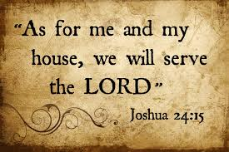
We see it as Joshua lies on his death bed:
“Now, therefore, fear the Lord and serve Him in sincerity and truth; and put away the gods which your fathers served beyond the River and in Egypt, and serve the Lord. If it is disagreeable in your sight to serve the Lord, choose for yourselves today whom you will serve: whether the gods which your fathers served which were beyond the River, or the gods of the Amorites in whose land you are living; but as for me and my house, we will serve the Lord.” Joshua 24:14-15

Slide 8
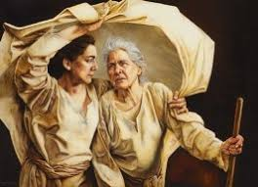
Free Choice rings from the words of Ruth as she proclaims her loyalty:
But Ruth said, “Do not urge me to leave you or turn back from following you; for where you go, I will go, and where you lodge, I will lodge. Your people shall be my people, and your God, my God. Where you die, I will die, and there I will be buried. Thus may the Lord do to me, and worse, if anything but death parts you and me.” When she saw that she was determined to go with her, she said no more to her. Ruth 1:16-17

Slide 9
We hear Elijah implore God’s people to make a choice:
Elijah came near to all the people and said, “How long will you hesitate between two opinions? If the Lord is God, follow Him; but if Baal, follow him.” But the people did not answer him a word. Then Elijah said to the people, “I alone am left a prophet of the Lord, but Baal’s prophets are 450 men. I Kings 18:21-22

Slide 10
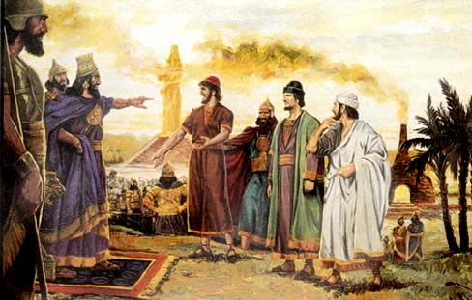
Free Choice touches us in Daniel 3
"If it be so, our God whom we serve is able to deliver us from the furnace of blazing fire; and He will deliver us out of your hand, O king. But even if He does not, let it be known to you, O king, that we are not going to serve your gods or worship the golden image that you have set up.“
Daniel 3:17-18

Slide 11
And again as we read Daniel 6
Then the king gave orders, and Daniel was brought in and cast into the lions' den. The king spoke and said to Daniel, "Your God whom you constantly serve will Himself deliver you." A stone was brought and laid over the mouth of the den; and the king sealed it with his own signet ring and with the signet rings of his nobles, so that nothing would be changed in regard to Daniel. Then the king went off to his palace and spent the night fasting, and no entertainment was brought before him; and his sleep fled from him. Then the king arose at dawn, at the break of day, and went in haste to the lions' den. When he had come near the den to Daniel, he cried out with a troubled voice. The king spoke and said to Daniel, "Daniel, servant of the living God, has your God, whom you constantly serve, been able to deliver you from the lions?“ Daniel 6:16-20

Slide 12
Free choice is even present as Jesus calls his apostles.
Now as Jesus was walking by the Sea of Galilee, He saw two brothers, Simon who was called Peter, and Andrew his brother, casting a net into the sea; for they were fishermen. And He said to them, "Follow Me, and I will make you fishers of men." Immediately they left their nets and followed Him. Going on from there He saw two other brothers, James the son of Zebedee, and John his brother, in the boat with Zebedee their father, mending their nets; and He called them. Immediately they left the boat and their father, and followed Him.
Matthew 4:18-22

Slide 13
Choice is there as Jesus gives his life for us.
Then He said to them, "My soul is deeply grieved, to the point of death; remain here and keep watch with Me." And He went a little beyond them, and fell on His face and prayed, saying, "My Father, if it is possible, let this cup pass from Me; yet not as I will, but as You will.“ Matthew 26: 38-39

Slide 14
Free choice is even present as God’s plan is fulfilled.
So when the people gathered together, Pilate said to them, "Whom do you want me to release for you? Barabbas, or Jesus who is called Christ?" For he knew that because of envy they had handed Him over. While he was sitting on the judgment seat, his wife sent him a message, saying, "Have nothing to do with that righteous Man; for last night I suffered greatly in a dream because of Him." But the chief priests and the elders persuaded the crowds to ask for Barabbas and to put Jesus to death. But the governor said to them, "Which of the two do you want me to release for you?" And they said, "Barabbas." Matthew 27: 17-21

Slide 15
Choice is even there as Jesus hangs on the Cross
…Or do you think that I cannot appeal to My Father, and He will at once put at My disposal more than 12 legions of Angels? Matthew 26:53
…And Jesus cried out again with a loud voice, and yielded up His Spirit. Matthew 27: 50

Slide 16
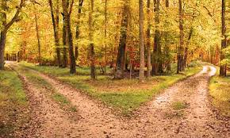
Two roads

Slide 17
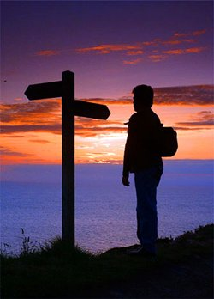
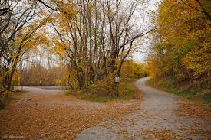

Slide 18
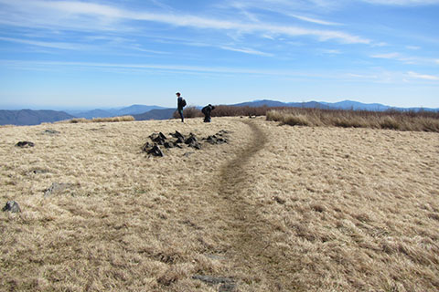

Slide 19
