Slide 1
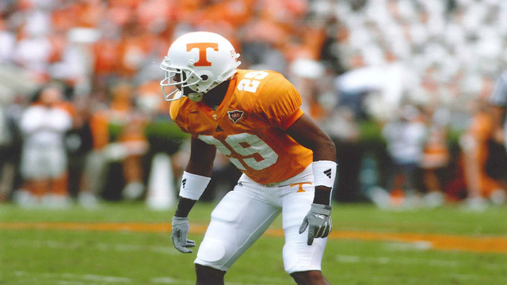
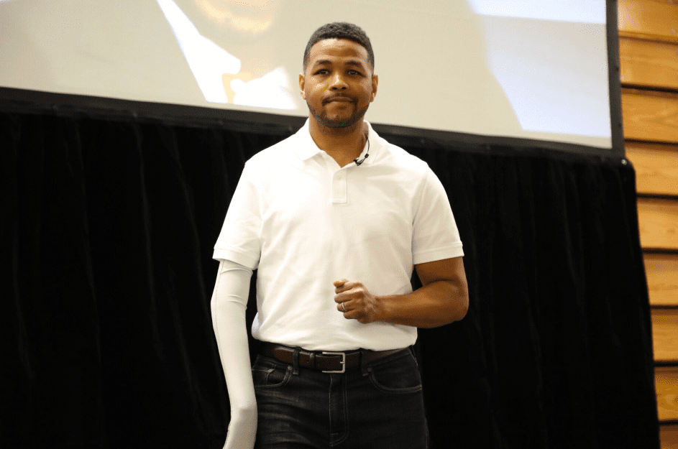
Inky Johnson

Slide 2
Christians Enduring Trials
James 1:2-4

Slide 3
James 1:2-4
2 My brethren, count it all joy when you fall into various trials, 3 knowing that the testing of your faith produces patience. 4 But let patience have its perfect work, that you may be perfect and complete, lacking nothing.
Everyone Goes Through Trials
Trials Help Produce and Reveal a Person’s Character

Slide 4
How do we endure trials?
Count it all as joy

Slide 5
Count it all as joy
2 Corinthians 6:4-10
4 But in all things we commend ourselves as ministers of God: in much patience, in tribulations, in needs, in distresses, 5 in stripes, in imprisonments, in tumults, in labors, in sleeplessness, in fastings; 6 by purity, by knowledge, by longsuffering, by kindness, by the Holy Spirit, by sincere love, 7 by the word of truth, by the power of God, by the armor of righteousness on the right hand and on the left, 8 by honor and dishonor, by evil report and good report; as deceivers, and yet true;

Slide 6
Count it all as joy
9 as unknown, and yet well known; as dying, and behold we live; as chastened. And yet not killed; 10 as sorrowful, yet always rejoicing; as poor, yet making many rich; as having nothing, and yet possessing all things.
Paul is creating a contrast between the outward appearance and the inward heart.
How does Paul deal with all of these hardships?

Slide 7
Count it all as joy
Philippians 1:12-14
12 But I want you to know, brethren, that the things which happened to me have actually turned out for the furtherance of the gospel, 13 so that it has become evident to the whole palace guard, and to all the rest, that my chains are in Christ; 14 and most of the brethren in the Lord, having become confident by my chains, are much more bold to speak the word without fear.
A key to being joyful in a time of trial is to have a change of perspective.

Slide 8
Count it all as joy
Philippians 1:20-23
20 according to my earnest expectation and hope that in nothing I shall be ashamed, but with all boldness, as always, so now also Christ will be magnified in my body, whether by life or by death. 21 For to me, to live is Christ, and to die is gain. 22 But if I live on in the flesh, this will mean fruit from my labor ; yet what I shall choose I cannot tell. 23 For I am hard-pressed between the two, having a desire to depart and be with Christ, which is far better.

Slide 9
Count it all as joy
True Joy does not necessarily mean happiness, rather it is a knowledge of the better things to come.
Romans 8:18
For I consider that the sufferings of this present time are not worthy to be compared with the glory which shall be revealed in us.

Slide 10
How do we endure trials?
Count it all as joy
Keep Faith In God

Slide 11
Keep Faith in God
James 1:12
Blessed is the man who endures temptation; for when he has been approved, he will receive the crown of life which the Lord has promised to those who love Him.
Elijah (1 Kings 18)
  Our faith in God is not a blind faith!
  God shows his faithfulness to us, and in turn we should show our faithfulness to him.

Slide 12
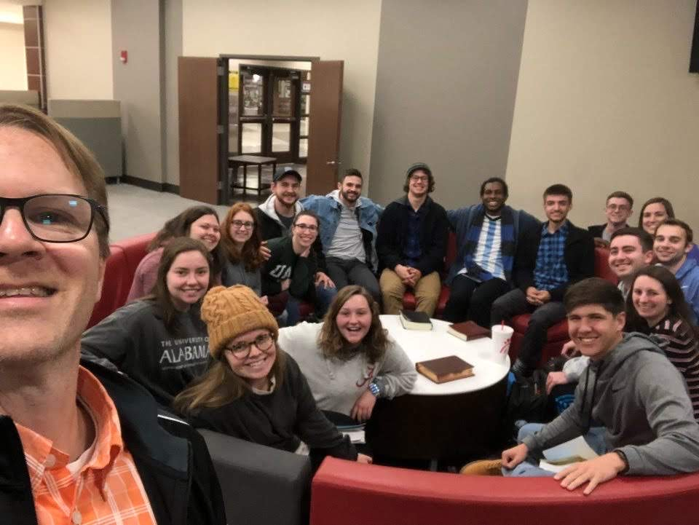
Vitek Lustyk
“All I need to know is that God is on my side and that makes everything else easier.”

Slide 13
Keep Faith in God
Romans 8:31
What then shall we say to these things? If God is for us, who can be against us?

Slide 14
How do we endure trials?
Count it all as joy
Keep Faith In God
Do not worry

Slide 15
Do Not Worry
Mark 4:35-41
35 On the same day, when evening had come, He said to them, “Let us cross over to the other side.” 36 Now when they had left the multitude, they took Him along in the boat as He was. And other little boats were also with Him. 37 And a great windstorm arose, and the waves beat into the boat, so that it was already filling. 38 But He was in the stern, asleep on a pillow. And they awoke Him and said to Him, “Teacher, do you not care that we are perishing?”

Slide 16
Do Not Worry
39 Then He arose and rebuked the wind, and said to the sea, “Peace, be still!” And the wind ceased and there was a great calm. 40 But He said to them, “Why are you so fearful? How is it that you have no faith? 41 And they feared exceedingly, and said to one another, “Who can this be, that even the wind and the sea obey Him?”
We sometimes worry because we do not know what the outcome may be, but we shouldn’t worry as Christians, because we know what the outcome is!

Slide 17
Do Not Worry
Romans 8:28
And we know that all things work together for good to those who love God, to those who are called according to His purpose.
Matthew 6:26-27
26 “Look at the birds of the air, for they neither sow nor reap nor gather into barns; yet your heavenly Father feeds them. Are you not of more value than they? 27 Which one of you by worrying can add one cubit to his stature?
God will provide for His people!

Slide 18
How do we endure trials?
Count it all as joy
Keep Faith In God
Do not worry
Pray about them

Slide 19
Pray About Them
Philippians 4:6-7
6 Be anxious for nothing, but in everything by prayer and supplication, with thanksgiving, let your requests be made known to God; 7 and the peace of God, which surpasses all understanding, will guard your hearts and minds through Christ Jesus.
The Lord’s prayer

Slide 20
Pray About Them
We can pray for others as they enter trials!
  Jesus in Luke 22:32
  “But I have prayed for you that your faith should not fail; and when you have returned to Me, strengthen your brethren

Slide 21
How do we endure trials?
Count it all as joy
Keep Faith In God
Do not worry
Pray about them

