Slide 1
Commitment
Notes:
It’s been almost 4 ½ months since many of us in here made New Year’s resolutions? How many of us are still committed to our New Year’s Resolutions? Anyone?

Slide 2
Commitment
An agreement or pledge to do something (webster’s dictionary)
Synonyms: Dedication, devotedness, devotion, faithfulness, loyalty

Slide 3
How committed are we?

Slide 4
Matthew 19:22
22 But when the young man heard that saying, he went away sorrowful: for he had great possessions.
Notes:
16 And, behold, one came and said unto him, Good Master, what good thing shall I do, that I may have eternal life?
21 Jesus said unto him, If thou wilt be perfect, go and sell that thou hast, and give to the poor, and thou shalt have treasure in heaven: and come and follow me.

Slide 5
How Dedicated are we?

Slide 6
Matthew 10:36-37
37 He that loveth father or mother more than me is not worthy of me: and he that loveth son or daughter more than me is not worthy of me.

Slide 7
How
Faithful are we?

Slide 8
Matthew 25:21
21 His lord said unto him, Well done, thou good and faithful servant: thou hast been faithful over a few things, I will make thee ruler over many things: enter thou into the joy of thy lord.

Slide 9
How
Loyal are we?

Slide 10
Matthew 26:21
35 Peter said unto him, Though I should die with thee, yet will I not deny thee. Likewise also said all the disciples.

Slide 11
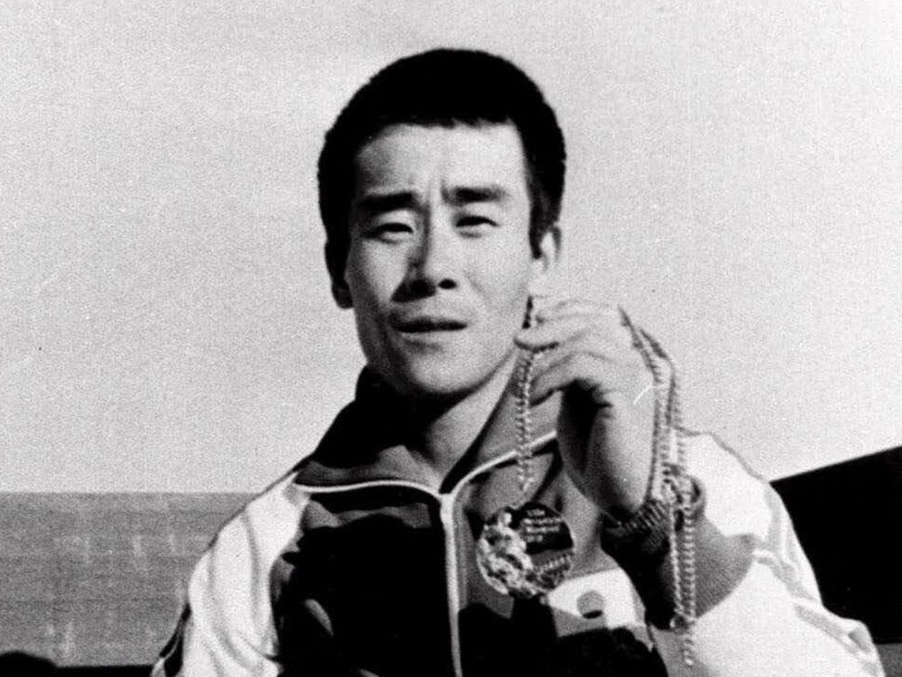
Shun FujiMoto
Notes:
In the 1976 Summer Olympics, Shun Fujimoto competed in the team gymnastics competition for Japan. In a quest for the gold metal, Fujimoto suffered a broken right knee in the floor exercise.
But this injury did not stop him, for during the next week he competed in his strongest event, the rings. His routine was excellent, but he astounded everyone by squarely dismounting with a triple somersault twist on a broken right knee.
When asked concerning his feat, he said, “Yes, the pain shot through me like a knife. It brought tears to my eyes. But now I have the gold metal and the pain is gone.”
Here we have one who was truly committed to his sport and his country.
So committed was this man that he would let nothing stop him short of his goal.
We need this same type of commitment today in the Lord’s church!
Paul tells us that we need to be “fervent in spirit; serving the Lord” (Romans 12:11).

Slide 12
Romans 12:11
11 Not slothful in business; fervent in spirit; serving the Lord;

Slide 13
How committed are we to the Lord?
Notes:
Many today are not willing to be totally committed to the Lord because it demands too much of them.
Illustration
A hen and a pig came upon a church building and read the advertised sermon on the billboard out front, which read, “What can we do to help the poor?” Immediately the hen suggested they feed them bacon and eggs.
The pig thought for a moment and said,
“There is one thing wrong with feeding bacon and eggs to the poor.
For you it only requires a contribution, but for me it requires total commitment!”

Slide 14
Romans 8:18
18 For I reckon that the sufferings of this present time are not worthy to be compared with the glory which shall be revealed in us.
Notes:
We need to remember Romans 8:18
It is worth every effort.

Slide 15
None of Self and All of Thee
#449
Notes:
We live in a society today that is all about being committed to self, dedicated to what I want, devoted to my needs, loyal to me, myself and I. We constantly put other things in our life above serving our Lord & Savior.
Many times we are All of Self and None of Thee,
Sometimes we are Some of Self & Some of Thee,
There are times we are Less of Self and More of Thee---almost got it right
but we should always be striving to be None of Self and All of Thee.

Slide 16
How much of our Heart does Jesus want?

Slide 17
Luke 10:27
27 And he answering said, Thou shalt love the Lord thy God with all thy heart, and with all thy soul, and with all thy strength, and with all thy mind; and thy neighbor as thyself.
Notes:
Jesus agreed with the lawyer who answered….

Slide 18
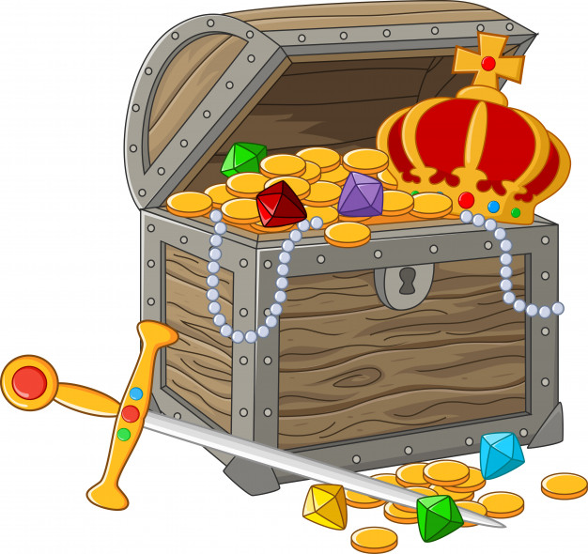
For Where your treasure is…

Slide 19
Where is our treasure?

Slide 20



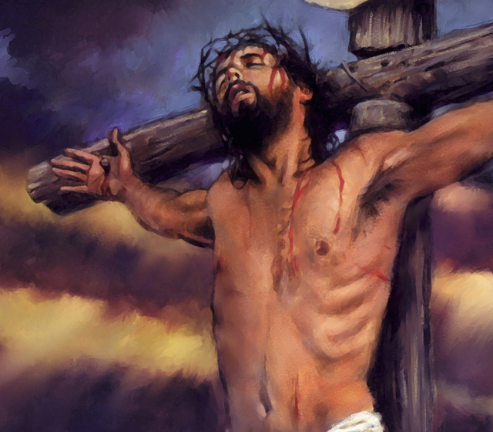
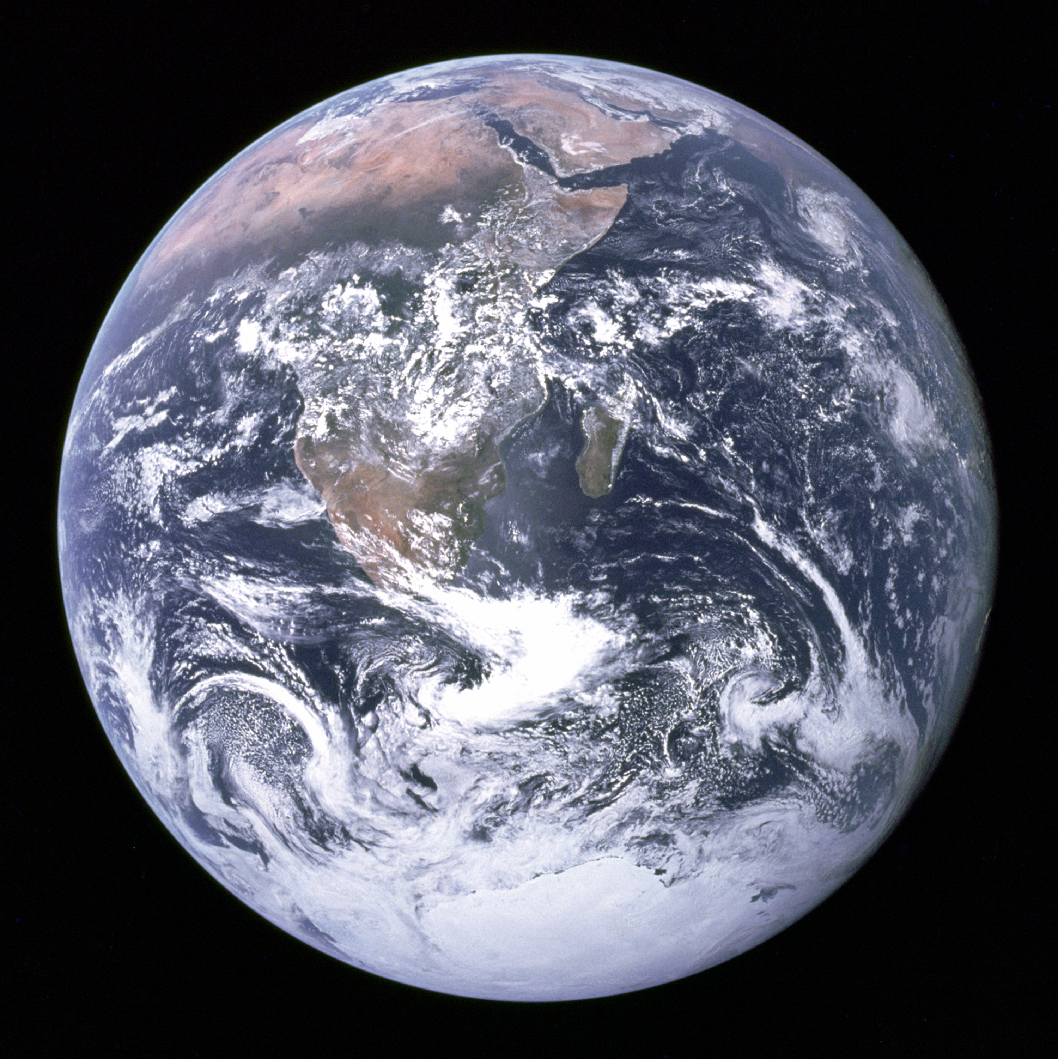
World vs Jesus

Slide 21
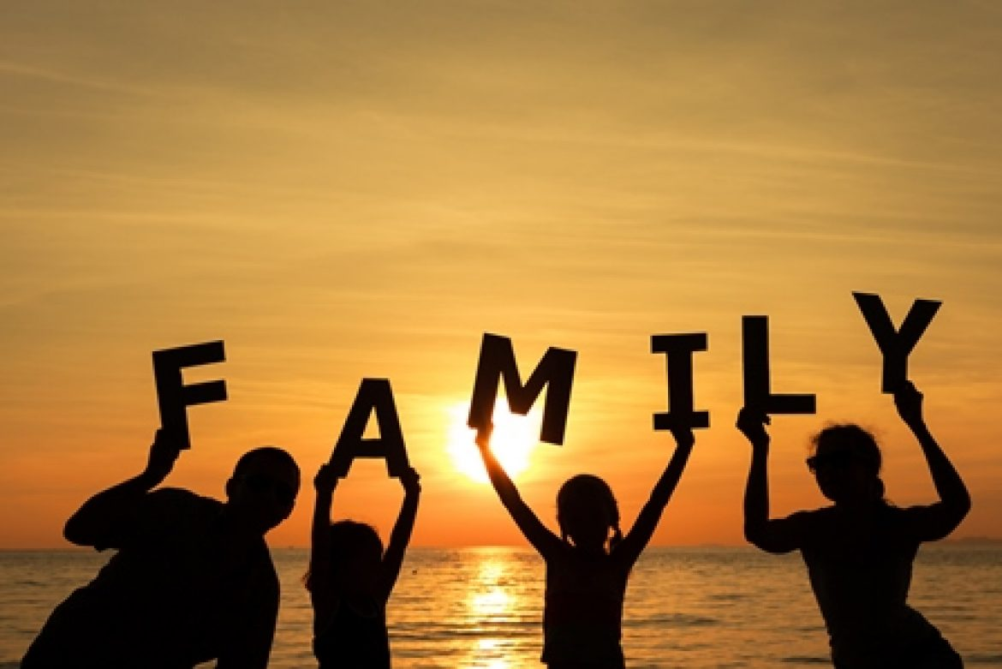
Family vs Jesus

Slide 22

Friends vs Jesus

Slide 23
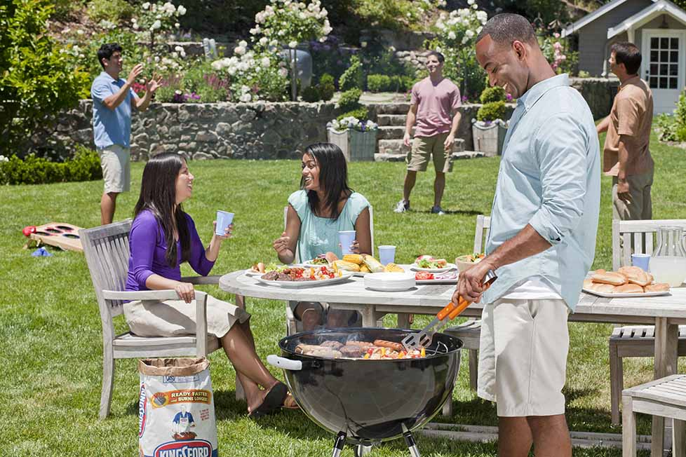
Gatherings vs Jesus

Slide 24

Working vs Jesus

Slide 25

School vs Jesus

Slide 26

Homework vs Jesus

Slide 27

Sports vs Jesus

Slide 28
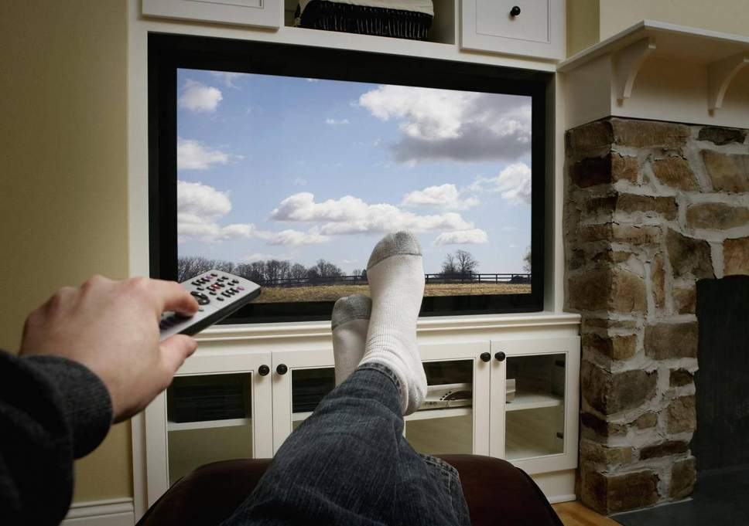
TV vs Jesus

Slide 29

Cell Phone vs Jesus

Slide 30

Social Media vs Jesus

Slide 31

For Where your treasure is…
There will your Heart be also.
Matthew 6:21

Slide 32
What’s #1 in your life?

Slide 33
Priority List:
1.
2.
3.
4.
5.
Notes:
If serving God in faithful obedience isn’t number 1, then our treasure lies somewhere else.

Slide 34
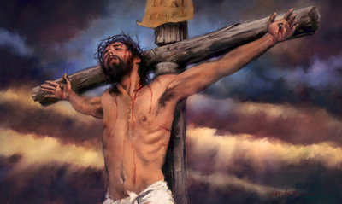
Notes:
Jesus made us His priority.
In John 6:38, Jesus said,
³⁸ For I came down from heaven, not to do mine own will, but the will of him that sent me.
Luke 19:10 For the Son of man is come to seek and to save that which was lost.

Slide 35
1 Peter 2:24
24 Who his own self bare our sins in his own body on the tree, that we, being dead to sins, should live unto righteousness: by whose stripes ye were healed.

Slide 36
I Gave My Life for Thee
#268

Slide 37
What Excuse Do I have for Not being committed?

Slide 38
Excuses
Lack of ability
Not important
Too difficult
I’m not perfect. Can’t please Him.
Don’t have the time
Notes:
EXCUSES FOR LACK OF COMMITMENT TO GOD
1. I don’t have the ability. Remember Moses. “Who am I? … what shall I say unto them? … I am not eloquent,” (Exodus 3:11, 13, 4:10)
2. I’m not important. What did Gideon say? “Oh my Lord, wherewith shall I save Israel? behold, my family is poor in Manasseh, and I am the least in my father’s house” (Judges 6:15)
3. It’s just too difficult. “The slothful man saith, There is a lion without, I shall be slain in the streets” (Proverbs 22:13) Nothing of lasting value ever comes easy.
4. I’m not perfect. No one is. Can’t please the master. So we hide our talent---we hide our commitment. Matthew 25:24-25 24 Then he which had received the one talent came and said, Lord, I knew thee that thou art an hard man, reaping where thou hast not sown, and gathering where thou hast not strawed: 25 And I was afraid, and went and hid thy talent in the earth: lo, there thou hast that is thine.
Think how hard the Master will be on us if we are not totally committed!
5. I don’t have the time.
Luke 14:18-20
18 And they all with one consent began to make excuse. The first said unto him, I have bought a piece of ground, and I must needs go and see it: I pray thee have me excused.
19 And another said, I have bought five yoke of oxen, and I go to prove them: I pray thee have me excused.
20 And another said, I have married a wife, and therefore I cannot come.

Slide 39
Stop the Excuses.
Stay Committed!

Slide 40
1 John 2:1
1 My little children, these things write I unto you, that ye sin not. And if any man sin, we have an advocate with the Father, Jesus Christ the righteous:
Notes:
None of us are perfect. I don’t think anyone would even claim to be.
Jesus was the only perfect person to walk the earth.
Using our sinful self as an excuse for not striving for His perfection in our commitment to God is just that---an excuse.

Slide 41
Romans 3:23
23 For all have sinned, and come short of the glory of God;

Slide 42
Romans 6:23
23 For the wages of sin is death; but the gift of God is eternal life through Jesus Christ our Lord.

Slide 43
1 John 1:9
9 If we confess our sins, he is faithful and just to forgive us our sins, and to cleanse us from all unrighteousness.
Notes:
When we fail in our commitment to God, listen to Him through the Scriptures.

Slide 44
God Does not want our 2nd best!
Notes:
Do we have complete commitment to God and His requirements for us, or are we just trying to get by?
God does not want our second best. He has never excepted anyone’s second best.

Slide 45
Notes:
He gave us His best.
Are you a Christian? If not, no better time to commit yourself to the Lord than right now.
If you are a Christian and your commitment to God is lacking, come forward, confess your faults and humbly ask for His forgiveness.

