Slide 1
March Sermon Series
Looking to Jesus
  Authority, Right Living, Hope, Mercy, Forgiveness, True Church, Salvation, and Restoring the Church
  Mark your calendars for our Spring Gospel Meeting on March 3-6.

Slide 2
Proverbs 31:10-31
10 Who can find a virtuous woman? for her price is far above rubies.
11 The heart of her husband doth safely trust in her, so that he shall have no need of spoil.
12 She will do him good and not evil all the days of her life.
13 She seeketh wool, and flax, and worketh willingly with her hands.
14 She is like the merchants' ships; she bringeth her food from afar.

Slide 3
Proverbs 31:10-31
15 She riseth also while it is yet night, and giveth meat to her household, and a portion to her maidens.
16 She considereth a field, and buyeth it: with the fruit of her hands she planteth a vineyard.
17 She girdeth her loins with strength, and strengtheneth her arms.
18 She perceiveth that her merchandise is good: her candle goeth not out by night.
19 She layeth her hands to the spindle, and her hands hold the distaff.

Slide 4
Proverbs 31:10-31
20 She stretcheth out her hand to the poor; yea, she reacheth forth her hands to the needy.
21 She is not afraid of the snow for her household: for all her household are clothed with scarlet.
22 She maketh herself coverings of tapestry; her clothing is silk and purple.
23 Her husband is known in the gates, when he sitteth among the elders of the land.
24 She maketh fine linen, and selleth it; and delivereth girdles unto the merchant.

Slide 5
Proverbs 31:10-31
25 Strength and honour are her clothing; and she shall rejoice in time to come.
26 She openeth her mouth with wisdom; and in her tongue is the law of kindness.
27 She looketh well to the ways of her household, and eateth not the bread of idleness.
28 Her children arise up, and call her blessed; her husband also, and he praiseth her.
29 Many daughters have done virtuously, but thou excellest them all.

Slide 6
Proverbs 31:10-31
30 Favour is deceitful, and beauty is vain: but a woman that feareth the Lord, she shall be praised.
31 Give her of the fruit of her hands; and let her own works praise her in the gates.

Slide 7
The Conversion of
Lydia
Notes:
When we think of capable, worthy women of the Bible, who comes to mind?
Deborah who led Israel in battle against Sisera, captain of the Canaanites,
Esther who saved her nation from extinction under wicked Haman,
Rahab who declared her faith in Jehovah's ability to conquer Canaan by hiding the two spies,
Elizabeth the mother of John the Baptist
Mary who gave birth to Jesus,
Mary & Martha—sisters of Lazarus, who loved Jesus
Naomi & Ruth, and many others - all of whom are significant and important people.
And the one who we are talking about tonight--Lydia

Slide 8
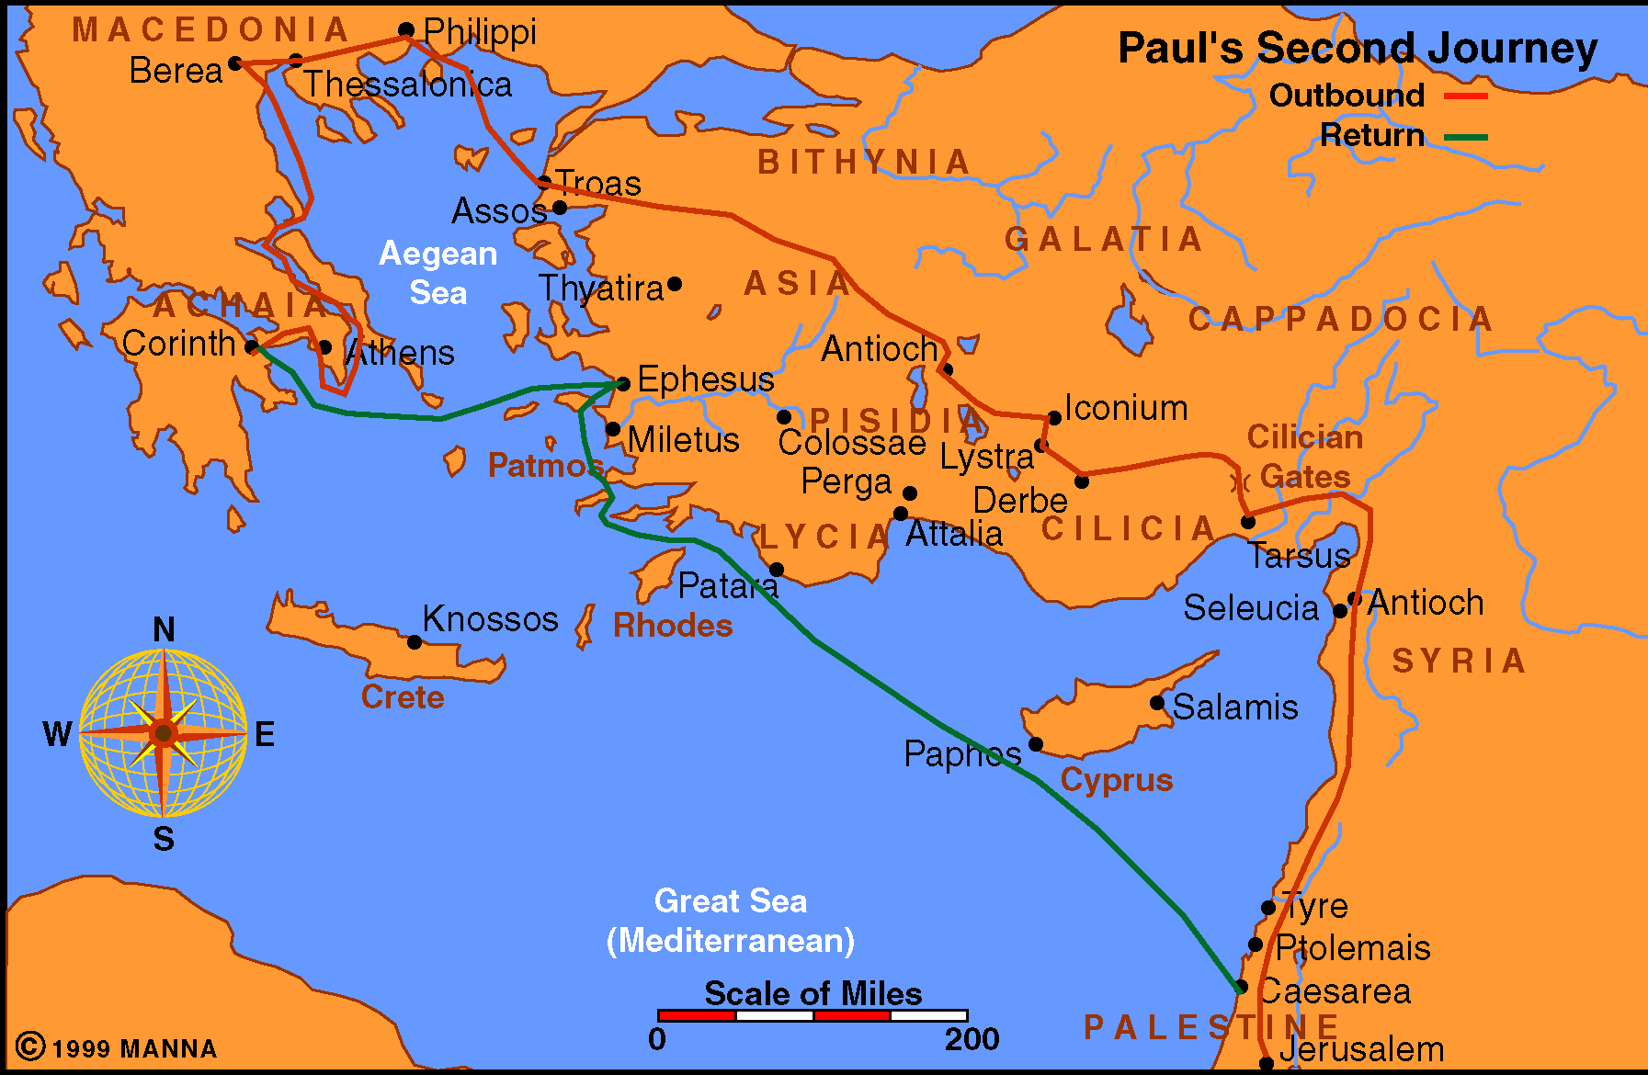
Acts 16-18
Notes:
In Acts 15:40, Paul and Silas began their second missionary journey from Antioch of Syria. When they came to Derbe and Lystra, Timothy joined them (Acts 16:1). After going throughout Phrygia and Galatia, they wanted to go to Asia, but the Holy Spirit forbade them (Acts 16:6). They traveled to Mysia, intending to preach in Bithynia "but the Spirit suffered them not" (Acts 16.7).
From thence, they came to Troas where Luke joined them and Paul had a vision of a man of Macedonia crying, "Come over into Macedonia, and help us" (Acts 16:9).
10 And after he had seen the vision, immediately we endeavoured to go into Macedonia, assuredly gathering that the Lord had called us for to preach the gospel unto them.
11 Therefore loosing from Troas, we came with a straight course to Samothracia, and the next day to Neapolis;
12 And from thence to Philippi, which is the chief city of that part of Macedonia, and a colony: and we were in that city abiding certain days.

Slide 9
Acts 16:13-15
¹³ And on the sabbath we went out of the city by a river side, where prayer was wont to be made; and we sat down, and spake unto the women which resorted thither.
¹⁴ And a certain woman named Lydia, a seller of purple, of the city of Thyatira, which worshipped God, heard us: whose heart the Lord opened, that she attended unto the things which were spoken of Paul.
¹⁵ And when she was baptized, and her household, she besought us, saying, If ye have judged me to be faithful to the Lord, come into my house, and abide there. And she constrained us.
Notes:
Wont= customarily made

Slide 10
What we know about Lydia
Where she was from
The work she did
Her character
The heart she had
The influence she had
The obedience she gave
Notes:
How significant is Lydia’s story in the Bible?

Slide 11
The Conversion
of Lydia
The Prospect: Lydia
Notes:
Prospect: Potential convert?
Would Lydia had been worth your time to share the gospel?
Would she have been on your radar? Do we have people on our radar?
Are we actively seeking to spread the gospel?

Slide 12
The Prospect: Lydia
Of Thyatira (v. 14)
  In Asia (Rev. 1:11)
  300 Miles away
  What brings her here?
  From province where Paul forbidden to go
Notes:
She was not a native of Philippi where Paul met her; rather, she was from Thyatira, a city in the province of Asia listed among the seven churches of Asia later in the book of Revelation. Thyatira was approximately 300 miles from Philippi.
Thyatira—1 of the 7 churches of Asia in Rev. 1:1

Slide 13
The Prospect: Lydia
Of Thyatira (v. 14)
Seller of Purple (v. 14)
  Either cloth or dye
    Very expensive (wear name of dye – not cloth)
    Associated with royalty (Luke 16:19)
Notes:
She is described as a "seller of purple," referring either to purple fabric or purple dye used to color the fabric. In either case, she was a business woman dealing with the upper class in her society; hence, she was a woman of some means. Like the virtuous woman of Proverbs 31, she sold her goods in the market place.
Remember the story of the Rich Man and Lazarus:
Luke 16:19 ¹⁹ There was a certain rich man, which was clothed in purple and fine linen, and fared sumptuously every day:

Slide 14
The Prospect: Lydia
Of Thyatira (v. 14)
Seller of Purple (v. 14)
  Either cloth or dye
  Successful business woman
    Such a business would require some capital
    Success & spirituality are not enemies
    Business / Work & spirituality are not enemies
Notes:
Can you have both? Key is prioritizing!
What do we seek the most?
Riches of the world: Matthew 13:22 He also that received seed among the thorns is he that heareth the word; and the care of this world, and the deceitfulness of riches, choke the word, and he becometh unfruitful.
What did Jesus tell the Rich man? Matthew 19:21 Jesus said unto him, If thou wilt be perfect, go and sell that thou hast, and give to the poor, and thou shalt have treasure in heaven: and come and follow me.
Lay not up treasures: Matthew 6:19-21
¹⁹ Lay not up for yourselves treasures upon earth, where moth and rust doth corrupt, and where thieves break through and steal:
²⁰ But lay up for yourselves treasures in heaven, where neither moth nor rust doth corrupt, and where thieves do not break through nor steal:
²¹ For where your treasure is, there will your heart be also.
Where was Lydia’s heart?
Her job was not more important than the service of God. Some Christians excuse themselves from worshiping God on the Lord's day by saying their obligations to their job take precedence over their obligations to Jehovah. Lydia was not of that character.

Slide 15
The Prospect: Lydia
Of Thyatira (v. 14)
Seller of Purple (v. 14)
Religious (v. 14)
  Worshiped God
    God fearing (Acts. 13:16)
    Like Cornelius
Notes:
She is described as a "worshiper of God." Lydia worshiped on the Sabbath day.
The significance of that might not impress us at first glance. 300 miles away…
Unlike many who claim to be Christians, Lydia took her worshiping habit with her when she traveled. Some Christians who worship God regularly while at home seem to leave their religion at home when they travel. They go away to some far city and neglect the worship of God. They are too caught up in their business or recreation to find time to worship God. Lydia was not of that character.
She reminds me of Cornelius. His character:
Sometimes we call attention to the moral character of Cornelius prior to his conversion (Acts 10:1-2). He was a devout man who feared God, gave much alms to the people and prayed to God always. Yet, he was a lost man.
Lydia was a wonderful person - yet lost in her sins.
They both were without Jesus!

Slide 16
The Prospect: Lydia
Of Thyatira (v. 14)
Seller of Purple (v. 14)
Religious (v. 14)
  Worshiped God
  Prayed
Notes:
Prayer: Do you make it a priority to pray?
1 Thessalonians 5:17 Pray without ceasing.
Romans 12:12 Rejoicing in hope; patient in tribulation; continuing instant in prayer;
Philippians 4:6 Be careful for nothing; but in every thing by prayer and supplication with thanksgiving let your requests be made known unto God.

Slide 17
The Prospect: Lydia
Of Thyatira (v. 14)
Seller of Purple (v. 14)
Religious (v. 15)
Hospitable (v. 15)
  “If you have…”
  Insisted – constrained them
Notes:
Lydia was a hospitable woman. Hospitable: Given to generous reception of guests, friendly welcoming to guests or visitors.
This is shown by her inviting Silas, Timothy, Luke and Paul to stay in her house during their preaching stay in Philippi.
Are we hospitable? At our homes? Here at church? Do we go out of our way to make our visitors welcome? Even our own members? Building each other up?
We see Lydia at the end of Acts 16:
When Paul and Silas were released from prison after the conversion of the Philippian jailer, read vs. 40 of chapter 16 to see where they went:
⁴⁰ When Paul and Silas left the prison, they returned to the home of Lydia. There they met with the believers and encouraged them once more. Then they left town.

Slide 18
The Conversion
of Lydia
The Prospect: Lydia
Her Heart: Opened

Slide 19
Her Heart: Opened
How Does The Lord Operate on Heart?
  Gospel is power to salvation (Rom. 1:16)
  What did the Gospel do? (Acts 2:37)
  Preaching of Paul was to open the hearts of Gentiles (Acts 26:17-18)
Notes:
Romans 1:16 For I am not ashamed of the gospel of Christ: for it is the power of God unto salvation to every one that believeth; to the Jew first, and also to the Greek.
On the day of Pentecost, Acts 2:37 Now when they heard this, (What did they hear? Acts 2:36 –God made Jesus whom they had crucified both Lord & Christ) they were pricked in their heart, and said unto Peter and to the rest of the apostles, Men and brethren, what shall we do?
Acts 26:17-18
17 Delivering thee from the people, and from the Gentiles, unto whom now I send thee,
18 To open their eyes, and to turn them from darkness to light, and from the power of Satan unto God, that they may receive forgiveness of sins, and inheritance among them which are sanctified by faith that is in me.
The Gospel opens the eyes to the light. By obeying it, we receive forgiveness of sins. Being faithful to it, we receive an inheritance.

Slide 20
Her Heart: Opened
How Does The Lord Operate on Heart?
Context Tells Us How
  “Heard us” – before heart opened
  “Lord opened heart”
  “Gave heed…”

Slide 21
Acts 16:14-15 NKJ
14 Now a certain woman named Lydia heard us. She was a seller of purple from the city of Thyatira, who worshiped God. The Lord opened her heart to heed the things spoken by Paul.
15 And when she and her household were baptized, she begged us, saying, "If you have judged me to be faithful to the Lord, come to my house and stay." So she persuaded us.

Slide 22
Her Heart: Opened
How Does The Lord Operate on Heart?
Context Tells Us How
  “Heard us” – before heart opened
  “Lord opened heart”
  “Gave heed…”
Notes:
The Scriptures teach that the Lord opened Lydia's heart (Acts 16:14). This implies that her heart was previously closed in some sense.
In what sense was Lydia's heart closed? Her heart was closed in the same sense as every other Jewish person's heart was closed toward Christ. Assembling to worship on the Sabbath day is evidence that Lydia was a Jew. As a Jew, she lived in expectation of the coming of the Messiah. Still waiting for him.
Listen to what Paul said in 1 Corinthians 1:20-24
²⁰ Where is the wise? where is the scribe? where is the disputer of this world? hath not God made foolish the wisdom of this world?
²¹ For after that in the wisdom of God the world by wisdom knew not God, it pleased God by the foolishness of preaching to save them that believe.
²² For the Jews require a sign, and the Greeks seek after wisdom:
²³ But we preach Christ crucified, unto the Jews a stumblingblock, and unto the Greeks foolishness;
²⁴ But unto them which are called, both Jews and Greeks, Christ the power of God, and the wisdom of God.

Slide 23
Her Heart: Opened
Not opened so she would listen – already heard!
Means: Gospel pricked her heart – so she willingly obeyed
Notes:
How was Lydia's heart opened? Lydia's heart was opened the same way that every other Jew's heart was opened - through the preaching of the gospel. Notice that Lydia heard Paul preaching before her heart was opened. Hence, Paul preached to Lydia.

Slide 24
Her Heart: Opened
How Does The Lord Operate on Heart?
Context Tells Us How
Hardening & Opening of Heart – Depends upon the Heart
  Hardened –
    Pharaoh (Ex. 4:21; 8:32)
    Heb. 3:8
  Opened – (Acts 2:37, 41)
  Same Sun
Notes:
As we read in the scriptures, we see examples of open hearts and closed/hardened hearts.
Hardened hearts: Exodus 4:21 And the Lord said unto Moses, When thou goest to return into Egypt, see that thou do all those wonders before Pharaoh, which I have put in thine hand: but I will harden his heart, that he shall not let the people go.
Hebrews 3:8 Harden not your hearts,
Opened Hearts
Acts 2:37 Now when they heard this, they were pricked in their heart, and said unto Peter and to the rest of the apostles, Men and brethren, what shall we do? 41 Then they that gladly received his word were baptized: and the same day there were added unto them about three thousand souls.
People’s reaction to the gospel is similar to clay and butter:
Same Sun:
Hardens clay
Melts butter
What kind of heart do you have?

Slide 25
Her Heart: Opened
How Does The Lord Operate on Heart?
Context Tells Us How
Hardening & Opening of Heart – Depends upon the Heart
Consequences of Arbitrary Opening One Heart & Not Another
  Respecter of persons (Rom. 2:11)
  Gospel powerless (Rom. 1:16)
  Christ didn’t die for all (Heb. 2:9)
  No free will (Rom. 6)
  If heart not opened – God’s fault!
Notes:
Some may say that God chooses which heart He wants to open. Is that what happens?
If so, then He is a respecter of persons, BUT Romans 2:11 For there is no respect of persons with God.
If so, then the Gospel is powerless, BUT Romans 1:16 For I am not ashamed of the gospel of Christ: for it is the power of God unto salvation to every one that believeth; to the Jew first, and also to the Greek.
If so, Christ died for a few, BUT, Hebrews 2:9 But we see Jesus, who was made a little lower than the angels for the suffering of death, crowned with glory and honour; that he by the grace of God should taste death for every man.
If so, we don’t have free will, BUT we do.
If so, if you are lost, it’s God’s fault, BUT it’s not.
2 Thessalonians 2:14
14 Whereunto he called you by our gospel, to the obtaining of the glory of our Lord Jesus Christ.

Slide 26
The Conversion
of Lydia
The Prospect: Lydia
Her Heart: Opened
Her Response: Obedience

Slide 27
Her Response: Obedience
Heard (v. 14)
Believed (v. 14)
  “that she attended unto the things which were spoken of Paul.” KJV
  The Lord opened her heart to respond to Paul’s message. NIV
  whose heart the Lord opened to give heed unto the things which were spoken by Paul. ASV
  As she listened to us, the Lord opened her heart, and she accepted what Paul was saying. NLT
Baptized (v. 15)
Notes:
The Scriptures report that Lydia "attended unto the things which were spoken of Paul. And when she was baptized. . . " (Acts 16:14-15). The preaching of the gospel leaves. man with things to attend; the preaching which produces faith (Rom. 10:17) directs man to the obedience of faith (Rom. 1:5; 16:26).
When you believe the gospel, a response is necessary.
Why was Lydia baptized?
When Lydia heard Paul preaching, she attended unto the things which were spoken of Paul.
Lydia is not like that group of men who make excuses for not being baptized. She did not put off to the indefinite tomorrow her obligations to God which should be met today.
When she heard the conditions for salvation, she attended to them, being baptized. Her faith led her to obey the gospel.

Slide 28
The Conversion
of Lydia
The Prospect: Lydia
Her Heart: Opened
Her Response: Obedience
Her Household: Influenced

Slide 29
Her Household: Influenced
Influence on her Family
  ¹⁵ And when she was baptized, and her household …
  Those who were to be baptized:
    Believers (Mk. 16:16)
    Repent (Acts 2:38)
    Sinners (Acts 22:16)
Notes:
Like Cornelius and his household
The Philippian jailer and his
Mark 16:16 He that believeth and is baptized shall be saved; but he that believeth not shall be damned.
Acts 2:38 Then Peter said unto them, Repent, and be baptized every one of you in the name of Jesus Christ for the remission of sins, and ye shall receive the gift of the Holy Ghost.
Acts 22:16 And now why tarriest thou? arise, and be baptized, and wash away thy sins, calling on the name of the Lord.

Slide 30
The Conversion
of Lydia
The Prospect: Lydia
Her Heart: Opened
Her Response: Obedience
Her Household: Influenced
Notes:
There are many lessons to be learned from Lydia.
May her example inspire each of us to attend to the things which God would have us to do.
What reason do you have, which God will accept, for not obeying the gospel?
2 Thessalonians 1:7-9
7 And to you who are troubled rest with us, when the Lord Jesus shall be revealed from heaven with his mighty angels,
8 In flaming fire taking vengeance on them that know not God, and that obey not the gospel of our Lord Jesus Christ:
9 Who shall be punished with everlasting destruction from the presence of the Lord, and from the glory of his power;
Just like surviving the flood was easy—God gives direction—it’s up to us to follow it.

