Slide 1
The Crucifixion

Slide 2
Arrest of Jesus
Arrest at Gethsemane
  Mark 14:43-52
Appearance before Sanhedrin
  Annas, Caiaphas (High Priest)
  Matthew 26:57-68; John 18:12-14, 19-24

Slide 3
Jesus’ Fate
Trial by Pilate (governor of Judaea)
  Pilate, Herod (Galilee), Pilate
  Luke 23:1-16
Choice of the people
  Mark 15:6-15
Pilot fails to act
  Matthew 27:19
  John 19:4-16

Slide 4
Roman crucifixion
Crucifixion was usually preserved for slaves, foreigners, revolutionaries, and most notorious criminals
1st phase – Flogging/scourging
  Flagrum – Whip that had small pieces of bone and metal attached to leather strands
  Used flagrum to “whip” back of victim
    Bone and metal fragments ripped victim’s flesh to the bone
  Intended to weaken victim to point of shock

Slide 5
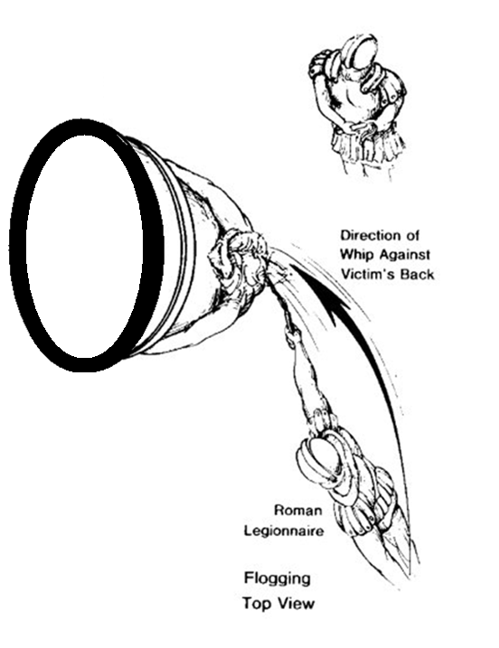
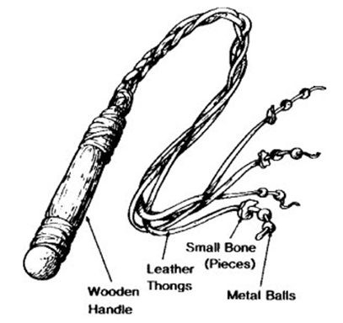

Slide 6
Roman Crucifixion
2nd phase
  Stripped of clothes
  Carried crossbeam to site of crucifixion
    75-125 Pounds
    Guarded by Roman soldiers who held sign

Slide 7
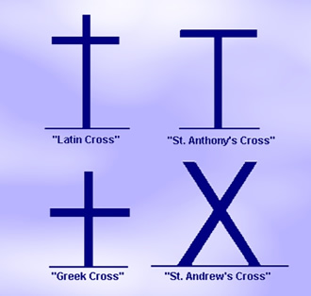
Types of crosses
crux simplex (Greek cross)
crux commissa (St. Andrew’s cross)
crux decussata (St. Anthony’s Cross)
crux immissa (Latin Cross)
  Believed to be cross used for Jesus

Slide 8
Roman Crucifixion
3rd Phase
  Hands were bound/nailed at wrists/forearm
  Feet were bound/nailed at sides or front
    Nails were 5-7 inches in length
  Sign was attached above victim’s head
Notes:
After death, the body was either left to be eaten by animals or released to family. Body could not be left on Sabbath

Slide 9
Death by Crucifixion
Death
  Asphyxiation – main cause
  Hunger
  Pain/shock
Designed to be a slow, agonizing death
Legs sometimes broken to quicken death (Sabbath)
Roman guard would pierce side to ensure death
Death occured from 3-4 hours to 3-4 days (depended on scourging)

Slide 10
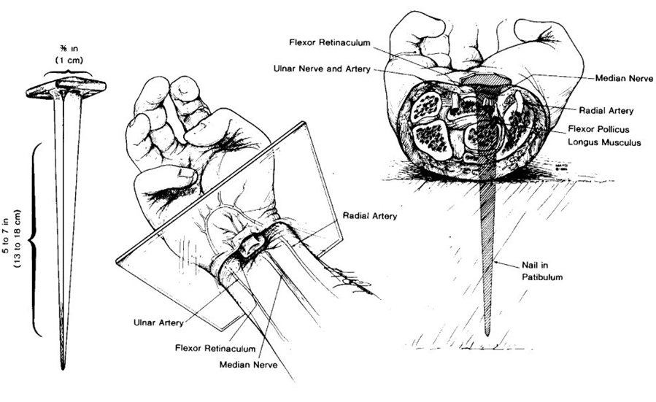
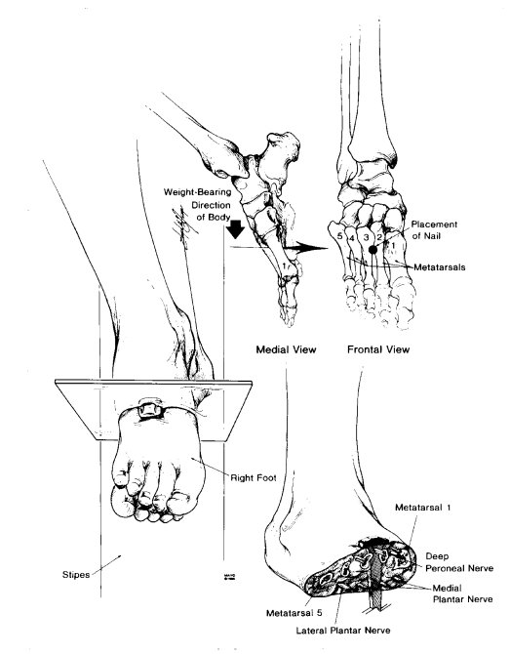

Slide 11
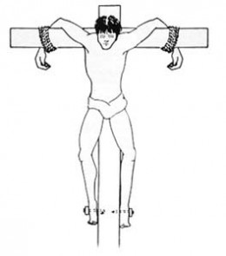
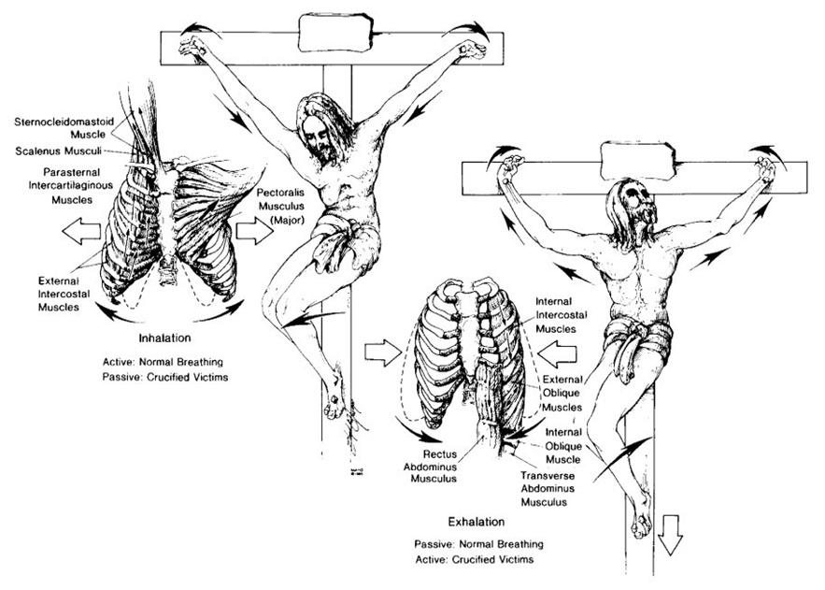

Slide 12
Crucifixion begins
Matthew 27:27-31
Mark 15:14-20
John 19:1-4

Slide 13
Jesus on the cross
Matthew 27:32-38
Mark 15:21-28
Luke 23:26-34
John 19:17-27

Slide 14
Jesus is mocked
Matthew 27: 38-44
Mark 15:28-32
Luke 23:34-43

Slide 15
Death of jesus
Matthew 27:45-56
Mark 15:33-43
Luke 23:44-49
John 19:28-37

Slide 16
Are You Serving God?
Singing
Prayer
Coming to Worship
Paying attention
Spreading the gospel
Taking the Lord’s Supper

Slide 17
God’s Plan of Salvation
Hear
  Acts 18:8
Believe
  John 3:16; Mark 16:16; Acts 16:31
Confess
  Matthew 10:32-33; Romans 10:9-10
Repent
  Matthew 4:17; Acts 2:38; Luke 13:3; Acts 8:22
Be Baptized
  Mark 16:14-20; John 3:3, 5-8; Romans 6:4; I Peter 3:21; Acts 2:38
Live a Faithful Life
  Revelation 2:10

