Slide 1
“We went on the air in 2003. Since then, weed has become increasingly legal, religion is on the decline, and less people are having children…You’re welcome, America.”
- Bill Maher

Slide 2
The decline of the church…and how to fix it

Slide 3
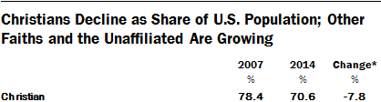
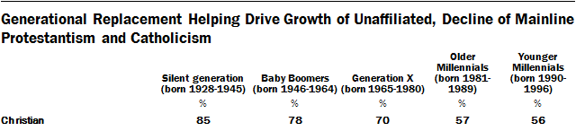

Slide 4
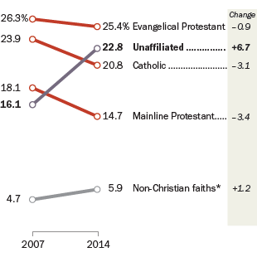

Slide 5
According to the numbers
Christianity in the U.S. has declined as a whole
  How many of these are part of the Lord’s Church?
Youngest generations less likely to identify as Christian
Unaffiliated groups are on the rise
  Breaking away from traditional congregations
Non-believers are also increasing
What does this tell us about the current state of the Lord’s Church?

Slide 6
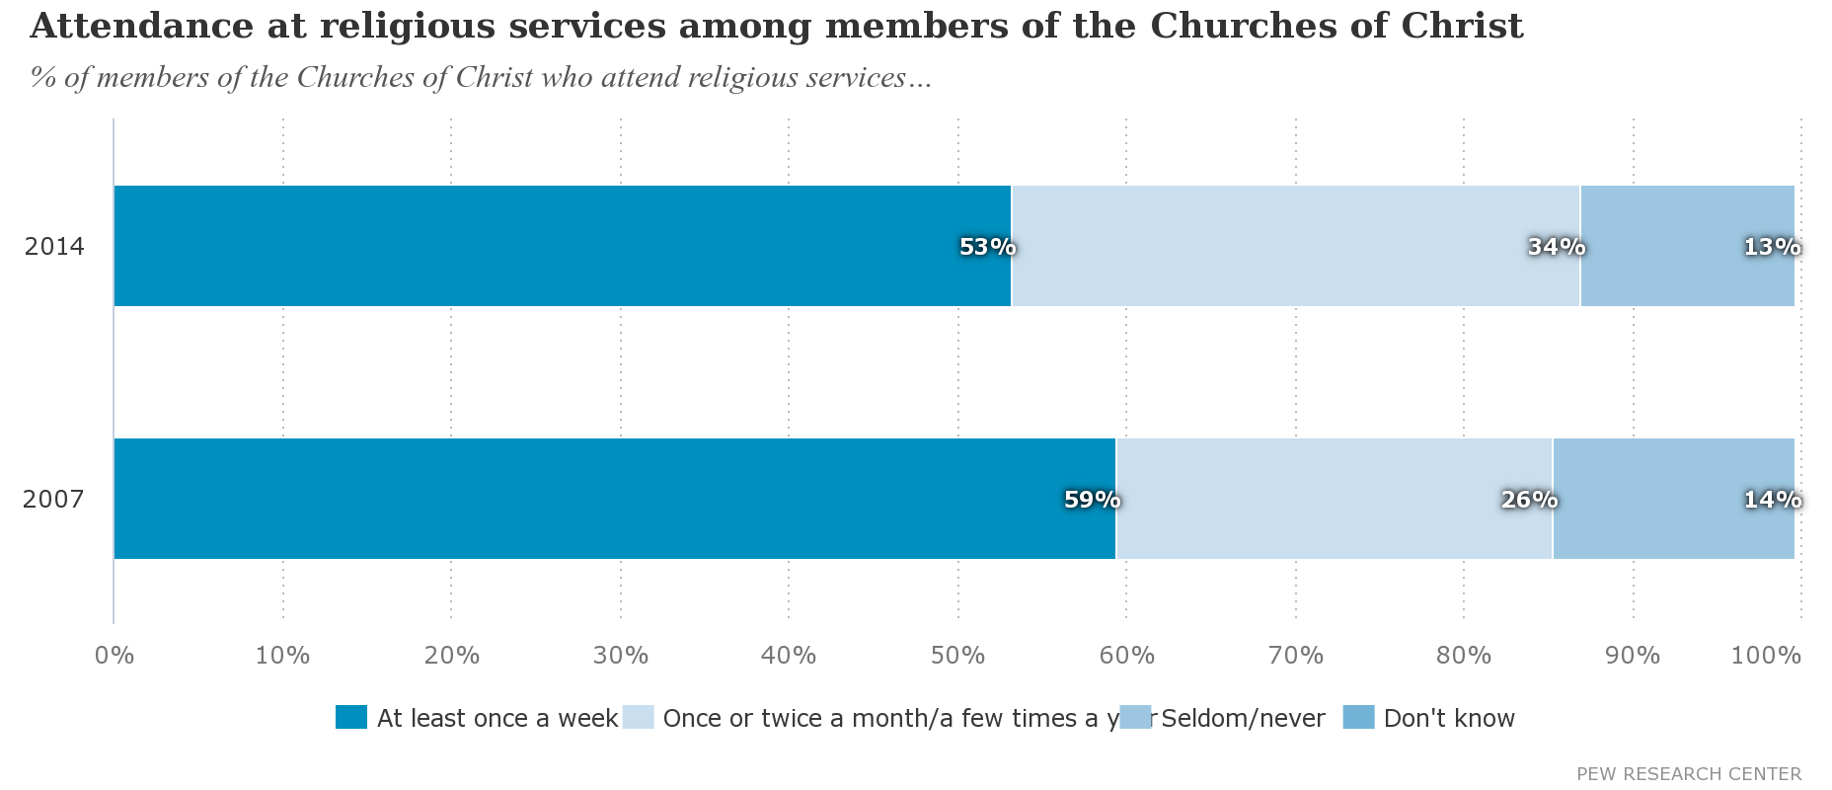

Slide 7
The Lord’s Church is in decline
How do we fix it?

Slide 8
Be willing to serve
1 Corinthians 12:4-11
We all have different talents
Romans 12:3-8
Each talent is an important part of the church
The Lord’s church cannot survive without all working parts
We must all use our talents in worship to serve God

Slide 9
Worship according to scripture
Revelation 22:18-19
Matthew 15:5-9
Follow the scripture as closely as possible
Make sure we are teaching the true Gospel
Teach from the words of God, not from words of men
The Lord’s church must grow in its truest form

Slide 10
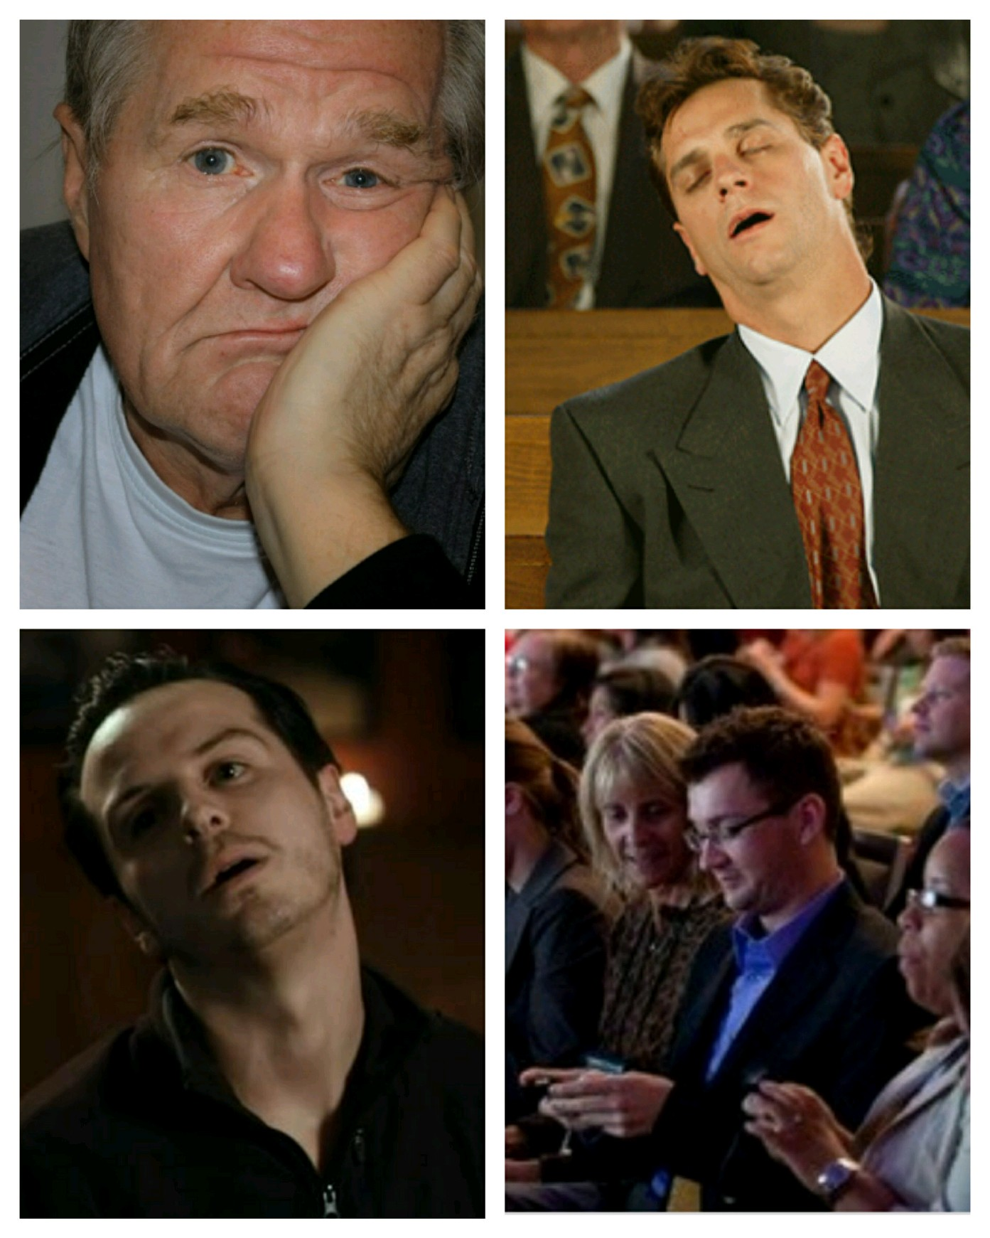

Slide 11
Be enthusiastic
Matthew 18:20
Thrive off of the fact that God is with us
Colossians 3:15-16
Hebrews 10:22-25
Help each other grow
Do not fall into the “rut” of the routine
We must keep the enthusiasm of VBS
  Baptisms
  Singing
We cannot grow if we act lifeless

Slide 12
Don’t be divisive
Matthew 12:25
Titus 3:9-11
1 Corinthians 1:10
Do not let non-scriptural matters divide us
Handle scriptural disagreements the way the scriptures tells us to
A united church thrives
If we are divided, we set ourselves up to fail

Slide 13
Be good examples
Matthew 5:14-16
Ephesians 5:1-21
1 Timothy 4:12-16
Let our light shine upon others
Conduct ourselves in the world as we do during worship
Be an example that others can/will follow
Our example has a big influence others

Slide 14
Spread the gospel
Mark 16:15
Romans 1:16-17
Matthew 28:19
Teaching others about the Bible is a commandment
Christianity spreads when the scriptures are spread
How can we add to the church if we do not teach others?

Slide 15
Promote the church
Talk to others about our congregation
Invite others to church
Advertise about upcoming lessons, gospel meetings, etc.
  Facebook, Twitter, etc.
We help the church grow when we reach out to those that are not Christians

Slide 16


Slide 17
God’s Plan of Salvation
Hear
  Acts 18:8
Believe
  John 3:16; Mark 16:16; Acts 16:31
Repent
  Matthew 4:17; Acts 2:38; Luke 13:3; Acts 8:22
Confess
  Matthew 10:32-33; Romans 10:9-10
Be Baptized
  Mark 16:14-20; John 3:3, 5-8; Romans 6:4; I Peter 3:21; Acts 2:38
Live a Faithful Life
  Revelation 2:10

