Slide 1
Does God Exist?
Notes:
The story is told of a family who had two young boys, ages 8 and 10, who were excessively mischievous.
1. They were always getting into trouble and their parents knew that, if any mischief occurred in their school or neighborhood, their sons were probably involved.
2. They boys' mother heard that a clergyman in town had been successful in disciplining children, so she asked if he would speak with her boys.
3. The clergyman agreed, but asked to see them individually.
4. So the minister met with her 8-year-old, one morning, and was to see the older boy that afternoon.
5. The minister, a huge man with a booming voice, sat the younger boy down and asked him sternly, “Where is God?”
6. The boy's eyes widened and his mouth dropped open, but he made no response.
7. So the minister repeated the question in an even sterner tone, “Where is God!!?”
8. Again the boy made no attempt to answer. So the clergyman raised his voice even more and shook his finger in the boy's face and bellowed, “WHERE IS GOD!?”
9. The boy screamed, bolted from the room, ran directly home and dove into his closet, slamming the door behind him.
10. When his older brother found him in the closet, he asked, “What happened?”
11. The younger brother, gasping for breath, replied, “We are in BIG trouble this time, dude. God is missing - and they think WE did it!”
The preacher asked an important question—Where is God? Does God exist? This has been a debate for years and its becoming more and more prevalent in our society.
The Christian share of the U.S. population is declining.

Slide 2
Does God Exist?
Notes:
So tonight we are addressing the question, “How do we know that God exists?” That question is becoming a very popular question in our culture. No longer is the existence of God something people just take as a given.
Is this a problem? According to the Pew Research Center, the share of U.S. adults who say they believe in God, has declined, from approximately 92% to 89%, since 2007.¹ (If population is 321 million, then almost 35 million don’t believe in God.)
The share of Americans who say they are “absolutely certain” God exists has dropped more sharply, from 71% in 2007 to 63% in 2014. (119 million aren’t absolutely certain)
Where is God? Does He exist?
Now, people are demanding that God, if he exists, come down to them and show himself to them, and then they will believe in him.

Slide 3
Hebrews 11:6
But without faith it is impossible to please him: for he that cometh to God must believe that he is, and that he is a rewarder of them that diligently seek him.
Notes:
The existence of God- Can it be proved or disproved? If God Himself stood before us and revealed Himself, would everyone believe in Him?
Wait a minute…..His Son came and miracle after miracle proved who He was…..yet there were those who wouldn’t believe.
The Bible says that we must accept by faith the fact that God exists:
Hebrews 11:6

Slide 4
John 20:29
Jesus saith unto him, Thomas, because thou hast seen me, thou hast believed: blessed are they that have not seen, and yet have believed.
Notes:
If God so desired, He could simply appear and prove to the whole world that He exists. But if He did that, there would be no need for faith.
He sent His Son who proved over and over, miracle after miracle, testimony after testimony, witness after witness, that He was the Son of God, yet many would not believe…….
John 20:29

Slide 5
Psalms 19:1-4
The heavens declare the glory of God; and the firmament sheweth his handywork. Day unto day uttereth speech, and night unto night sheweth knowledge. There is no speech nor language, where their voice is not heard. Their line is gone out through all the earth, and their words to the end of the world.
Notes:
That does not mean, however, that there is no evidence of God’s existence. The Bible states,
Psalms 19:1-4

Slide 6
Ecclesiastes 3:11
He hath made every thing beautiful in his time: also he hath set the world in their heart, so that no man can find out the work that God maketh from the beginning to the end.
Notes:
Looking at the stars, understanding the vastness of the universe, observing the wonders of nature, seeing the beauty of a sunset, the beauty of a snowfall—all of these things point to a Creator--God.
If these were not enough, there is also evidence of God in our own hearts.
Ecclesiastes 3:11

Slide 7
Psalms 14:1
The fool hath said in his heart, There is no God. They are corrupt, they have done abominable works, there is none that doeth good.
Notes:
Deep within us is the recognition that there is something beyond this life and someone beyond this world. We can deny this knowledge, but God’s presence in us and all around us is still obvious.
Despite this, the Bible warns that some will still deny God’s existence: Psalms 14:1

Slide 8
Ontological Argument
Definition of God
  a being than which no greater can be conceived
Notes:
In addition to the biblical arguments for God’s existence, there are logical arguments.
First, there is the ontological argument. The most popular form of the ontological argument uses the concept of God to prove God’s existence. It begins with the definition of God as “a being than which no greater can conceive.”
It is then argued that to exist is greater than to not exist, and therefore the greatest conceivable being must exist. If God did not exist, then God would not be the greatest conceivable being, and that would contradict the very definition of God.

Slide 9
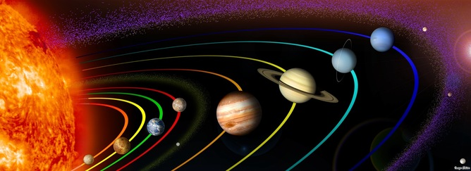
Teleological Argument
Since the universe displays an amazing design, there must be a divine Designer.
Notes:
A second argument is the teleological argument. The teleological argument states that since the universe displays such an amazing design, there must have been a divine Designer.
For example, if the Earth were significantly closer or farther away from the sun, it would not be capable of supporting much of the life it currently does. (Any closer we would burn up. Any farther away—we would freeze.)
If the elements in our atmosphere were even a few percentage points different, nearly every living thing on earth would die.
Think about a single cell—it is made up of millions of protein molecules.
The odds of a single protein molecule forming by chance is 1 in 10²⁴³ (that is a 1 followed by 243 zeros).

Slide 10

Teleological Argument
Notes:
William Paley, a clergyman, philosopher, and defender of faith, is best known for his natural theology exposition of the teleological argument for the existence of God which made use of the watchmaker analogy.
He introduced one of the most famous metaphors in the philosophy of science, the image of the watchmaker:
. . . when we come to inspect the watch, we perceive. . . that its several parts are framed and put together for a purpose, e.g. that they are so formed and adjusted as to produce motion, and that motion so regulated as to point out the hour of the day;
that if the different parts had been differently shaped from what they are, or placed after any other manner or in any other order than that in which they are placed, either no motion at all would have been carried on in the machine, or none which would have answered the use that is now served by it. . . . the inference we think is inevitable, that the watch must have had a maker -- that there must have existed, at some time and at some place or other, an artificer or artificers who formed it for the purpose which we find it actually to answer, who comprehended its construction and designed its use.
Living organisms, Paley argued, are even more complicated than watches, "in a degree which exceeds all computation."
How else to account for the often amazing adaptations of animals and plants? Only an intelligent Designer could have created them, just as only an intelligent watchmaker can make a watch:
The marks of design are too strong to be got over. Design must have had a designer. That designer must have been a person. That person is GOD.

Slide 11
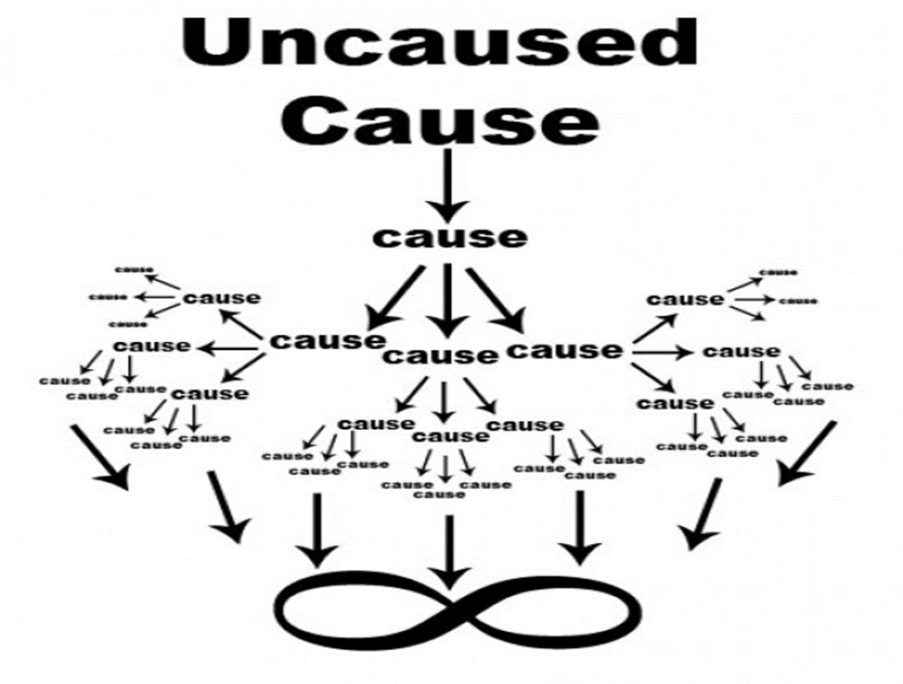
Cosmological Argument
GOD
How did the universe begin?
Why was the universe created?
Who created the universe?
Hebrews 11:3 "Through faith we understand that the worlds were framed by the word of God, so that things which are seen were not made of things which do appear.”
Notes:
A third logical argument for God’s existence is called the cosmological argument. The argument appears to answer the questions:
• How did the universe begin?
• Why was the universe created?
• Who created the universe?
CLICK!! Every effect must have a cause. This universe and everything in it is an effect. There must be something that caused everything to come into existence. Ultimately, there must be something “un-caused” in order to cause everything else to come into existence. That “un-caused” cause is God.
Over the centuries, the terminology used by philosophers for the first cause of the universe has varied. Creator of the universe as the 'First Cause' or 'First Mover'; others to a 'necessary being', or a 'self-existent being' - and for many it is God.
Hebrews 11:3

Slide 12

Moral Argument
Notes:
A fourth argument is known as the moral argument. Every culture throughout history has had some form of law. Everyone has a sense of right and wrong, good and evil. Murder, lying, stealing, and immorality are almost universally rejected.
Where did this sense of right and wrong come from if not from a holy God?
Logical argument:
1. If God did not exist, then objective moral values would not exist.
2. Objective moral values do exist.
3. Therefore, God exists.
If there is no morality, then what compels us to do good or even defines for us what is good to do?
If an absolute morality exists. If the word "good" "right" "wrong" and "evil" have any real meaning, then we have a strong argument for God.
Does a human being have value? Then we accept the moral argument.
Do you believe in innate human rights? US Constitution: We hold this truth to be self-evident: All men were created equal. If so, then you believe in the moral argument.

Slide 13
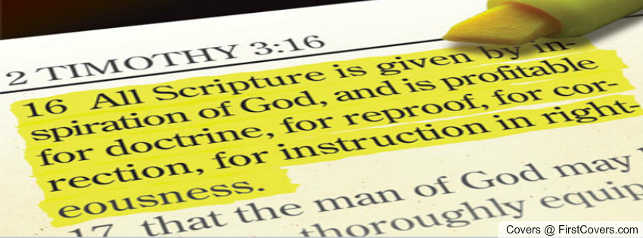
The Inspiration of the Bible
Notes:
If it can be shown that the most reasonable conclusion from all the evidence is that the Bible is divinely -then we have a strong argument for the existence of God.
2 Timothy 3:16-17 ¹⁶ All scripture is given by inspiration of God, and is profitable for doctrine, for reproof, for correction, for instruction in righteousness:
¹⁷ That the man of God may be perfect, thoroughly furnished unto all good works.
How do we know God exists?
As Christians, we know God exists because we speak to Him every day. We do not audibly hear Him speaking to us, but we sense His presence, we feel His leading, we know His love, we desire His grace. Things have occurred in our lives that have no possible explanation other than God.
God has so miraculously saved us and changed our lives that we cannot help but acknowledge and praise His existence.
None of these arguments can persuade anyone who refuses to acknowledge what is already obvious.
In the end, God’s existence must be accepted by faith (Hebrews 11:6).

Slide 14
Faith in God is not a blind leap into the dark; it is safe step into a well-lit room where the vast majority of people are already standing.

Slide 15
Rejection of God
Romans 1:25
²⁵ Who changed the truth of God into a lie, and worshipped and served the creature more than the Creator, who is blessed for ever.
Notes:
Despite all of this, the Bible tells us that people will reject the clear knowledge of God and believe a lie instead.
Romans 1:25 declares,

Slide 16
Without Excuse
Romans 1:20
²⁰ For the invisible things of him from the creation of the world are clearly seen, being understood by the things that are made, even his eternal power and Godhead; so that they are without excuse:
Notes:
The Bible also proclaims that people are without excuse for not believing in God:
Romans 1:20

Slide 17
Romans 3:23
For all have sinned, and come short of the glory of God;
Notes:
People claim to reject God’s existence because it is “not scientific” or “because there is no proof.”

Slide 18
Romans 6:23
For the wages of sin is death; but the gift of God is eternal life through Jesus Christ our Lord.
Notes:
The true reason is that once they admit that there is a God, they also must realize that they are responsible to God and in need of forgiveness from Him (Romans 3:23, 6:23).
If God exists, then we are accountable to Him for our actions.
If God does not exist, then we can do whatever we want without having to worry about God judging us.
God exists and ultimately everyone knows that He exists. The very fact that some attempt so aggressively to disprove His existence is in fact an argument for His existence.

Slide 19
Romans 1
¹⁶ For I am not ashamed of the gospel of Christ: for it is the power of God unto salvation to every one that believeth; to the Jew first, and also to the Greek. ¹⁷ For therein is the righteousness of God revealed from faith to faith: as it is written,
The just shall live by faith.
Notes:
So, what does a person who does not believe in God need in order to believe?
They need the same thing that we need.
Those of us who have become Christians, in our former state, we were no different from them. We might like to think that we have never been that bad, but that’s not what the Bible says.
We ourselves have been in a state where we loved our sin more than God. When we do that we are denying his existence.
What did we need to turn from unbelief to belief? What do those who reject the existence of God need in order to believe?
“What has the power to produce belief in God’s existence?” We see the answer in verses 16-17, “For I am not ashamed of the gospel, for it is the power of God for salvation to everyone who believes, to the Jew first and also to the Greek. For in it the righteousness of God is revealed from faith for faith, as it is written, ‘the just shall live by faith.’”
The gospel is the only thing that has the power to produce belief in the heart of an unbeliever.

Slide 20
The Gospel
1 Corinthians 15:1-4
1 Moreover, brethren, I declare unto you the gospel which I preached unto you, which also ye have received, and wherein ye stand;
² By which also ye are saved, if ye keep in memory what I preached unto you, unless ye have believed in vain.
³ For I delivered unto you first of all that which I also received, how that Christ died for our sins according to the scriptures;
⁴ And that he was buried, and that he rose again the third day according to the scriptures:
Notes:
The gospel is the good news that Jesus Christ has come into the world to save sinners. All people are wholly lost in sin and unable to come to God based upon anything within themselves.
The good news is that we can come into fellowship with the eternal God because he has sent Jesus Christ to die our death. Our sins deserved the wrath of God. The gospel is that Jesus Christ took our place on the cross and bore the wrath of God in our place. God was gracious towards us in giving up his own Son because he loved us.
And, we receive the benefits of Christ’s sacrifice by exercising our faith in him. There are no works we perform to earn salvation. Salvation is wholly a gift of grace and it is received by faith alone.
The good news is that all sinners – no matter how bad, no matter how sinful, no matter how guilty, no matter how disgusting – all sinners can be renewed through the grace extended by God through Jesus Christ.
That is the message of the gospel. That is the message in which we stand, the message which saves us, the message which we rally around. We are saved by grace through faith.

Slide 21
Does God Exist?

Slide 22
YES

Slide 23
Do You Know God?
Do You Know His Son?
Do You Know Jesus?
Are you ready to meet Him?
Notes:
Are you ready to meet the Lord? Don’t leave Him out of your life! He gave His life so we could have life!
The most basic sin of omission is the failure to repent of one’s sins, openly confess faith in Christ and surrender to Him in baptism for the remission of one’s sins ( Mk. 16:15-16; Acts 2:38 ). If you aren’t a Christian, obey his commandment and follow after Him.
As we struggle through this life trying our best not to commit sin or omit good opportunities, let us remember 1 John 1:9, “If we confess our sins, he is faithful and just to forgive us our sins and to cleanse us from all unrighteousness.”

