Slide 1
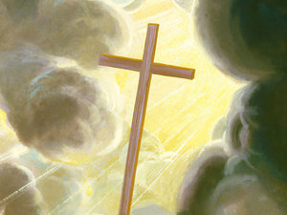
If I Be
Lifted up
John 12:32-36

Slide 2
I
I will draw all men
Unto me!

Slide 3
John 12:32-36³² And I, if I be lifted up from the earth, will draw all men unto me.
³³ This he said, signifying what death he should die.
³⁴ The people answered him, We have heard out of the law that Christ abideth for ever: and how sayest thou, The Son of man must be lifted up? who is this Son of man?

Slide 4
³⁵ Then Jesus said unto them, Yet a little while is the light with you. Walk while ye have the light, lest darkness come upon you: for he that walketh in darkness knoweth not whither he goeth.
³⁶ While ye have light, believe in the light, that ye may be the children of light. These things spake Jesus, and departed, and did hide himself from them

Slide 5
Lifted up ... The primary reference of this is to Jesus' death by being lifted up upon the cross; but the words suggest other truth also.
1. Christ was lifted up upon the cross;
2. Christ was lifted up from the grave;
3. Christ was lifted up into heaven;
4. Christ has been lifted up in the hearts of men by the preaching of the gospel in all ages since then.

Slide 6
Draw all men unto myself ...
1. He draws men in that he alone loved men sufficiently to die for them,
2. He draws men in that he is the only true revelation of God,
3. He draws men in that he is the only perfect soul who ever lived on earth,
4. He draws men and in that he alone is the satisfaction of the soul's deepest desires.

Slide 7
How does Jesus draw all men to
Him?

Slide 8
Acts 20:32 And now, brethren, I commend you to God, and to the word of his grace, which is able to build you up, and to give you an inheritance among all them which are sanctified. Heb. 4:12;
Acts 8:30 Understandest thou What thy readest? V.32 The place of the scripture Which he read was this: Isa.53:7 “He was led as a sheep To the slaughter ; and like a lamb dumb before his shearer,
So opened he not his mouth: v.33 In his humiliation his judgment
Was taken away: and who shall declare his generation? For his
Life is taken from the earth. The eunuch asked Philip: I pray thee, of whom speaketh the prophet This? Of himself, or of some other man?
And Philip began at the same scripture,and preached unto him Jesus.

Slide 9
That’s how people are drawn unto
Jesus!
By His Word!

Slide 10
Second: When we care for each other, men are drawn unto Jesus.
John 13:34,35
³⁴ A new commandment I give unto you, That ye love one another; as I have loved you, that ye also love one another.
³⁵ By this shall all men know that ye are my disciples, if ye have love one to another

Slide 11
Rom. 12:15 Rejoice with those who rejoice;
mourn with those who mourn.
Rom. 12:15 Rejoice with them that do rejoice, and weep
with them that weep. KJV
1. Good example: Phil.4:4
2. Good example: Acts 8:2 Godly men buried Stephen
and mourned deeply for him. NIV
And devout men carried Stephen to his burial,and
Made great lamentation over him. KJV

Slide 12
We draw people unto Jesus when we show our concern for them..

Slide 13
Thirdly; We draw others to Jesus by Bearing
One Another’s Burdens.
Gal. 6:2 Bear ye one another’s burdens,
And so fulfill the law of Christ.
Let others know when you are ‘struggling’..
Ask for help!!
Brethren, help me!

Slide 14
Fourthly, We draw people unto Jesus when we pray for them.
..I Thess. 5:17 Pray without ceasing.
..Acts 2:42 Continued stedfastly .
⁴² And they continued stedfastly in the apostles' doctrine and fellowship, and in breaking of bread, and in prayers.
Rom. 10:1-2 10 Brethren, my heart's desire and prayer to God for Israel is, that they might be saved.
² For I bear them record that they have a zeal of God, but not according to knowledge
.

Slide 15
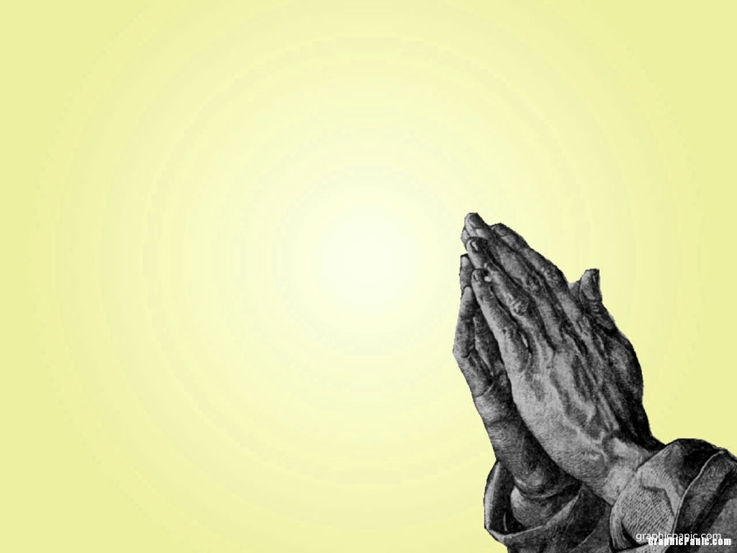
Praying for
One Another

Slide 16
Pray a lot together.
Acts 20:36 And when he had thus spoken,
he kneeled down, and prayed with them all.
{Paul praying with the brethren!}

Slide 17
Acts 16:25 And at midnight Paul and Silas prayed,
and sang praises unto God: and the prisoners heard them.
People hear us when we
pray and sing!

Slide 18
Luke 22:31 Simon, Simon, behold, Satan has demanded
permission to sift you like wheat;
32 but
I have prayed for you, that your faith may not fail;
and you, when once you have turned again,
strengthen your brothers.”

Slide 19
Just as Jesus prayed for Peter
So He is praying for us!
Luke 22:31-32

Slide 20
Men are drawn to Jesus
By:
1. By His Word
2. When we show them our care for them
3. By our helping to bear the burdens of others
4. By prayer to God for them.

Slide 21
Who have you drawn to Jesus?
Who will be in heaven because of you?

