Slide 1


Slide 2
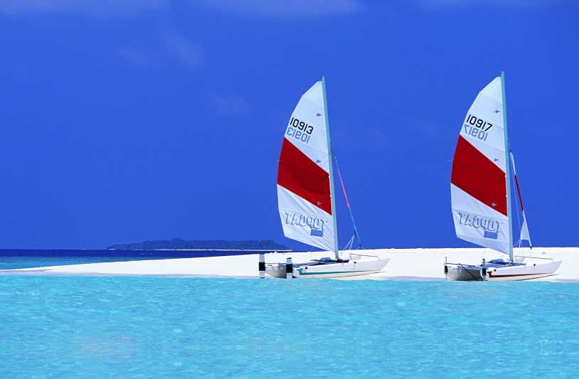

Slide 3


Slide 4
Drifting Requires No Effort
The same is true for Christians…
Which is why we are told to "give the more earnest heed“ (NKJV)
We often drift when we relax…
Hebrews 2:1 NASB For this reason we must pay much closer attention to what we have heard, so that we do not drift away from it.
E
22

Slide 5
It’s An Unconscious Process...
In a boat, undercurrents are often unnoticeable from the surface.
The same is true spiritually. Many Christians and churches have slowly drifted away.
Eventually they become far removed from the Scriptures.
N
20

Slide 6
The Distance Drifted Increases...
And the dangers also increase.
When we lose sight of land, it is more difficult to discern that we are drifting.
Spiritually, as we move farther and farther away from the Lord, we care less and less about what we do.
We grow apart from others too.
N
1

Slide 7
We drift with the currents...
E
13
Spiritual drifters may follow the current of the majority.
  Popularity (peer pressure)
  Worldliness (temptation of sin)
  Neglect (indifference, apathy, unconcern)
Matthew 7:13 “Enter by the narrow gate; for wide is the gate and broad is the way that leads to destruction, and there are many who go in by it.

Slide 8
We Drift With The Current...
And if drifters follow other currents…
Then faithfulness to the Lord is like “tacking” or sailing upwind.
D
9

Slide 9


wind
wind
wind

Slide 10

wind
wind
wind

Slide 11
To Go Against the Current...
T
10
We must be ever mindful. When we stop moving forward, we start drifting.
Drifting doesn’t just affect the one doing it…
2 Peter 3:17 Therefore, dear friends, since you have been forewarned, be on your guard so that you may not be carried away by the error of the lawless and fall from your secure position. 18 But grow in the grace and knowledge of our Lord and Savior Jesus Christ.

Slide 12
It Is Dangerous To Others Too...
T
3
A drifting boat is hazardous to its passengers and all other vessels at sea.
Parents who are just drifting, will soon lose the best opportunity to teach their children.
Ephesians 6:4 And you, fathers, do not provoke your children to wrath, but bring them up in the training and admonition of the Lord.

Slide 13
It Ends In Disaster...
A boat adrift will capsize in a storm, crash on the rocks, or go over the falls.
But by the time we hear the noise of the waterfall, it may be too late.
T
23

Slide 14
It Ends In Disaster...
If we drift spiritually through our own neglect, we will not escape punishment.
A
8
Hebrews 2:3 how shall we escape if we ignore so great a salvation? This salvation, which was first announced by the Lord, was confirmed to us by those who heard him.

Slide 15

Seeing the red flags
O
21
The most serious of all beach warning flags, red flags warn swimmers of serious hazards in the water. The red flag means that the surf is high or there are dangerous currents, or both.

Slide 16

Seeing the red flags spiritually…
Diminishing desire to pray or study God’s Word.
O
4

Slide 17
Remedies Against Drifting
KEEP ROWING...
Spiritually, this involves diligence.
W
12
2 Peter 1:5 For this very reason, make every effort to add to your faith goodness; and to goodness, knowledge; 6 and to knowledge, self-control; and to self-control, perseverance; and to perseverance, godliness; 7 and to godliness, mutual affection; and to mutual affection, love. 8 For if you possess these qualities in increasing measure, they will keep you from being ineffective and unproductive in your knowledge of our Lord Jesus Christ.

Slide 18
Remedies Against Drifting
R
5
KEEP ROWING...There’s no "retirement" from living the Christian life!
Philippians 3:14 I press toward the goal for the prize of the upward call of God in Christ Jesus. 15 Therefore let us, as many as are mature, have this mind;
2 Corinthians 4:16 Therefore we do not lose heart. Though outwardly we are wasting away, yet inwardly we are being renewed day by day.

Slide 19
Seeing the red flags spiritually…
Diminishing desire to be with other Christians.
I
16

Slide 20
Remedies Against Drifting
W
7
ACCURATELY GAUGE YOUR POSITION… When we aren’t around other Christians, we might be tempted to measure ourselves against the world.
2 Corinthians 10:12 We do not dare to classify or compare ourselves with some who commend themselves. When they measure themselves by themselves and compare themselves with themselves, they are not wise.

Slide 21
Remedies Against Drifting
C
18
WORK WITH OTHERS IN THE BOAT...
Proverbs 27:17 Iron sharpens iron, So one man sharpens another.
Ecclesiastes 4:9 Two are better than one because they have a good return for their labor. 10 For if either of them falls, the one will lift up his companion. But woe to the one who falls when there is not another to lift him up. 11 Furthermore, if two lie down together they keep warm, but how can one be warm alone?

Slide 22
Seeing the red flags spiritually…
Diminishing desire to share the Gospel.
B
14

Slide 23
Remedies Against Drifting
UNDERSTAND THE SERIOUSNESS OF BEING LOST…
Goal is to present every man perfect.
H
15
Mark 16:16 Whoever believes and is baptized will be saved, but whoever does not believe will be condemned.
Colossians 1:28 He is the one we proclaim, admonishing and teaching everyone with all wisdom, so that we may present everyone fully mature in Christ.

Slide 24
Remedies Against Drifting
The Gospel is the power of God that brings salvation!
T
17
Romans 1:16 For I am not ashamed of the gospel, because it is the power of God that brings salvation to everyone who believes: first to the Jew, then to the Gentile. 17 For in the gospel the righteousness of God is revealed—a righteousness that is by faith from first to last, just as it is written: “The righteous will live by faith.”

Slide 25
Seeing the red flags spiritually…
Increasing thrill over things of the world.
U
24

Slide 26
Remedies Against Drifting
WATCH OUT FOR UNDERCURRENTS...
It’s easy to get wrapped up in this life.
Matthew 13:22 Now he who received seed among the thorns is he who hears the word, and the cares of this world and the deceitfulness of riches choke the word, and he becomes unfruitful.
2 Timothy 4:10 for Demas has forsaken me, having loved this present world,
N
2

Slide 27
Remedies Against Drifting
The things of this world won’t last!
Proverbs 18:11 NLT The rich think of their wealth as a strong defense; they imagine it to be a high wall of safety.
Hebrews 13:14 For here we do not have an enduring city, but we are looking for the city that is to come.
R
19

Slide 28
So… Are You Drifting
Is my desire to pray and study God’s Word diminishing?
Is my desire to be with God's people not what it has been in the past?
Have I lost my desire to teach the lost?
Am I too consumed by the things of this world?
H
6
A
11

Slide 29
Conclusion
We want to be anchored in Truth.
Puzzle Answer
Ephesians 4:14 Then we will no longer be infants, tossed back and forth by the waves, and blown here and there by every wind of teaching and by the cunning and craftiness of people in their deceitful scheming. 15 Instead, speaking the truth in love, we will grow to become in every respect the mature body of him who is the head, that is, Christ.

