Slide 1
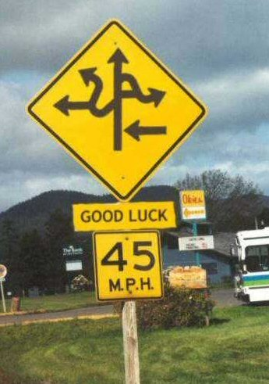
Driving Signs

Slide 2
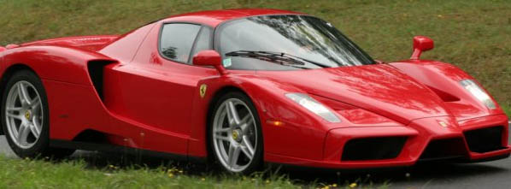

Slide 3
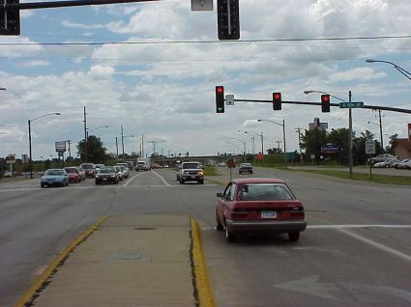

Slide 4
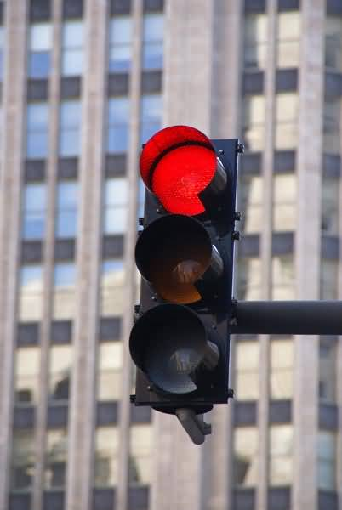

Slide 5
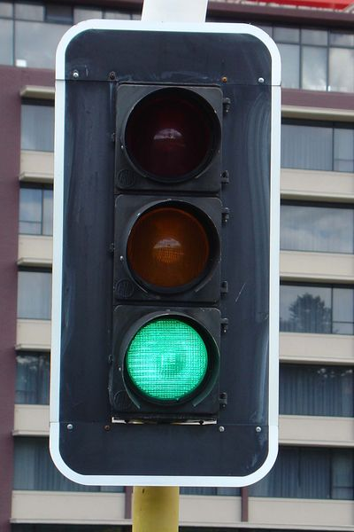

Slide 6
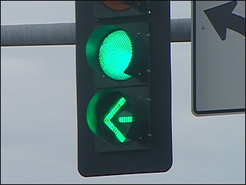

Slide 7
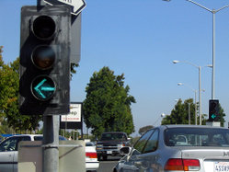

Slide 8


Slide 9


Slide 10


Slide 11


Slide 12
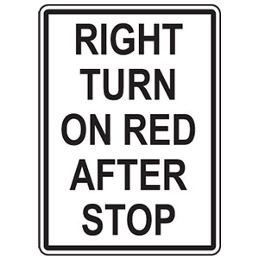

Slide 13
The Driving Signs of the Bible
There are times when God tells us exactly what to do, and there are times when he does not
We must follow the Bible exactly word for word
Revelation 22:18-19
Deuteronomy 4:2
In times where God does not give us specific instructions, we must be careful in how we translate the Bible
In short, WE MUST SPEAK WHERE THE BIBLE SPEAKS, AND BE SILENT WHERE THE BIBLE IS SILENT!

Slide 14
Where the Bible Speaks
Noah and the Ark
Genesis 6:14-22
God gave Noah explicit instructions on how to build the ark
The Building of the Tabernacle
Exodus 25-30
God meant for Moses to follow his instructions exactly

Slide 15
Baptism
Mark 16:15-16
“He who believes and is baptized will be saved; but he who does not believe will be condemned.”
Acts 2:38
John 3:3 & 5-8
Romans 6:4
I Peter 3:21
Acts 11:16; 1:4-5
God plainly tells us to be baptized for the remission of our sins

Slide 16
Prayer
Matthew 6:5-15
1 Thessalonians 5:17-18
“pray without ceasing”
James 5:13-18
Matthew 26:36-44; Mark 14:32-41; Luke 22:39-46
Jesus prays in the Garden
John 17:1-26
Jesus prays for Himself, His disciples, and all believers
The Bible gives a direct commandment to pray

Slide 17
Where the Bible is Silent
It is easy to understand commands from God, but what about things that we are not told?
Musical Instruments
Ephesians 5:18-19
“…be filled with the Spirit, speaking to one another in psalms and hymns and spiritual songs, singing and making melody in your heart to the Lord.”
Colossians 3:16
“Let the word of Christ dwell in you richly in all wisdom, teaching and admonishing one another in psalms and hymns and spiritual songs, singing with grace in your hearts to the Lord.”
The Bible never says to not play musical instruments during services, but it doesn’t say to do it, either

Slide 18
What about…
Sports Teams
Church Plays
School Programs
Concerts
Church Gym
Eating Hall
Just because the Bible does not say to not do it, it does not mean we can do it!

Slide 19
Consequences of Wrong Translation
U.S. Constitution
Marbury v. Madison; McCulloch v. Maryland
How has the Constitution changed due to translation?
Bible
Denominations
Different versions of the Bible
Different meanings of being “saved”
Weeping and gnashing of teeth (Luke 13:22-30)
Proverbs 14:12
There is a way that seems right to a man, But its end is the way of death
If we are not careful when we translate the Bible, we can easily go down the wrong path

Slide 20
God’s Plan for Salvation
Hear
Acts 18:8
Believe
John 3:16; Mark 16:16; Acts 16:31
Confess
Matthew 10:32-33; Romans 10:9-10
Repent
Matthew 4:17; Acts 2:38; Luke 13:3; Acts 8:22
Be Baptized
Mark 16:14-20; John 3:3, 5-8; Romans 6:4; I Peter 3:21; Acts 2:38
Live a Faithful Life
Revelation 2:10

