Slide 1
Faith

Slide 2
Definition
Webster’s Dictionary
Complete trust or confidence in someone or something
Strong belief in God or in the doctrines of a religion, based on spiritual apprehension rather than proof
Bible
Hebrews 11:1
Now faith is the substance of things hoped for, the evidence of things not seen

Slide 3
Old Testament Examples
Abraham
Genesis 22:1-14
David
I Samuel 17:1-58
Shadrach, Meshach, and Abed-Nego
Daniel 3:10-28

Slide 4
New Testament Examples
Paul
Acts 9: 1-8
Martha
John 11:1-44
Peter
Matthew 14:22-33

Slide 5
Those Who Doubted
Jonah
Jonah 1:1-3
Scribes and Pharisees
Matthew 12:9-14; 22-24; 38-41
Thomas
John 20:24-29

Slide 6
How Strong Is Our Faith?
Personal matters
Job, finances, etc.
Health
Surgeries, treatments, etc.
Decision-making
Tough choices
Life-changing decisions
Society
Government, social issues, etc.

Slide 7
How Do We Show Our Faith?
Prayer
Studying
Being faithful
Teaching others
Give thanks go God
Accept the results even when it does not go our way

Slide 8
Proverbs 3:5-6
5 Trust in the Lord with all your heart, And lean not on your own understanding; 6 In all your ways acknowledge Him, And He shall direct your paths.
Isaiah 40:31
Isaiah 41:10-13
Lamentations 3:25-26
Matthew 17:14-21
Acts 1:7
⁷ And He said to them, “It is not for you to know times or seasons which the Father has put in His own authority.

Slide 9
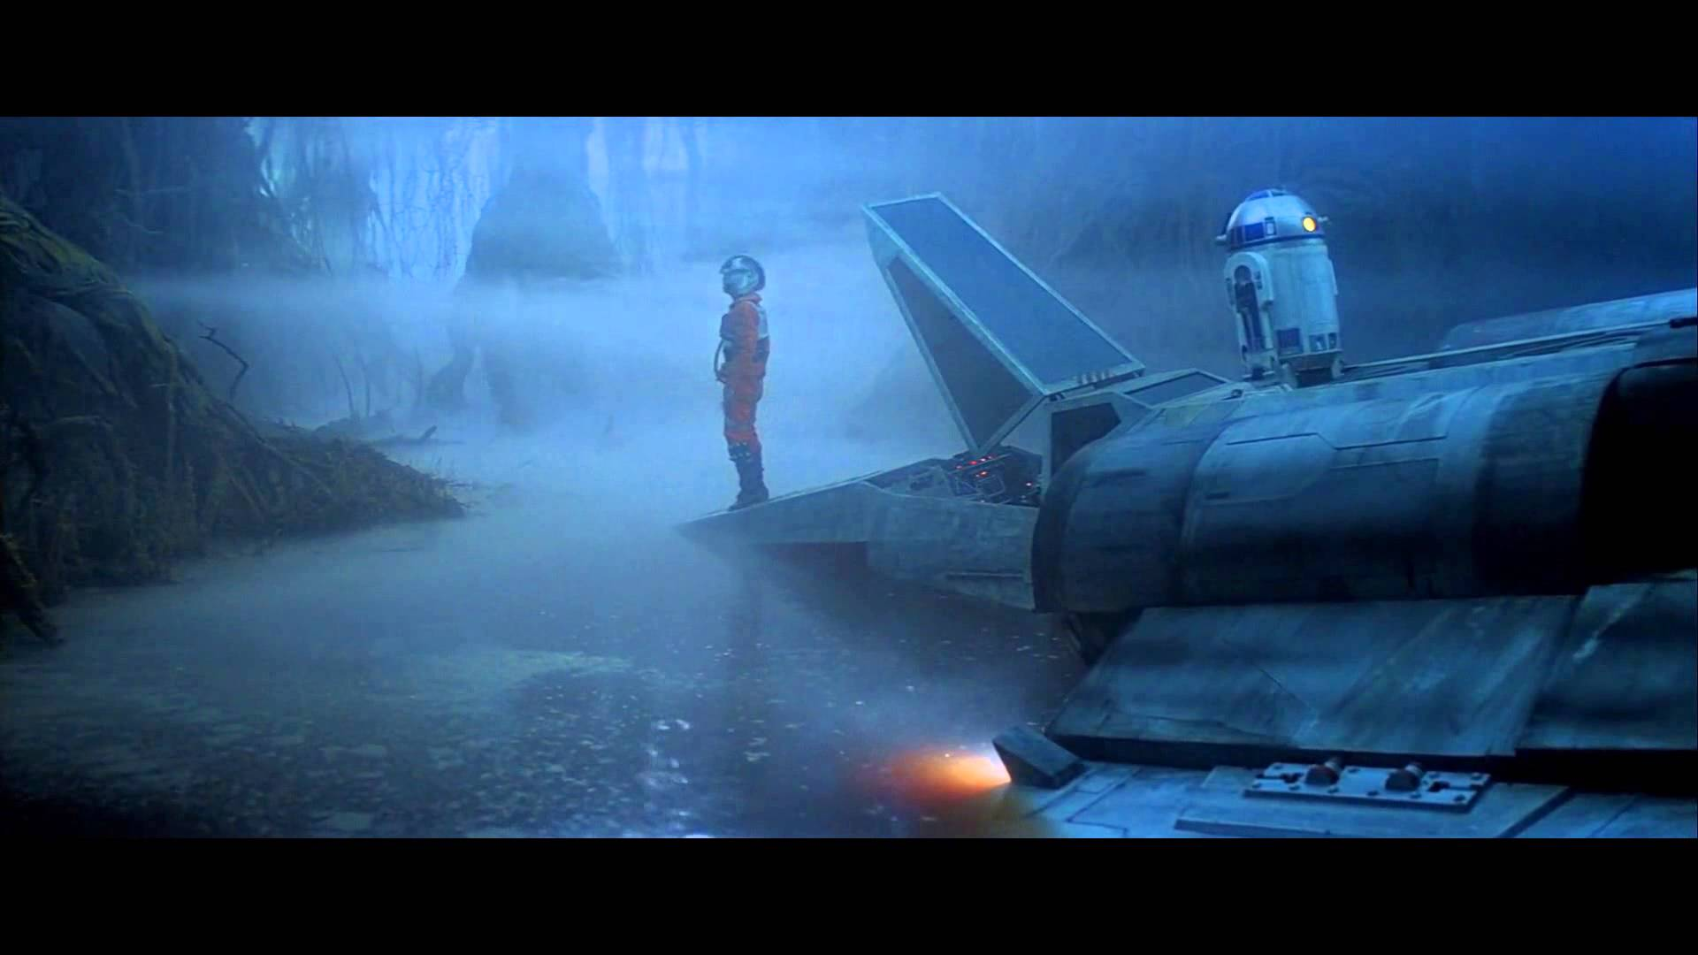

Slide 10


Slide 11
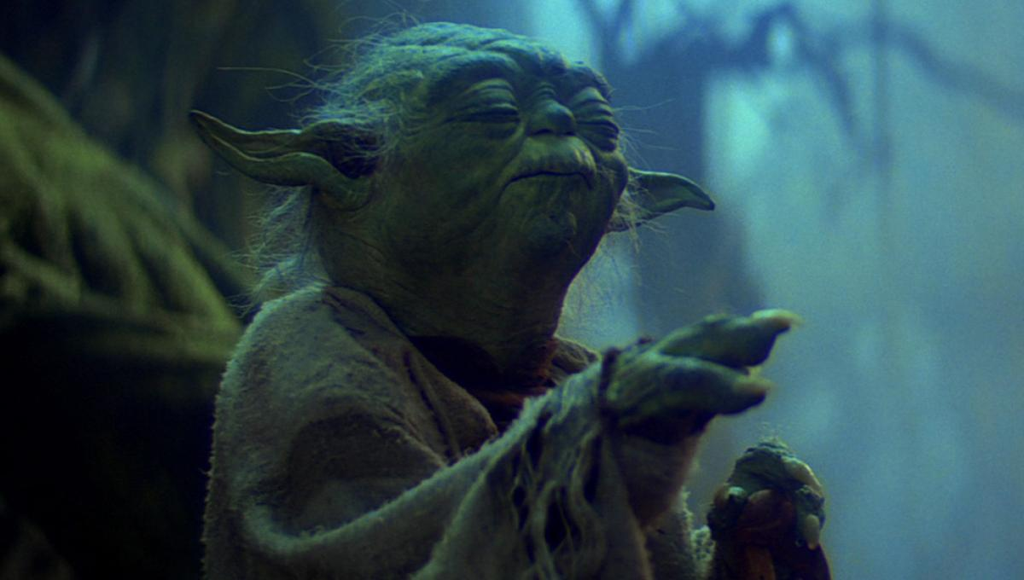

Slide 12
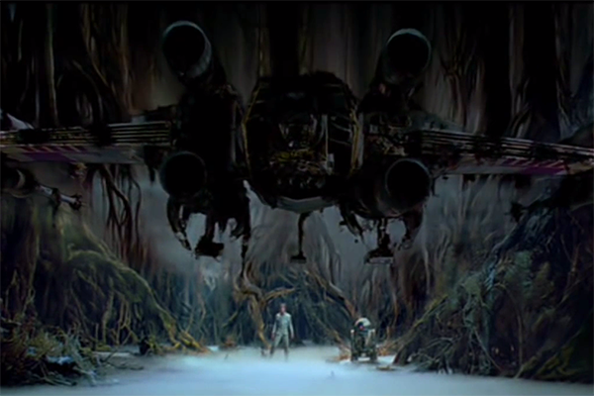

Slide 13
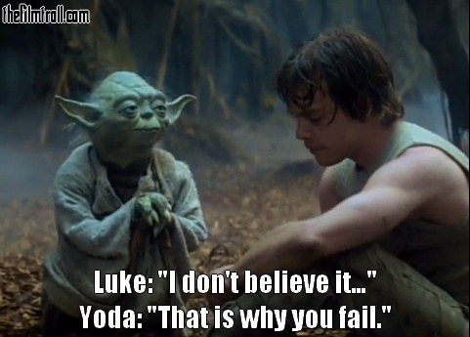

Slide 14


