Slide 1


Slide 2


Slide 3
Abraham
Gen. 18:19

Slide 4
Genesis 18:19
For I know him, that he will command his children and his household after him, and they shall keep the way of the Lord, to do justice and judgment; that the Lord may bring upon Abraham that which he hath spoken of him.
Genesis 22:12
¹² And he said, Lay not thine hand upon the lad, neither do thou any thing unto him: for now I know that thou fearest God, seeing thou hast not withheld thy son, thine only son from me.

Slide 5
We want to notice 2 things that God told
Abraham to do:

Slide 6
1. Leave his father’s house. Gen. 12:1-3
He didn’t know where he was going.
He showed complete trust and faith and obedience
to God. He packed up and did God’s bidding!
Heb. 11:8-10 By faith Abraham, when he was called to go out into a place which he should after receive for an inheritance, obeyed; and he went out, not knowing whither he went.
⁹ By faith he sojourned in the land of promise, as in a strange country, dwelling in tabernacles with Isaac and Jacob, the heirs with him of the same promise:
¹⁰ For he looked for a city which hath foundations, whose builder and maker is God.

Slide 7
#2 Abraham was told to offer his only son Issac.
Gen. 22:1ff.
a. His faith is powerful.
b. He didn’t waver. He had complete confidence
in God.
c. What he truly believed: Heb. 11:17-19 ¹⁷ By faith Abraham, when he was tried, offered up Isaac: and he that had received the promises offered up his only begotten son,
¹⁸ Of whom it was said, That in Isaac shall thy seed be called:
¹⁹ Accounting that God was able to raise him up, even from the dead; from whence also he received him in a figure.

Slide 8
We want to be more like Faithful Abraham
God speaks so often to those who are Fathers

Slide 9
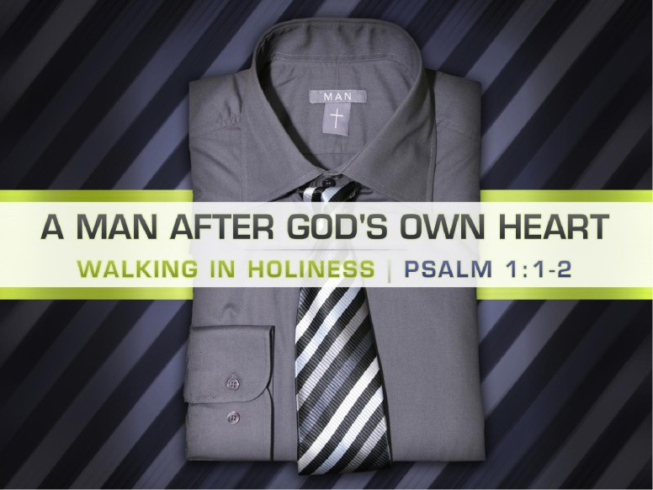

Slide 10
Psalm 1:1-21 Blessed is the man that walketh not in the counsel of the ungodly, nor standeth in the way of sinners, nor sitteth in the seat of the scornful.
² But his delight is in the law of the Lord; and in his law doth he meditate day and night
Fathers be glad that you can be a man
Like that!!

Slide 11
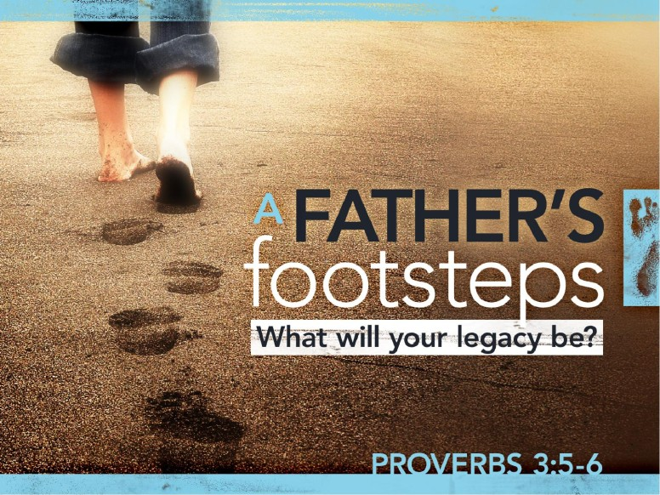

Slide 12
Proverbs 3:5-6 Trust in the Lord with all thine heart; and lean not unto thine own understanding.
⁶ In all thy ways acknowledge him, and he shall direct thy paths.
Isn’t it wonderful that we have fathers who
Trust in God like Abraham!!

Slide 13


Slide 14
Proverbs 17:24²⁴ Wisdom is before him that hath understanding; but the eyes of a fool are in the ends of the earth.
Let all the fathers at O’Neal take note:
Seek Wisdom from God!

Slide 15


Slide 16
Numbers 6:24-27²⁴ The Lord bless thee, and keep thee:
²⁵ The Lord make his face shine upon thee, and be gracious unto thee:
²⁶ The Lord lift up his countenance upon thee, and give thee peace.
²⁷ And they shall put my name upon the children of Israel, and I will bless them
Surely every father wants God’s blessings!

Slide 17


Slide 18
Psalm 139
139 O lord, thou hast searched me, and known me.
² Thou knowest my downsitting and mine uprising, thou understandest my thought afar off.
³ Thou compassest my path and my lying down, and art acquainted with all my ways.
⁴ For there is not a word in my tongue, but, lo, O Lord, thou knowest it altogether
Remember the man that use to use verse 2 often
In his prayers!

Slide 19


Slide 20
Proverbs 22:6
⁶ Train up a child in the way he should go: and when he is old, he will not depart from it.
Remember the man that use to sing:
“My name is written in the book…”
Is yours? Be a good example!

Slide 21


Slide 22


Slide 23
Proverbs 6:20-23King James Version (KJV)
²⁰ My son, keep thy father's commandment, and forsake not the law of thy mother:
²¹ Bind them continually upon thine heart, and tie them about thy neck.
²² When thou goest, it shall lead thee; when thou sleepest, it shall keep thee; and when thou awakest, it shall talk with thee.
²³ For the commandment is a lamp; and the law is light; and reproofs of instruction are the way of life:

Slide 24
Fathers! Be
A Leader
An Instructor
An Example
A Worker
A Shepherd
A man of wisdom
A man of God
A man of Protection

Slide 25


Slide 26
Psalm 127:4-5
⁴ As arrows are in the hand of a mighty man; so are children of the youth.
⁵ Happy is the man that hath his quiver full of them: they shall not be ashamed, but they shall speak with the enemies in the gate.

Slide 27


Slide 28
If you are not a Christian,
Won’t you become one today?
Hear God’s Word. Rom. 10:17
Believe Jesus is God’s Son. John 8:24
Repent. Acts 2:38
Confess Christ. Matt. 10:32,33
Be Baptized. Acts 22:16
If you are an unfaithful Christian,
Ask God’s forgiveness and let us
Pray for you to be restored to the Lord!
Acts 8:

