Slide 1
Finish Strong

Slide 2




Slide 3
Judas
Matthew 26:14-16; 47-56; 27:3-5 (NKJV)
14. “Then one of the twelve, called Judas Iscariot, went to the chief priests
15. and said, ‘What are you willing to give me if I deliver Him to you?’ And they counted out to him thirty pieces of silver.
16. So from that time he sought opportunity to betray Him.”

Slide 4
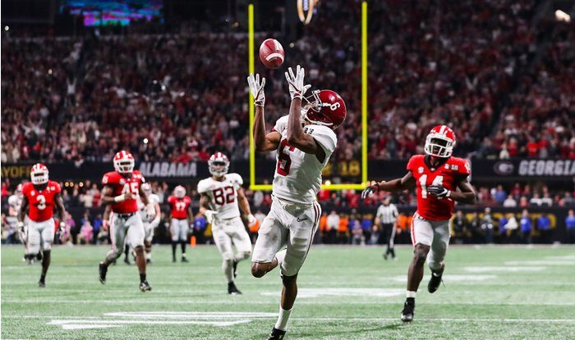


Slide 5
Peter
Luke 22:54-62 (NKJV)
2 Peter 1:12-15 (NASV)
¹² Therefore, I will always be ready to remind you of these things, even though you already know them, and have been established in the truth which is present with you. ¹³ I consider it right, as long as I am in this earthly dwelling, to stir you up by way of reminder, ¹⁴ knowing that the laying aside of my earthly dwelling is imminent, as also our Lord Jesus Christ has made clear to me. ¹⁵ And I will also be diligent that at any time after my departure you will be able to call these things to mind.

Slide 6
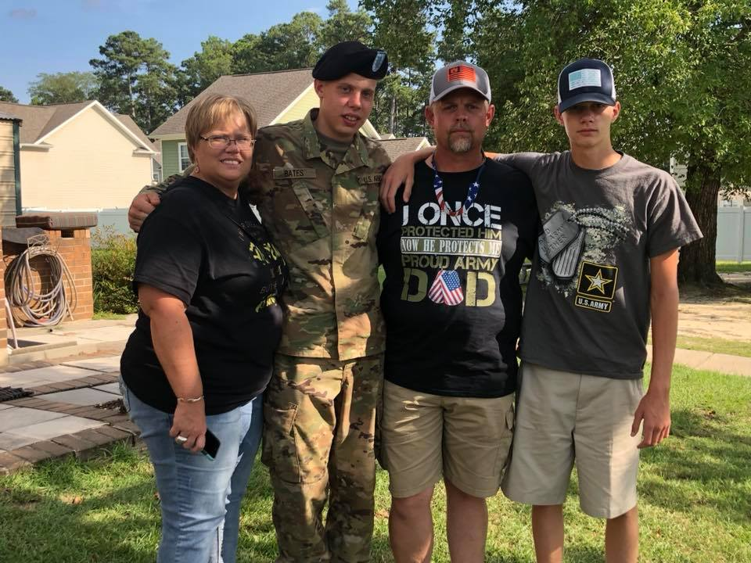

Slide 7
Jesus
Arrest at Gethsemane
Mark 14:43-52
Appearance before Sanhedrin
Matthew 26:57-68; John 18:12-14, 19-24
Trial by Pilate (governor of Judaea)
Luke 23:1-16
Pilot fails to act
John 19:4-16

Slide 8
Jesus on the Cross
Crucifixion begins
Matthew 27:27-31
Jesus on the cross
Mark 15:21-28
Death of Jesus
John 19:28-37 – “It is finished”

Slide 9
