Slide 1
Notes:
The Bible teaches that sin is a transgression of God’s law (1 John 3:4).
All people who know the difference between right and wrong have sinned (Romans 3:23).
Our sins separate us from God (Isaiah 59:1-2). The punishment for sin is death (Romans 6:23). This is the second death which is the lake that burneth with fire (Revelation 21:8).
God loves us. He does not want us to be punished for our sins. Therefore, He has provided a way for us to be forgiven (John 3:16). God sent His only begotten Son, Jesus Christ, to die for our sins (1 John 4:10).
Jesus suffered the punishment which we should have received for our sins (Isaiah 53:4-6). He did not die for His own sins, for He had none (2 Corinthians 5:21). He suffered for our sins on the cross so that we can be forgiven (Romans 5:6-8; 1 Peter 2:24). In order for us to be forgiven of our sins, and therefore receive eternal life, we must accept the salvation which Christ has made possible.
There are five steps which we must take to receive this salvation.
HEAR
BELIEVE
REPENT
CONFESS
BE BAPTIZED

Slide 2
How Do I get Rid of sin?
Notes:
The Bible teaches that sin is a transgression of God’s law (1 John 3:4).
All people who know the difference between right and wrong have sinned (Romans 3:23).
Our sins separate us from God (Isaiah 59:1-2). The punishment for sin is death (Romans 6:23). This is the second death which is the lake that burneth with fire (Revelation 21:8).
God loves us. He does not want us to be punished for our sins. Therefore, He has provided a way for us to be forgiven (John 3:16). God sent His only begotten Son, Jesus Christ, to die for our sins (1 John 4:10).
Jesus suffered the punishment which we should have received for our sins (Isaiah 53:4-6). He did not die for His own sins, for He had none (2 Corinthians 5:21). He suffered for our sins on the cross so that we can be forgiven (Romans 5:6-8; 1 Peter 2:24). In order for us to be forgiven of our sins, and therefore receive eternal life, we must accept the salvation which Christ has made possible.
There are five steps which we must take to receive this salvation.
HEAR
BELIEVE
REPENT
CONFESS
BE BAPTIZED

Slide 3
Arise!
Acts 22:16
  16 And now why tarriest thou? arise, and be baptized, and wash away thy sins, calling on the name of the Lord.

Slide 4
Steps to Salvation: hear
Notes:
The Bible teaches that sin is a transgression of God’s law (1 John 3:4).
All people who know the difference between right and wrong have sinned (Romans 3:23).
Our sins separate us from God (Isaiah 59:1-2). The punishment for sin is death (Romans 6:23). This is the second death which is the lake that burneth with fire (Revelation 21:8).
God loves us. He does not want us to be punished for our sins. Therefore, He has provided a way for us to be forgiven (John 3:16). God sent His only begotten Son, Jesus Christ, to die for our sins (1 John 4:10).
Jesus suffered the punishment which we should have received for our sins (Isaiah 53:4-6). He did not die for His own sins, for He had none (2 Corinthians 5:21). He suffered for our sins on the cross so that we can be forgiven (Romans 5:6-8; 1 Peter 2:24). In order for us to be forgiven of our sins, and therefore receive eternal life, we must accept the salvation which Christ has made possible.
There are five steps which we must take to receive this salvation.
HEAR
BELIEVE
REPENT
CONFESS
BE BAPTIZED

Slide 5
HEAR
Romans 10:17
  17 So then faith cometh by hearing, and hearing by the word of God.

Slide 6
HEAR what?
Mark 16:15
  15 And he said unto them, Go ye into all the world, and preach the gospel to every creature.

Slide 7
HEAR what?
1 Corinthians 15:1-4
  Moreover, brethren, I declare unto you the gospel which I preached unto you, which also ye have received, and wherein ye stand;
  2 By which also ye are saved, if ye keep in memory what I preached unto you, unless ye have believed in vain.
  3 For I delivered unto you first of all that which I also received, how that Christ died for our sins according to the scriptures;
  4 And that he was buried, and that he rose again the third day according to the scriptures:

Slide 8
Steps to Salvation: bELIEVE

Slide 9
BELIEVE What?
Acts 16:30-31
  30 And brought them out, and said, Sirs, what must I do to be saved?
  31 And they said, Believe on the Lord Jesus Christ, and thou shalt be saved, and thy house.

Slide 10
BELIEVE What?
Mark 16:16
  16 He that believeth and is baptized shall be saved; but he that believeth not shall be damned.

Slide 11
BELIEVE
John 8:24
  24 I said therefore unto you, that ye shall die in your sins: for if ye believe not that I am he, ye shall die in your sins.

Slide 12
Steps to Salvation: rEPENT

Slide 13
REPENT
Acts 17:30
  30 And the times of this ignorance God winked at; but now commandeth all men every where to repent:

Slide 14
REPENT
Luke 24:47
  47 And that repentance and remission of sins should be preached in his name among all nations, beginning at Jerusalem.

Slide 15
REPENTance
2 Corinthians 7:10
  10 For godly sorrow worketh repentance to salvation not to be repented of: but the sorrow of the world worketh death.

Slide 16
REPENTance Demonstrated
Acts 2:37-38
  37 Now when they heard this, they were pricked in their heart, and said unto Peter and to the rest of the apostles, Men and brethren, what shall we do?
  38 Then Peter said unto them, Repent, and be baptized every one of you in the name of Jesus Christ for the remission of sins, and ye shall receive the gift of the Holy Ghost.

Slide 17
Steps to Salvation:
Confess

Slide 18
Confess
Matthew 10:32-33
  32 Whosoever therefore shall confess me before men, him will I confess also before my Father which is in heaven.
  33 But whosoever shall deny me before men, him will I also deny before my Father which is in heaven.

Slide 19
Confess Jesus
Romans 10:8-10
  8 But what saith it? The word is nigh thee, even in thy mouth, and in thy heart: that is, the word of faith, which we preach;
  9 That if thou shalt confess with thy mouth the Lord Jesus, and shalt believe in thine heart that God hath raised him from the dead, thou shalt be saved.
  10 For with the heart man believeth unto righteousness; and with the mouth confession is made unto salvation.

Slide 20
Confess
Acts 8:35-38
  ….See, here is water; what doth hinder me to be baptized?
  37 And Philip said, If thou believest with all thine heart, thou mayest. And he answered and said, I believe that Jesus Christ is the Son of God.

Slide 21
Steps to Salvation:
Be Baptized

Slide 22
Be Baptized
Mark 16:16
  16 He that believeth and is baptized shall be saved; but he that believeth not shall be damned.

Slide 23
Be Baptized
Acts 2:38
  38 Then Peter said unto them, Repent, and be baptized every one of you in the name of Jesus Christ for the remission of sins, and ye shall receive the gift of the Holy Ghost.

Slide 24
Be Baptized
Matthew 26:28
  28 For this is my blood of the new testament, which is shed for many for the remission of sins.

Slide 25
Be Baptized
Romans 6:3-4
  3 Know ye not, that so many of us as were baptized into Jesus Christ were baptized into his death?
  4 Therefore we are buried with him by baptism into death: that like as Christ was raised up from the dead by the glory of the Father, even so we also should walk in newness of life.

Slide 26
New Life
Notes:
2 Corinthians 5:17 Therefore if any man be in Christ, he is a new creature: old things are passed away; behold, all things are become new.

Slide 27
What if I start to Backslide? What if I fall back in sin?
Notes:
But sometimes we, like Simon, fail to live up to the standard of God.
Backsliding is not just falling backward, but it is also failing to go forward spiritually. If we are not moving forward in Christ, then we are naturally going backward.

Slide 28
Progressing or
Regressing
Notes:
In the Christian life, there is no standing still. We are either progressing or regressing.

Slide 29
Falling Away
1. Self-confidence
-Prideful, confident in self not God
2. Lack of Prayer
-stop Praying
3. Following at a distance
-distance our self from the Lord

Slide 30
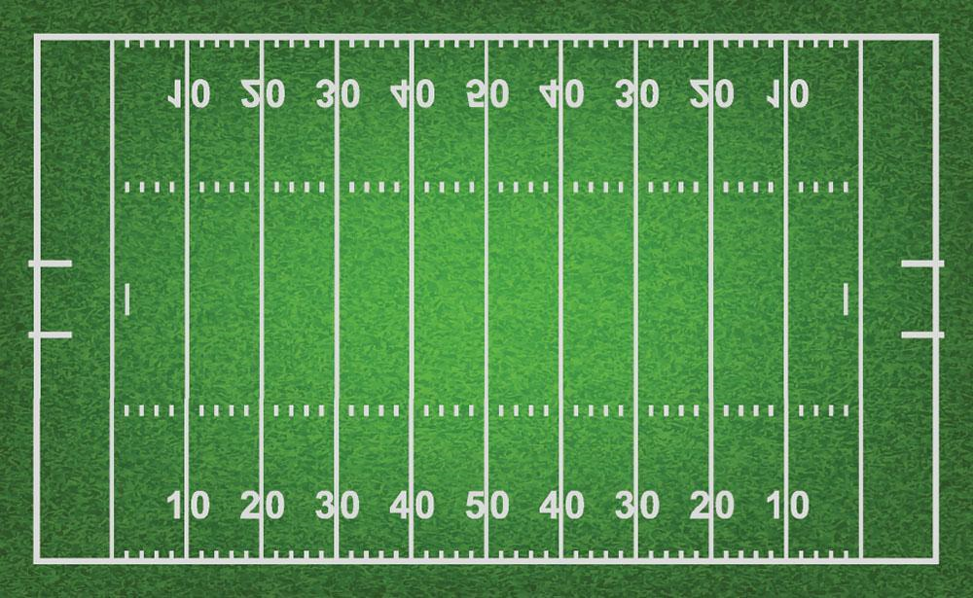

Notes:
Sometimes this is what we do.
We are like a football player who catches the ball and runs down the sidelines, stepping out of bounds and then keep on going to the endzone. We are super excited about scoring a touchdown. We think no thought about when we stepped out of bounds.
But after the replay…..

Slide 31
Notes:
We are called back to the spot where we stepped out of bounds or to the spot where the foul occurred.

Slide 32
When we sin, how do we get back on Track?

Slide 33
Repent
Acts 8:22
  Repent therefore of this thy wickedness, and pray God, if perhaps the thought of thine heart may be forgiven thee.
Notes:
Simon was told…

Slide 34
Confess Sins
James 5:16
  16 Confess your faults one to another, and pray one for another, that ye may be healed. The effectual fervent prayer of a righteous man availeth much.

Slide 35
Confess Sins
1 John 1:9
  9 If we confess our sins, he is faithful and just to forgive us our sins, and to cleanse us from all unrighteousness.
Notes:
We confess our sins to God. It’s His forgiveness that we seek.

Slide 36
If we mess up, then we need to Confess up.
Notes:
I tell my students all the time to just tell the truth. I also remind them that cameras don’t lie.

Slide 37
When there is confession, god is praised, sin is acknowledged, and faith is declared.

Slide 38
Confession Begins by calling sin as it really is.

Slide 39
The sin is ALWAYS Condemned!

Slide 40
Confession involves seeing ourselves as we really are.

Slide 41
Pharisee/Publican
Luke 18:10-14
  10 Two men went up into the temple to pray; the one a Pharisee, and the other a publican.
  11 The Pharisee stood and prayed thus with himself, God, I thank thee, that I am not as other men are, extortioners, unjust, adulterers, or even as this publican.
  12 I fast twice in the week, I give tithes of all that I possess.

Slide 42
Pharisee/Publican
Luke 18:10-14
  13 And the publican, standing afar off, would not lift up so much as his eyes unto heaven, but smote upon his breast, saying, God be merciful to me a sinner.
  14 I tell you, this man went down to his house justified rather than the other: for every one that exalteth himself shall be abased; and he that humbleth himself shall be exalted.
Notes:
Which one saw himself as he really was?

Slide 43
Confession releases us of guilt.

Slide 44
Psalms 32:1-5
  32 Blessed is he whose transgression is forgiven, whose sin is covered.
  2 Blessed is the man unto whom the Lord imputeth not iniquity, and in whose spirit there is no guile.
  3 When I kept silence, my bones waxed old through my roaring all the day long.
  4 For day and night thy hand was heavy upon me: my moisture is turned into the drought of summer. Selah.
  5 I acknowledge my sin unto thee, and mine iniquity have I not hid. I said, I will confess my transgressions unto the Lord; and thou forgavest the iniquity (GUILT) of my sin.

Slide 45
Why do we have a hard time confessing?

Slide 46
Lack of humility
What will people think?
Lack of Fear in God
Not willing to change
Won’t admit wrongs

Slide 47
Confession…. restores our reliance on the Lord.
Restores our relationship with God.
1st Step in bringing about change.
Notes:
What happens when we confess?
God hears
God forgives
God heals

Slide 48
2 Choices When we look at our sin:
1. Confession or
2. Denial
Notes:
1 John 1:8 If we say that we have no sin, we deceive ourselves, and the truth is not in us.
1 Corinthians 6:7-11 ⁹ Know ye not that the unrighteous shall not inherit the kingdom of God? Be not deceived: neither fornicators, nor idolaters, nor adulterers, nor effeminate, nor abusers of themselves with mankind,
¹⁰ Nor thieves, nor covetous, nor drunkards, nor revilers, nor extortioners, shall inherit the kingdom of God.
¹¹ And such were some of you: but ye are washed, but ye are sanctified, but ye are justified in the name of the Lord Jesus, and by the Spirit of our God.
1 John 2:1 My little children, these things write I unto you, that ye sin not. And if any man sin, we have an advocate with the Father, Jesus Christ the righteous:
2 And he is the propitiation for our sins: and not for ours only, but also for the sins of the whole world.

Slide 49
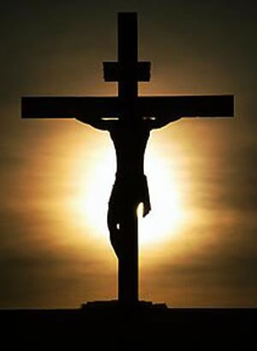
Jesus
Notes:
Let us choose to humbly come to the one who died for our sins. It’s through Him that we receive forgiveness.
Let us ask for the prayers of our brothers and sisters.
Let us reclaim our influence for righteousness.
Let us be restored faithfully.
We can’t move forward unless our sin has been forgiven.
Do you have sin in your life? Have you confessed it to the Lord?
If you aren’t a Christian, in order to have forgiveness, you must be a Christian. Come and confess the sweetest name on mortal tongue.
Come now as we stand and sing.

