Slide 1

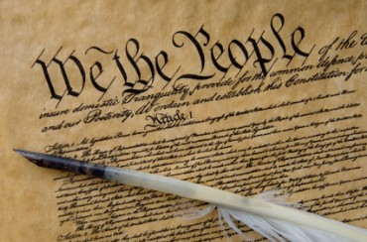
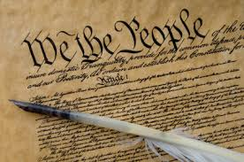
God vs. America
The Bible vs. The Constitution

Slide 2
Denominations
What are denominations?
Protestant Reformation
  Martin Luther broke away from Catholic Church
  Began first protestant religion
    Basis for many churches today
How many denominations are there?
  21 religions
  30,000-40,000 Christian denominations
Going from 1 church to 40,000
  Translation of the Bible
  Religious liberty
  Political correctness

Slide 3
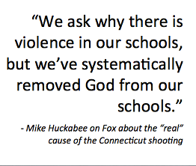

Slide 4


Slide 5
The Bible on Teaching our Youth
Mark 16:15
  Go unto the world and preach the gospel to every creature
Proverbs 13:24
  He who spares his rod hates his son, but he who loves him disciplines him promptly
Proverbs 22:6
  Train up a child in the way he should go, and when he is old he will not depart from it
Proverbs 23:13
  Do not withhold correction from a child
Ephesians 6:4
  Fathers, do not provoke your children to anger, but bring them up in the discipline and instruction of the Lord

Slide 6
Abortion
Conservatives
  Pro-life
Liberals
  Pro-choice
Moderates
  Pro-choice to a certain point

Slide 7
The Bible on Abortion
Isaiah 44:24
  ²⁴ Thus says the Lord, your Redeemer, and the one who formed you from the womb, “I, the Lord, am the maker of all things, Stretching out the heavens by Myself And spreading out the earth ^{[s]}all alone
Jeremiah 1:4-5
  ⁴ Now the word of the Lord came to me saying, ⁵ “Before I formed you in the womb I knew you, And before you were born I consecrated you;
  I have appointed you a prophet to the nations.”
Luke 1:39-45

Slide 8
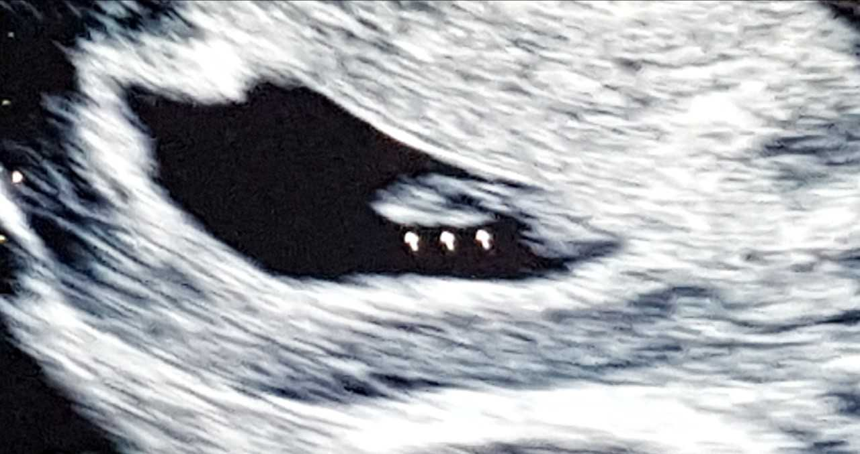

Slide 9
Homosexuality in Today’s America
Privacy (Due Process)
Homophobia
Gay Marriage
  Civil Rights
  Public Opinion
    Media
    Hollywood
    Politicians

Slide 10
The Bible on Homosexuality
Adam and Eve
  Genesis 2:24
Sodom and Gomorrah (Gen. 18 & 19)
  Wickedness of S&G
  God’s punishment
Leviticus 18:22 & 20:13
Matthew 19:4-5
Mark 10:6-9
Romans 1:27
I Corinthians 6:9
I Timothy 2:5 (One God)

Slide 11
Hate the Sin, Love the Sinner
How should we treat homosexuals?
  Matthew 9:10-12
  Romans 12:18-21
Does that mean we have to support their views?
If man makes homosexuality ok, where do they draw the line?
  Pedophiles, bestiality, etc.

Slide 12
How Do You Vote?
How will you vote in November?

Slide 13

What the Future Looks Like

Slide 14
Supporters of the “Modern” Family
Democrats
Jimmy Carter
Bill and Hillary Clinton
Barack Obama
Joe Biden
Doug Jones
Republicans
Laura Bush
Dick Cheney
Mitt Romney
  Partnerships, not marriage
  Would not sign pledge in 2011
4 current Republican Senators and 5 Congressmen

Slide 15
Supporters of the “Modern” Family
Apple Hallmark San Francisco Giants
Amazon Hewlitt-Packard Staples
American Airlines Instagram Starbucks
AT&T Jim Henson Company Tampa Bay Rays
Barnes and Noble Johnson & Johnson Target
Ben & Jerry’s Levi Strauss Twitter
Chobani Marriott Tylenol
Directv Microsoft United Airlines
Ebay Nationwide Verizon
Facebook New England Patriots Walgreens
General Electric Nike Walt Disney
General Mills Office Depot Wells Fargo
Google Pandora
Groupon PepsiCo

Slide 16
Fighting The Good Fight
2 Timothy 4:2
  Be ready in season and out of season
Mark 16:15
  Go into all the world and preach the gospel to every creature
1 Timothy 6:12 – Fight the good fight
Psalm 33: 12
  Blessed is the nation whose God is the LORD,
  The people He has chosen as His own inheritance.
Be a good example to others
Build Christian Homes
Vote

Slide 17
