Slide 1
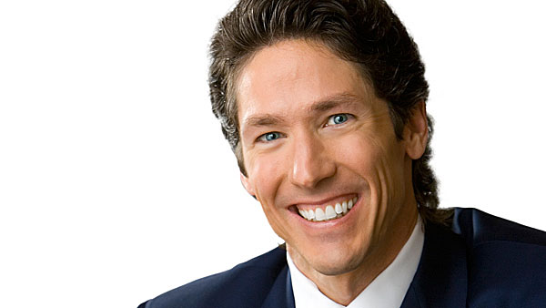

Slide 2
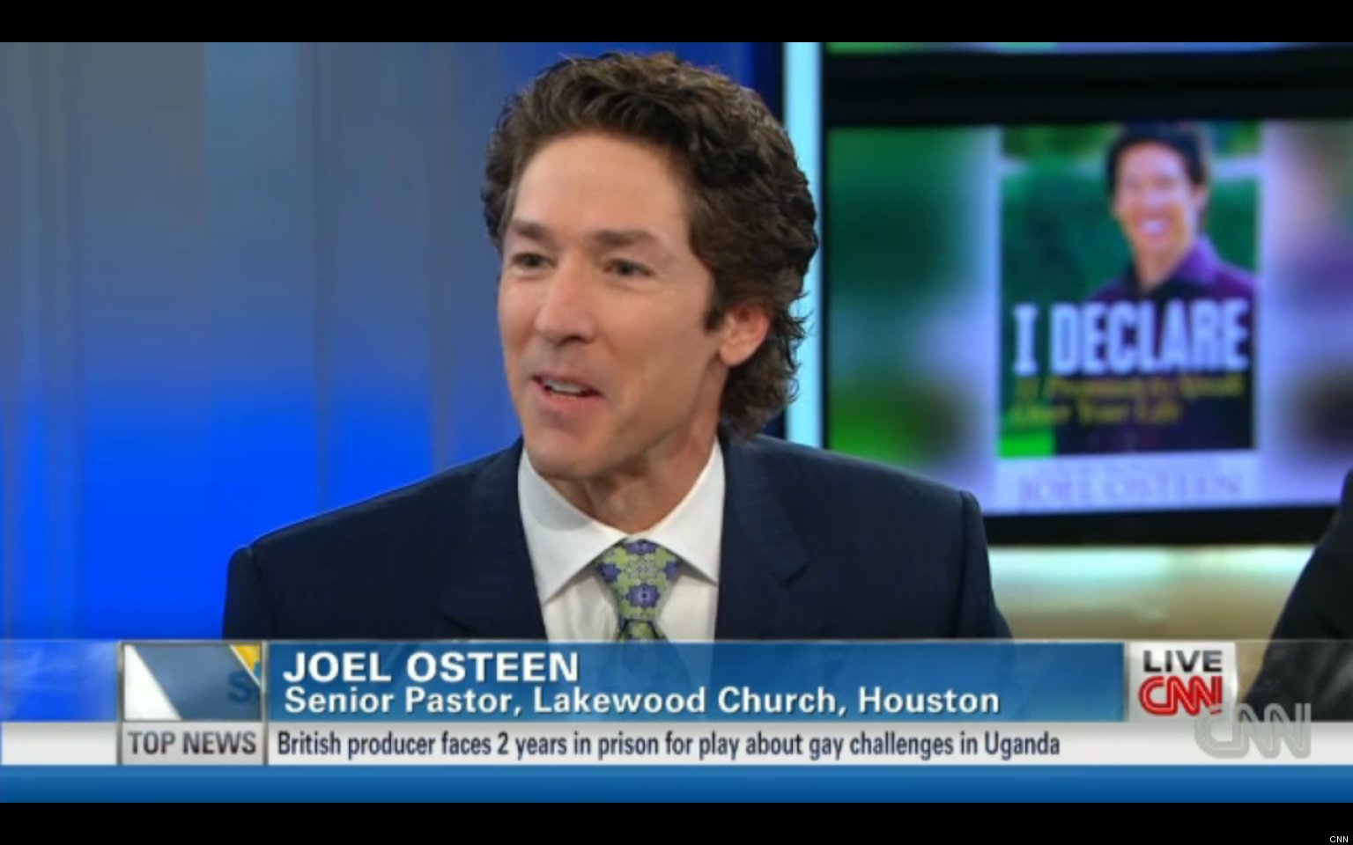
“I believe that Homosexuality isn’t God’s best for people” – Joel Osteen

Slide 3
What is your best for god?
Therefore I urge you, brethren, by the mercies of God, to present your bodies a living and holy sacrifice, acceptable to God, which is your spiritual service of worship…. Romans 12:1
Your lamb shall be without blemish, a male of the first year. You may take it from the sheep or from the goats. Exodus 12:5

Slide 4
But its more than that!
…although you were formerly alienated and hostile in mind, engaged in evil deeds, yet He has now reconciled you in His fleshly body through death, in order to present you before Him holy and blameless and beyond reproach Colossians 1:21-22
Whatever you do, do your work heartily, as for the Lord rather than for men, Col. 3:23

Slide 5
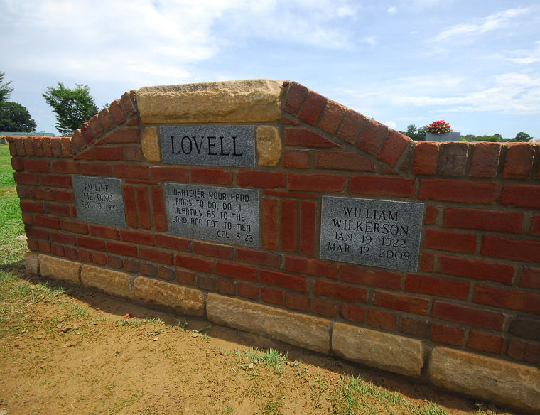
Jointing the wall by head lights…

Slide 6
Before Life ever ask for the best of you. God demands it!
For God has not called us for the purpose of impurity, but in sanctification. I Thessalonians 4:7
For God did not call us to be impure, but to live a holy life. NIV

Slide 7
A pertinent lesson at this time of year!
I came to my teacher with quivering lip, My task undone. “Teacher have you a new sheet for me? I’ve spoiled this one.” He took my old sheet, soiled and blotted and gave me a new one clean and unspotted. And into my glad heart smiled, “Do better this time, my child.”
I came to my Lord with a trembling heart; the year was done. “Master, have you a new year for me? I’ve spoiled this one.” He took the old year, stained and blotted and gave me a new one clean and unspotted. And into my glad heart he smiled, “Do better this time, my child.” -- Author unknown

Slide 8
Give God your best in 2018!!!

Slide 9
But what is God’s best for me?!?!?!?
What can I do better?
How can I improve?
What will life look like if change?
How will this affect my day?
What kinds of things will I have to give up?
How difficult will this be!?!?!?!?
Why do 99.99999999% of all resolutions fail?

Slide 10
How bout our best in worship?
God is spirit, and those who worship Him must worship in spirit and truth.” John 4:24
So then do not be foolish, but understand what the will of the Lord is. And do not get drunk with wine, for that is dissipation, but be filled with the Spirit, speaking to one another in psalms and hymns and spiritual songs, singing and making melody with your heart to the Lord; always giving thanks for all things in the name of our Lord Jesus Christ to God, even the Father; and be subject to one another in the fear of Christ. Ephesians 5: 17-20
Singing = Psalo = To pluck, strum or play.

Slide 11
We are to play our heart before God!
Are we giving him our best when we refuse to sing?

Slide 12
What about our best in learning his word?
But sanctify Christ as Lord in your hearts, always being ready to make a defense to everyone who asks you to give an account for the hope that is in you, yet with gentleness and reverence; I Peter 3:15
Be sober, be vigilant. For your adversary, the devil, prowls about like a roaring lion, seeking WHOM he may devour. I Peter 5:8

Slide 13
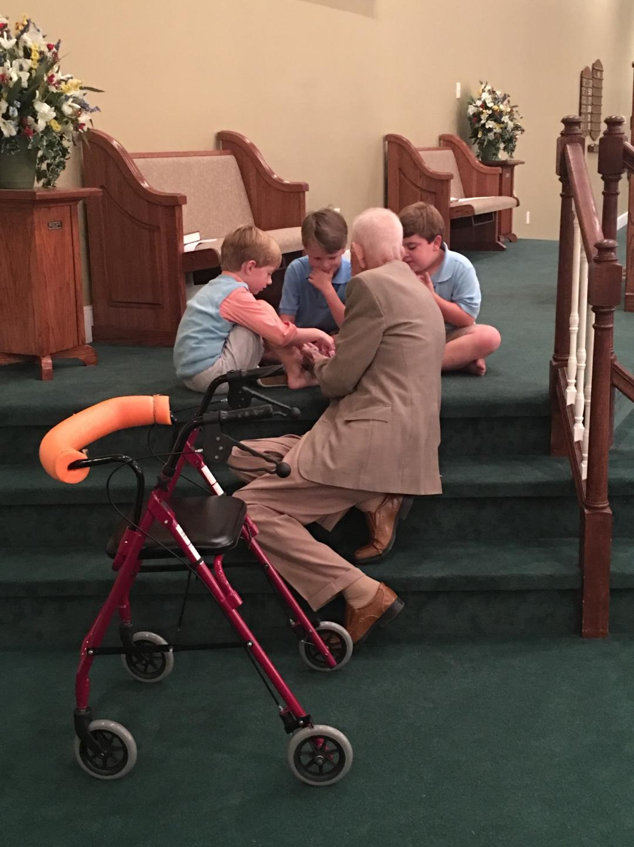
But I am too young!
Let no one look down on your youthfulness, but rather in speech, conduct, love, faith and purity, show yourself an example of those who believe I Timothy 4:12

Slide 14
God wants the best for you as well!
But do not let this one fact escape your notice, beloved, that with the Lord one day is like a thousand years, and a thousand years like one day. ⁹ The Lord is not slow about His promise, as some count slowness, but is patient toward you, not wishing for any to perish but for all to come to repentance. II Peter 3:8-9

Slide 15
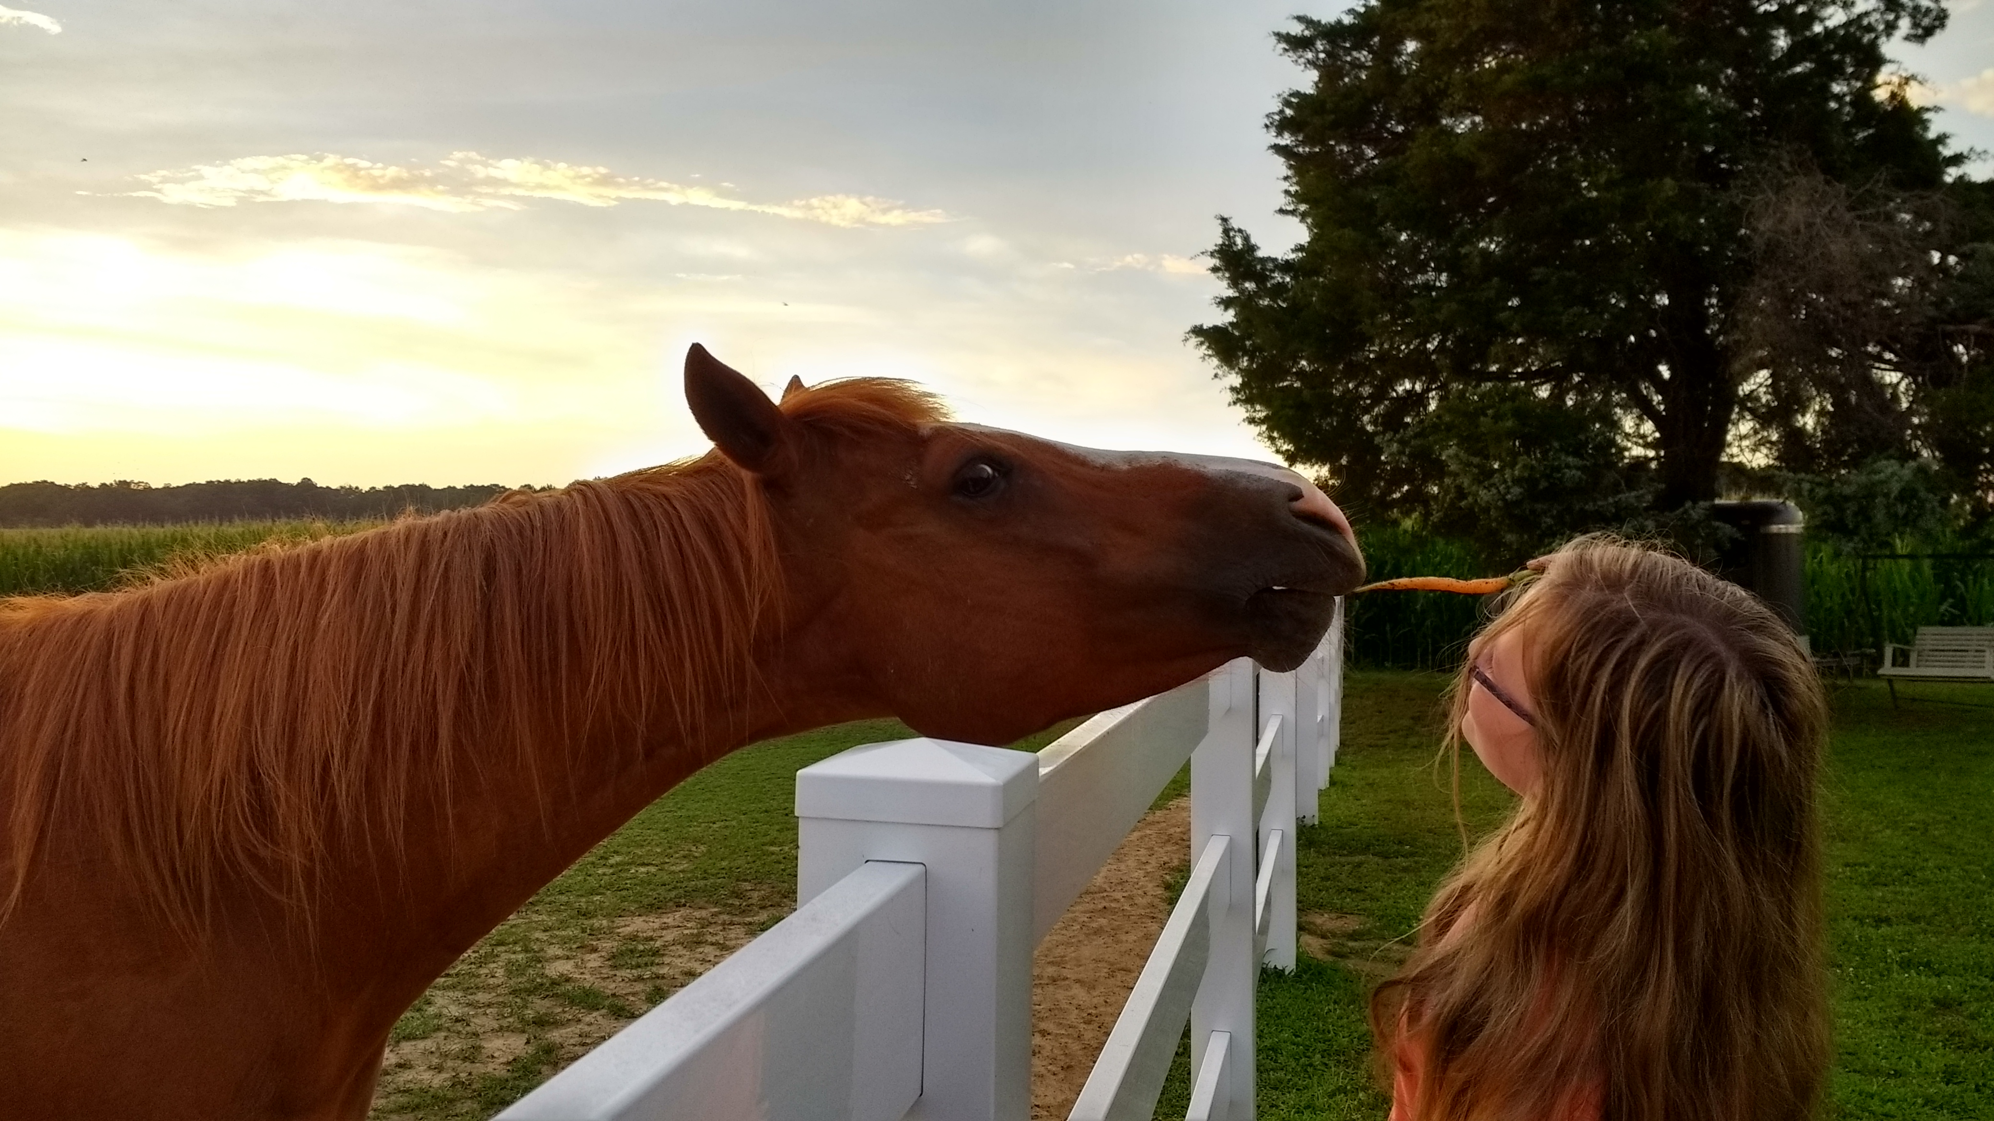
Final lesson – Job 39:19-25

