Slide 2
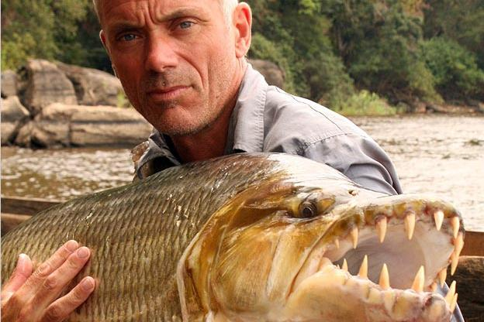
Jeremy Wade
Despite our differences we share a fundamental belief that there is more to this world than what’s on the surface.

Slide 3
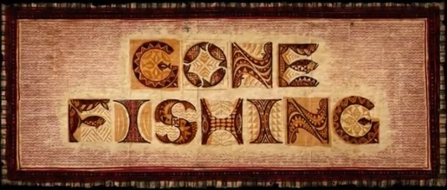

Slide 4
Peter goes fishing.
After these things Jesus revealed Himself again to the disciples at the Sea of Tiberias. And He revealed Himself this way: Simon Peter, and Thomas called the Twin, and Nathanael from Cana in Galilee, and the sons of Zebedee, and two others of His disciples were together. Simon Peter said to them, I am going out to fish. They said to him, We will go with you also. They went out and entered into a boat immediately and that night they caught nothing. John 21:1-3

Slide 5
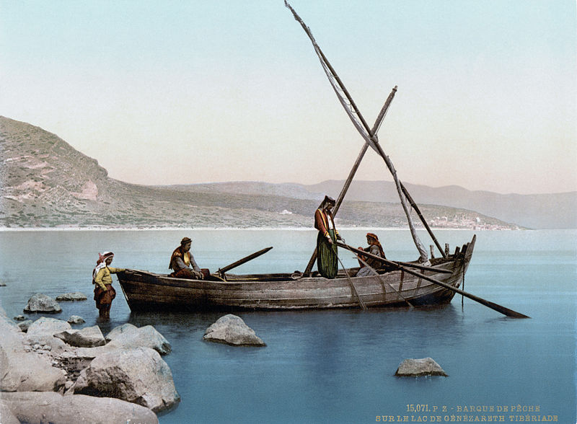
What’s beneath the surface of this story?
Why go fishing now?

Slide 6
Jesus had just been crucified.
Now it was the day of preparation for the Passover; it was about the sixth hour. And he said to the Jews, “Behold, your King!” So they cried out, “Away with Him, away with Him, crucify Him!” Pilate *said to them, “Shall I crucify your King?” The chief priests answered, “We have no king but Caesar.” So he then handed Him over to them to be crucified. They took Jesus, therefore, and He went out, [i]bearing His own cross, to the place called the Place of a Skull, which is called in Hebrew, Golgotha. There they crucified Him, and with Him two other men, one on either side, and Jesus in between. John 19:14-18

Slide 7
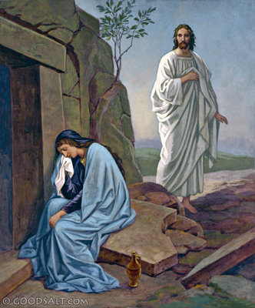
Jesus had just risen!
Now on the first day of the week Mary Magdalene came early to the tomb, while it was still dark, and saw the stone already taken away from the tomb. So she ran and came to Simon Peter and to the other disciple whom Jesus loved, and said to them, “They have taken away the Lord out of the tomb, and we do not know where they have laid Him.” So Peter and the other disciple went forth, and they were going to the tomb. The two were running together… John 20:1-4

Slide 8

What’s beneath the surface?
Jesus was put to death.
Jesus was laid in the tomb.
Jesus had risen.
Peter had seen the tomb.

Slide 9
Peter decides to go fishing?!?!?!
...Simon Peter said to them, I am going out to fish...

Slide 10
We know that Peter was a fisherman.
And walking by the Sea of Galilee, Jesus saw two brothers, Simon called Peter, and Andrew his brother, casting a net into the sea. For they were fishermen. And He said to them, Follow Me, and I will make you fishers of men. And they immediately left their nets and followed him. Matt. 4:18-20

Slide 11
Was Peter going back to life before Christ?

Slide 12
The Peter who walked on Water!
Matthew 14:28

Slide 13
The same Peter who drew his sword to defend Jesus!
John 18:10

Slide 14
The same Peter who was ready to die for Jesus.
Then Jesus said to them, All of you will be offended because of Me this night. For it is written, "I will smite the Shepherd, and the sheep of the flock shall be scattered abroad." But after I have risen again, I will go before you into Galilee. Peter answered and said to Him, though all shall be offended because of You, I will never be offended. Jesus said to him, Truly I say to you that this night, before the cock crows, you shall deny Me three times. Peter said to Him, though I should die with You, yet I will not deny You. All the disciples also said the same. Matt. 26:31-35

Slide 15
The same Peter who failed.
And Peter sat outside in the court. And a girl came to him, saying, You also were with Jesus of Galilee. But he denied all before them, saying, I do not know what you say. And when he had gone out into the porch, another saw him and said to those there, This one was also with Jesus of Nazareth. And again he denied with an oath, I do not know the man. And after a little while those who stood by came and said to Peter, Surely you also are one of them, for your speech betrays you. Then he began to curse and to swear, I do not know the man...
Matthew 26: 69-74

Slide 16
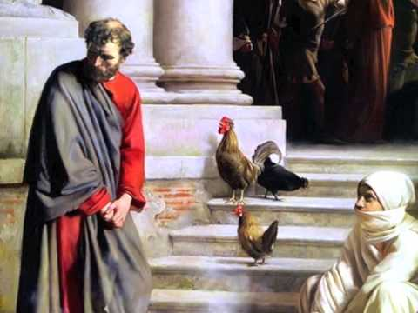
It was a vow he could not keep.
...And immediately the cock crowed. And Peter remembered the word of Jesus, Who said to him, Before the cock crows, you shall deny Me three times. And he went out and wept bitterly. Verse 75

Slide 17
Have we felt like Peter?
Lord I will never again….
I promise to not…
I will noit…

Slide 18
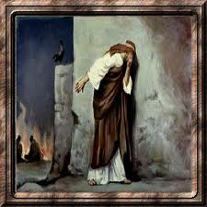
Does God have a place for a sinner like Peter?
Romans 3:23

Slide 19
But Jesus welcomed Peter back.
But when the day was now breaking, Jesus stood on the beach; yet the disciples did not know that it was Jesus. So Jesus said to them, “Children, you do not have [c]any fish, do you?” They answered Him, “No.” And He said to them, “Cast the net on the right-hand side of the boat and you will find a catch.” So they cast, and then they were not able to haul it in because of the great number of fish. Therefore that disciple whom Jesus loved *said to Peter, “It is the Lord.” So when Simon Peter heard that it was the Lord, he put his outer garment on (for he was stripped for work), and threw himself into the sea. But the other disciples came in the little boat, for they were not far from the land, but about [d]one hundred yards away, dragging the net full of fish. John 21: 4-8

Slide 20
Jesus forgave Peter
So when they had finished breakfast, Jesus said to Simon Peter, “Simon, son of John, do you love Me more than these?” He said to Him, “Yes, Lord; You know that I love You.” He said to him, “Tend My lambs.” He said to him again a second time, “Simon, son of John, do you love Me?” He said to Him, “Yes, Lord; You know that I love You.” He said to him, “Shepherd My sheep.” He said to him the third time, “Simon, son of John, do you love Me?” Peter was grieved because He said to him the third time, “Do you love Me?” And he said to Him, “Lord, You know all things; You know that I love You.” Jesus said to him, “Tend My sheep. John 21: 15-17

Slide 21

God does not demand a perfect person...
He demands a perfect heart.
Yet even now, says Jehovah, turn to Me with all your heart, and with fasting, and with weeping, and with mourning. Yes, tear your heart and not your robes, and turn to Jehovah your God: for He is gracious and merciful, slow to anger, and of great kindness, and He pities because of the evil. Joel 2:12-13
If we confess our sins, He is faithful and just to forgive us our sins, and to cleanse us from all unrighteousness. I John 1:9

Slide 22
