Slide 1
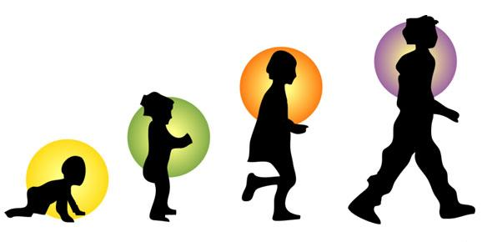
Growing Up
Notes:
Have you ever heard someone tell you or maybe you have heard someone telling someone else—You need to Grow Up!
The other day I overheard an adult telling a child to Grow Up. What does that mean? Of course, the adult wasn’t telling the child to grow up physically. They were talking about the child’s intellectual maturity.
We all go through stages in our life. Circumstances and choices in life sometimes cause people up to grow up too fast. While others we wonder will ever grow up.
Growing up isn’t always easy, but it is something we must all do.

Slide 2
The Life of a Christ
Luke 2
Notes:
Tonight I want to take a look at the life of Christ and compare that to the life of a Christian.
As we grow up and take on our role in life, does our life look anything like the life of Christ?

Slide 3
The Child Is Born
Luke 2:7 And she brought forth her firstborn son, and wrapped him in swaddling clothes, and laid him in a manger; because there was no room for them in the inn.
How vividly do you remember the first time you saw your child? Or your grandchild? Did you count his/her fingers and toes? Did you watch him/her sleep? How many pictures did you take? Did you think about who he/she would grow up to be?
Notes:
⁸ And there were in the same country shepherds abiding in the field, keeping watch over their flock by night.
⁹ And, lo, the angel of the Lord came upon them, and the glory of the Lord shone round about them: and they were sore afraid.
¹⁰ And the angel said unto them, Fear not: for, behold, I bring you good tidings of great joy, which shall be to all people.

Slide 4
Rejoicing
Luke 2:13 And suddenly there was with the angel a multitude of the heavenly host praising God, and saying,
14 Glory to God in the highest, and on earth peace, good will toward men.
This Son was born to save the world! What an honor to be the earthly parents to the Savior of the world!
Psalms 127:3 Lo, children are an heritage of the Lord: and the fruit of the womb is his reward.
4 As arrows are in the hand of a mighty man; so are children of the youth.
5 Happy is the man that hath his quiver full of them:
Notes:
What a blessing children are! Psalms 127:3….
¹¹ For unto you is born this day in the city of David a Saviour, which is Christ the Lord.
¹² And this shall be a sign unto you; Ye shall find the babe wrapped in swaddling clothes, lying in a manger.

Slide 5

The Child Grew
Luke 2:40 And the child grew, and waxed strong in spirit, filled with wisdom: and the grace of God was upon him.
We record all the firsts of our children: smile, laugh, word, crawl, step, tooth, etc….
Notes:
Our children were no different than baby Jesus who also had to physically grow into an adult.
But you also see growth in other areas of Christ.
We are no different. Which is the most important growth?

Slide 6
Pre-Teens
As our children grow, we are “to bring them up in the nurture and admonition of the Lord.” Ephesians 6:4
Sometimes that involves correction: Prov. 19:18 Chasten thy son while there is hope, and let not thy soul spare for his crying.
Testimony of Upbringing: 2 Timothy 1:5 When I call to remembrance the unfeigned faith that is in thee, which dwelt first in thy grandmother Lois, and thy mother Eunice; and I am persuaded that in thee also.
Luke 2:42 And when he was twelve years old, they went up to Jerusalem after the custom of the feast.
Parents Worried
⁴⁶ And it came to pass, that after three days they found him in the temple, sitting in the midst of the doctors, both hearing them, and asking them questions.

Slide 7
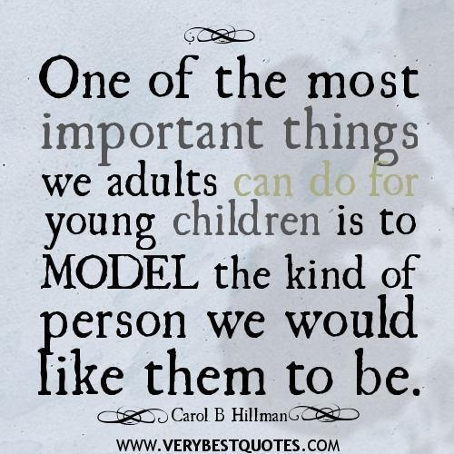
Notes:
What a responsibility on our shoulders to be the right model for our children!

Slide 8
Amazed by Jesus
⁴⁷ And all that heard him were astonished at his understanding and answers.
⁴⁸ And when they saw him, they were amazed:…….
We all have proud parent moments, but what makes us most proud of our kids? Is it the things of this world that the accomplish or is it their love, service and faithfulness to God?

Slide 9
Worrying Our Parents
You can be your parents’ greatest joy or your parents’ greatest heartache.
⁴⁸ ……..and his mother said unto him, Son, why hast thou thus dealt with us? behold, thy father and I have sought thee sorrowing.
Colossians 3:20 Children, obey your parents in all things: for this is well pleasing unto the Lord.
Love your parents. Kids are so busy growing up, we often forget our parents are also growing old.
Notes:
Deuteronomy 21:18-21 “If a man has a stubborn and rebellious son who will not obey the voice of his father or the voice of his mother, and, though they discipline him, will not listen to them, then his father and his mother shall take hold of him and bring him out to the elders of his city at the gate of the place where he lives, and they shall say to the elders of his city, ‘This our son is stubborn and rebellious; he will not obey our voice; he is a glutton and a drunkard.’ Then all the men of the city shall stone him to death with stones. So you shall purge the evil from your midst, and all Israel shall hear, and fear.

Slide 10
Subject Unto His Parents
⁵¹ And he went down with them, and came to Nazareth, and was subject unto them: but his mother kept all these sayings in her heart.
Proverbs 22:6 Train up a child in the way he should go: and when he is old, he will not depart from it.
Ephesians 6:1-3 Children, obey your parents in the Lord: for this is right.
Notes:
Ephesians 6:1-3 Children, obey your parents in the Lord: for this is right.
² Honour thy father and mother; which is the first commandment with promise;
³ That it may be well with thee, and thou mayest live long on the earth.

Slide 11
He Continues to Grow
1 Corinthians 15:33 Be not deceived: evil communications corrupt good manners.
⁵² And Jesus increased in wisdom and stature, and in favour with God and man.
Mentally
Physically
Spiritually
Socially
You are constantly growing and making decisions. Are they decisions that will help you grow closer to God?
2 Timothy 2:15 Study to shew thyself approved unto God, a workman that needeth not to be ashamed, rightly dividing the word of truth.

Slide 12
Fulfills His Father’s Will
Are we about our Father’s business? What’s most important in our life? Being a Christian? How would our book read?
Matthew 3:13 Then cometh Jesus from Galilee to Jordan unto John, to be baptized of him.
¹⁴ But John forbad him, saying, I have need to be baptized of thee, and comest thou to me?
¹⁵ And Jesus answering said unto him, Suffer it to be so now: for thus it becometh us to fulfil all righteousness. Then he suffered him.

Slide 13
Pleases the Father
A part of growing up is learning to make decisions about your salvation. Are you a Christian?
Matthew 3:16 And Jesus, when he was baptized, went up straightway out of the water: and, lo, the heavens were opened unto him, and he saw the Spirit of God descending like a dove, and lighting upon him:
¹⁷ And lo a voice from heaven, saying, This is my beloved Son, in whom I am well pleased.

Slide 14
Become a Child of God
Rev. 2:10
Acts 2:38
baptism
MT. 10:32
confess
LK. 13:3
OBEDIENT
UNTIL DEATH
repent
JN. 8:24
believe
ROM 10:17
hear
Notes:
Romans 10:17 ¹⁷ So then faith cometh by hearing, and hearing by the word of God.
John 8:24 ²⁴ I said therefore unto you, that ye shall die in your sins: for if ye believe not that I am he, ye shall die in your sins.
Luke 13:3 ³ I tell you, Nay: but, except ye repent, ye shall all likewise perish.
Matt. 10:32 ³² Whosoever therefore shall confess me before men, him will I confess also before my Father which is in heaven.
Acts 2:38 ³⁸ Then Peter said unto them, Repent, and be baptized every one of you in the name of Jesus Christ for the remission of sins, and ye shall receive the gift of the Holy Ghost.
Rev. 2:10 ……be thou faithful unto death, and I will give thee a crown of life.

Slide 15
Tempted of Satan
1 John 2:16 For all that is in the world, the lust of the flesh, and the lust of the eyes, and the pride of life, is not of the Father, but is of the world.
1 Corinthians 10:13 There hath no temptation taken you but such as is common to man: but God is faithful, who will not suffer you to be tempted above that ye are able; but will with the temptation also make a way to escape, that ye may be able to bear it.
Luke 4:2 Being forty days tempted of the devil. And in those days he did eat nothing: and when they were ended, he afterward hungered.
1 John 2:15-17
Lust of the Flesh: stone to bread
Pride of Life: If you are who you say you are….
Lust of the Eyes: I’ll give you all of this…
Notes:
1 John 2:15-17
¹⁵ Love not the world, neither the things that are in the world. If any man love the world, the love of the Father is not in him.
¹⁶ For all that is in the world, the lust of the flesh, and the lust of the eyes, and the pride of life, is not of the Father, but is of the world.
¹⁷ And the world passeth away, and the lust thereof: but he that doeth the will of God abideth for ever.
1 Corinthians 10:13
There hath no temptation taken you but such as is common to man: but God is faithful, who will not suffer you to be tempted above that ye are able; but will with the temptation also make a way to escape, that ye may be able to bear it.

Slide 16
Sinless
Does this describe our walk in life?
²¹ For even hereunto were ye called: because Christ also suffered for us, leaving us an example, that ye should follow his steps:
²² Who did no sin, neither was guile found in his mouth:
²³ Who, when he was reviled, reviled not again; when he suffered, he threatened not; but committed himself to him that judgeth righteously:
We aren’t sinless, but we can definitely sin less.
1 Peter 2:21 Christ left us an example
1 John 2:6 Walk as He walked.
1 Corinthians 11:1 Be a follower of Christ.
Ephesians 5:1-2 Be a follower of God, Walk in love as Christ walked.
John 14:15 If ye love me, keep my commandments.
Notes:
1 Peter 2:21
²¹ For even hereunto were ye called: because Christ also suffered for us, leaving us an example, that ye should follow his steps:
1 John 2:6
⁶ He that saith he abideth in him ought himself also so to walk, even as he walked.
1 Corinthians 11:1
11 Be ye followers of me, even as I also am of Christ.
Ephesians 5:1-2
5 Be ye therefore followers of God, as dear children;
² And walk in love, as Christ also hath loved us, and hath given himself for us an offering and a sacrifice to God for a sweetsmelling savour.
John 14:15
¹⁵ If ye love me, keep my commandments.

Slide 17
Death
Mark 15:15 And so Pilate, willing to content the people, released Barabbas unto them, and delivered Jesus, when he had scourged him, to be crucified.
Mark 15:24 And when they had crucified him, they parted his garments, casting lots upon them, what every man should take.
Hebrews 9:27 And as it is appointed unto men once to die, but after this the judgment:

Slide 18
Burial
Matthew 27:59 And when Joseph had taken the body, he wrapped it in a clean linen cloth,
60 And laid it in his own new tomb, which he had hewn out in the rock: and he rolled a great stone to the door of the sepulchre, and departed.
Date of birth
Date of Death

Slide 19
Resurrection
Matthew 28:2 And, behold, there was a great earthquake: for the angel of the Lord descended from heaven, and came and rolled back the stone from the door, and sat upon it.
6 He is not here: for he is risen, as he said. Come, see the place where the Lord lay.
2 Corinthians 5:10 For we must all appear before the judgment seat of Christ; ……
Notes:
2 Corinthians 5:10
¹⁰ For we must all appear before the judgment seat of Christ; that every one may receive the things done in his body, according to that he hath done, whether it be good or bad.

Slide 20
New Life
1 Corinthians 15:52 In a moment, in the twinkling of an eye, at the last trump: for the trumpet shall sound, and the dead shall be raised incorruptible, and we shall be changed.
2 Corinthians 5:17 Therefore if any man be in Christ, he is a new creature: old things are passed away; behold, all things are become new.
Notes:
Galatians 3:27 For as many of you as have been baptized into Christ have put on Christ.

Slide 21
Grow Up to Go Up!
1 Corinthians 13:11 When I was a child, I spake as a child, I understood as a child, I thought as a child: but when I became a man, I put away childish things.
Grow Up in Christ to Go Up with Him in Heaven.
James 1:12 Blessed is the man that endureth temptation: for when he is tried, he shall receive the crown of life, which the Lord hath promised to them that love him.

Slide 22

Crown of Life
Be thou faithful unto death…. Rev. 2:10

