Slide 2
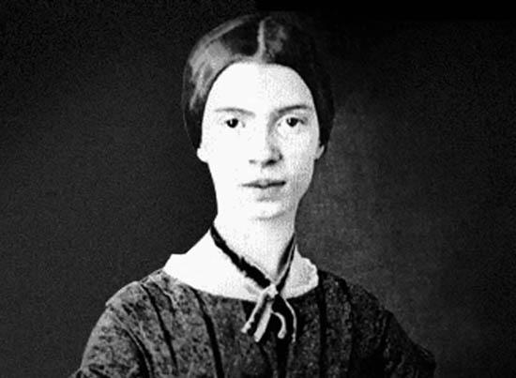

Slide 3
“Hope” is the thing with feathers -
That perches in the soul -
And sings a tune without the words -
And never stops - at all.
And sweetest - in the Gale - is heard -
And sore must be the storm -
That could abash that little Bird
That kept so many warm.
I’ve heard it in the chillest land -
And on the strangest Sea -
Yet - never - in Extremity,
It asked a crumb - of me.

Slide 4

Hope the thing with feathers.
I Peter 3:15

Slide 5
Hope in the Bible
Hope is mentioned 146 times in the NASB.
73 in the OT and 73 in the NT.
In Job 13 times (a book about trials)
In Psalm 22 times (a book about praise)
In Romans 12 times (a book written to a persecuted church)

Slide 6
Romans 8: 23-25
And not only this, but also we ourselves, having the first fruits of the Spirit, even we ourselves groan within ourselves, waiting eagerly for our adoption as sons, the redemption of our body. For in hope we have been saved, but hope that is seen is not hope; for who hopes for what he already sees? But if we hope for what we do not see, with perseverance we wait eagerly for it.

Slide 7

Esperar and Esperanza

Slide 8
A story of hope?
When the Sabbath was over, Mary Magdalene, Mary the mother of James, and Salome bought spices so that they could go and anoint Jesus’ dead body. Very early on the first day of the week, just after sunrise, they came to the tomb. They were saying to each other, “Who’s going to roll the stone away from the entrance for us?” When they looked up, they saw that the stone had been rolled away. (And it was a very large stone!) Going into the tomb, they saw a young man in a white robe seated on the right side; and they were startled. But he said to them, “Don’t be alarmed! You are looking for Jesus of Nazareth, who was crucified. He has been raised. He isn’t here. Look, here’s the place where they laid him. Go, tell his disciples, especially Peter, that he is going ahead of you into Galilee. You will see him there, just as he told you.” Overcome with terror and dread, they fled from the tomb. They said nothing to anyone, because they were afraid. Mark 16:1-8

Slide 9
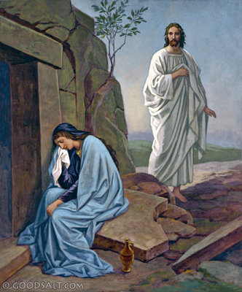
What did Jesus mean to them?

Slide 10
They had been taught by Him!
There were also some women looking on from a distance, among whom were Mary Magdalene, and Mary the mother of James the Less and Joses, and Salome. When He was in Galilee, they used to follow Him and minister to Him; and there were many other women who came up with Him to Jerusalem.
Mark 15: 40-41

Slide 11
They had seen Him perform miracles!
Soon afterwards, He began going around from one city and village to another, proclaiming and preaching the kingdom of God. The twelve were with Him, and also some women who had been healed of evil spirits and sicknesses: Mary who was called Magdalene, from whom seven demons had gone out, and Joanna the wife of Chuza, Herod’s steward, and Susanna, and many others who were contributing to their support out of their private means.
Luke 8:1-3

Slide 12
They had been there at the Cross.
It was now about the sixth hour, and darkness fell over the whole land until the ninth hour, because the sun was obscured; and the veil of the temple was torn [t]in two. And Jesus, crying out with a loud voice, said, “Father, into Your hands I commit My spirit.” Having said this, He breathed His last. Now when the centurion saw what had happened, he began praising God, saying, “Certainly this man was [u]innocent.” And all the crowds who came together for this spectacle, when they observed what had happened, began to return, beating their breasts. And all His acquaintances and the women who accompanied Him from Galilee were standing at a distance, seeing these things. Luke 23: 44-49

Slide 13
They had even watched as He was laid in the tomb.
And Joseph took the body and wrapped it in a clean linen cloth, and laid it in his own new tomb, which he had hewn out in the rock; and he rolled a large stone against the entrance of the tomb and went away. And Mary Magdalene was there, and the other Mary, sitting opposite the grave.
Matthew 27: 59-60

Slide 14
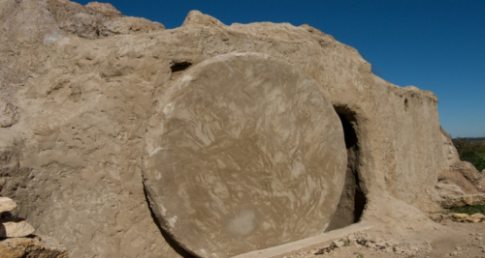
And now they were sealed away from their hope.
...Very early on the first day of the week, just after sunrise, they came to the tomb. They were saying to each other, “Who’s going to roll the stone away from the entrance for us?”
Mark 16: 1-8

Slide 15
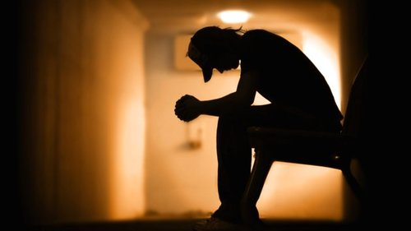
Have we ever felt like hope is lost.
Like We are sealed away from hope, and cut off from reaching joy?
“My days are swifter than a weaver’s shuttle, And come to an end without hope. Job 7:6

Slide 16
But their hope was not sealed away! The stone was gone!
The angel said to the women, “Do not be afraid; for I know that you are looking for Jesus who has been crucified. He is not here, for He has risen, just as He said.
Matthew 28:5

Slide 17
The stone has been rolled away. We are never sealed off from hope!
Now may the God of hope fill you with all joy and peace in believing, so that you will abound in hope by the power of the Holy Spirit. Romans 15:13

Slide 18
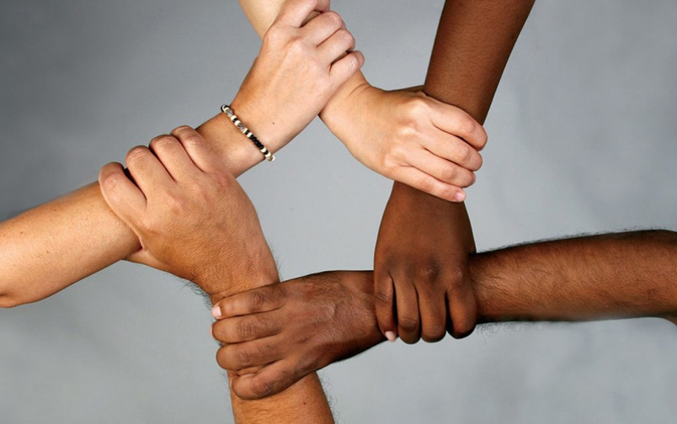
We serve the God of Hope
And the Word became flesh, and dwelt among us, and we saw His glory, glory as of the only begotten from the Father, full of grace and truth. John 1:14

