Slide 1
How’s Your Heart?
Psalms 139:23-24

Slide 2
Psalms 139:23-24
23 Search me, O God, and know my heart: try me, and know my thoughts:
24 And see if there be any wicked way in me, and lead me in the way everlasting.

Slide 3
Do we Really want God searching our Hearts?
What will He find?
Will He be honored and glorified?
Will He be pleased?
Are we pleased with what is in our hearts?
Do we feel like our hearts are in a good condition?
Notes:
It is easy for us to be fooled into thinking that our heart is in pretty good condition.
Have you ever said or thought:
I’m a good person.
I attend church 2-3 times a week.
I go to Bible study.
I read my Bible regularly.
I give every Sunday.
I’m kind to my family and friends.
I pray for others
I volunteer in the community.
These are wonderful characteristics of a good heart. This may be a description of
many people in our congregation, but I ask that you look a little deeper in your
heart.

Slide 4
Would we Be…..?
If the Thoughts of our hearts were visible for all to see…..
Justified?

Slide 5
Would we Be…..?
If the Thoughts of our hearts were visible for all to see…..
Humiliated?
Notes:
When someone tells a lie on you? How’s your heart?
When someone hurts your kids? Breaks your heart? How’s your heart?
When you’re impatient and frustrated? How’s your heart?
When you hear inappropriate topics? How’s your heart?
When you watch or listen to things that are suggestive? How’s your heart?
When we are not thinking on Phil. 4:8, how’s my heart?

Slide 6
Philippians 4:8
TRUE
HONEST
JUST
PURE
LOVELY
OF GOOD REPORT

Slide 7

IS YOUR HEART RIGHT WITH God?
Notes:
Even sometimes the best hearts can get burdened down, weak, sick with sin. That’s why we have to constantly be aware of our heart’s condition?

Slide 8
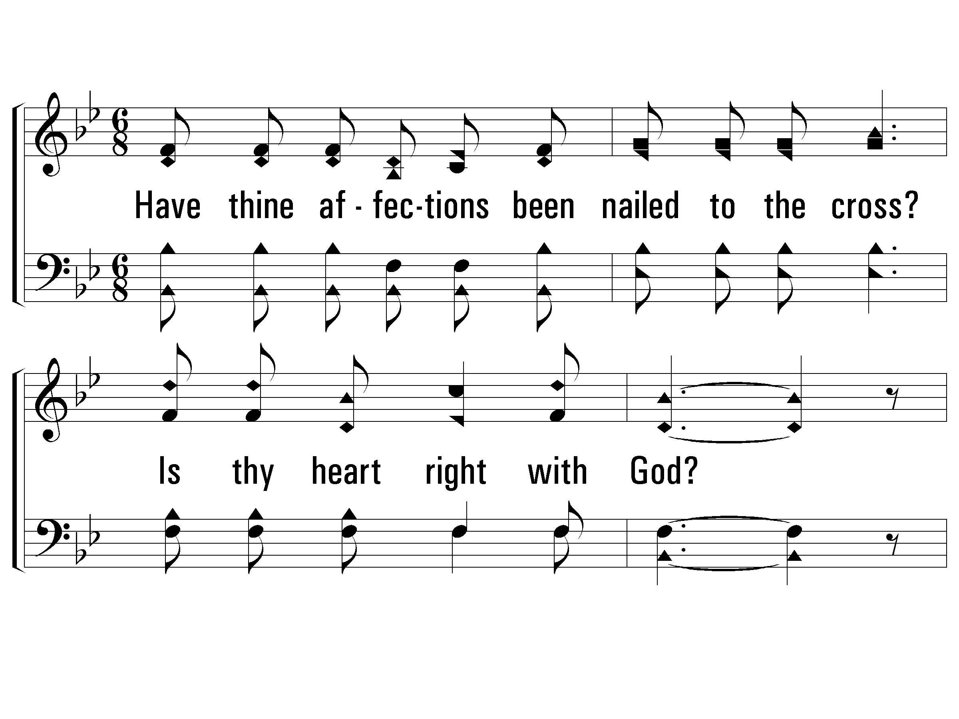
1 – Is Thy Heart Right With God?
1.
Have thine affection been nailed to the cross?
Is thy heart right with God?
Dost thou count all things for Jesus but loss?
Is thy heart right with God?
Words & Music: E. A. Hoffman
© 2002 The Paperless Hymnal™

Slide 9
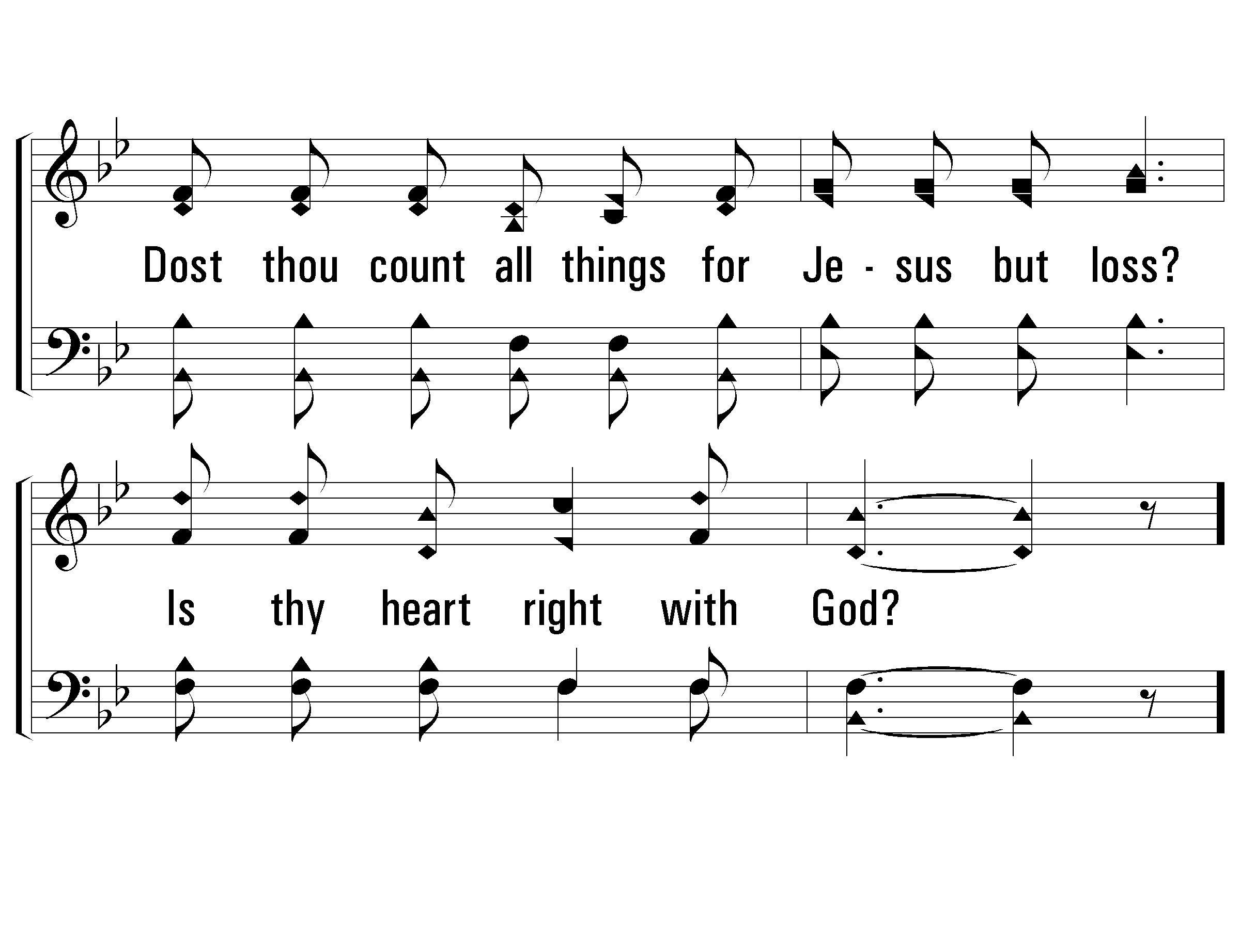
1 – Is Thy Heart Right With God?
© 2002 The Paperless Hymnal™

Slide 10
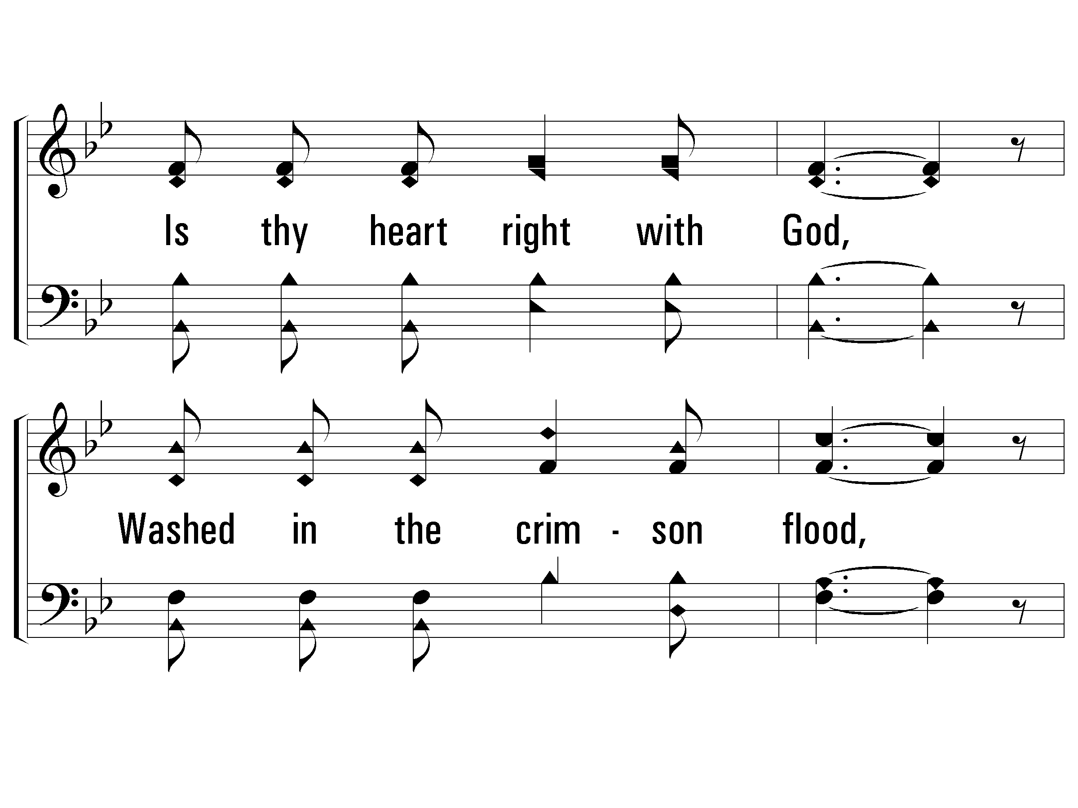
c – Is Thy Heart Right With God?
Is thy heart right with God,
Washed in the crimson flood,
Cleansed and made holy,
humble and lowly,
Right in the sight of God?
© 2002 The Paperless Hymnal™

Slide 11
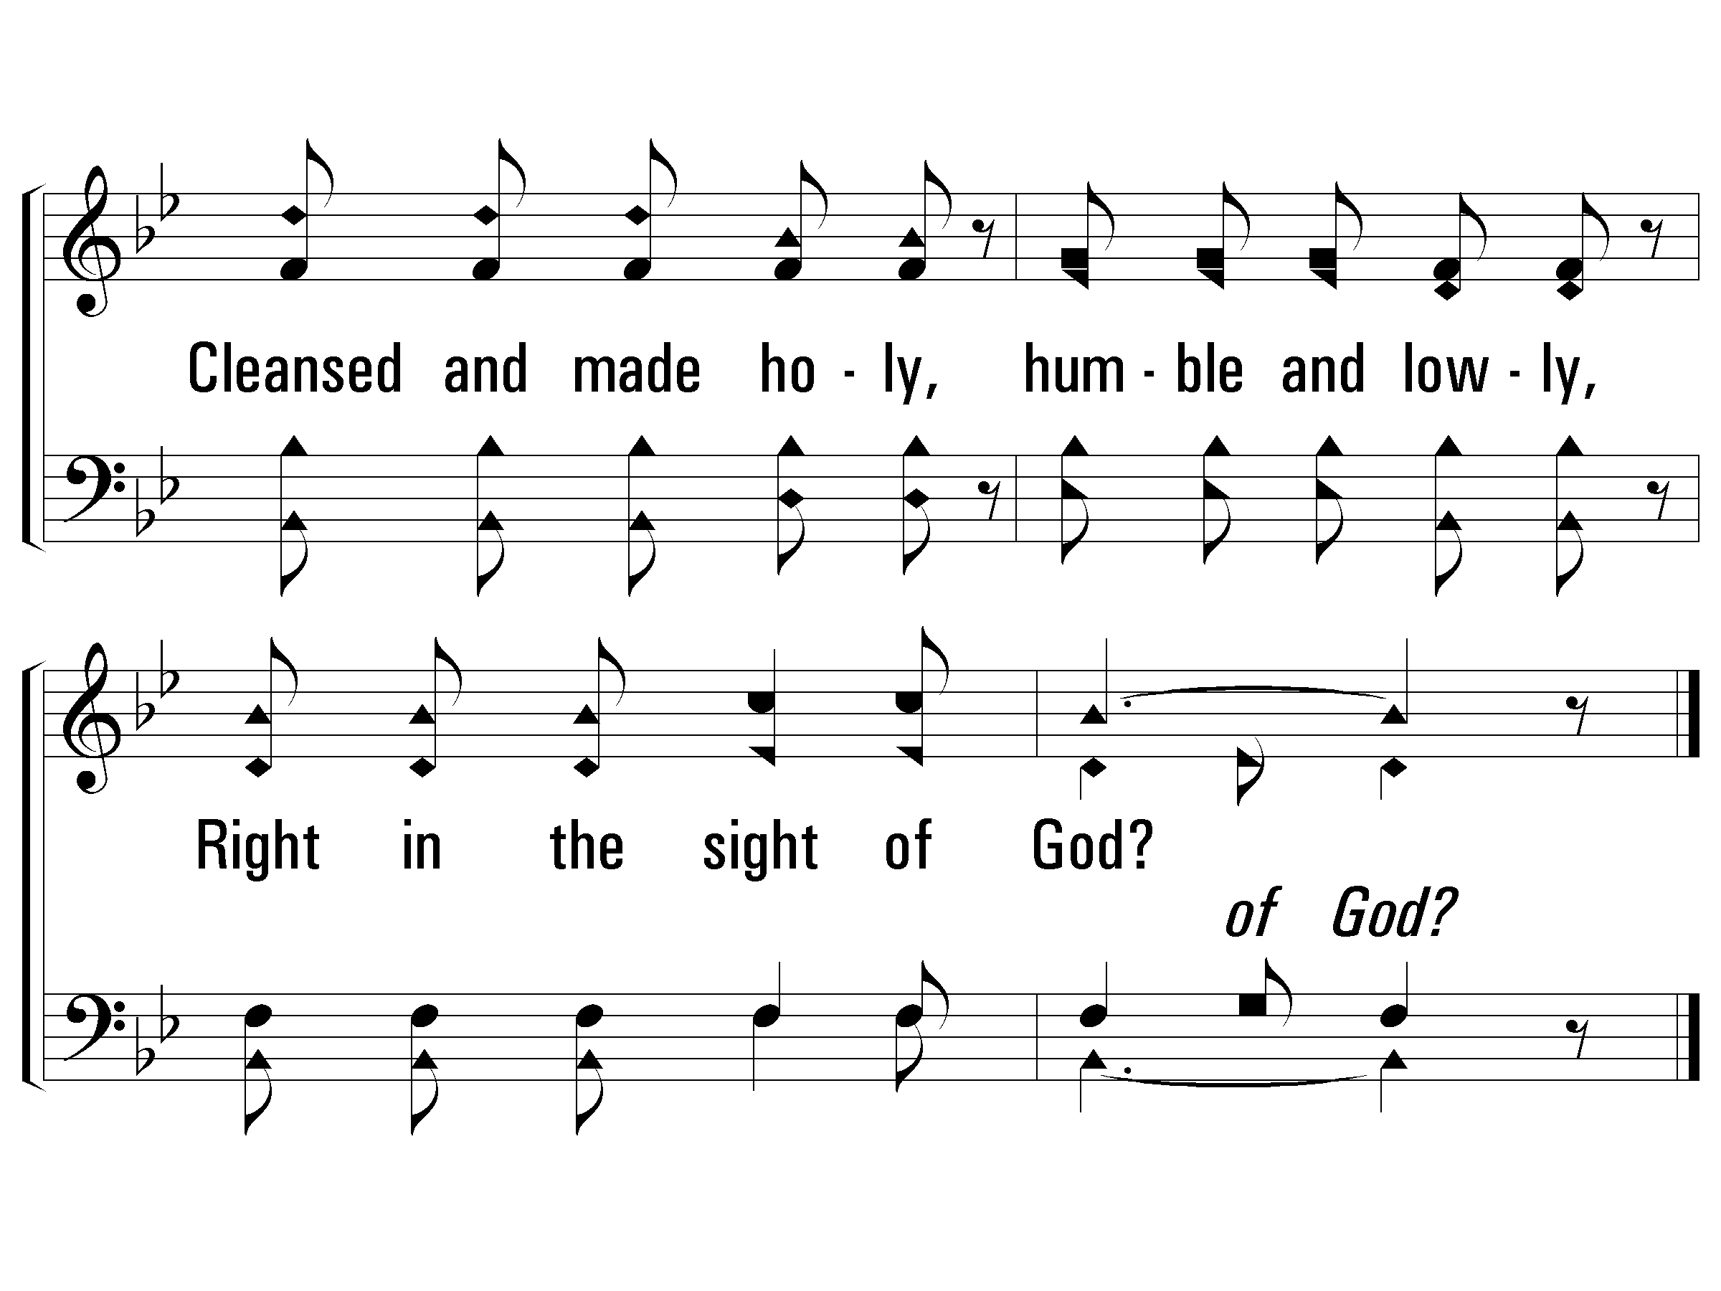
c – Is Thy Heart Right With God?
© 2002 The Paperless Hymnal™

Slide 12
Sick List
Notes:
We are very aware of our sick & Shut-in list.
Every service we post our sick list.
We have people that we want to pray for their physical condition to improve.

Slide 13
The following names have continuing health issues that we want to keep in our prayers.
Prayer Requests
Martha Bates | Randy Bates | Walter Curnutt | Member
Don Berzett | Member | Annette Gooch | Eddie Gooch
Tim Jones | Nanette Taylor | Dan Harris | Member
Keith Pyron | Martha Pyron | Joyce Moffitt | Randolph Chittam
Jay Conley | Glen Pressnell | Dalphney Moss | Member
Darla Laymon | Joe Winecke | Betty Stark | Martha Taylor
Ann Griffin | Member | Amanda Winecke | Joe Winecke
“The effectual fervent prayer of a righteous man availeth much.” James 5:16

Slide 14
Prayer Requests
Sherrill Schrimsher | Member | Milinea Wineinger | Member
Frank Kyle | Member | Priscilla Tucker | Member
JW McKinney | Jeff McKinney | JoAnn Sandlin | Member
Pat Butler | Betty Curnutt/Sandra Wray | Phillip Christopher | Family
Merri Britton Crumbly | Deanie Britton | Frank Wineinger | Shirley Long
Neal Love | Joe Winecke | Linda Faulk | Kimberly Sanderson
Judy Nelson | Member | Larry Patrick | Heidi Stinnett
Elizabeth Hamby | Alan Hamby | Marquita Cook | Rhonda Lauderdale
Alex Moss | Matt Burns | Gary Lovell | Member
Doris Anderson | Brittany Greene | Sherry Hudson-Sampson | Tonya Patterson
“Bear ye one another's burdens, and so fulfil the law of Christ.” Gal. 6:2

Slide 15
Sick
Soul List
Notes:
What if we had a Sick Soul List? Whose name would be on it? Would it be mine? Yours?

Slide 16

Broken Heart
Notes:
When we allow God to search our heart, He may find a Broken Heart—especially this time of year…
When we may be Missing a loved one, Longing for better health, Relationships that didn’t work out, Kids that we don’t see…..

Slide 17

Divided Heart
Notes:
When we allow God to search our hearts, He may find a divided heart.
James 4:8
Matthew 6:24
1 John 2:15
Revelation 3:15-18

Slide 18

Hardened Heart
Notes:
When we allow God to search our hearts, He may find a hard heart.

Slide 19
Where do we go when we are sick?

Slide 20
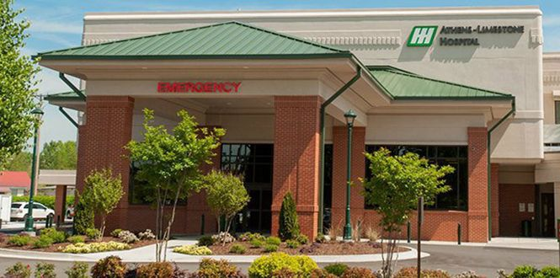
Hospital
Notes:
Doctors, nurses, medicine

Slide 21
Have you ever wondered?
Am I beyond repair?
Am I beyond saving?
Is God listening to my pleas?
Will He forgive me for my mistakes?
Can I forgive myself?
Will God heal me of my sickness?
Will He be long-suffering with me?

Slide 22
There is a balm in Gilead
In Jeremiah 8, Judah is warned of the destruction they will face by the Babylonians.
Vs. 3- Death shall be chosen rather than life
Jeremiah responds:
  vs. 22 “Is there no balm in Gilead; is there no physician there?...”
Notes:
These scriptural references to the balm of Gilead have inspired many literary and cultural allusions, including references in “The Raven” by Edgar Allen Poe and movies such as The Spitfire Grill.
Notably, "There Is a Balm in Gilead" is an African-American spiritual that compares the healing balm to the saving power of Jesus—the one true treatment that never fails to heal our spiritual wounds.

Slide 23
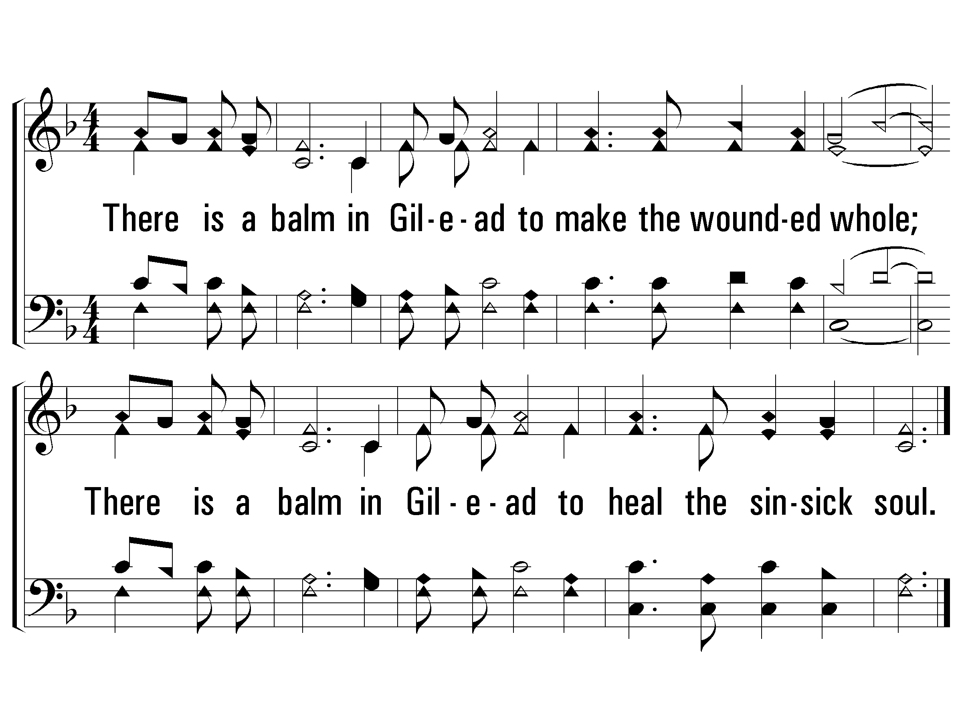
c – There Is A Balm In Gilead
There is a balm in Gilead to make the wounded whole;
There is a balm in Gilead to heal the sinsick soul.
Words & Music: Traditional Spiritual
© 2003 The Paperless Hymnal™

Slide 24
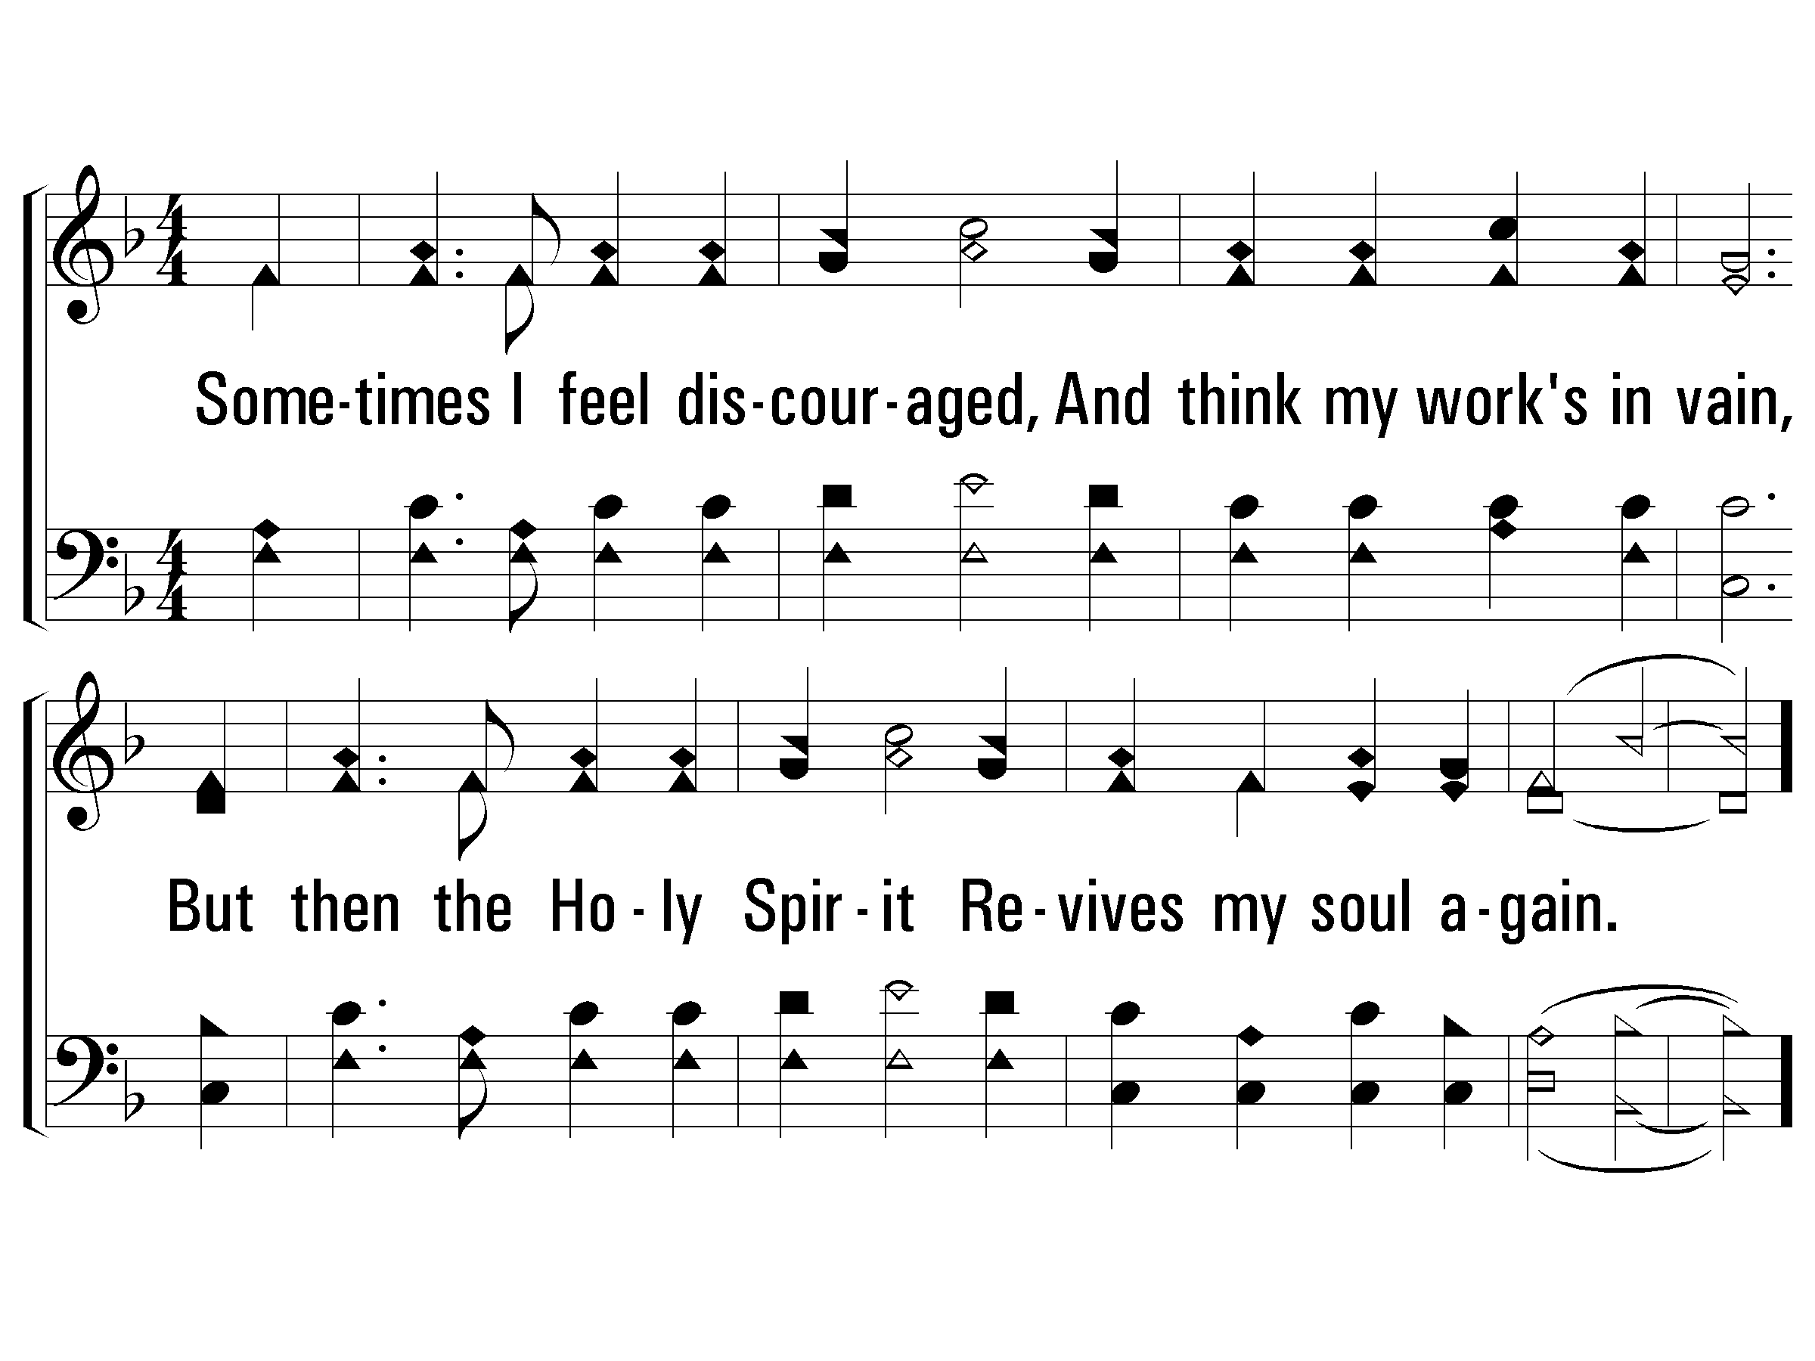
1 – There Is A Balm In Gilead
1.
Sometimes I feel discouraged,
And think my work's in vain,
But then the Holy Spirit
Revives my soul again.
Words & Music: Traditional Spiritual
© 2003 The Paperless Hymnal™

Slide 25
c – There Is A Balm In Gilead
There is a balm in Gilead to make the wounded whole;
There is a balm in Gilead to heal the sinsick soul.
Words & Music: Traditional Spiritual
© 2003 The Paperless Hymnal™

Slide 26
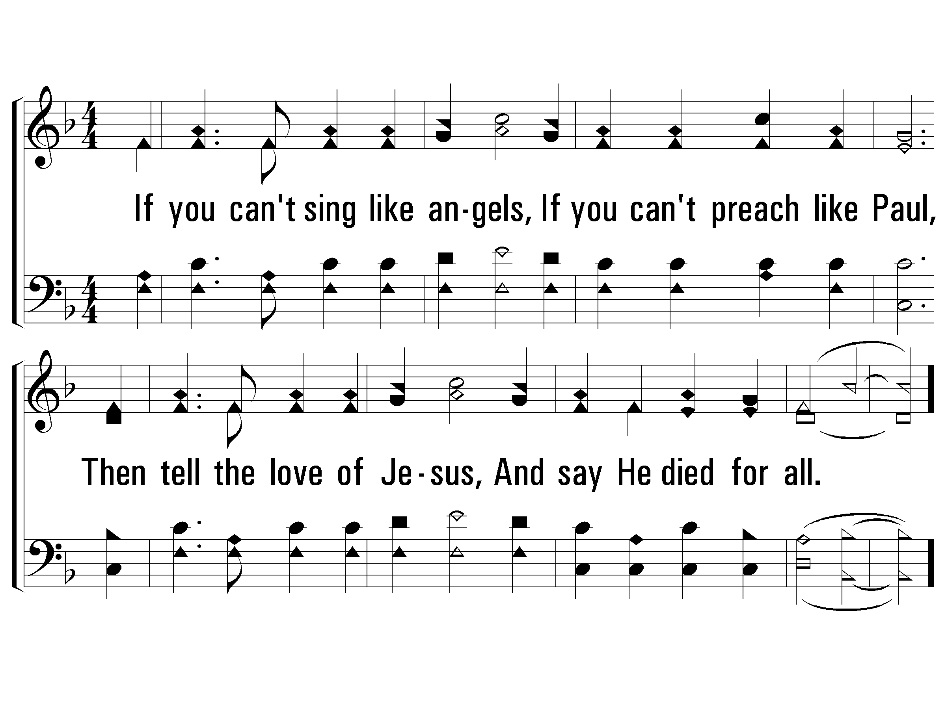
2 – There Is A Balm In Gilead
2.
If you can't sing like angels,
If you can't preach like Paul,
Then tell the love of Jesus,
And say He died for all.
Words & Music: Traditional Spiritual
© 2003 The Paperless Hymnal™

Slide 27
c – There Is A Balm In Gilead
There is a balm in Gilead to make the wounded whole;
There is a balm in Gilead to heal the sinsick soul.
Words & Music: Traditional Spiritual
© 2003 The Paperless Hymnal™

Slide 28
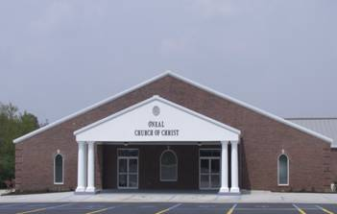
Spiritual Hospital
Hebrews 10:24-25
Notes:
I’ve often likened the church to a hospital. It’s where we visit our doctor. It’s where we get our medicine.
It’s where we visit our loved ones. It’s where we go to get healed.
When we get spiritually sick, we need encouragement from our brothers and sisters…
Hebrews 10:24-25
²⁴ And let us consider one another to provoke unto love and to good works:
²⁵ Not forsaking the assembling of ourselves together, as the manner of some is; but exhorting one another: and so much the more, as ye see the day approaching.

Slide 29
Broken Heart
Notes:
Proverbs 17:22
22 A merry heart does good, like medicine,
But a broken spirit dries the bones.
Our broken heart can become a

Slide 30

Mended Heart
Notes:
Mended heart
In God’s Word we find words to help heal our broken heart:
Psalm 34:18 The Lord is close to the brokenhearted and saves those who are crushed in spirit.
Psalm 147:3 He heals the brokenhearted and binds up their wounds.
No matter what we face in life….
Romans 8:39
neither height nor depth, nor anything else in all creation, will be able to separate us from the love of God that is in Christ Jesus our Lord.
Matthew 11:28-30
28 Come unto me, all ye that labour and are heavy laden, and I will give you rest.
29 Take my yoke upon you, and learn of me; for I am meek and lowly in heart: and ye shall find rest unto your souls.
30 For my yoke is easy, and my burden is light.

Slide 31
Divided Heart
Notes:
Our divided heart can become a

Slide 32
United Heart
Notes:
United Heart
Psalm 86:11
¹¹ Teach me thy way, O Lord; I will walk in thy truth: unite my heart to fear thy name.
James 4:8
8 Draw nigh to God, and he will draw nigh to you. Cleanse your hands, ye sinners; and purify your hearts, ye double minded
Matthew 6:24
24 No man can serve two masters: for either he will hate the one, and love the other; or else he will hold to the one, and despise the other. Ye cannot serve God and mammon.
1 John 2:15
Love not the world, neither the things that are in the world. If any man love the world, the love of the Father is not in him.

Slide 33
Hardened Heart
Notes:
Our hard heart can become an …

Slide 34

Open Heart
Notes:
Matthew 13:15; Acts 28:27
15 For this people's heart is waxed gross, and their ears are dull of hearing, and their eyes they have closed; lest at any time they should see with their eyes and hear with their ears, and should understand with their heart, and should be converted, and I should heal them.
Acts 16:14-15
¹⁴ And a certain woman named Lydia, a seller of purple, of the city of Thyatira, which worshipped God, heard us: whose heart the Lord opened, that she attended unto the things which were spoken of Paul.
¹⁵ And when she was baptized, and her household, she besought us, saying, If ye have judged me to be faithful to the Lord, come into my house, and abide there. And she constrained us.

Slide 35

1 Samuel 16:7

Slide 36
How’s Your Heart?
Psalms 139:23-24
Notes:
As we search our hearts today
Do we need our heart to be
CLEANED?
Psalm 51:10
¹⁰ Create in me a clean heart, O God, And renew a steadfast spirit within me.
THEN PUT AWAY
Ephesians 4:31-32
³¹Let all bitterness, wrath, anger, clamor, and evil speaking be put away from you, with all malice. ³² And be kind to one another, tenderhearted, forgiving one another, even as God in Christ forgave you.
SEEK FORGIVENESS through the ONE WHO FORGIVES
Colossians 1:13-14
13 Who hath delivered us from the power of darkness, and hath translated us into the kingdom of his dear Son:
14 In whom we have redemption through his blood, even the forgiveness of sins:

