Slide 1

THE PREPARING OF JONAH
(Text Passage: Jonah 1-4)

Slide 2
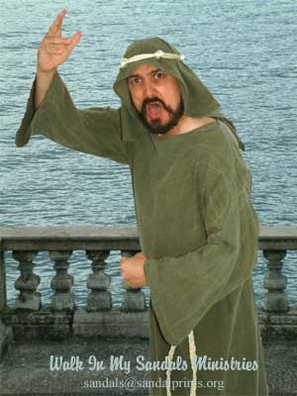
JONAH’S PREPARATING (Text: Jonah 1-4)
God prepares his people for His service.
Sometimes we want to serve God but we may not be prepared to serve God.
Sometimes God wants us to serve, but we don’t want to serve Him.
Jonah was a prophet in Israel in the days of Jeroboam, about 780 B.C.. (2 Kings 14:23-25)
God was “preparing” Jonah to preach to a wicked city.
What lessons can we learn from Jonah?

Slide 3
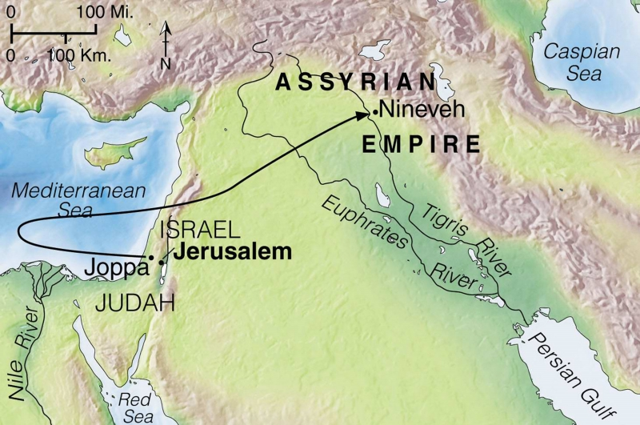

Slide 4
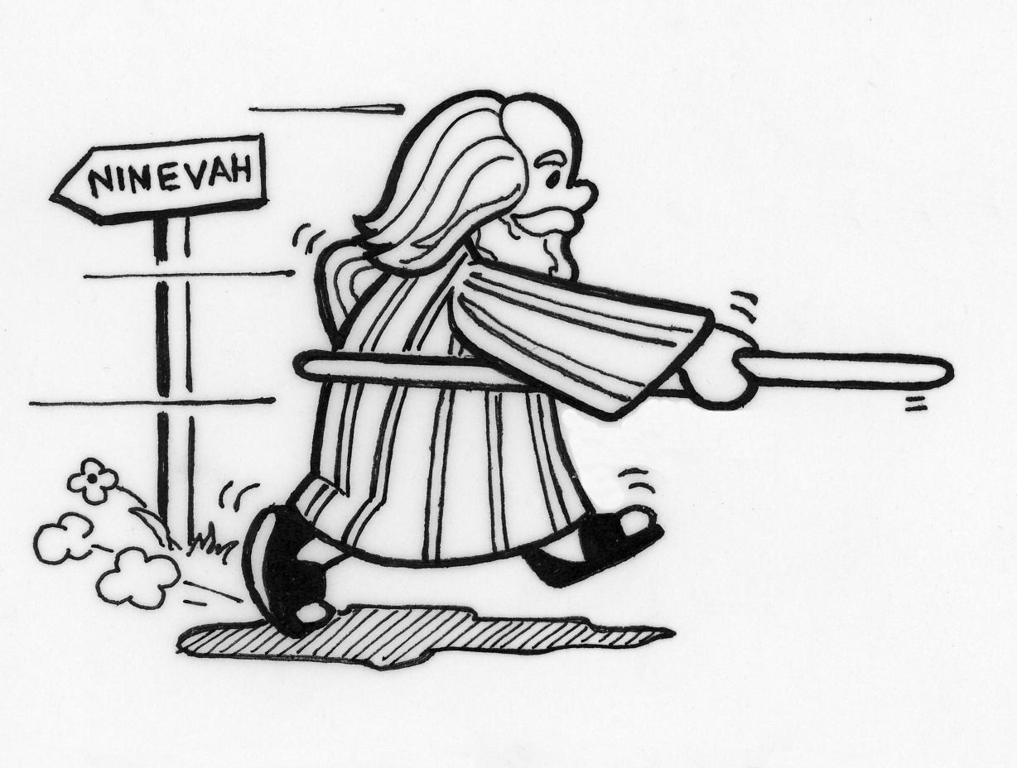
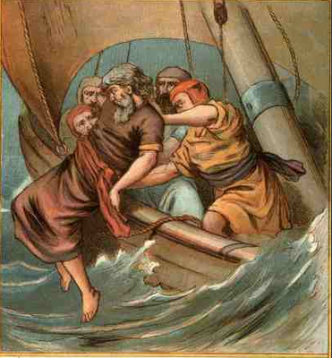

JONAH’S PREPARATING (Text: Jonah 1-4)
Jonah’s call for service.
God called Jonah to go and preach to the wicked city of Nineveh. (Jonah 1:1-2)
The city of Nineveh was renowned for their wickedness and cruelty.
Jonah ran from God.
Jonah gets on a boat to Tarshish. (1:3)
God prepares a great wind on the sea, a torrential storm. (Jonah 1:4)
The boat was sinking, Jonah was sleeping, & the sailors were afraid. (Jonah 1:5-11)
Jonah suggested his fate. (Jonah 1:12-16)

Slide 5
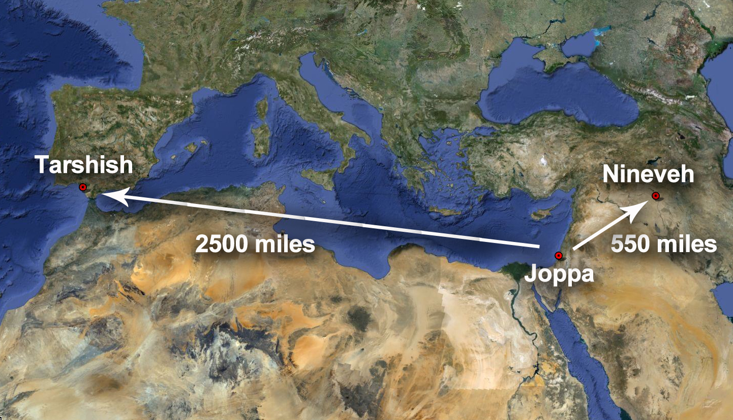

Slide 6
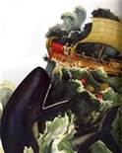
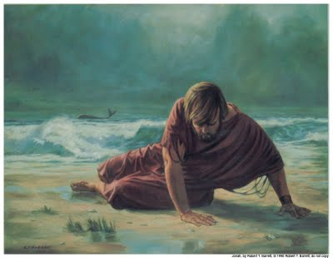
JONAH’S PREPARATING (Text: Jonah 1-4)
Jonah’s humbling.
God prepares a great fish for Jonah. (Jonah 1:17)
Jonah prays to God from the belly of the fish. (Jonah 2:1-9)
The great fish deposited Jonah on dry land. (Jonah 2:10)
Do you believe it happened that way? Jesus did. (Matt. 12:39-41)
God can humble us! (i.e. King Nebuchadnezzar-Dan. 4:28-33; King Manasseh (2 Chron. 33:11f)

Slide 7
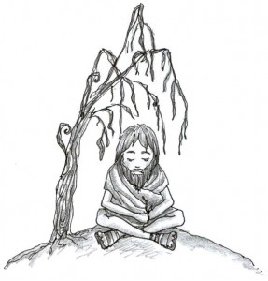
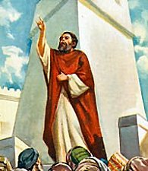
JONAH’S PREPARATING (Text: Jonah 1-4)
Jonah’s reluctant obedience.
Jonah finally obeyed God’s commands and preached to the people of Nineveh. (Jonah 3:f)
Jonah’s worst fears were realized—they people repented. (Jonah 3:5-10; 4:1)
Jonah learns a lesson about God’s love and mercy.
Jonah knew God’s nature. (Jonah 4:2-4)
God prepares a plant. (Jonah 4:5-6)
God prepares a worm. (Jonah 4:7-9)
God’s lesson of forgiveness. (Jonah 4:10-11)

Slide 8
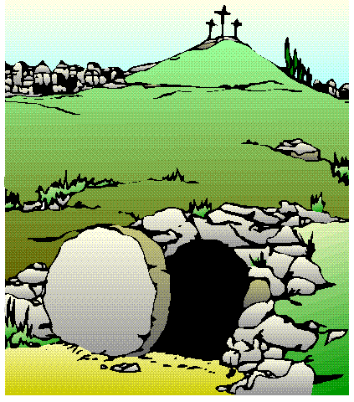
Jesus said; “Come unto me, all ye that labour and are heavy laden, and I will give you rest.”—Matt. 11:28
The Lord’s invitation:
Hear the Gospel message—Rom. 10:17.
Believe the historical facts—Heb. 11:6.
Repent of your sins—Acts 3:19.
Confess your faith in Jesus—Rom. 10:10.
Be baptized for the
remission of your sins—
Acts 2:38; Acts 22:16.
Live faithfully for God.
Heb. 10:23; Rev. 2:10.

