Slide 1


Slide 2

Harry Potter and the Philosopher’s Stone: 76,944 words
Harry Potter and the Chamber of Secrets: 85,141 words
Harry Potter and the Prisoner of Azkaban: 107,253 words
Harry Potter and the Goblet of Fire: 190,637 words
Harry Potter and the Order of the Phoenix: 257,045 words
Harry Potter and the Half-Blood Prince: 168,923 words
Harry Potter and the Deathly Hallows: 198,227 words
Totaling: 1,084,170 words
The current KJV: 790,676 words
The popular NIV: 726,109 words
The NASB: 782,815 words
The ESV: 757,439 words
The NLT: 747,891 words

Slide 3
What is the Bible?
The word bible comes from the Greek word biblia meaning simply books
It is actually made up of 66 books
39 in the Old Testament
27 in the New Testament
The bible is written by 40 authors over approx. 1500 years
It was written in 3 different languages
It was written from 3 different continents
This is possible because there is actually one author, God

Slide 4
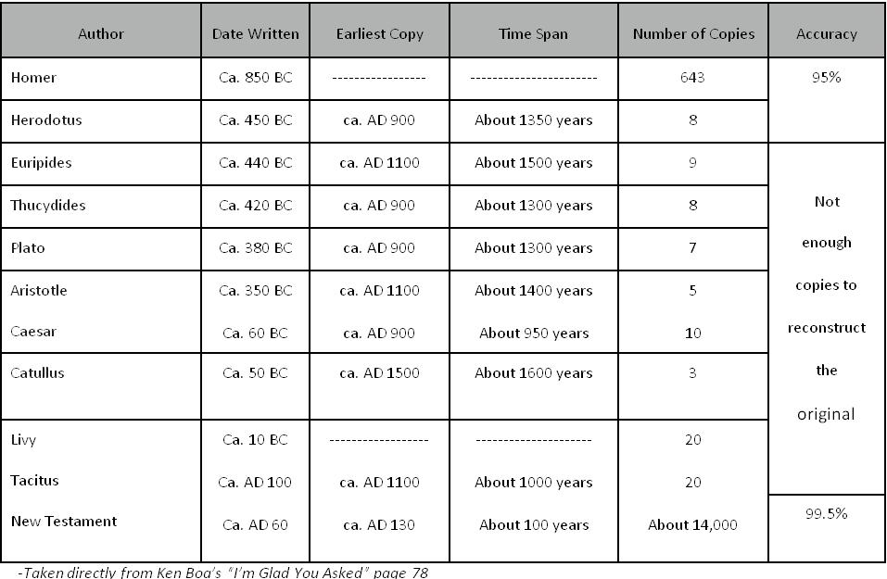

Slide 5
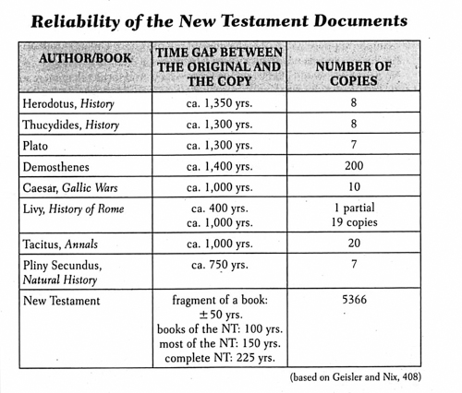

Slide 6
“All Scripture is inspired by God and profitable for teaching, for reproof, for correction, for training in righteousness; so that the man of God may be adequate, equipped for every good work.”
-2 Timothy 3:16-17

Slide 7
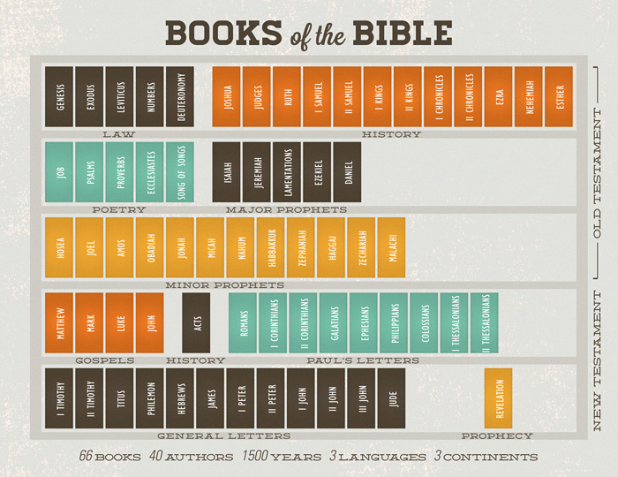

Slide 8
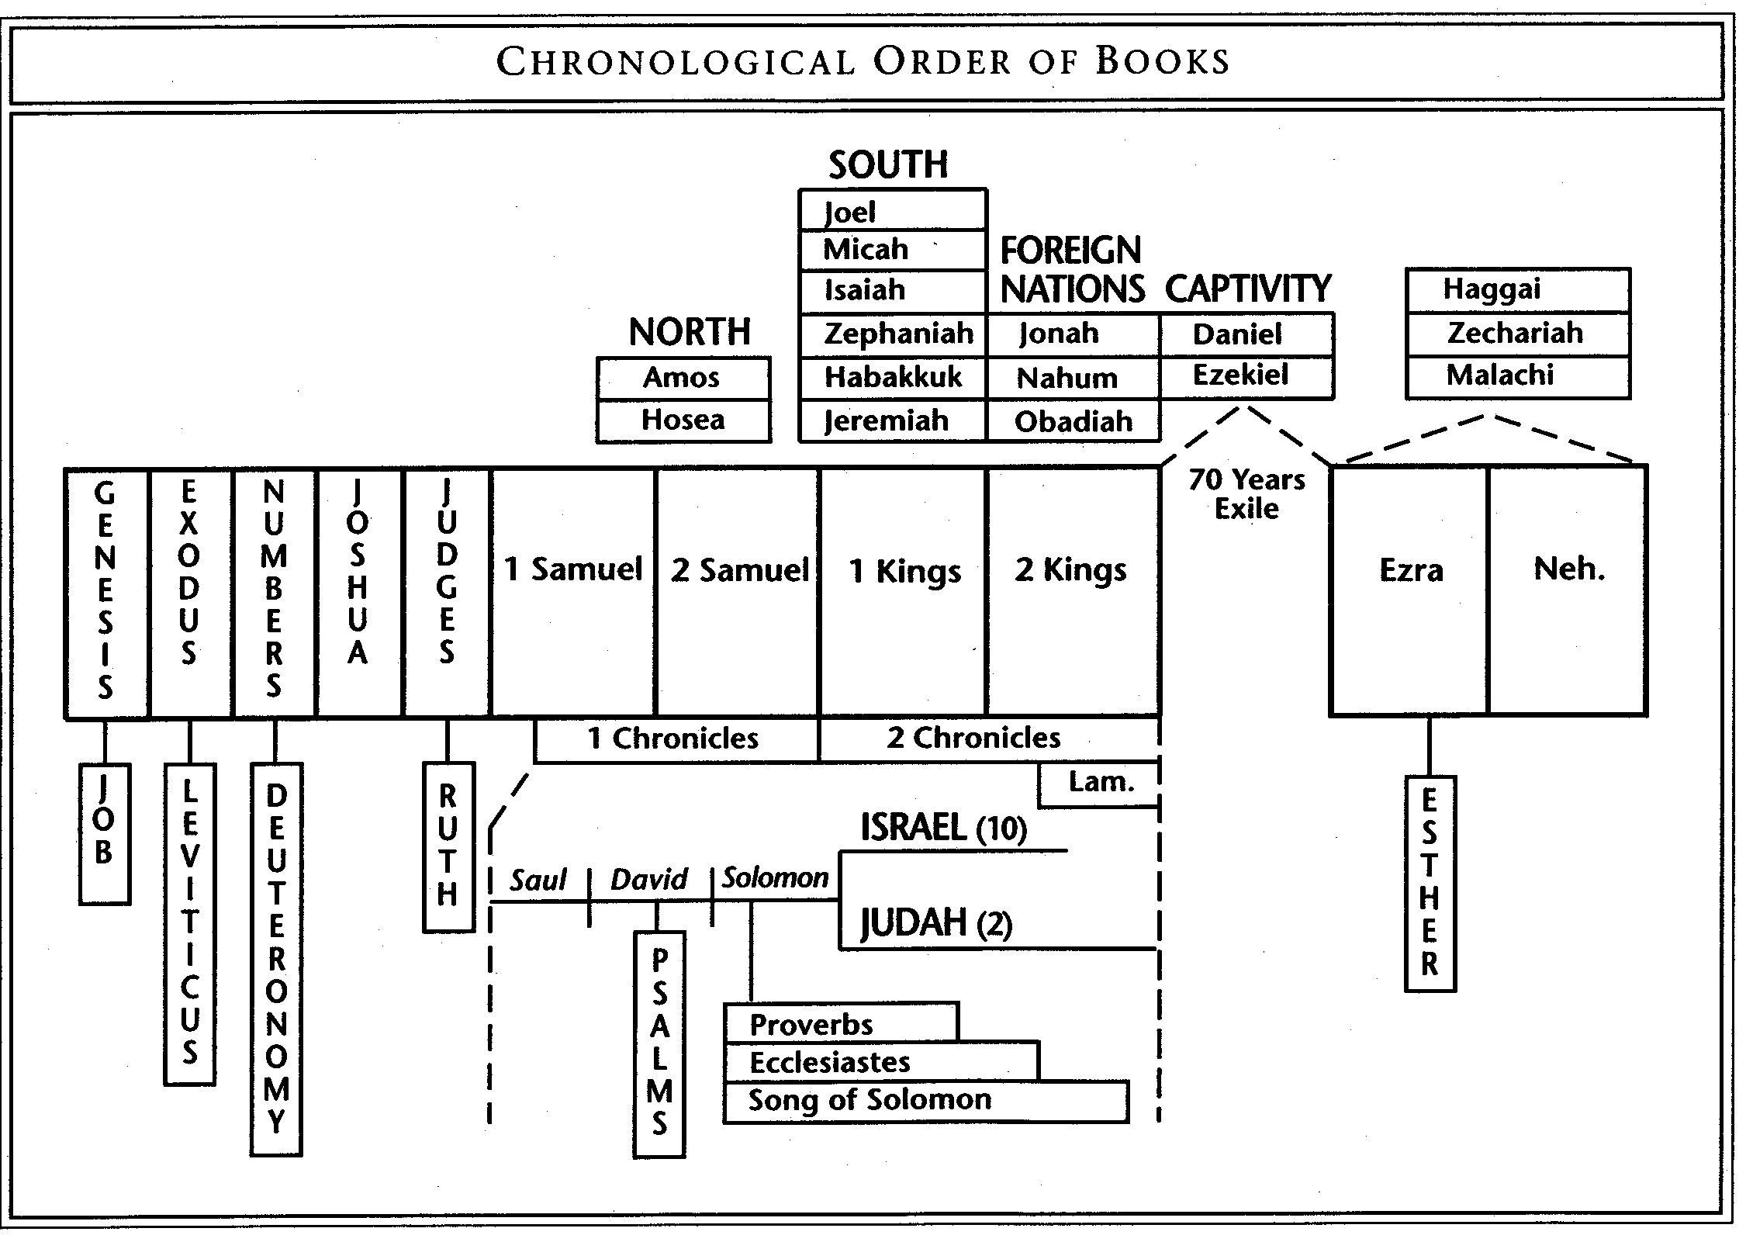

Slide 9
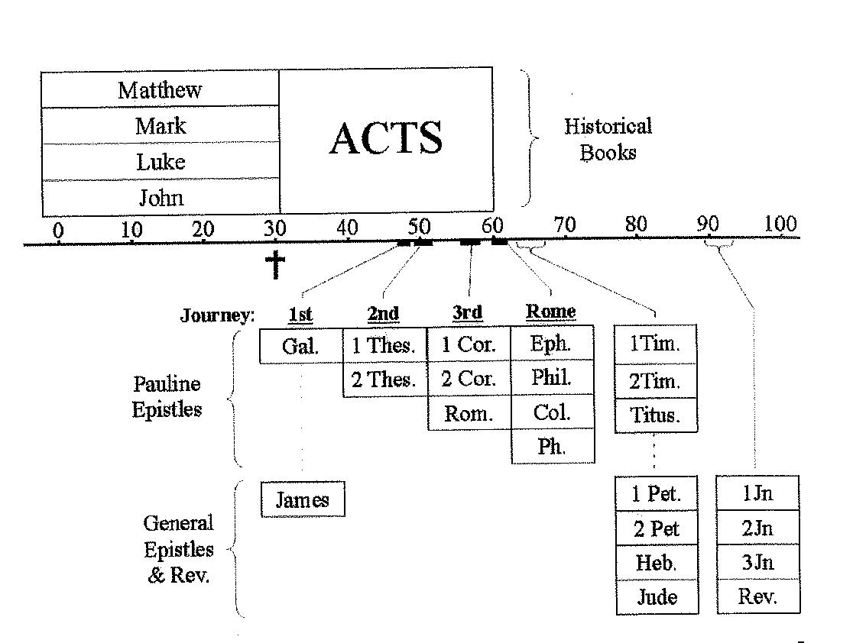

Slide 10
Periods of Bible History
Creation
Before the Flood
The Flood
Scattering of the People
The Rule of the Fathers
Egyptian Bondage
Wilderness wandering
Conquering the Land of Promise
The Rule of Judges
The Rule of Kings-United
The Rule of Kings-Divided
The Rule of Kings-Judah alone
The Babylonian Captivity
The Return from Captivity
Years of Prophetic Silence
The Life of Christ
The Beginning and spread of the church
The Letters of Instruction and encouragement

Slide 11
The Bible Story
Jesus is coming
Jesus is here
Jesus is coming again

Slide 12
Two Religions from One Story
Old Testament
Prepare for Jesus
God chose one family
Israel or the Jews
They were His example
A descendant of David to rule forever
He is Jewish royalty
New Testament
Shows Jesus living
Shows Him fulfilling prophecy
Shows a new kingdom
Jesus is the king
Christians are the kingdom
This was the fulfillment

Slide 13
Why a New Testament
The problem of sin
Man rejected God
Genesis 3
Genesis 3

Slide 14
“When the woman saw that the tree was good for food, and that it was a delight to the eyes, and that the tree was desirable to make one wise, she took from its fruit and ate; and she gave also to her husband with her, and he ate.”
-Genesis 3:6

Slide 15
Why a New Testament
The problem of sin
Man rejected God
Man dies
Genesis 3
Genesis 3
Genesis 3

Slide 16
“By the sweat of your face You will eat bread, Till you return to the ground, Because from it you were taken; For you are dust, And to dust you shall return.”
-Genesis 3:19

Slide 17
“Then the Lord God said, ‘Behold, the man has become like one of Us, knowing good and evil; and now, he might stretch out his hand, and take also from the tree of life, and eat, and live forever’”
-Genesis 3:22

Slide 18
Why a New Testament
The problem of sin
Man rejected God
Man dies
God cursed man
Genesis 3
Genesis 3
Genesis 3
Genesis 3

Slide 19
“Then to Adam He said, ‘Because you have listened to the voice of your wife, and have eaten from the tree about which I commanded you, saying, 'You shall not eat from it’; Cursed is the ground because of you; In toil you will eat of it All the days of your life. Both thorns and thistles it shall grow for you; And you will eat the plants of the field; By the sweat of your face You will eat bread, Till you return to the ground, Because from it you were taken; For you are dust, And to dust you shall return.’”
-Genesis 3:17-19

Slide 20
Why a New Testament
The problem of sin
Man rejected God
Man dies
God cursed man
God promised a way
Genesis 3
Genesis 3
Genesis 3
Genesis 3
Genesis 3, 12

Slide 21
“And I will put enmity Between you and the woman, And between your seed and her seed; He shall bruise you on the head, And you shall bruise him on the heel.”
-Genesis 3:15

Slide 22
“Now the Lord said to Abram, ‘Go forth from your country, And from your relatives And from your father's house, To the land which I will show you; And I will make you a great nation, And I will bless you, And make your name great; And so you shall be a blessing; And I will bless those who bless you, And the one who curses you I will curse. And in you all the families of the earth will be blessed.’”
-Genesis 12:1-3

Slide 23
Why a New Testament
The problem of sin
Man rejected God
Man dies
God cursed man
God promised a way
Jesus is the way
Genesis 3
Genesis 3
Genesis 3
Genesis 3
Genesis 3, 12
John 14

Slide 24
“Jesus said to him, ‘I am the way, and the truth, and the life; no one comes to the Father but through Me.’”
-John 14:6

Slide 25
Why a New Testament
The problem of sin
Man rejected God
Man dies
God cursed man
God promised a way
Jesus is the way
Jesus brings life
Jesus heals the cursed
Genesis 3
Genesis 3
Genesis 3
Genesis 3
Genesis 3, 12
John 14
John 14; Revelation 22
Revelation 22

Slide 26
“Jesus said to him, ‘I am the way, and the truth, and the life; no one comes to the Father but through Me.’”
-John 14:6

Slide 27
“Then he showed me a river of the water of life, clear as crystal, coming from the throne of God and of the Lamb, in the middle of its street. On either side of the river was the tree of life, bearing twelve kinds of fruit, yielding its fruit every month; and the leaves of the tree were for the healing of the nations. There will no longer be any curse; and the throne of God and of the Lamb will be in it, and His bond-servants will serve Him; they will see His face, and His name will be on their foreheads. And there will no longer be any night; and they will not have need of the light of a lamp nor the light of the sun, because the Lord God will illumine them; and they will reign forever and ever.”
-Revelation 22:1-5

