Slide 1


Slide 2


Slide 3
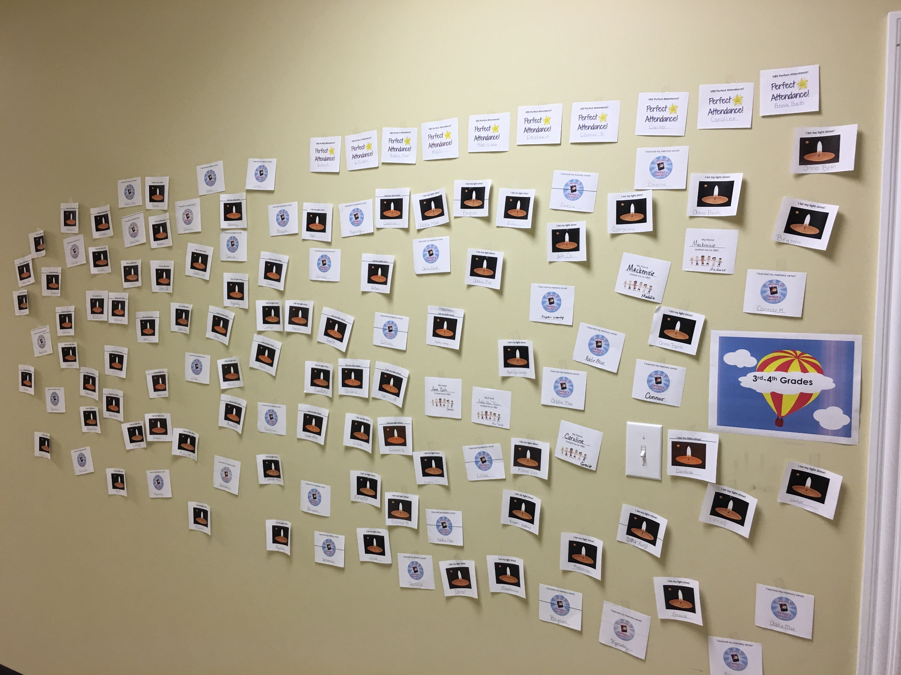

Slide 4


Slide 5
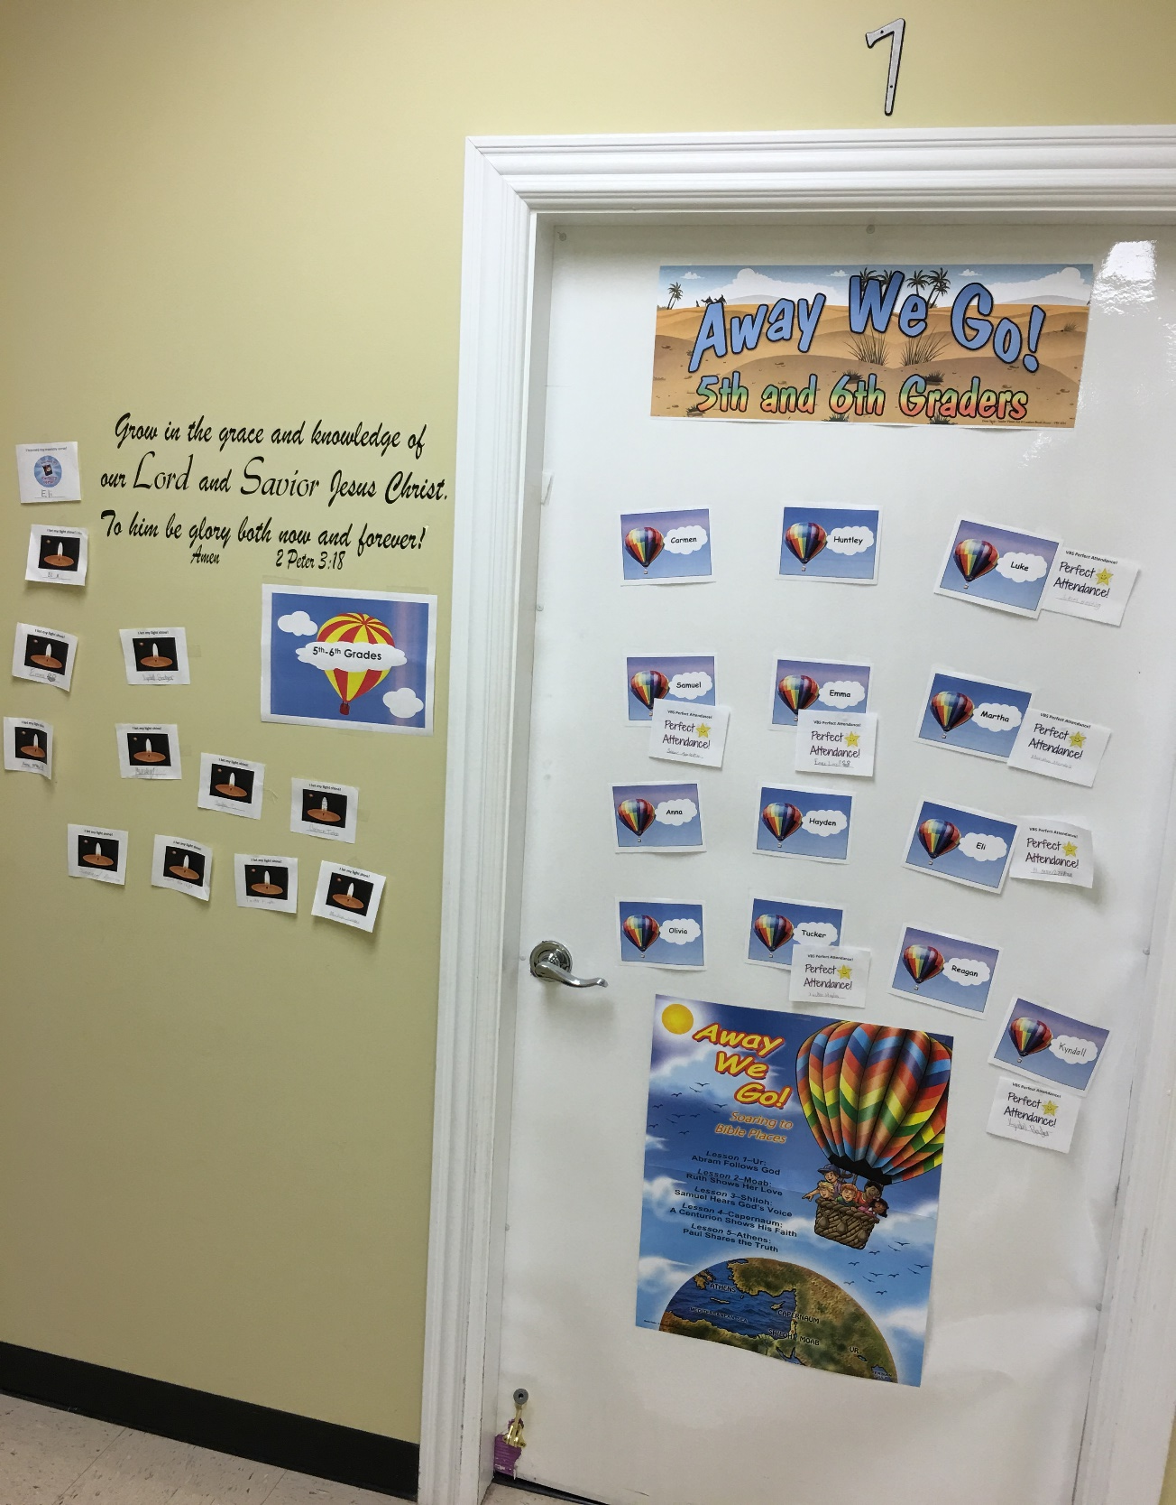


Slide 6

O’Neal church of Christ, Athens, Al. Sunday, June 19,2016

Slide 7
Father’s Day

Slide 8
Matt. 1:18-25
¹⁸ Now the birth of Jesus Christ was on this wise: When as his mother Mary was espoused to Joseph, before they came together, she was found with child of the Holy Ghost.
¹⁹ Then Joseph her husband, being a just man, and not willing to make her a public example, was minded to put her away privily.
²⁰ But while he thought on these things, behold, the angel of the Lord appeared unto him in a dream, saying, Joseph, thou son of David, fear not to take unto thee Mary thy wife: for that which is conceived in her is of the Holy Ghost.
²¹ And she shall bring forth a son, and thou shalt call his name Jesus: for he shall save his people from their sins

Slide 9
²² Now all this was done, that it might be fulfilled which was spoken of the Lord by the prophet, saying,
²³ Behold, a virgin shall be with child, and shall bring forth a son, and they shall call his name Emmanuel, which being interpreted is, God with us.
²⁴ Then Joseph being raised from sleep did as the angel of the Lord had bidden him, and took unto him his wife:
²⁵ And knew her not till she had brought forth her firstborn son: and he called his name Jesus.

Slide 10
Someone has said:
Prerequisites to being a good Father:
1. Being a man
2. Functioning as a man
3. Taking responsibility as a man
4. Thinking like a man
5. Acting like a man
6. Working like a man…. All of these prerequisites to being
A good Father!

Slide 11
1. Joseph was a just man : Fathers are to be Just”
V. ¹⁹ Then Joseph her husband, being a just man, and not willing to make her a public example, was minded to put her away privily
Just: doing the right thing.
Husbands are to do the right thing toward their
wives…Eph. 5:25 “Husbands, love your wives”
Husbands who become fathers are to do the right
thing to work and provide for them his own.. I Tim. 5:8
⁸ But if any provide not for his own, and specially for those of his own house, he hath denied the faith, and is worse than an infidel

Slide 12
2. Joseph was an obedient man

Slide 13
²⁴ Then Joseph being raised from sleep did as the angel of the Lord had bidden him, and took unto him his wife:
All Fathers should be men who do what the Lord bids them:

Slide 14
God speaks to Fathers:
Teach your children..
Deuteronomy 6:6-9 - "These commandments that I give you today are to be on your hearts. Impress them on your children. Talk about them when you sit at home and when you walk along the road, when you lie down and when you get up. Tie them as symbols on your hands and bind them on your foreheads. Write them on the doorframes of your houses and on your gates."(NIV)

Slide 15
Malachi 4:6 - "He will turn the hearts of the parents to their children, and the hearts of the children to their parents; or else I will come and strike the land with total destruction."(NIV

Slide 16
Proverbs 22:6
⁶ Train up a child in the way he should go: and when he is old, he will not depart from it.
Proverbs 22:6 - "Start children off on the way they should go, and even when they are old they will not turn from it."(NIV)

Slide 17
Eph. 6:4
⁴ And, ye fathers, provoke not your children to wrath: but bring them up in the nurture and admonition of the Lord.
"Fathers, do not exasperate your children; instead, bring them up in the training and instruction of the Lord."(NIV)

Slide 18
Joshua 24: ¹⁵ And if it seem evil unto you to serve the Lord, choose you this day whom ye will serve; whether the gods which your fathers served that were on the other side of the flood, or the gods of the Amorites, in whose land ye dwell: but as for me and my house, we will serve the Lord.
Joshua 24:15 - "But if serving the LORD seems undesirable to you, then choose for yourselves this day whom you will serve, whether the gods your ancestors served beyond the Euphrates, or the gods of the Amorites, in whose land you are living. But as for me and my household, we will serve the LORD."(NIV)

Slide 19
Scripture on God as the Example of Fatherhood
Genesis 18:19 - "For I have chosen him, so that he will direct his children and his household after him to keep the way of the LORD by doing what is right and just, so that the LORD will bring about for Abraham what he has promised him."(NIV)
Psalm 103:13 - "As a father has compassion on his children, so the LORD has compassion on those who fear him"(NIV)
Proverbs 3:11-12 - "My son, do not despise the LORD’s discipline, and do not resent his rebuke, because the LORD disciplines those he loves, as a father the son he delights in"(NIV)
Proverbs 14:26 - "Whoever fears the LORD has a secure fortress, and for their children it will be a refuge."(NIV)
Hebrews 12:7 - "Endure hardship as discipline; God is treating you as his children. For what children are not disciplined by their father?"(NIV)

Slide 20
Proverbs 3:11-12
"My son, do not despise the LORD's discipline and do not resent his rebuke,
because the LORD disciplines those he loves, as a father the son he delights in."

Slide 21
Fathers teach their children what God has done in their days!
"We have heard with our ears, O God,
Our fathers have told us,
The deeds You did in their days,
In days of old:"
Psalm 44:1 (NKJV)

Slide 22
“This book of the Law shall not depart from your mouth, but you shall MEDITATE in it day and night, that you may observe to DO
according to all that is written in it.
For then you will make your way prosperous, and then you will have good success.” - Joshua 1:81

Slide 23
Honor their Father
Exodus 20:12 - "Honor your father and your mother, so that you may live long in the land the LORD your God is giving you."(NIV)
Proverbs 20:20 - "If someone curses their father or mother, their lamp will be snuffed out in pitch darkness."(NIV)
Proverbs 23:22 - "Listen to your father, who gave you life, and do not despise your mother when she is old."(NIV)
Proverbs 23:24 - "The father of a righteous child has great joy; a man who fathers a wise son rejoices in him."(NIV)
Collosians 3:20 - "Children, obey your parents in everything, for this pleases the Lord."(NIV)
Ephesians 6:1-2 - "Children, obey your parents in the Lord, for this is right. “Honor your father and mother”—which is the first commandment with a promise"(NIV)

Slide 24
1. Be In the Kingdom of God—the church
Be a faithful Christian! Rev. 2:10
2 Tim. 4:7-8
Acts 2:47

Slide 25
2. Be a good Example…worthy to have your children to follow
Footprints in the snow! Wait, Daddy, I’m following you.
Matt.5:16
Matt. 6:33

Slide 26
3. Be a good husband- demonstrating to your children what a union of God is best!
Children should see and know that the husband/father,
Loves and respects his wife and the children’s mother!

Slide 27
4. Be a worker…provide for your own!
I Tim. 5:8

Slide 28
5. Put FIRST THINGS THINGS!
Matt.6:33

