Slide 1
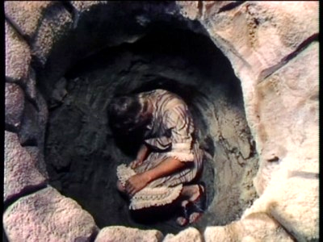
Life’s Pits
Learning to Trust God’s Promises and Providence
Notes:
Joseph was thrown in a pit and later sold into slavery by his brothers who envied and hated him. In spite of it all, Joseph lived a life of faithfulness. His circumstances did not nullify God’s plans or promises. We may also experience pits in our lives. We must not allow bitterness, despair or resentment to take control, but in faith we must trust God’s promises and providence, and wait patiently for Him to accomplish His will.

Slide 2
How Joseph wound up in the Pit
Joseph was the favored son (Genesis 37:1-3)

Slide 3
37 And Jacob dwelt in the land wherein his father was a stranger, in the land of Canaan.
² These are the generations of Jacob. Joseph, being seventeen years old, was feeding the flock with his brethren; and the lad was with the sons of Bilhah, and with the sons of Zilpah, his father's wives: and Joseph brought unto his father their evil report.
³ Now Israel loved Joseph more than all his children, because he was the son of his old age: and he made him a coat of many colours.

Slide 4
How Joseph wound up in the Pit
Joseph was the favored son (Genesis 37:1-3)
Sibling rivalry and jealousy ensued (37:4)

Slide 5
⁴ And when his brethren saw that their father loved him more than all his brethren, they hated him, and could not speak peaceably unto him.

Slide 6
How Joseph wound up in the Pit
Joseph was the favored son (Genesis 37:1-3)
Sibling rivalry and jealousy ensued (37:4)
Joseph had a dream about his future status over his brothers (37:5-8)

Slide 7
⁵ And Joseph dreamed a dream, and he told it his brethren: and they hated him yet the more.
⁶ And he said unto them, Hear, I pray you, this dream which I have dreamed:
⁷ For, behold, we were binding sheaves in the field, and, lo, my sheaf arose, and also stood upright; and, behold, your sheaves stood round about, and made obeisance to my sheaf.
⁸ And his brethren said to him, Shalt thou indeed reign over us? or shalt thou indeed have dominion over us? And they hated him yet the more for his dreams, and for his words.

Slide 8
How Joseph wound up in the Pit
Joseph was the favored son (Genesis 37:1-3)
Sibling rivalry and jealousy ensued (37:4)
Joseph had a dream about his future status over his brothers (37:5-8)
Joseph is sent to check on his brothers. (37:14)
He finds them in Dothan (37:17)

Slide 9
¹⁴ And he said to him, Go, I pray thee, see whether it be well with thy brethren, and well with the flocks; and bring me word again. So he sent him out of the vale of Hebron, and he came to Shechem.
¹⁷ And the man said, They are departed hence; for I heard them say, Let us go to Dothan. And Joseph went after his brethren, and found them in Dothan.

Slide 10
How Joseph wound up in the Pit
Joseph was the favored son (Genesis 37:1-3)
Sibling rivalry and jealousy ensued (37:4)
Joseph had a dream about his future status over his brothers (37:5-8)
Joseph is sent to check on his brothers. (37:14)
He finds them in Dothan (37:17)
They initially conspire to kill him, but Reuben convinces them to throw him alive in a pit. (37:18-24)

Slide 11
¹⁸ And when they saw him afar off, even before he came near unto them, they conspired against him to slay him.
¹⁹ And they said one to another, Behold, this dreamer cometh.
²⁰ Come now therefore, and let us slay him, and cast him into some pit, and we will say, Some evil beast hath devoured him: and we shall see what will become of his dreams.
²¹ And Reuben heard it, and he delivered him out of their hands; and said, Let us not kill him.
²² And Reuben said unto them, Shed no blood, but cast him into this pit that is in the wilderness, and lay no hand upon him; that he might rid him out of their hands, to deliver him to his father again.
²³ And it came to pass, when Joseph was come unto his brethren, that they stript Joseph out of his coat, his coat of many colours that was on him;
²⁴ And they took him, and cast him into a pit: and the pit was empty, there was no water in it.

Slide 12
Joseph in the Pit
Joseph still had his dreams.
His brothers could not take away God’s promises or alter God’s intention (Genesis 37:20; 50:20)

Slide 13
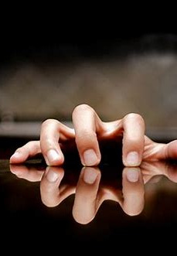
Some of Life’s Pits
Tragic events and troubling circumstances.
Medical problems.
Focus on self instead of God (self-pity).
Consequences of poor decisions.
Financial Problems

Slide 14
Hazards of Pits
Bitterness (Genesis 42:21)
Despair
Resentment
(Ephesians 4:31-32)

Slide 15

If You Fall in a Pit
Don't allow it to steal your dreams!
Expect persecution and difficulty! (2 Timothy 3:12)
Let your conduct be worthy of the good news of the gospel, come what may! (Philippians 1:27-30)
Trust that God is working it all out for the best. (Romans 8:28)
Wait patiently! (Psalm 40:1-2)

Slide 16
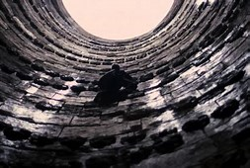
God has a purpose
To teach us patience
To rid us of pride
To help us learn to trust His providence
To prepare us for future service

Slide 17
Conclusion
--------------Romans 8:18------------------
----------2nd Corinthians 4:16-18--------
-Are you in one of life's pits?
-Have you been in a pit of life before and overcome that tough time?
-Why don’t you lean on the Lord to help you during the pits of life. Trusting his Providence and Plan!

