Slide 1
Why did Jesus come to the earth?
Luke 19:10

Slide 2
Luke 19:10 For the Son of man
is come to seek and to save
that which was lost.

Slide 3
Luke 19:1-10
1 And Jesus entered and passed through Jericho.
² And, behold, there was a man named Zacchaeus, which was the chief among the publicans, and he was rich.
³ And he sought to see Jesus who he was; and could not for the press, because he was little of stature.
⁴ And he ran before, and climbed up into a sycomore tree to see him: for he was to pass that way.
⁵ And when Jesus came to the place, he looked up, and saw him, and said unto him, Zacchaeus, make haste, and come down; for to day I must abide at thy house.

Slide 4
6 And he made haste, and came down, and received him joyfully.
⁷ And when they saw it, they all murmured, saying, That he was gone to be guest with a man that is a sinner.
⁸ And Zacchaeus stood, and said unto the Lord: Behold, Lord, the half of my goods I give to the poor; and if I have taken any thing from any man by false accusation, I restore him fourfold.
⁹ And Jesus said unto him, This day is salvation come to this house, forsomuch as he also is a son of Abraham.
Why did Jesus come?
¹⁰ For the Son of man is come to seek and to save that which was lost.

Slide 5
Some People are Lost!
Rather:
Many People are lost.
Matt. 7:12 ¹³ Enter ye in at the strait gate: for wide is the gate, and broad is the way, that leadeth to destruction, and many there be which go in thereat:
¹⁴ Because strait is the gate, and narrow is the way, which leadeth unto life, and few there be that find it.

Slide 6

" Seeking The Lost "

Slide 7
How many lost people does Jesus want to save? (Mtt. 11:28-30- All!!)
I Tim. 1:15 This is a faithful saying and worthy of all acceptation,
That Christ Jesus came into the world to save sinners,
Of whom I am chief.
Jesus came to save Saul, later called Paul!
He came to save us all!.

Slide 8
But, there are people who will not obey
Jesus!
He is the savior to them that obey Him, not to them
that will not obey him>
1. Matt. 7:21 Why call ye me Lord, Lord, and do not the thing
That I say?
2. Jesus wants to save you, but if you don’t want Him to save
You, then you will be lost…and you will be to blame for it!

Slide 9
What causes a person to be lost and needs to be saved?
His Sin! Ez. 18:20 not his mother/not his father..
Rom.3:23 For all have sinned
Rom. 6:23 For the wages of sin is death…
Isa. 59:1-2
So Jesus came to save you and me!

Slide 10
The Very reason that Jesus came to the earth was to Save Us Sinners!
Luke 15:32 It was meet that we should make merry, and be glad: for this thy brother was dead, and is alive again; and was lost, and is found.
John 17:12 While I was with them in the world, I kept them in thy name: these that thou gavest me I have kept, and none of them is lost, but the son of perdition; that the scripture might be fulfilled.

Slide 11
Alright, we know Why Jesus came, but what does it mean to be lost? God says:
1. It means you are separated from God!How do we know?
separated from God. Isa. 59:1-2 / God says so!
2. It means you are not in the church where all saved people are. Acts 2:47 How do we know? / God says so!
3. It means Your prayers are Not heard and answered by God.
How do we know? / God says so!
John 9:31 “Now we know that God heareth not sinners: but if any man be a worshipper of God, and doeth his will, him he heareth!.

Slide 12
Being Lost also means that there is NO
Hope for you in the next life! How do we know?
Listen what God says in His Word. He is telling you the truth! / God tells you so!
Eph. 2:12-13 That at that time ye were without Christ, being aliens from the commonwealth of Israel, and strangers from the covenants of promise, having NO HOPE, and without God in the world. But now In Christ Jesus, ye who sometimes were far off are made nigh by the Blood of Christ.

Slide 13
I Thess. 4:13-14 But I would not have you to be ignorant, brethren, concerning them which are asleep, that ye sorrow not, even as others which have no hope. For if we believe that Jesus died and rose again, even so them also which sleep in Jesus will God bring with him.
There are people who have NO HOPE! (How do we
Know? / God says so
The Lost Have No Hope!
What about you? Do you have any hope??

Slide 14
Write this down: If you are lost, you will not be granted entrance into HEAVEN!.
You’ll Never see Heaven!
You’ll Never see those who are there. How do we know? / God says so!
There will never, never be given you an entrance into Heaven. None will be granted you!
Hear it from the Master’s words! (Heb. 9:27)
Matt. 25:38 And cast ye the unprofitable servant into outer darkness: there shall be weeping and gnashing of teeth.

Slide 15
You cannot spend eternity with anyone who is
Righteous! Your association will only be with the devil
And his angels! How do we know? / God tells us so!
Matt. 25:32-34³² And before him shall be gathered all nations: and he shall separate them one from another, as a shepherd divideth his sheep from the goats:
³³ And he shall set the sheep on his right hand, but the goats on the left.
³⁴ Then shall the King say unto them on his right hand, Come, ye blessed of my Father, inherit the kingdom prepared for you from the foundation of the world:
Matt. 25:41 Then shall he say also unto them on the left hand, Depart from me, ye cursed, into everlasting fire, prepared for the devil and his angels:

Slide 16
And the awful thing about being lost, is that you will be in hell fire forever and ever!
How do we know that? God tells us so!
Mark 3:29 ⁴¹ Then shall he say also unto them on the left hand, Depart from me, ye cursed, into everlasting fire, prepared for the devil and his angels:

Slide 17
" Seeking The Lost "

Slide 18
What does the LORD require of thee?
Remember Micah 6:6-8
Remember the people on the day of Pentecost? Acts 2:37
Remember Saul? Acts 9:6
Remember Philip and the Eunuch. Acts 8:36-38
Remember Felix..trembled but did not obey. Acts 24:25
Remember Agrippa said “almost thou persaudest me to be A Christian Acts 26:28

Slide 19
Knowing what Jesus wants you to do….
What doth hinder you from doing it?
Knowing what the Lord wants you to do…
What doth hinder you from doing it?
Matt Taylor uses the following powerpoint
Slides with the small children’s class…

Slide 20
What is God’s plan of salvation?

Slide 21

Hear
Notes:
Hear the Word of God

Slide 22
Romans 10:17
So then Faith cometh by
hearing, and hearing by the
Word of God!.

Slide 23
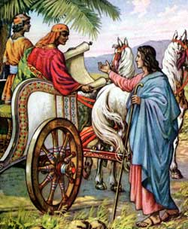
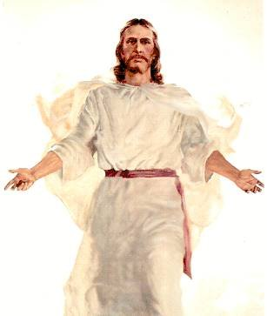
Believe
Notes:
Believe that Jesus is the Son of God.

Slide 24
John 8:24
…. for if ye __________ not that I am he, ye shall ______ in your sins.
believe
die

Slide 25

Repent
Notes:
Turn around our life. Change and follow after Jesus.

Slide 26
Acts 2:38
Then Peter said unto them, _______, and be baptized every one of you in the name of Jesus Christ for the ___________ of sins, and ye shall receive the gift of the Holy Ghost.
Repent
remission

Slide 27

Confess

Slide 28
Matthew 10:32-33
³² Whosoever therefore shall confess me before men, him will I _________ also before my Father which is in heaven.
³³ But whosoever shall deny me before men, him will I also ________ before my Father which is in heaven.
confess
deny

Slide 29
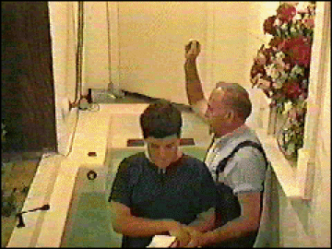
Be Baptized

Slide 30
Galatians 3:27
For as many of you as have been _______ into Christ have put on Christ.
baptized

Slide 31

Remain Faithful

Slide 32
Revelation 2:10
….be thou faithful unto death, and I will give thee a crown of life.

Slide 33
Are You
Saved Or Lost
As You Are today?

