Slide 1
Making the Right Decisions in Life
Notes:
Good evening!
Next month, we want to revisit a sermon that we did since we first started 2010.
The personnel manager had advertised a job opening, and a large group of applicants was waiting in her waiting room. The first young man was ushered into her office, and she began explaining the job to him. “We need someone in this job who can make fast decisions,” she said, “someone who can really think on his feet. Can you show me that you’re capable of doing that?” Without a word, the young man got to his feet, stuck his head out the door, and announced to the waiting applicants, “Okay, you guys. You can all go home- the job’s just been filled.”

Slide 2


Notes:
Every day, multiple times a day, we are confronted with making decisions? That’s just a part of life. Some decisions we make have little or no consequence--like what you have for breakfast, what color shirt you wear to town. Other decisions can be life changing---sometimes life ending.
Am I going to a party with alcohol? Do I drink? If I do, do I drive? Do I wear a seatbelt or do I not? Do I drive with excessive speed or do I drive the limit? Do I commit fornication? Do I smoke my first cigarette or try drugs just one time?
How many people have ruined their lives or ended it because of making a bad decision? How many people have you talked with who live a lifetime of regret because of decisions of the past—even when God has forgiven them a long time ago? God forgives so easily, but sometimes we can’t forgive ourselves.

Slide 3

Notes:
Do you know people who seem to always make good decisions in life? It seems like anything that comes their way, they are able to handle it. Why is that?
Making good decisions—the right decisions—in this life can be a challenge at times.
We see examples in the Bible of people faced with decisions, but the way they answered God’s call was very different.
We see Jonah who answered God’s call----Here I am, but I’m not going.
We see Moses who answered God’s call----Here I am, send someone else.
We see Isaiah who answered God’s call----Here I am, send me.
What’s the difference between those who make wrong, harmful decisions than those who more often than not, make the right ones?
How can I make better decisions in my life?

Slide 4
Looking Unto Jesus
Hebrews 12:1-2
1 Wherefore seeing we also are compassed about with so great a cloud of witnesses, let us lay aside every weight, and the sin which doth so easily beset us, and let us run with patience the race that is set before us,
2 Looking unto Jesus the author and finisher of our faith; who for the joy that was set before him endured the cross, despising the shame, and is set down at the right hand of the throne of God.
Notes:
I believe that the major decision-making difference for a Christian is Jesus Christ!
I think a Christian knows the burden of the weight—knows the consequences of sin—The wages of sin is death. Romans 6:23
Knows the endurance it takes to pace himself/herself on the journey of life and is like the tortoise and continues the race…No time to stop, no time to rest,
The Christian looks to the source of his/her motivation.
Isaiah 40:31 But they that wait upon the Lord shall renew their strength; they shall mount up with wings as eagles; they shall run, and not be weary; and they shall walk, and not faint.
Our motivation to do what’s right begins with looking unto Jesus!
When we look to Jesus, what do we see?

Slide 5

We See…
Notes:
We see Purpose.
When we know where we want to go in life.
We begin with the end in mind! We look to Jesus who is the author and finisher of our faith!
When we have a sense of purpose, then our decisions are easier to make.

Slide 6
Living with Purpose
John 6:38
38 For I came down from heaven, not to do mine own will, but the will of him that sent me.
Luke 19:10
10 For the Son of man is come to seek and to save that which was lost.
Notes:
When we look to Jesus, we see our Savior with a deep sense of purpose.
He had one purpose and that was to do His Father’s will.
When we look to Jesus what do we see? We see our Savior who came to do His Father’s will. John 6:38
Jesus knew His purpose! Luke 19:10

Slide 7
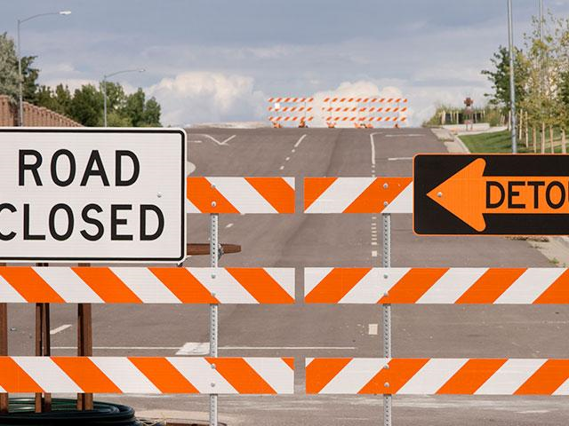
We See…
Notes:
When we look to Jesus to guide us in our decision making, we see Dedication and Devotion to God’s Word.
Jesus didn’t allow road blocks and detours STOP Him from completing His Father’s will.

Slide 8
It is written…
Matthew 4:1-4
1 Then was Jesus led up of the Spirit into the wilderness to be tempted of the devil.
2 And when he had fasted forty days and forty nights, he was afterward an hungred.
3 And when the tempter came to him, he said, If thou be the Son of God, command that these stones be made bread.
4 But he answered and said, It is written, Man shall not live by bread alone, but by every word that proceedeth out of the mouth of God.
Notes:
Jesus was dedicated to His Father’s will. When Jesus was tempted in the wilderness in Matthew 4, Satan posted 3 questions to Jesus, and all 3 times He responded……It is written!
Let’s look at it….
Even at His weakest—very hungry—tempted—yet still focused and dedicated to the living word.

Slide 9
It is written…
Matthew 4:5-7
5 Then the devil taketh him up into the holy city, and setteth him on a pinnacle of the temple,
6 And saith unto him, If thou be the Son of God, cast thyself down: for it is written, He shall give his angels charge concerning thee: and in their hands they shall bear thee up, lest at any time thou dash thy foot against a stone.
7 Jesus said unto him, It is written again, Thou shalt not tempt the Lord thy God.

Slide 10
It is written…
Matthew 4:8-11
8 Again, the devil taketh him up into an exceeding high mountain, and sheweth him all the kingdoms of the world, and the glory of them;
9 And saith unto him, All these things will I give thee, if thou wilt fall down and worship me.
10 Then saith Jesus unto him, Get thee hence, Satan: for it is written, Thou shalt worship the Lord thy God, and him only shalt thou serve.
11 Then the devil leaveth him, and, behold, angels came and ministered unto him.
Notes:
• Jesus firmly stood on “it is written!”
1 Corinthians 10:13 There hath no temptation taken you but such as is common to man: but God is faithful, who will not suffer you to be tempted above that ye are able; but will with the temptation also make a way to escape, that ye may be able to bear it.
Hebrews 4:12 For the word of God is quick, and powerful, and sharper than any twoedged sword, piercing even to the dividing asunder of soul and spirit, and of the joints and marrow, and is a discerner of the thoughts and intents of the heart.
God’s word is alive! It will clear up the fog involved in any of the decisions we make in life.

Slide 11
Profitable
2 Timothy 3:16
All scripture is given by inspiration of God, and is profitable for doctrine, for reproof, for correction, for instruction in righteousness:
Notes:
• Most of the confusion comes when we go to God’s word for help and we do not like the answer we get.
MOST of the bad decisions you will make in life can be avoided by simply obeying God’s word.

Slide 12

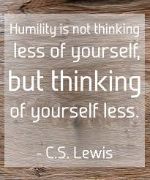
We See…
Notes:
When we look to Jesus, we see Humility.
Philippians 2:8 And being found in fashion as a man, he humbled himself, and became obedient unto death, even the death of the cross.
How many decisions in our lives are selfish?
How many selfless?

Slide 13
Put Others First
Luke 18:15-17
15 And they brought unto him also infants, that he would touch them: but when his disciples saw it, they rebuked them.
16 But Jesus called them unto him, and said, Suffer little children to come unto me, and forbid them not: for of such is the kingdom of God.
17 Verily I say unto you, Whosoever shall not receive the kingdom of God as a little child shall in no wise enter therein.
Notes:
Jesus modeled putting others first.

Slide 14
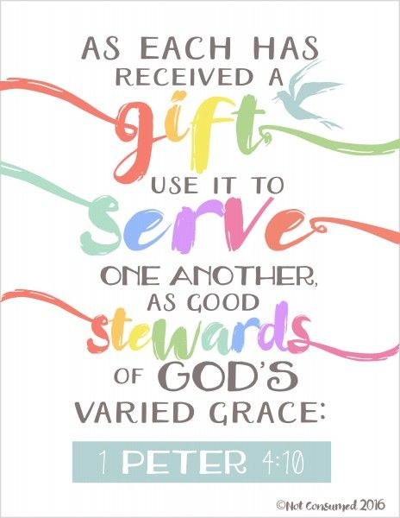
Notes:
1 Peter 4:10 As every man hath received the gift, even so minister the same one to another, as good stewards of the manifold grace of God.
What is your gift?
What are you good at? How are you using your talent? Is it self-serving or do you use it to serve others?
Use it to serve others because in doing so, you are using what God gave you.

Slide 15

We See…
Notes:
When we look to Jesus, we see obedience to God’s Will.

Slide 16
God’s Will
John 8:28
Therefore Jesus answered and was saying to them, "Truly, truly, I say to you, the Son can do nothing of Himself, unless it is something He sees the Father doing; for whatever the Father does, these things the Son also does in like manner.
Notes:
• Jesus restricted His decisions to the will of the Father. When Jesus spoke to the people, He spoke what God wanted Him to say.
• For many of us, this is hard to do because we have our minds fixed on what WE want to do in life.
• When God’s will conflicts with what WE want to do, God gets tossed to the side. Then when things go bad, we want God to fix it.
Think about Jesus on the night before the crucifixion---Matthew 26:30
• Even though carrying out God’s will was going to be painful for Jesus, He ultimately told God that He would do as the Father willed!
• Life can be simple, but that does not mean it’s easy. A simple principle, honor God’s will. Not always an easy principle to carry out.
• You will NEVER go wrong by honoring God’s will in your decision making.

Slide 17
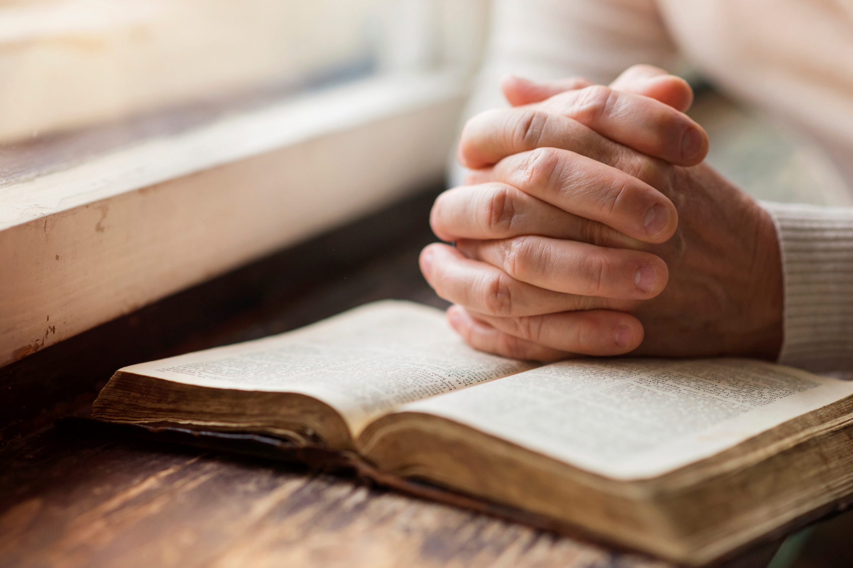
We See…
Notes:
We see Jesus fervent in prayer.

Slide 18
Fervent in Prayer
Luke 6:12-13
12 And it came to pass in those days, that he went out into a mountain to pray, and continued all night in prayer to God.
13 And when it was day, he called unto him his disciples: and of them he chose twelve, whom also he named apostles;
Notes:
• One of the things we need to do in order to make good decisions, we need to spend a lot of time in prayer.
Philippians 4:6 Be anxious for nothing, but in everything by prayer and supplication with thanksgiving let your requests be made known to God.
1 Thessalonians 5:17 Pray without ceasing.
• Prayer is a key that will open many doors for us. Go to our Father before you make the decision!

Slide 19
Making the Right Decisions in Life
Notes:
Making the Right Decisions in Life isn’t always easy, but when we look to Jesus’ example.
We need to…
Have a Purpose!
Be dedicated and devoted to God’s Word.
Humbly obey His will and…
Be Fervent in prayer to our Father through His beloved Son!

Slide 20
Notes:
How do we know we made the right or wrong choice or decision?
Consider:
Who will profit? Who will be hurt? Will the work of the Lord be hindered or made to prosper?
Will my decision be pleasing to God or will my choice bring shame to His name?

Slide 21
JESUS
Notes:
No matter what decision you have in life, there’s one decision that matters most and that decision is the one to follow JESUS!
What will stop you from faithfully following Jesus?
In Mark 2, we find a crippled man carried by 4 men trying to get inside a house that was full, lowered down through a roof, to be healed by Jesus. He did whatever it took to be in the presence of Jesus. He may have been carried inside the house, but he held the bed and walked out of it by himself.
We may be burdened down with the weight of sin in our life, but I can guarantee that when you come to Jesus, that burden will be light.
If you aren’t a Christian, what’s stopping you from becoming one? There will be no good excuse on Judgement Day.
If you are subject to the Lord’s invitation, Come!

