Slide 2
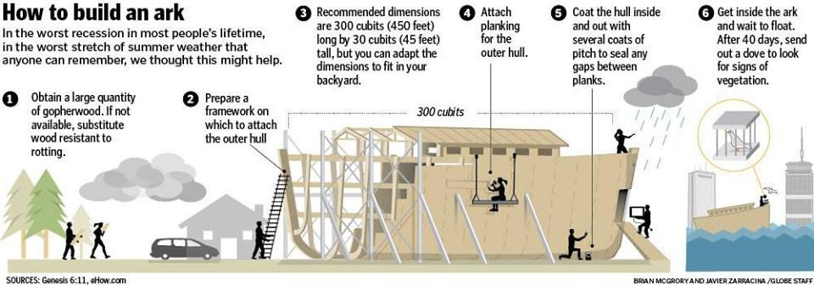
You should probably be on step 5 by now

Slide 3
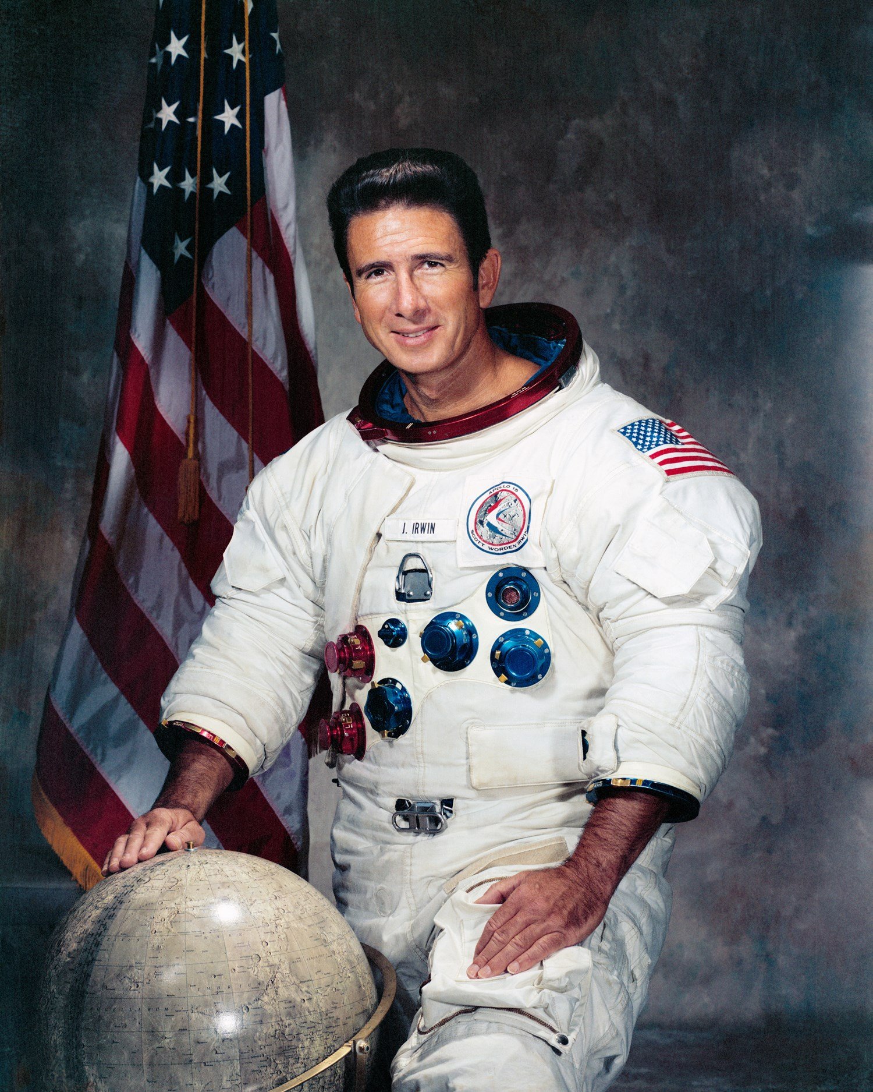
James Irwin
Apollo 15 Astronaut
Walked on the moon
Led several expeditions to find the Ark
1974 to 1982

Slide 4
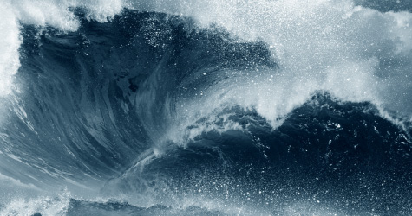
We have always been fascinated by the flood
God is beyond us. He is transcendent, mysterious, and endless. We cannot grasp him with our intellect alone. To try to do so would be to emulate the Pharisees that Jesus so castigated while he walked the earth. We were meant to engage God with our imagination as well as our intellect… --Brennan S. McPherson

Slide 5
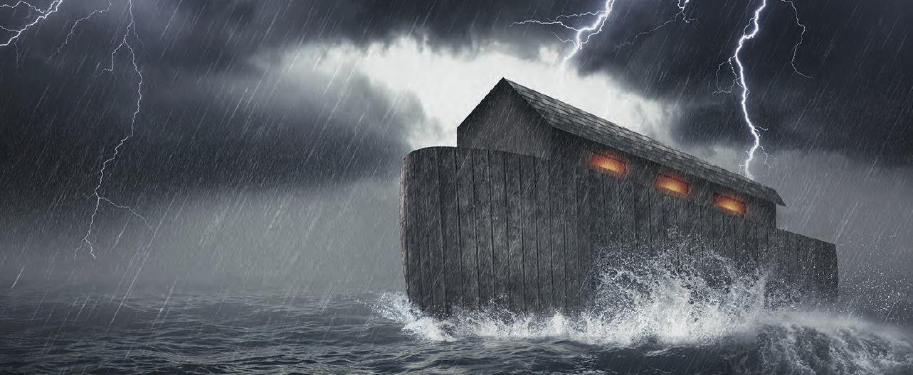
Noah, how to survive a flood

Slide 6
Step one
Flee Corruption

Slide 7
Genesis 6:5
Then the Lord saw that the wickedness of man was great on the earth, and that every intent of the thoughts of his heart was only evil continually. The Lord was sorry that He had made man on the earth, and He was grieved in His heart.

Slide 8
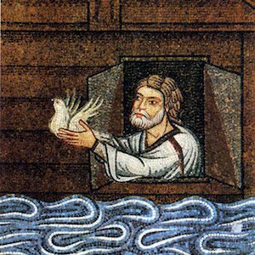
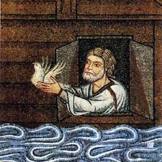
Noah fled the corruption.
But Noah found favor in the eyes of the Lord. 6:8
Now the earth was corrupt in the sight of God, and the earth was filled with violence. God looked on the earth, and behold, it was corrupt; for all flesh had corrupted their way upon the earth. Then God said to Noah, “The end of all flesh has come before Me; for the earth is filled with violence because of them; and behold, I am about to destroy them with the earth. Make for yourself an ark of gopher wood… Genesis 6:11-14

Slide 9
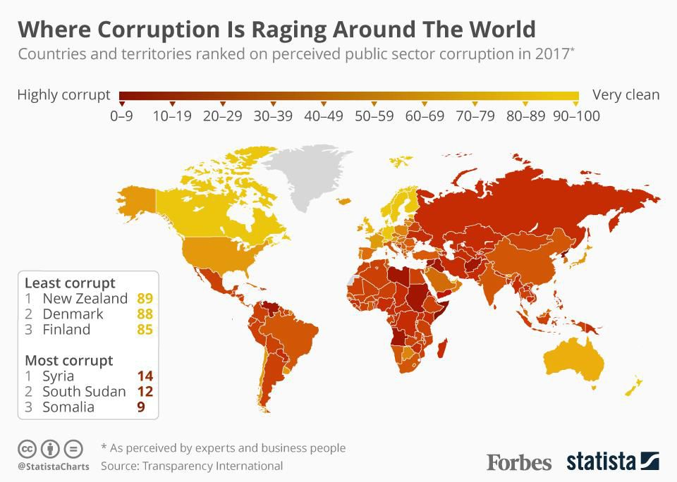
How does today’s world compare?
For you yourselves know full well that the day of the Lord will come just like a thief in the night. While they are saying, “Peace and safety!” then destruction will come upon them suddenly like labor pains upon a woman with child, and they will not escape.
I Thessalonians 5:2-3

Slide 10
Step two:
Prepare for Destruction

Slide 11
Genesis 7:20-24
The water prevailed fifteen cubits higher, and the mountains were covered. All flesh that moved on the earth perished, birds and cattle and beasts and every swarming thing that swarms upon the earth, and all mankind; of all that was on the dry land, all in whose nostrils was the breath of the spirit of life, died. Thus He blotted out every living thing that was upon the face of the land, from man to animals to creeping things and to birds of the sky, and they were blotted out from the earth; and only Noah was left, together with those that were with him in the ark. The water prevailed upon the earth one hundred and fifty days.

Slide 12
To prepare Noah followed directions
Then God said to Noah, “The end of all flesh has come before Me; for the earth is filled with violence because of them; and behold, I am about to destroy them with the earth. Make for yourself an ark of gopher wood; you shall make the ark with rooms, and shall cover it inside and out with pitch. This is how you shall make it: the length of the ark three hundred cubits, its breadth fifty cubits, and its height thirty cubits. You shall make a window for the ark, and finish it to a cubit from [o]the top; and set the door of the ark in the side of it; you shall make it with lower, second, and third decks. Genesis 6: 13-16

Slide 13




Slide 14
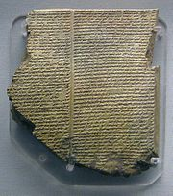
Is there proof of Global destruction?
The Epic of Gilgamesh:
Babylonian flood story that takes place around 1,500 B.C.
Striking similarities between this story and the flood in the Bible. But many details are omitted with a fragmented story structure.
It was probably based on the oral traditions that Moses later recorded about the Biblical flood.

Slide 15
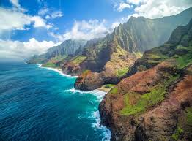
Hawaii
-A god sends a flood:
-Nu-u is chosen and warned about the flood.
-He is instructed to build a boat, fill it with animals and take his wife, his 3 sons and their wives and enter the boat to be saved from the flood.

Slide 16

China
-God created the heavens, the earth, man and woman. Man became wicked and God decided to destroy mankind with a flood.
-He warned one man, Fuhi and commanded him the build a “great boat” to save his family. He had 3 sons and 3 daughters.
-It rained for 40 days and the entire earth was covered with water.

Slide 17

The Chinese language
The oldest known written language.
The character for “Boat” is actually comprised of separate characters combined.
VESSEL+ EIGHT + PEOPLE

Slide 18
Over 200 hundred ancient flood stories
Almost every ancient civilization has a story about a global flood and one family that was saved.

Slide 19


Slide 20
Step three:
Seek Salvation

Slide 21
Genesis 8: 1-3
But God remembered Noah and all the beasts and all the cattle that were with him in the ark; and God caused a wind to pass over the earth, and the water subsided. Also the fountains of the deep and the floodgates of the sky were closed, and the rain from the sky was restrained; and the water receded steadily from the earth, and at the end of one hundred and fifty days the water decreased.

Slide 22
Noah was saved BY the FLOOD
Then the Lord saw that the wickedness of man was great on the earth, and that every intent of the thoughts of his heart was only evil continually. The Lord was sorry that He had made man on the earth, and He was grieved in His heart. Genesis 6:5
...Now the earth was corrupt in the sight of God, and the earth was filled with violence. Genesis 6:11

Slide 23
I Peter 3: 20-21
...the patience of God kept waiting in the days of Noah, during the construction of the ark, in which a few, that is, eight persons, were brought safely through the water. Corresponding to that, baptism now saves you… NASB
...God waited patiently in the days of Noah while the ark was being built. In it only a few people, eight in all, were saved through water, and this water symbolizes baptism that now saves you also... -NIV
...God was waiting patiently for them while Noah was building the boat. Only a few people—eight in all—were saved by water. And that water is like baptism that now saves you… -NCV

Slide 24
Noah was saved through water just as we are saved through Baptism.

Slide 25
Step four:
Accept and be thankful for Protection

Slide 26
Genesis 8: 21-22
The Lord smelled the soothing aroma; and the Lord said to Himself, “I will never again curse the ground on account of man, for the intent of man’s heart is evil from his youth; and I will never again destroy every living thing, as I have done. “While the earth remains, Seedtime and harvest, And cold and heat, And summer and winter, And day and night Shall not cease.”

Slide 27
Genesis 9: 8-9, 11-13
Then God spoke to Noah and to his sons with him, saying, “Now behold, I Myself do establish My covenant with you, and with your descendants after you … I establish My covenant with you; and all flesh shall never again be cut off by the water of the flood, neither shall there again be a flood to destroy the earth.” God said, “This is the sign of the covenant which I am making between Me and you and every living creature that is with you, for all successive generations; I set My bow in the cloud, and it shall be for a sign of a covenant between Me and the earth. It shall come about, when I bring a cloud over the earth, that the bow will be seen in the cloud, and I will remember My covenant, ...

Slide 28
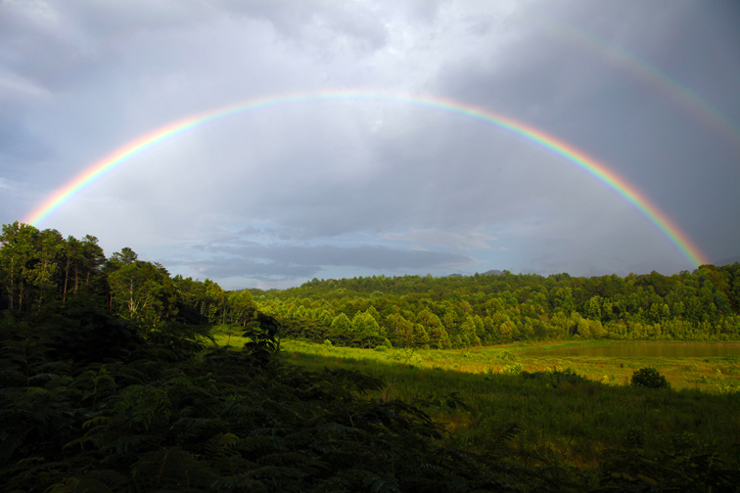

Slide 29
I can only Imagine
Now faith is the assurance of things hoped for, the conviction of things not seen. For by it the men of old gained approval. Hebrews 11: 1
By faith Noah, being warned by God about things not yet seen, in reverence prepared an ark for the salvation of his household, by which he condemned the world, and became an heir of the righteousness which is according to faith. Hebrews 11: 7

Slide 30
By faith I will oneday see...
Gideon, Cornelius, Nebuchadnezzar, Moses, Aaron, Noah and Lydia

