Slide 2
Have you ever faced a time in your life where your circumstances just seemed plain awful? Like things could not get any worse, only to get worse.
Maybe you are in a marriage where it seems your spouse just doesn’t care about you.
Maybe you have faced death in your family and think, I just can’t do this.
Maybe you are in a financial hardship that is really no fault of your own and you wonder, “God, what are you doing?”

Slide 3
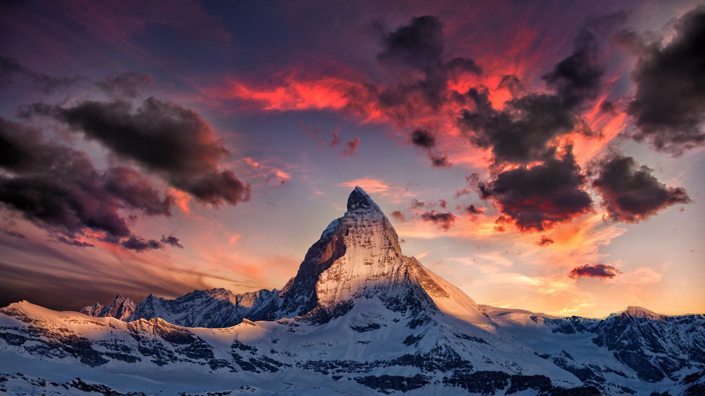
Climbing through life

Slide 4
Learning to Climb: Using Knots
“We cannot safely climb without rope. And we cannot use rope without knots. Knots like life, are slippery, full of twist and complications. Both are unforgiving, make one wrong turn and the whole mess falls apart, or you find yourself wrapped in a hairy snarl.” -Duane Raleigh

Slide 5
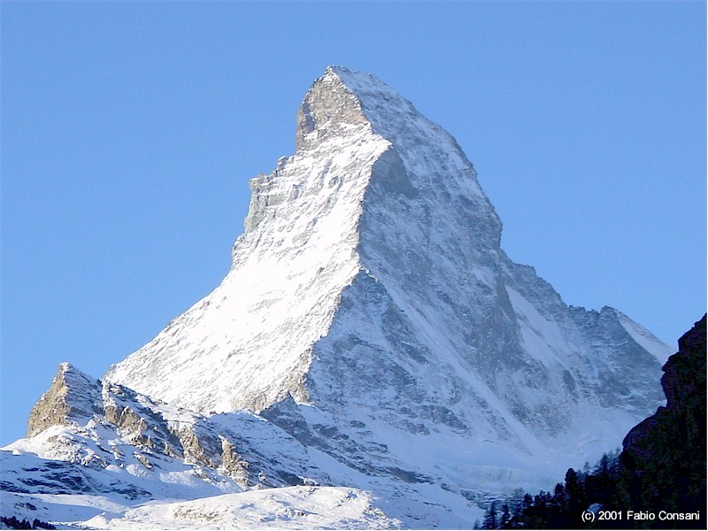
How many times has that happened to us?
Life happens…
What can go wrong will go wrong.
One thing goes wrong and everything else snowballs till we find ourselves standing in front of a mountain of problems.

Slide 6
When troubles come, they come not as single spies but in battalions.
--William Shakespeare

Slide 7
Climbing is tough: But we have a climbing manual
Which teaches us to use our Nots
Philippians 3:1-16

Slide 8
Focus on the goal and nothing else
For we are the circumcision who worship God in the spirit and rejoice in Christ Jesus and do not place confidence in the flesh; Phil. 3:3
And He said to them, Watch and keep yourselves from covetousness. For a man's life is not in the abundance of the things which he possesses. Luke 12:15
Do not lay up treasures on earth for yourselves, where moth and rust corrupt, and where thieves break through and steal. But lay up treasures in Heaven for yourselves, where neither moth nor rust corrupt, and where thieves do not break through nor steal. For where your treasure is, there will your heart be also. Matt. 6:19-21

Slide 9
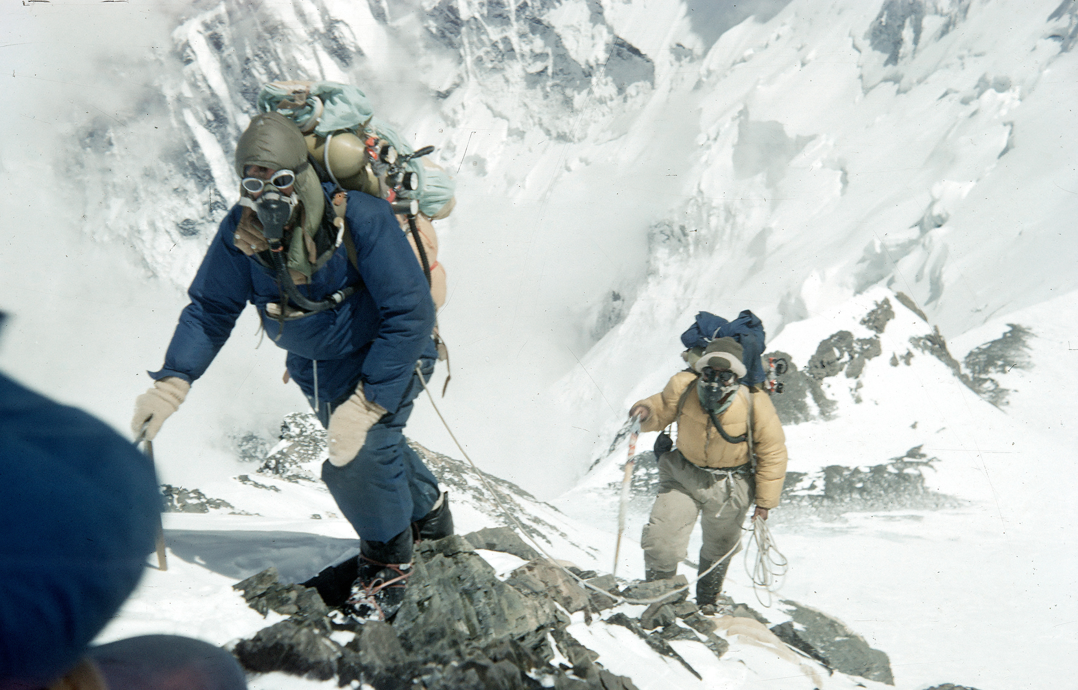

Slide 10
Our next step is to keep moving
Not as though I had already attained, either were already perfect, but I am pressing on, if I may lay hold of that for which I also was taken hold of by Christ Jesus. Phil. 3:12
we are pressed on every side, yet not straitened; perplexed, yet not unto despair; pursued, yet not forsaken; smitten down, yet not destroyed; always bearing about in the body the dying of Jesus, that the life also of Jesus may be manifested in our body. II Cor. 4:8-10
Finally, my brothers, be strong in the Lord and in the power of His might. Put on the whole armor of God so that you may be able to stand against the wiles of the devil. For we do not wrestle against flesh and blood, but against principalities, against powers, against the world's rulers, of the darkness of this age, against spiritual wickedness in high places. Eph. 6:10-12

Slide 11
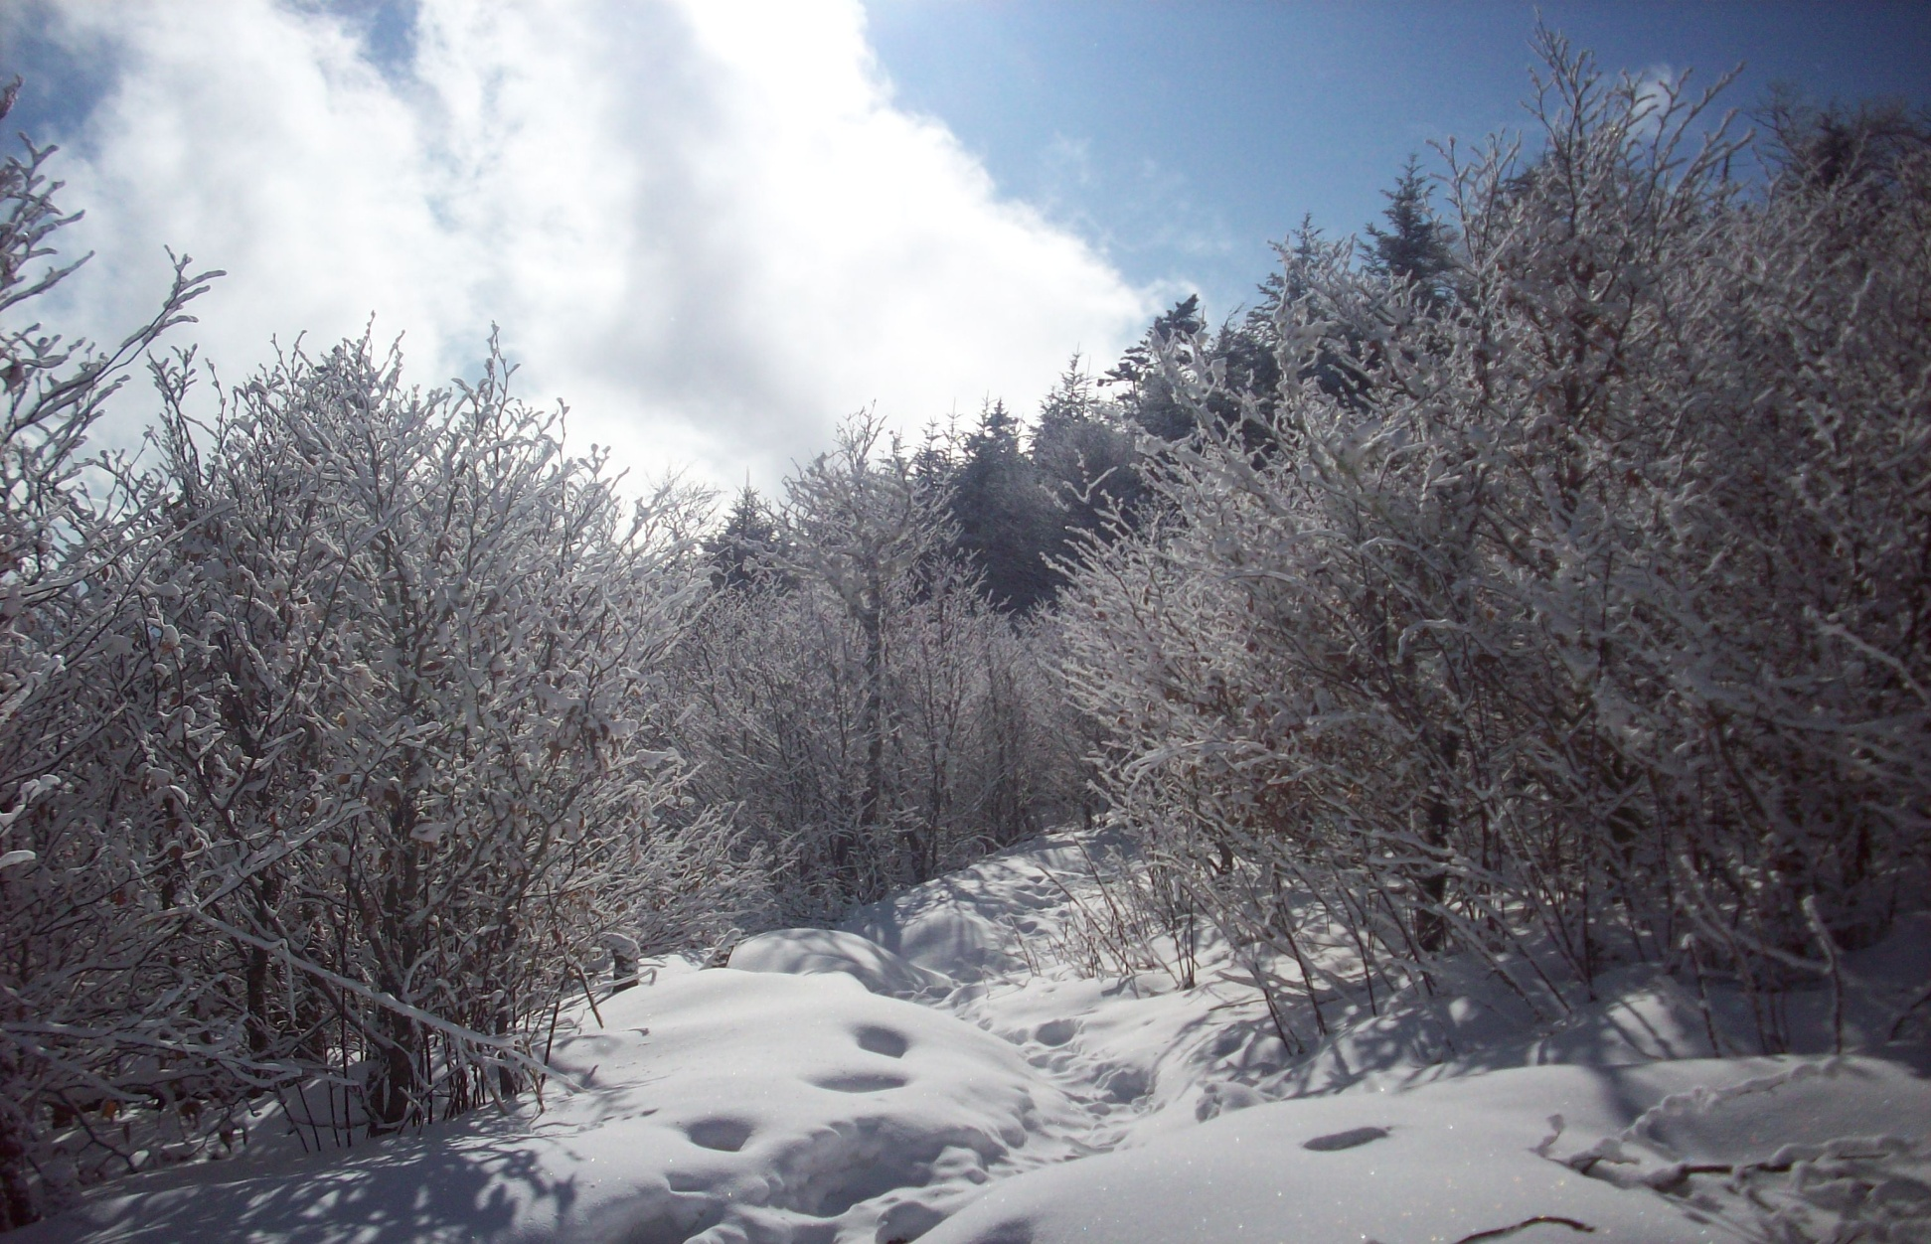
Pick out a tree
Then another tree
Then another tree
Then another tree
Then the top

Slide 12
Reach Forward
My brothers, I do not count myself to have taken possession, but one thing I do, forgetting the things behind and reaching forward to the things before, Phil. 3:13
As they were walking along the road, a man said to Jesus, "I'll follow you wherever you go." Jesus told him, "Foxes have holes, and birds have nests, but the Son of Man has nowhere to sleep." He told another man, "Follow me!" But the man said, "Sir, first let me go to bury my father." But Jesus told him, "Let the dead bury their own dead. You must go everywhere and tell about the kingdom of God." Another said, "I'll follow you, sir, but first let me tell my family goodbye." Jesus said to him, "Whoever starts to plow and looks back is not fit for the kingdom of God." Luke 9:57-62 (GW)

Slide 13
To climb Everest we simply climbed to the next camp. Had we tried to climb the mountain we would have failed.
-- Sir Edmund Hillary

Slide 14
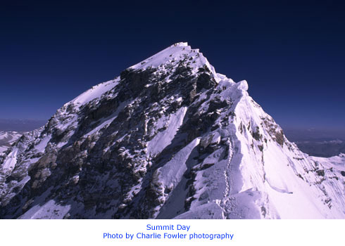

Slide 15
Finally, Never forget that we have a reward!
I press toward the mark for the of the high calling of God in Christ Jesus. Phil. 3:14
For I am already being poured out, and the time of my release is here. I have fought the good fight, I have finished the course, I have kept the faith. Now there is laid up for me the crown of righteousness, which the Lord, the righteous Judge, shall give me at that Day; and not to me only, but also to all those who love His appearing. II Timothy 4:6-8

Slide 16
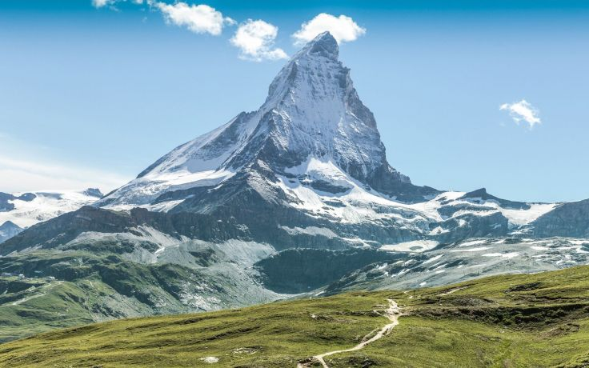

Slide 17
The Matterhorn
4,478 meters high:
Mt. Everest: well over 8,000 meters
Not even the tallest in Switzerland!
Not the most technically difficult in Alps!
However, it was the last mountain in the Alps to be conquered!

