Slide 1
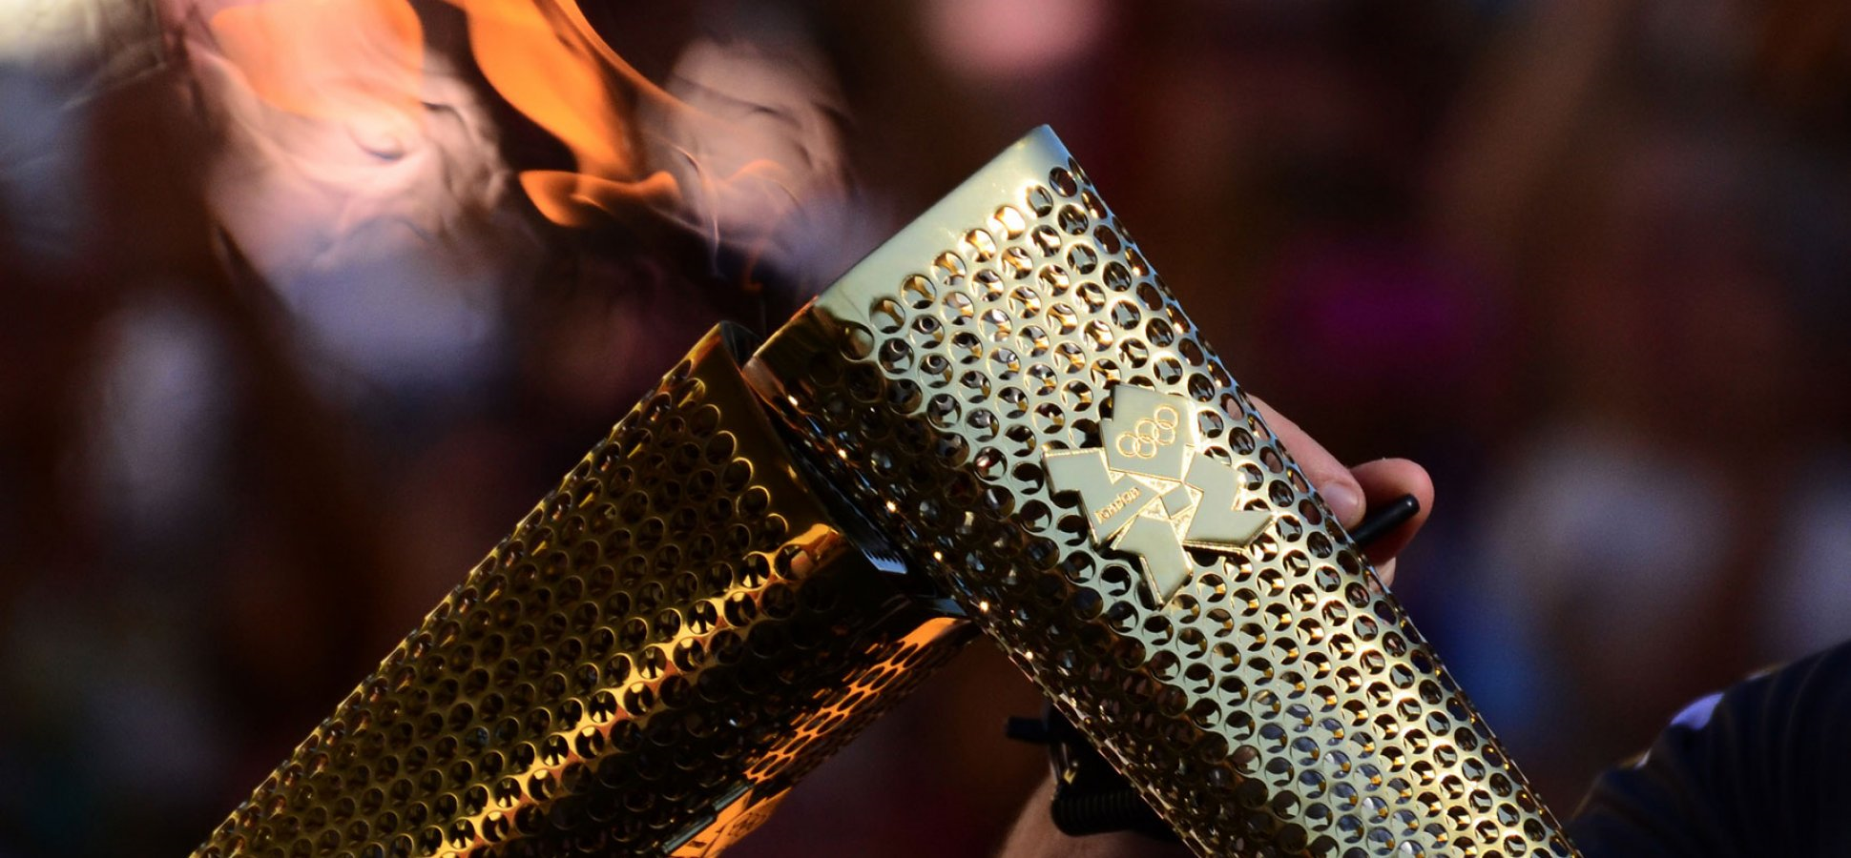
Passing the Torch
Psalms 78:1-8
Notes:
In the 2004 Summer Olympic Games in Athens, Greece, the American women's 4 x 100 relay race was favored to win the gold medal. The team featured Marion Jones, a sprinter who had won four gold medals at the previous games in Sydney. The American team was already off to a strong start when Jones took the baton for the second leg of the race. She gained ground as she ran her 100 meters and approached Lauryn Williams, a young speedster who would run the third leg.
Williams began running as Jones drew near, but when she reached back to receive the baton, they couldn't complete the handoff. Once, twice, three times Jones thrust the baton forward, but each time it missed William's hand—she couldn't seem to wrap her fingers around it. Finally, on the fourth try, they made the connection. But by that time, they had crossed out of the 20-yard exchange zone and were disqualified. Everyone knew they were the fastest team on the track. The night before, they'd had the fastest qualifying time. But when they couldn't complete the handoff, their race was over.
As important as it is for the previous generation to set the pace by living faithfully, at a certain point, a handoff must be made in which the next generation receives the baton of faith and begins to run with it.

Slide 2
Psalms 78:1-4
¹ Give ear, O my people, to my law: incline your ears to the words of my mouth.
² I will open my mouth in a parable: I will utter dark sayings of old:
³ Which we have heard and known, and our fathers have told us.
⁴ We will not hide them from their children, shewing to the generation to come the praises of the Lord, and his strength, and his wonderful works that he hath done.
Notes:
In Psalms 78, we find the Psalmist directing the attention of one generation to another concerning Passing the Torch—Teaching the Younger Generation. Listen to Asaph as he reminds Israel of the importance of God’s goodness and their responsibility to keep alive their knowledge and obedience to the Lord by Passing the Torch to the next generations.

Slide 3
Psalms 78:5-8
⁵ For he established a testimony in Jacob, and appointed a law in Israel, which he commanded our fathers, that they should make them known to their children:
⁶ That the generation to come might know them, even the children which should be born; who should arise and declare them to their children:
⁷ That they might set their hope in God, and not forget the works of God, but keep his commandments:
⁸ And might not be as their fathers, a stubborn and rebellious generation; a generation that set not their heart aright, and whose spirit was not stedfast with God.

Slide 4
Call to Attention
V. 1. Give ear; Incline your ears….What is he saying?
  Listen!
Not just to hear, but to Listen and….
  Obey!
Notes:
In verses 1-2, that we just read, Asaph tells Israel to Give ear and incline your ears! What’s he saying?
Have you ever told your child, “Listen to me!” Are you only wanting them to hear what you are saying? NO! What are you wanting them to do? OBEY!!

Slide 5
Incline Your Ear
Literally means to “stretch your ears to the words of my mouth.”
Listening- active, eager and responsive
Results= learning and obedience
Isaiah 55:3-5 Incline your ear, and come unto me: hear, and your soul shall live…
Notes:
Is. 55:3-5….
Jeremiah 34:14 Lord told Israel through Jeremiah that their fathers didn’t hearken unto him, nor did they incline their ears.
God wants us to do more than hear…he wants us to listen and obey!

Slide 6



Incline Your Ear

Slide 7
Why Should I Listen?
Vs. 2—I will open my mouth in parables.
Matthew 13:34 ¹³ Therefore speak I to them in parables: because they seeing see not; and hearing they hear not, neither do they understand.
Parable: Simple story to illustrate a lesson
Vs. 2—I will utter dark sayings of old (riddles, puzzles)
Notes:
Better be listening…I’m about to tell you something that is important!
Mattilea---Bless her heart….she’s into that stage where she is figuring things out the hard way…We tell her not to touch something and she will anyways. If she would have listened…..OBEYED…she would have been just fine.
¹⁴ And in them is fulfilled the prophecy of Esaias, which saith, By hearing ye shall hear, and shall not understand; and seeing ye shall see, and shall not perceive:
¹⁵ For this people's heart is waxed gross, and their ears are dull of hearing, and their eyes they have closed; lest at any time they should see with their eyes and hear with their ears, and should understand with their heart, and should be converted, and I should heal them.
¹⁶ But blessed are your eyes, for they see: and your ears, for they hear.
¹⁷ For verily I say unto you, That many prophets and righteous men have desired to see those things which ye see, and have not seen them; and to hear those things which ye hear, and have not heard them.

Slide 8
The Parable
History of Israel
  Exodus of Egypt vs. 9-31
    Rebellion
    Forgot what God had done
    God’s wrath upon people
  Continued Rebellion vs. 32-39
    Continually sinned despite His signs
    Sought Him after punished—Sound familiar?
Notes:
The parable---vs. 3—It was one they had already heard and ones that the Fathers were to tell.
So what did Asaph want the people to learn?
He recapped the history of Israel
Forgot what God had done: Parting Red Sea, Led by a pillar of cloud and fire, water from rock, deliverance from Egypt—10 plagues
God’s wrath: bc of their attitude—because of their heart—because of their rejection of His commands—because they wouldn’t listen
In spite of God’s goodness and mercy---they continued to sin.
Psalms 78:34 When he killed some of them, the others would turn back to him.
They would come running back to God.

Slide 9
The Parable
History of Israel
  God Forgotten vs. 40-64
    Forgot about the plagues
    Forgot God’s power over Egypt
    Rejected His own people
  God Keeps His Promises vs. 65-72
    Out of Judah—everyone blessed
    David
    Jesus!
Notes:
God Rejected His own! Are you listening? He wanted them to know that if you do these things, He will reject us!
Jesus said the same….
Matthew 10:33
³³ But whosoever shall deny me before men, him will I also deny before my Father which is in heaven.
That’s the lesson for

Slide 10

The Passing of the Torch
Psalm 78:4 We will not hide them from their children…
  Must not keep back; Refuse to make something known
Notes:
It is our duty as parents to Pass the Torch to our children.
We must not keep what we know concerning our faith and salvation from our kids. We must make it known to them.

Slide 11
Commanded to Teach
Ephesians 6:4
  ⁴ And, ye fathers, provoke not your children to wrath: but bring them up in the nurture and admonition of the Lord.
Deuteronomy 6:1-3
  Now these are the commandments, the statutes, and the judgments, which the Lord your God commanded to teach you, that ye might do them in the land whither ye go to possess it:
  ² That thou mightest fear the Lord thy God, to keep all his statutes and his commandments, which I command thee, thou, and thy son, and thy son's son, all the days of thy life; and that thy days may be prolonged.
  ³ Hear therefore, O Israel, and observe to do it; that it may be well with thee, and that ye may increase mightily, as the Lord God of thy fathers hath promised thee, in the land that floweth with milk and honey.
Notes:
Am I doing this as a parent? Do I talk with my kids about when I became a Christian? Do I dismiss my struggles with them and how Jesus helps me to overcome? Do I let my light shine and demonstrate my love for Christ even when I’m weak? Not just our words, but our actions, also, need to match what I’m telling my kids.

Slide 12
What Am I Passing?
2 Things I Need to Pass on:
  The works of God (What God has done)
    Exodus 13:8-9
    Mighty men and women whom God used
    What has God done for you? Share His impact on your life with them! Tell them about Jesus!
  The word of God (What God has said)
    His law
    His commandments
    His warnings
    His Promises
Notes:
2 Things I need to pass on to my kids—to the next generation:
The works of God
As the Lord was preparing Moses for the 10th Plague, listen to what Moses told the people. Exodus 13:3 Remember this day……..Exodus 13:8-9
⁸ And thou shalt shew thy son in that day, saying, This is done because of that which the Lord did unto me when I came forth out of Egypt.
⁹ And it shall be for a sign unto thee upon thine hand, and for a memorial between thine eyes, that the Lord's law may be in thy mouth: for with a strong hand hath the Lord brought thee out of Egypt.
Deuteronomy 4:9: Only take heed to thyself, and keep thy soul diligently, lest thou forget the things which thine eyes have seen, and lest they depart from thy heart all the days of thy life: but teach them thy sons, and thy sons' sons;
Do I do this enough? Do I pass along anything to my kids at all? Is it my responsibility or is it the church’s responsibility? Why would I keep the works of God from my child?
Its like….leaving your kids a letter that says I have left you a great inheritance. The will is buried in the Smoky Mountains. Best of luck! No parent would deliberately do that…but that’s exactly what we do when we don’t talk to our kids about the Lord.
The word of God
v. 5—make known the words of eternal life
Peter told the Lord—thou hast the words of eternal life in John 6:68---To whom shall we go?
Why was God’s word written?? Romans 15:4⁴ For whatsoever things were written aforetime were written for our learning, that we through patience and comfort of the scriptures might have hope.
It’s profitable! 2 Timothy 3:16-17 ¹⁶ All scripture is given by inspiration of God, and is profitable for doctrine, for reproof, for correction, for instruction in righteousness: ¹⁷ That the man of God may be perfect, thoroughly furnished unto all good works.

Slide 13

To Whom Am I Passing the Torch?
Notes:
My kids…..Short term vision.
We need a long-range vision!!!
Look at vs. 6 again…. ⁶ That the generation to come might know them, even the children which should be born; who should arise and declare them to their children:

Slide 14
What Are the Results?
What are the Results if We Pass on the Right Torch?
  Trust in God
  Remember God’s deeds
  Keep God’s commandments
  Learn from the mistakes of others
Notes:
Passing the Torch: How can something that seems so easy really be so hard??
Why is it so difficult?
An athlete compared the challenge of the baton exchange to two ships passing in the night (but if the ocean were the size of a phone booth),
Maybe….I’m not confident enough in my knowledge of the Bible. Maybe I’m too busy with work, school, or problems? Maybe I don’t feel it’s my place. Let them choose.
So what are the results if I pass on the torch like I should?
Results should be:
Vs. 7---

Slide 15

What Are the Results?
Notes:
What are the Results if We Pass on the Wrong Torch? Or Drop the Torch?
Trust in Self
No Spiritual Growth
Disobedient to God’s commandments—Reject Him
Continue making same mistakes

Slide 16
Pass the Torch!
Children learn faith from people who practice faith. You cannot expect to lead your child any higher in the Christian faith than you are willing to go yourself. So put God first in your life. Demonstrate to your children what it means to trust God in all areas of your life. Model it for them.
Notes:
**1. We must realize that the church is always only one generation away from extinction!! We must PASS THE TORCH!
Conclusion:
Unlike the Olympics, when we drop the baton of life, it can be picked back up. It may be that we may struggle and be weak in the area of Passing the Torch. We need to pick it up and start new! The race before us isn’t finished! The prize if far greater than an Olympic gold medal. The prize is eternal life! If you are a Christian and have fallen short, confess your faults and we will pray for you.
If you aren’t a Christian, become one tonight by believing on Jesus, repenting of your old sinful ways, confessing your faith is Jesus, and by washing away your sins in the burial of baptism and arising to walk in a new life—a Christian life!
If you are subject, Please come!

