Slide 1
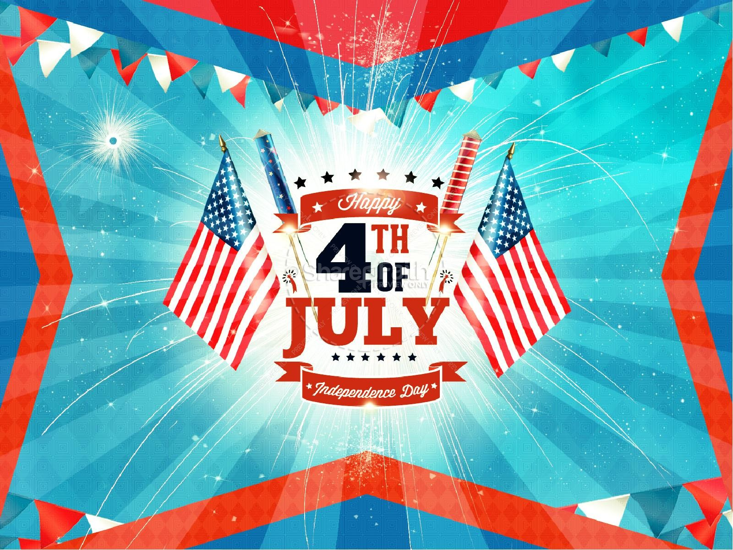

Slide 2
LIBERTY

Slide 3
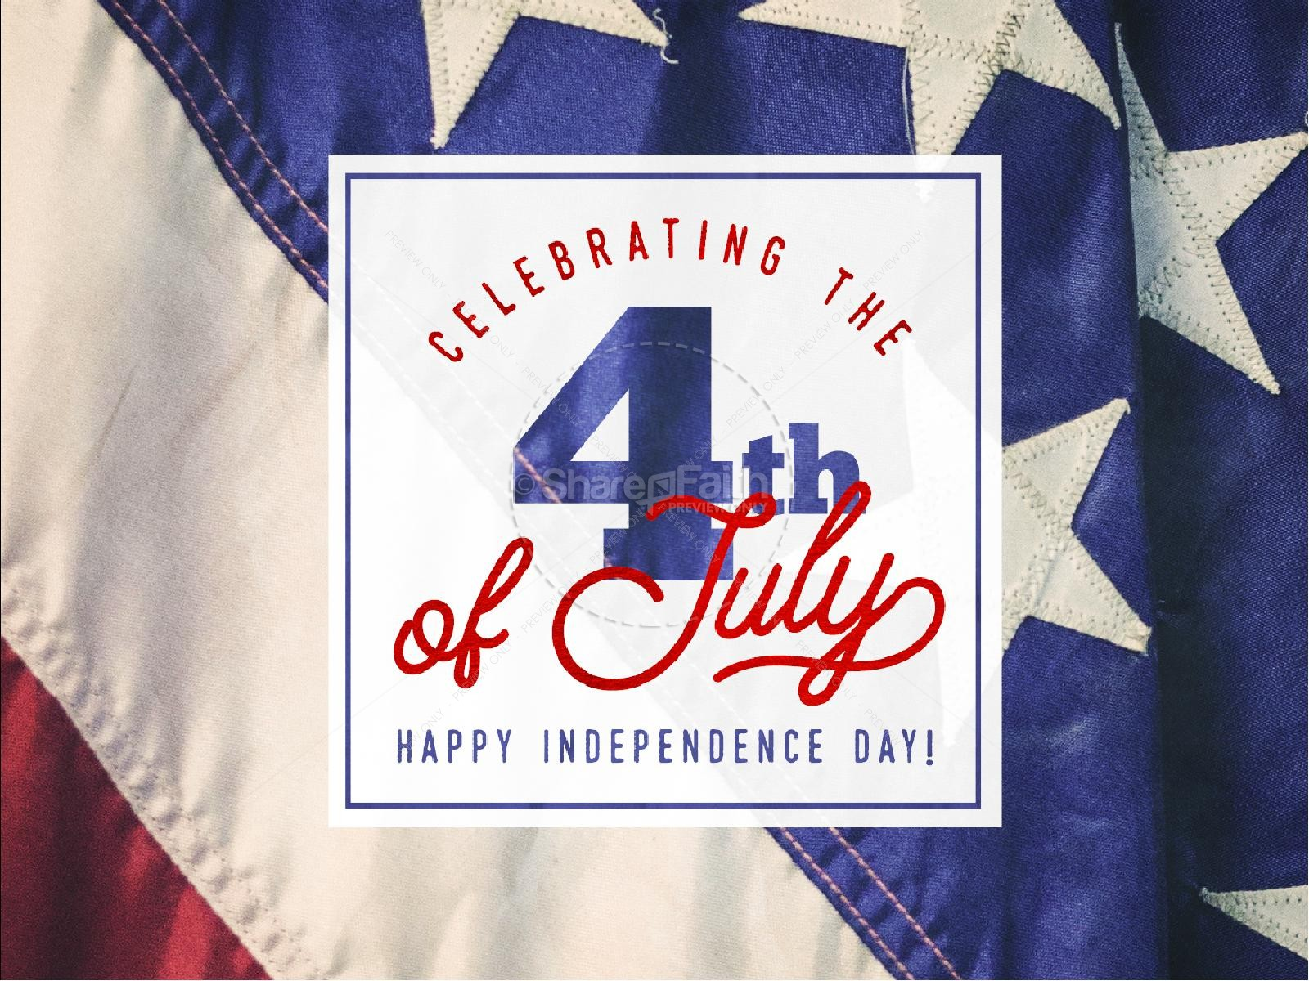

Slide 4
^{James 1: 21} Wherefore lay apart all filthiness and superfluity of naughtiness, and receive with meekness the engrafted word, which is able to save your souls.
²² But be ye doers of the word, and not hearers only, deceiving your own selves.
²³ For if any be a hearer of the word, and not a doer, he is like unto a man beholding his natural face in a glass:
²⁴ For he beholdeth himself, and goeth his way, and straightway forgetteth what manner of man he was.
²⁵ But whoso looketh into the perfect law of liberty, and continueth therein, he being not a forgetful hearer, but a doer of the work, this man shall be blessed in his deed.

Slide 5
For many in the world, “law” is a dirty word, a bad word.
They see law as something that takes away their freedom,
Their liberty to live as they please. But , just for a moment,
try to imagine our world today without law. Chaos would
Reign.. Murder, rape, stealing, would be rampant. No one
Would be safe. Civilization would breakdown. So law is good
For us; it protects us. !

Slide 6
Our Grandson is a Cub Scout:
They have a law
They have an oath

Slide 7
THE SCOUT LAW
A SCOUT IS:
1. Trustworthy 7. Obedient
2. Loyal 8. Cheerful
3. Helpful 9. Thrifty
4. Friendly 10. Brave
5. Courteous 11. Clean
6. Kind 12. and Reverent

Slide 8
THE SCOUT OATH
On my honor, I will do my best, to do my
Duty to God and my country
and to obey The Scout Law
to help other people at all times
to keep myself physically strong,
Mentally awake, and Morally straight.

Slide 9
# 1. It is a LAW
James, in verses 21-24, is discussing the Word, the
Word of God, Scripture.
James calls this a law because it is the authoritative
Body of divine truth which is the basis for the Christian
Faith. It is our rule of action, our standard of conduct.
A Christian’s life is to be regulated today by the gospel,
The New Testament.

Slide 10
Sometimes you hear some people say that we are not
Under law but under Grace.
While it is true we are
Not under the Law of Moses (Eph. 2:15-16)
we are Under law because if we weren’t
there would be no Sin. (I John 3:4)
This law is binding upon all men.
Titus 2:11

Slide 11
1. This law is elsewhere called
“the law of Christ” Gal. 6:2
2. The royal law (James 2:8)
3. “the law of the spirit
Of life. (Romans 8:1-2).

Slide 12
#2 It is Perfect.
The Gospel is complete and whole, lacking nothing.
2 Tim. 3:16-17. The perfect Lawgiver cannot be bettered!
It is without error and perfect for all situations and all
Circumstance.
Psalm 19:7-11.
God’s word has the power to turn sinners to a holy God.
It is sure and steadfast and capable of making us wise. This
Perfect law cannot be improved upon in any way. Any tampering by man will destroy is perfection.

Slide 13
#3 It is the Perfect law of Liberty.

Slide 14
It’s the Law of Liberty.
..It is freedom from the bondage of the Law of Moses.
Gal.5:1 “Stand fast therefore in the liberty by which
Christ has made us free, and do not be entangles again
With the yoke of bondage.
Romans 8:2
The law of Moses was incapable of the justification of
Sinners. (Acts 13:39)

Slide 15
..It is freedom from the bondage of sin. Rom. 6:16-18.
All who are under the tyranny of lust or anger or hate are
Slaves while all who live with the law are truly free.
John 8:34-36

Slide 16
There is Liberty in the Law of Liberty
This liberty is not a license to sin, to
live anyway that one desires.
1. Gal. 5:13
2. I Pet. 2:16
3. Romans 6:1-2.
True liberty is living as we should, not
As we please.
It influences us to serve and obey God not
Out of compulsion, but out of love. Men are truly
Free when they want to do what they ought to do.
2 Cor. 5:10

Slide 17
Conclusion:
Liberty! James tells us that it is in the Perfect
Law of Liberty..in which God wants us to be a ‘doer of
His work”. Thus, we shall be blessed in what we do,
Psalm 19:11.”moreoever by them your servant is
Warned, and in keeping them there is great reward.

Slide 18
John says in John 13:17 “If you know these things, blessed
Are you if you do them.”
Rev. 14:12-13 Here is the patience of the saints; here are
Those who keep the commandments of God and the faith
Of Jesus. Then I heard a voice from heaven saying unto me,
Write, blessed are the dead who die in the Lord from now on.
Yes, says the Spirit, that they may rest from their labors,
And their works follow them.
God makes it clear: “the blessed are singularly favored
By God!”

