Slide 2
Peter

Slide 3

What events do you remember?
Walked on water
Blundered at Mount of Transfiguration
Confessed Jesus
Rebuked by Jesus
Tried to defend Jesus with sword

Slide 4
What events do you remember?
Denied Jesus
“go tell the disciples, and Peter”
“Do you love me?”
Preached first gospel sermon

Slide 5
Lessons
We know Peter to be a strong leader, but before he could become a leader he had to address his FEARS and DOUBTS!

Slide 6
Peter
who struggled with FEAR

Slide 7
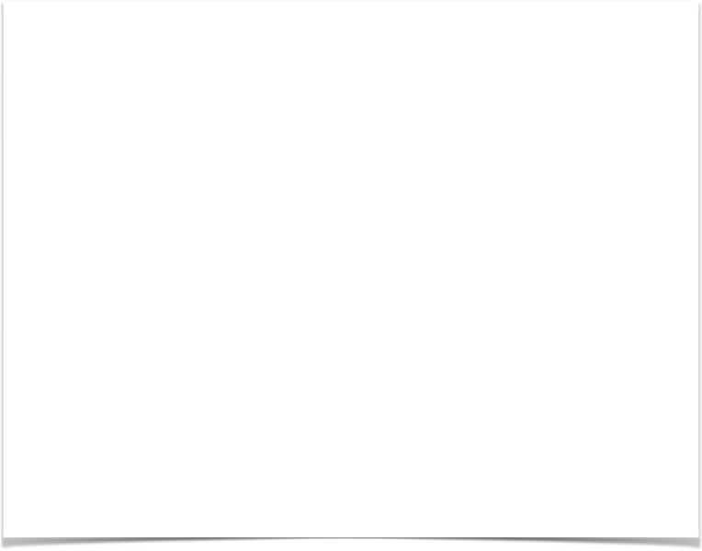
Matthew 14:22-33
What was he afraid of?

Slide 8
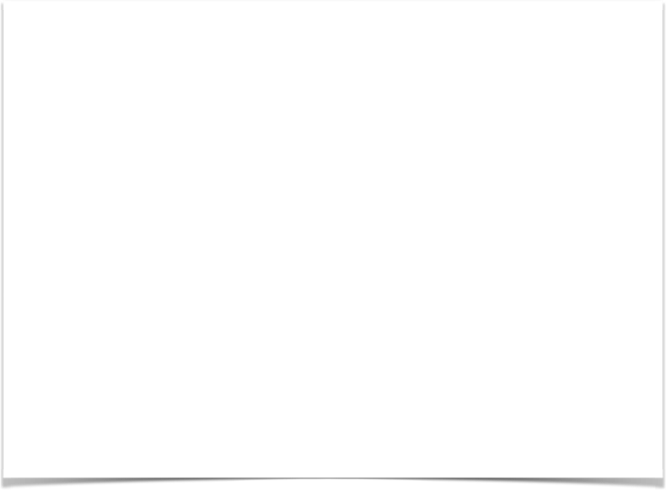
Luke 22:32-34, 54-62
What was he afraid of?

Slide 9
He Forgot
His confession - Matt. 16:16
His promise to defend Jesus to the end.
Matt. 10:22 - You will be hated by all because of My name, but it is the one who has endured to the end who will be saved.
Matt. 10:28 - Do not fear those who kill the body but are unable to kill the soul; but rather fear Him who is able to destroy both soul and body in hell.

Slide 10
He Forgot
Matt. 10:32-33 - “Therefore everyone who confesses Me before men, I will also confess him before My Father who is in heaven. But whoever denies Me before men, I will also deny him before My Father who is in heaven.”

Slide 11
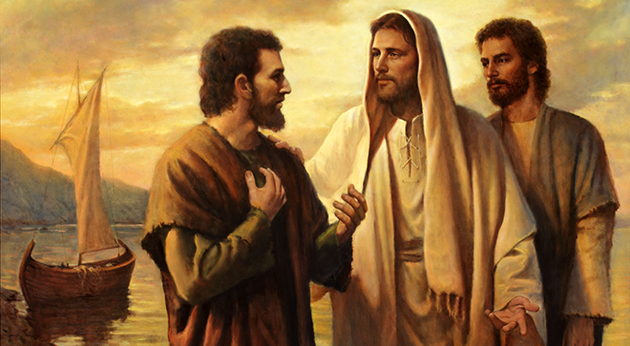
“Do you love me?”
John 21:15-17

Slide 12
But it happened again!
Gal. 2:11-13 - But when Cephas came to Antioch, I opposed him to his face, because he stood condemned. For prior to the coming of certain men from James, he used to eat with the Gentiles; but when they came, he began to withdraw and hold himself aloof, fearing the party of the circumcision. The rest of the Jews joined him in hypocrisy, with the result that even Barnabas was carried away by their hypocrisy.

Slide 13
Lesson:
Our fears challenge us again and again.
And tempt us to behave contrary to our values.
But the Lord restores us when we repent.
So we can start over in our service.
This is the beauty of God’s Love and Grace.

