Slide 1
Philippians: Rejoice in Christ

Slide 2
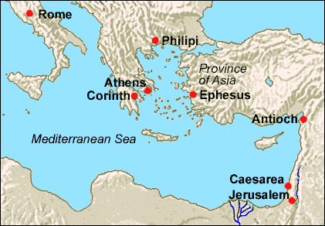

Slide 3
The Setting
Philippians is a letter from Paul to the Christians in Philippi.
Philippi was the leading city in Macedonia.
Paul and his companions established the congregation at Philippi on his second missionary journey. (Acts 16)
This is believed to be the first church on European soil.
The Philippians were very near and dear to Paul’s heart. They had supported him when others wouldn’t and he loved them very much.

Slide 4
The Setting
Paul authored this letter approx. 10 years after his first visit to Philippi.
Paul wrote the letter from Rome during his imprisonment there.
The church at Philippi send a man named Epaphroditus to Rome to visit Paul and take him some gifts.
Paul’s purpose for the letter was to thank them for the gifts and their continued support and to strengthen them by showing them that true Joy comes from Jesus Christ alone.

Slide 5
Happiness vs Joy
What comes to mind when you think of happiness in your life?
Family
House
Job
Money
Cars
Vacations
Hobbies

Slide 6
Happiness vs Joy
Often times we spend a lifetime in pursuit of happiness through these things.
What happens though when family members die, when you lose your job and with it goes your house, cars, vacations, money, and hobbies?
Usually happiness flees and despair if not bitterness sets in.
In contrast to happiness stands joy. Running deeper and stronger, joy is the quiet confident assurance of God’s love and work in our lives.
Happiness depends on happenings but joy depends on Christ!

Slide 7
Chapter 1:
Joy in suffering
Paul is in prison, not because of Roman hatred, but because of the envy and jealousy of other Christians.
Paul Rejoices in his imprisonment because it advanced the cause of Christ.
Paul wasn’t concerned with the motives of other preaching the gospel out of envy and rivalry because Christ was being preached.
Christianity doesn’t have an ego!

Slide 8
Chapter 1:
Joy in suffering
Paul understands he may be executed but considered it gain.
His main priority was to make sure Christ was exalted through his life.
He encourages the Philippians to conduct themselves in a manner worthy of the gospel of Christ no matter what happens to him.

Slide 9
Chapter 2:
Imitating Christ’s humility
Paul encourages the Philippians to be like Christ.
To be selfless, to be humble, and to value others more that self.
He promotes unity as he instructs them to do all things without grumbling or arguing.

Slide 10
Chapter 3: Setting your sights on heaven
He encourages them to use him and other Christians as examples.
He informs them that their citizenship is not of this world but in heaven.
Paul instructs them not to put confidence in flesh.
He says he more than anyone has reason to put confidence in the flesh but now considers all things a loss for the sake of Christ.

