Slide 2
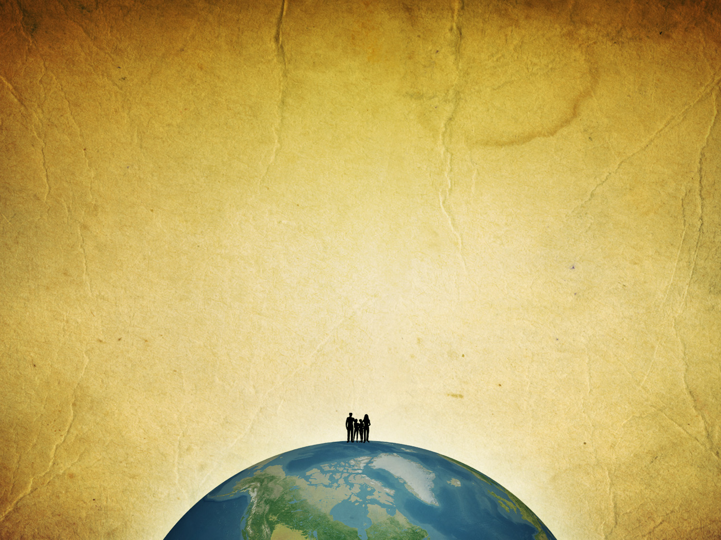
The Power of
Providence
Prayer
Faith

Slide 3
Psalm 104:10-24
10 He sends the springs into the valleys, They flow among the hills. 11 They give drink to every beast of the field; The wild donkeys quench their thirst. 12 By them the birds of the heavens have their home; They sing among the branches. 13 He waters the hills from His upper chambers; The earth is satisfied with the fruit of Your works. 14 He causes the grass to grow for the cattle, And vegetation for the service of man, That he may bring forth food from the earth,

Slide 4
15 And wine that makes glad the heart of man, Oil to make his face shine, And bread which strengthens man's heart. 16 The trees of the LORD are full of sap, The cedars of Lebanon which He planted, 17 Where the birds make their nests; The stork has her home in the fir trees. 18 The high hills are for the wild goats; The cliffs are a refuge for the rock badgers. 19 He appointed the moon for seasons; The sun knows its going down. 20 You make darkness, and it is night, In which all the beasts of the forest creep about.

Slide 5
21 The young lions roar after their prey, And seek their food from God. 22 When the sun rises, they gather together And lie down in their dens. 23 Man goes out to his work And to his labor until the evening. 24 O LORD, how manifold are Your works! In wisdom You have made them all. The earth is full of Your possessions-

Slide 6
General Providence
those things set in motion by the
laws of nature which God superintends
Special Providence
those things that God does
in the world for a specific purpose

Slide 7
General Providence
those things set in motion by the
laws of nature which God superintends
Psalm 104; Ecclesiastes 9:11; Matthew 10:29-31

Slide 8
Special Providence
those things that God does
in the world for a specific purpose
Daniel 4:17

Slide 9
'This decision is by the decree of the watchers, and the sentence by the word of the holy ones, in order that the living may know that the Most High rules in the kingdom of men, gives it to whomever He will, and sets over it the lowest of men.‘
Daniel 4:17

Slide 10
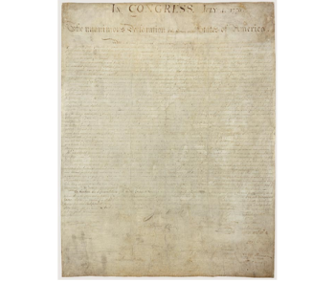
…that all men are created equal, that they are endowed by their Creator with certain unalienable rights, that among these are Life, Liberty and the Pursuit of Happiness– that to secure these rights, Governments are instituted among men, deriving their just powers from the consent of the goverened…
Declaration of Independence

Slide 11
Special Providence
those things that God does
in the world for a specific purpose
Acts 2:22-23

Slide 12
"Men of Israel, hear these words: Jesus of Nazareth, a Man attested by God to you by miracles, wonders, and signs which God did through Him in your midst, as you yourselves also know-- 23 "Him, being delivered by the determined purpose and foreknowledge of God, you have taken by lawless hands, have crucified, and put to death;
Acts 2:22-23

Slide 13
General providence and
Special providence
look the same

Slide 14
So…
what is my answer
to providence?
Eccl. 8:16-17

Slide 15
16 When I applied my heart to know wisdom and to see the business that is done on earth, even though one sees no sleep day or night, 17 then I saw all the work of God, that a man cannot find out the work that is done under the sun. For though a man labors to discover it, yet he will not find it; moreover, though a wise man attempts to know it, he will not be able to find it.
Ecc. 8:16-17

Slide 16
14 "For if you remain completely silent at this time, relief and deliverance will arise for the Jews from another place, but you and your father's house will perish. Yet who knows whether you have come to the kingdom for such a time as this?“
Esther 4:14

Slide 17
15 For perhaps he departed for a while for this purpose, that you might receive him forever,
Philemon 15

Slide 18
PRAYER
“pray without ceasing”
1 Thessalonians 5:17

Slide 19
2 Kings 20:1-6
1 In those days Hezekiah was sick and near death. And Isaiah the prophet, the son of Amoz, went to him and said to him, "Thus says the LORD: 'Set your house in order, for you shall die, and not live.'" 2 Then he turned his face toward the wall, and prayed to the LORD, saying, 3 "Remember now, O LORD, I pray, how I have walked before You in truth and with a loyal heart, and have done what was good in Your sight." And Hezekiah wept bitterly.

Slide 20
4 And it happened, before Isaiah had gone out into the middle court, that the word of the LORD came to him, saying, 5 "Return and tell Hezekiah the leader of My people, 'Thus says the LORD, the God of David your father: "I have heard your prayer, I have seen your tears; surely I will heal you. On the third day you shall go up to the house of the LORD. 6 "And I will add to your days fifteen years. I will deliver you and this city from the hand of the king of Assyria; and I will defend this city for My own sake, and for the sake of My servant David."'"

Slide 21
Then He spoke a parable to them, that men always ought to pray and not lose heart, 2 saying: "There was in a certain city a judge who did not fear God nor regard man. 3 "Now there was a widow in that city; and she came to him, saying, 'Get justice for me from my adversary.' 4 "And he would not for a while; but afterward he said within himself, 'Though I do not fear God nor regard man, 5 'yet because this widow troubles me I will avenge her, lest by her continual coming she weary me.'" 6 Then the Lord said, "Hear what the unjust judge said. 7 "And shall God not avenge His own elect who cry out day and night to Him, though He bears long with them?
Luke 18:1-7

Slide 22
"I tell you that He will avenge them speedily. Nevertheless, when the Son of Man comes, will He really find faith on the earth?"
Luke 18:8

