Slide 1
Prayer and Providence
Rom.8:31-39

Slide 2

Prayer and Providence
Oneal church of Christ, Athens, Ala. Feb. 19, 2017

Slide 3
Romans 8:31-39
³¹ What shall we then say to these things? If God be for us, who can be against us?
³² He that spared not his own Son, but delivered him up for us all, how shall he not with him also freely give us all things?
³³ Who shall lay any thing to the charge of God's elect? It is God that justifieth.

Slide 4
³⁴ Who is he that condemneth? It is Christ that died, yea rather, that is risen again, who is even at the right hand of God, who also maketh intercession for us.
³⁵ Who shall separate us from the love of Christ? shall tribulation, or distress, or persecution, or famine, or nakedness, or peril, or sword?
³⁶ As it is written, For thy sake we are killed all the day long; we are accounted as sheep for the slaughter.
³⁷ Nay, in all these things we are more than conquerors through him that loved us

Slide 5
³⁸ For I am persuaded, that neither death, nor life, nor angels, nor principalities, nor powers, nor things present, nor things to come,
³⁹ Nor height, nor depth, nor any other creature, shall be able to separate us from the love of God, which is in Christ Jesus our Lord

Slide 6
Some Things that are Universally Applicable

Slide 7
Gen. 8:22
²² While the earth remaineth,
seedtime and harvest,
and cold and heat,
and summer and winter,
and day and night shall not cease.

Slide 8
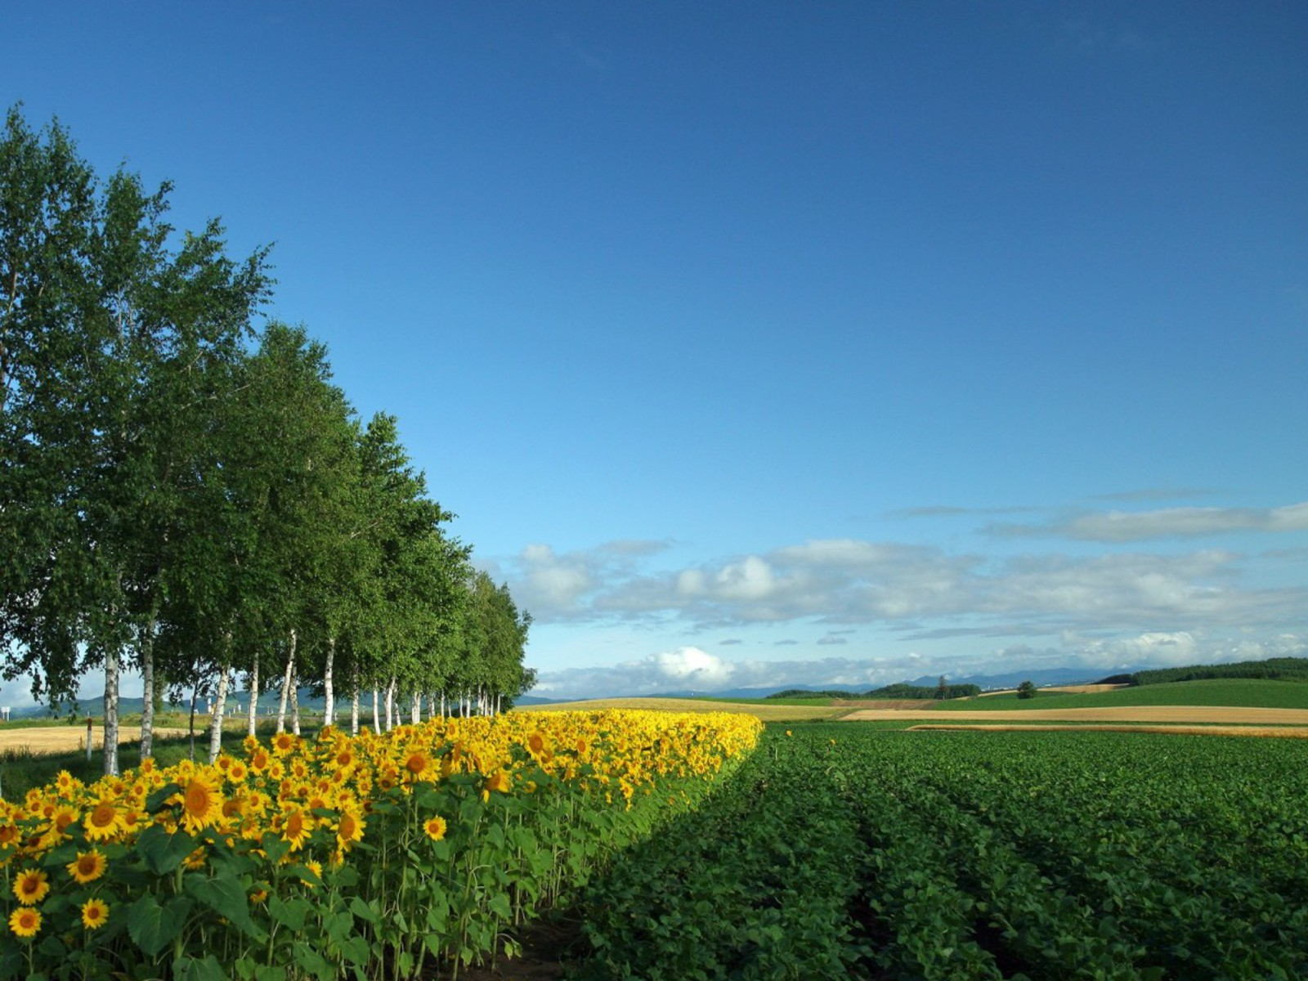
While the earth remaineth; seedtime and harvest,
And cold and heat, and summer and winter,
And day and night shall not cease” Gen. 8:22
A beautiful picture of the earth

Slide 9
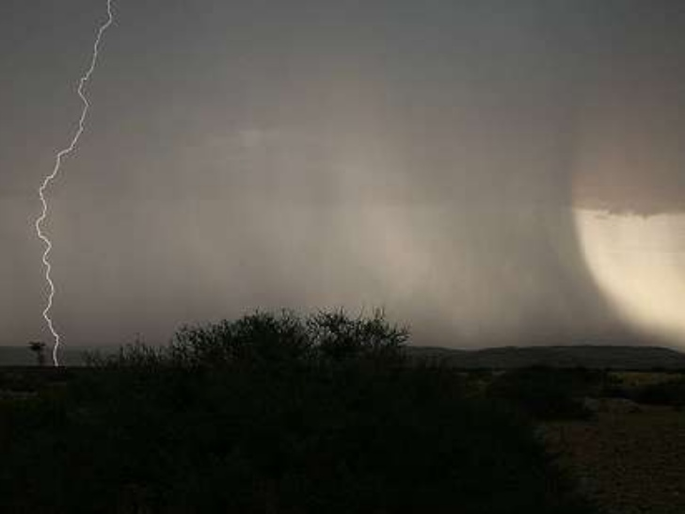

Slide 10
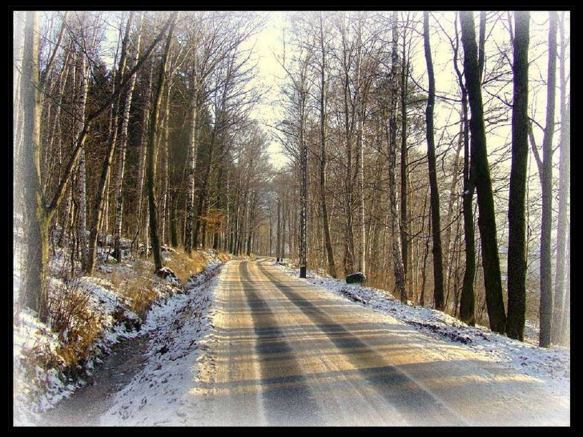

Slide 11
What Is prayer?
“ a solemn request for help or expression of thanks addressed to God”
"a religious service, especially a regular one, at which people gather in order to pray together:
an earnest hope or wish:

Slide 12
Much is said in the Bible about Prayer
Daniel, a man of prayer. Daniel 6:10
Hannah's Prayer for a child. I Sam.1:11-18
Solomon's Prayer for Wisdom I Kings 3:5-15
Jonah's Prayer: Out of the Depths Jonah 2:1ff
Jesus' Prayer for Unity ..John 17:20-21

Slide 13
Some things happen to all of us, whether good or evil

Slide 14
^{Matt. 5:43-48} Ye have heard that it hath been said, Thou shalt love thy neighbour, and hate thine enemy.
⁴⁴ But I say unto you, Love your enemies, bless them that curse you, do good to them that hate you, and pray for them which despitefully use you, and persecute you;
⁴⁵ That ye may be the children of your Father which is in heaven: for he maketh his sun to rise on the evil and on the good, and sendeth rain on the just and on the unjust.
⁴⁶ For if ye love them which love you, what reward have ye? do not even the publicans the same?
⁴⁷ And if ye salute your brethren only, what do ye more than others? do not even the publicans so?
⁴⁸ Be ye therefore perfect, even as your Father which is in heaven is perfect.

Slide 15
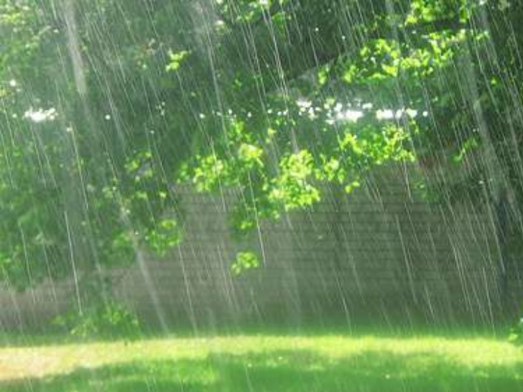

Slide 16
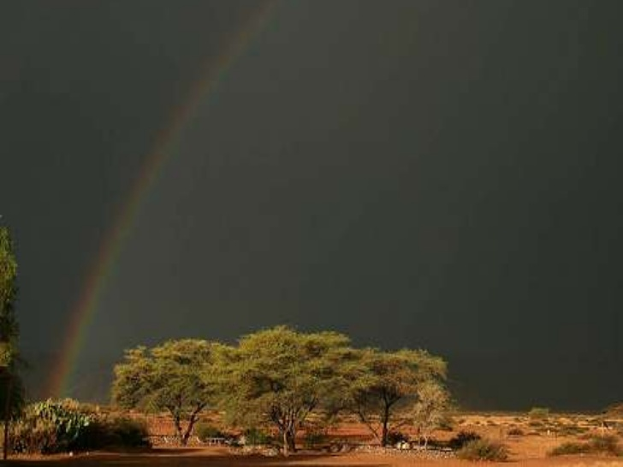

Slide 17
What is Providence?
"Providence is the working of God through His provision in the natural and spiritual realms, and yet it is a control that violates neither the sovereignty of the human will nor the divine natural and spiritual laws" (Homer Hailey).
The word "providence" is defined in the dictionary as
"the care or benevolent guidance of God."

Slide 18
God created a universe that He could control for His own purpose. God's control cannot be denied,
"For by Him all things were created that are in heaven and that are on earth, visible and invisible, whether thrones or dominions or principalities or powers. All things were created through Him and for Him. And He is before all things, and in Him all things consist" (Colossians 1:16-17).

Slide 19


Slide 20
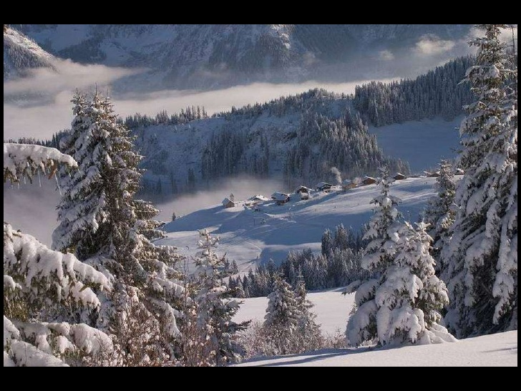

Slide 21
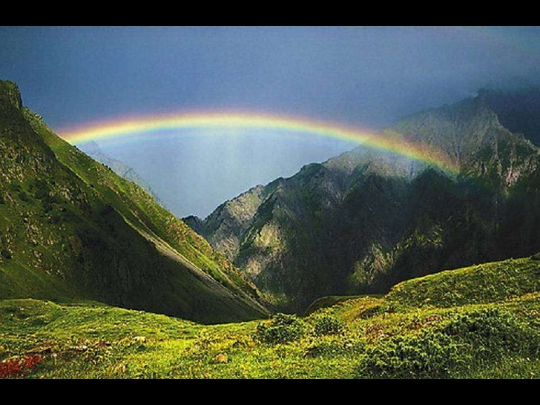

Slide 22
Our need
The need for prayer and
To truly believe in the
Providence of God.

Slide 23
Man’s anxieties
a feeling of worry, nervousness, or unease, typically about an imminent event or something with an uncertain outcome:

Slide 24
Anxiety:
about our children
about our grandchildren
about our spouses
about our jobs
about our country
about our social security checks
about our physical stature
about our health

Slide 25
About our age
About our hearing,sight,our walking,
About weather/rainy,cloudy,snowing,storms/sunny
About our clothes
About our marriages
About our homes
About our country

Slide 26
Ps. 37:25
• “I have been young, and now am old; yet have I not seen the righteous forsaken, nor his seed begging bread.”
• God provided generously for his people
“your Father knoweth what things you need”…Matt. 6:31-33

Slide 27
• In the Sermon On The Mount, Jesus talked of God’s care for the bird’s and the lilies of the field •
Matt. 6: ²⁶ Behold the fowls of the air: for they sow not, neither do they reap, nor gather into barns; yet your heavenly Father feedeth them. Are ye not much better than they?
. Matthew 6:28-29²⁸ And why take ye thought for raiment? Consider the lilies of the field, how they grow; they toil not, neither do they spin:²⁹ And yet I say unto you, That even Solomon in all his glory was not arrayed like one of these.
Jesus also spoke of God’s care for those who seek first the kingdom of God (Matt.6:33: ) “Does Jesus Care?”
• Jesus was talking about the providential care of God

Slide 28
It is not easy to understand how God does what he does but does one really need to know how God does something in order for it to be accepted and believed?
. God may be invisible to us, but He certainly is not inactive. He has not ceased to provide for that which He has created.

Slide 29
• It is God’s provision for what he has made
• “God’s providence, hardly understood by the wisest man, is able to accomplish things which are beyond human comprehension and power.” Bob Winton

Slide 30
General Providence is a blessing for all of mankind:
• God has provided marriage and the home &
the wicked enjoy this blessing as well as the righteous •
Gen. 2:18 • “And the LORD God said, It is not good that the man
should be alone; I will make him an help meet for him.”
•. Civil government is provided by God
•Rom.13:1-2 Let every soul be subject unto the higher powers. For there is no power but of God: the powers that be are ordained of God. Whosoever therefore resisteth the power, resisteth the ordinance of God: and they that resist shall receive to themselves damnation.
• God enables man to make money •
Ecclesiastes 9:11 “but time and chance happeneth
to them all.”

Slide 31
Special Providence for God’s Children>>
• The main purpose for special providence is for man’s spiritual well being • God may allow financial hardship, illness, and other physical trials that are for our spiritual benefit or to fulfill
His Will. Ill. Job
Man’s cooperation is required! •
The promise of God’s care does not mean that we do nothing •
We must both pray and work for our food
Mt. 6:11 Give us this day our daily bread.
2 Th. 3:10 For even when we were with you,
this we commanded you, that if any would not work, neither should he eat.

Slide 32
•
We must work out our own salvation with God help
Phil. 2:12-13
• Wherefore, my beloved, as ye have always obeyed, not as in my presence only, but now much more in my absence, work out your own salvation with fear and trembling. For it is God which worketh in you both to will and to do of his good pleasure.
1 Pet. 3:10-12
• For he that will love life, and see good days, let him refrain his tongue from evil, and his lips that they speak no guile: Let him eschew evil, and do good; let him seek peace, and ensue it.

Slide 33
Mordecai
Mordecai would not affirm God's providence in making Esther queen of Persia, rather he said, "Yet, who knows whether you have come to the kingdom for such a time as this?" (Esther 4:14).

Slide 34
Paul about Onesimus:
Paul did not know that the escape and ultimate conversion of Onesimus was caused by the hand of God. He wrote,
"For perhaps he departed for a while for this purpose, that you might receive him forever, no longer as a slave but more than a slave, as a beloved brother"
(Philemon 15, 16).

Slide 35
Joseph:
When did Joseph know that God had a hand in the things that happened in his life? It was years later, after being reconciled to his brothers that Joseph said, "So now it was not you who sent me here, but God; and He ... has made me Lord of Egypt" (Genesis 45:8-9).
He even understood that God's providence in his life was not for him alone.
"But as for me, you meant evil against me; but God meant it for good, in order to bring it about as it is this day to save many people alive" (Genesis 50:20).

Slide 36
People need to recognize their inability to know when and how God directs the affairs of this world.
Just accept the fact that He does, even if one never knows HOW He does it.
"For I considered all this in my heart, so that I could declare it all; that the righteous and the wise and their works are in the hand of God" (Ecclesiastes 9:1).

Slide 37
Pray and trust God to work out for
You through His Providence what is
Best for you!
Jerm. 29:11)
^{11 ”} For I know the plans I have for you,” declares the Lord, “plans to prosper you and not to harm you, plans to give you hope and a future.

Slide 38
Remember Paul asked:
Romans 8:34-39

Slide 39
³⁴ Who is he that condemneth? It is Christ that died, yea rather, that is risen again, who is even at the right hand of God, who also maketh intercession for us.
³⁵ Who shall separate us from the love of Christ? shall tribulation, or distress, or persecution, or famine, or nakedness, or peril, or sword?
³⁶ As it is written, For thy sake we are killed all the day long; we are accounted as sheep for the slaughter.
³⁷ Nay, in all these things we are more than conquerors through him that loved us

Slide 40
^{His Answer: NOTHING}
³⁸ For I am persuaded, that neither death, nor life, nor angels, nor principalities, nor powers, nor things present, nor things to come,
³⁹ Nor height, nor depth, nor any other creature, shall be able to separate us from the love of God, which is in Christ Jesus our Lord

Slide 41
Romans 8:26-30²⁶ Likewise the Spirit also helpeth our infirmities: for we know not what we should pray for as we ought: but the Spirit itself maketh intercession for us with groanings which cannot be uttered.
²⁷ And he that searcheth the hearts knoweth what is the mind of the Spirit, because he maketh intercession for the saints according to the will of God.
²⁸ And we know that all things work together for good to them that love God, to them who are the called according to his purpose

Slide 42
Demolition of the Madison Square Mall

