Slide 2
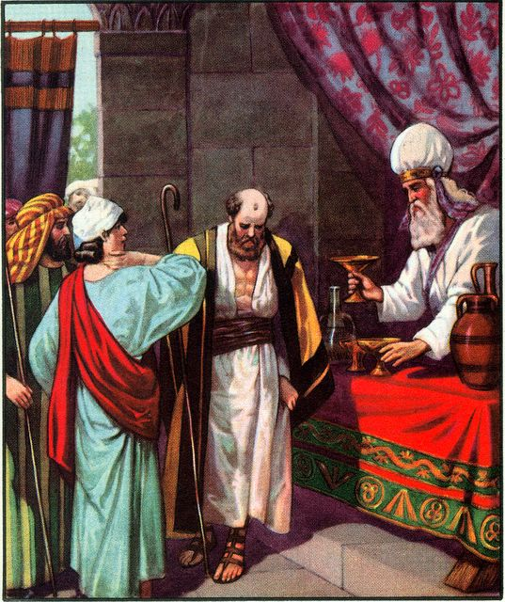
PROMISE KEEPERS
SHARED
STRANGE
SAVES
JEREMIAH 35

