Slide 1
Psalm 23

Slide 2
Psalm 23 (NKJV)
1 The Lord is my shepherd; I shall not want.
2 He makes me to lie down in green pastures; He leads me beside the still waters.
3 He restores my soul; He leads me in the paths of righteousness For His name’s sake.
4 Yea, though I walk through the valley of the shadow of death, I will fear no evil; For You are with me; Your rod and Your staff, they comfort me.
5 You prepare a table before me in the presence of my enemies; You anoint my head with oil; My cup runs over.
6 Surely goodness and mercy shall follow me All the days of my life; And I will dwell in the house of the Lord Forever.

Slide 3
Sheep recognize that they need the shepherd.
Psalm 23:1-3 (NKJV)
1 The Lord is my shepherd; I shall not want.
2 He makes me to lie down in green pastures; He leads me beside the still waters.
3 He restores my soul; He leads me in the paths of righteousness For His name’s sake.
Philippians 4:13
13 I can do all things through Christ who strengthens me.

Slide 4
Sheep recognize that they need the shepherd.
John 10:3
3 To him the doorkeeper opens, and the sheep hear his voice; and he calls his own sheep by name and leads them out
John 10:14
I am the good shepherd; and I know My sheep, and am known by My own.

Slide 5
The shepherd provides for the sheep
Psalm 23:4
4 Yea, though I walk through the valley of the shadow of death, I will fear no evil; For You are with me; Your rod and Your staff, they comfort me.
The shepherd provides protection and guidance in the field with his rod and staff

Slide 6
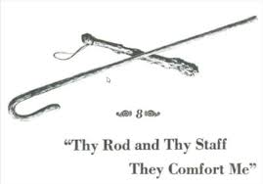

Slide 7
The shepherd provides for the sheep
John 10:1-2 (NKJV)
10 “Most assuredly, I say to you, he who does not enter the sheepfold by the door, but climbs up some other way, the same is a thief and a robber. 2 But he who enters by the door is the shepherd of the sheep.
And at night: in the sheepfold

Slide 8
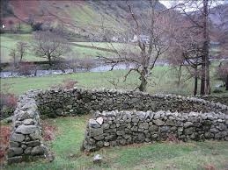

Slide 9
The shepherd provides for the sheep
John 10:9
9 I am the door. If anyone enters by Me, he will be saved, and will go in and out and find pasture.

Slide 10
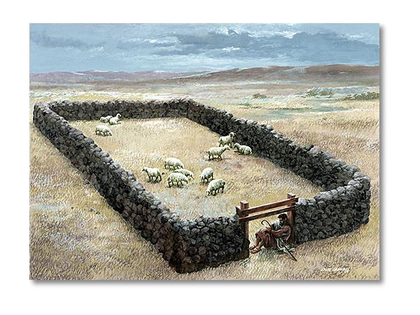

Slide 11
The shepherd provides for the sheep
John 10:11
11 “I am the good shepherd. The good shepherd gives His life for the sheep.

Slide 12
Jesus is the true shepherd
Psalm 23:1
The Lord is my shepherd, I shall not want.
John 10:4-5
4 And when he brings out his own sheep, he goes before them; and the sheep follow him, for they know his voice. 5 Yet they will by no means follow a stranger, but will flee from him, for they do not know the voice of strangers.”

Slide 13
Jesus is the true shepherd
John Nosker
Ephesians 4:13-15 (NKJV)
13 till we all come to the unity of the faith and of the knowledge of the Son of God, to a perfect man, to the measure of the stature of the fullness of Christ; 14 that we should no longer be children, tossed to and fro and carried about with every wind of doctrine, by the trickery of men, in the cunning craftiness of deceitful plotting, 15 but, speaking the truth in love, may grow up in all things into Him who is the head—Christ—

Slide 14
Jesus is the true shepherd
John 10:11-13
11 “I am the good shepherd. The good shepherd gives His life for the sheep. 12 But a hireling, he who is not the shepherd, one who does not own the sheep, sees the wolf coming and leaves the sheep and flees; and the wolf catches the sheep and scatters them. 13 The hireling flees because he is a hireling and does not care about the sheep.
John 10:16
16 And other sheep I have which are not of this fold; them also I must bring, and they will hear My voice; and there will be one flock and one shepherd.

