Slide 1

PSALM 84
I Love To Worship!

Slide 2
Psalm 84:1-4
O
15
“How lovely is your dwelling place, LORD Almighty! My soul yearns, even faints, for the courts of the LORD; my heart and my flesh cry out for the living God. Even the sparrow has found a home, and the swallow a nest for herself, where she may have her young— a place near your altar, LORD Almighty, my King and my God. Blessed are those who dwell in your house; they are ever praising you.”

Slide 3
“a place near your altar, LORD Almighty, my King and my God.”
The psalmist would have only had the opportunity to assemble in the temple courts 3 times a year.
He looked forward to worship!
Deuteronomy 16:16 “Three times a year all your men must appear before the Lord your God at the place he will choose: at the Festival of Unleavened Bread, the Festival of Weeks and the Festival of Tabernacles. No one should appear before the Lord empty-handed:”
S
22

Slide 4
“a place near your altar, LORD Almighty, my King and my God.”
David felt the same way...
Similarly today, genuine worshipers of God long to spend time in the worship assembly.
Psalm 122:1 “I rejoiced with those who said to me, “Let us go to the house of the Lord.””
S
4

Slide 5
“a place near your altar, LORD Almighty, my King and my God.”
We should have (or should want to have) the excitement the Psalmist has.
We should say:
“I get to be in the presence of my Creator!”
“I get to be with other Christians!”
“I get to sing songs of praise to God!”
“I get to hear the Word of God!”
“I get to speak to God thru Christ in prayer!”
“I get to remember the Lord’s death for my sins!”
“I get to give back from what He has given me!”
S
16

Slide 6
“a place near your altar, LORD Almighty, my King and my God.”
What worries you…
Sickness
Work problems or unemployment
Marital problems
Problems with parents or children
Problems with friends or peers
The Psalmist says when he is in the presence of God, when he is worshiping God, when he is focused on God, he is like that bird, without a care in the world. We don’t have to worry about life anymore. We can find strength in God!
L
19

Slide 7
Psalm 84:5-7
T
6
“Blessed are those whose strength is in you, whose hearts are set on pilgrimage. As they pass through the Valley of Baka, they make it a place of springs; the autumn rains also cover it with pools. They go from strength to strength, till each appears before God in Zion.”

Slide 8
“Blessed are those whose strength is in you, whose hearts are set on pilgrimage.”
The Ethiopian eunuch…
G
7

Slide 9
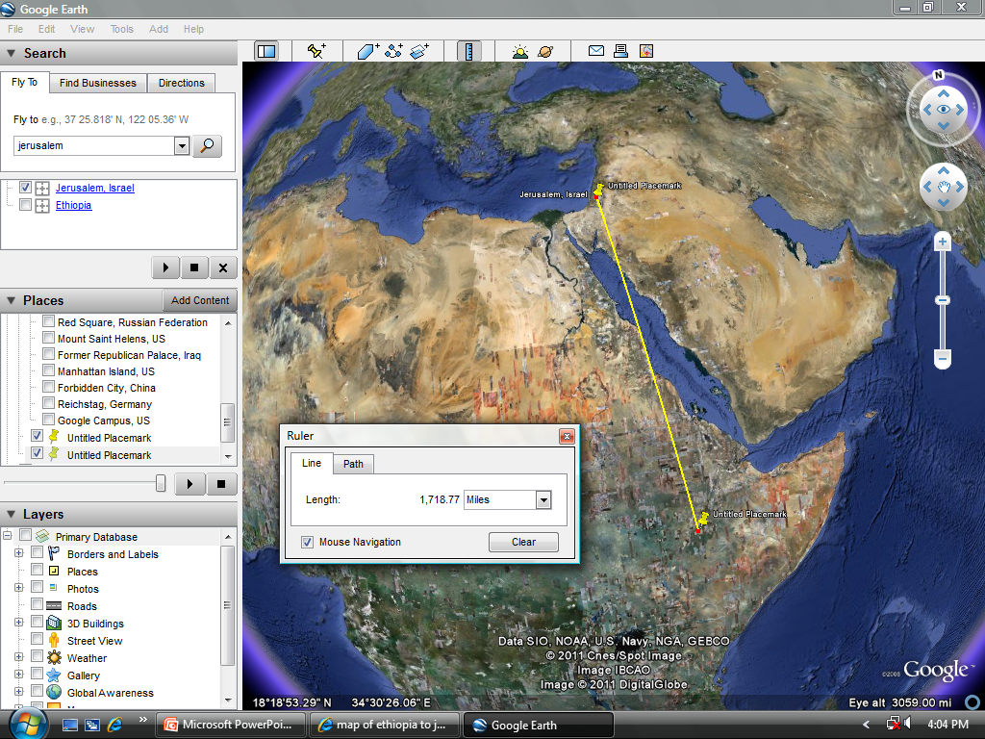

Slide 10
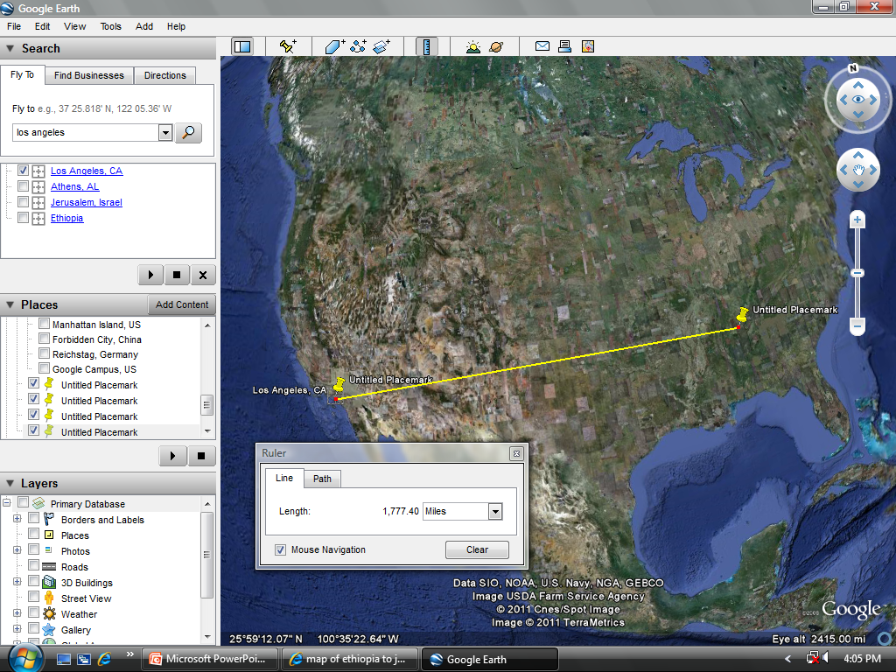

Slide 11
Blessed are those whose strength is in you, whose hearts are set on pilgrimage.
The eunuch lived in the time of the new testament, but was still following under the old law.
He was travelling 1700+ miles just to sit OUTSIDE the assembly of God’s people. It meant that much to him!
Why?!
Deuteronomy 23:1 No one who has been emasculated by crushing or cutting may enter the assembly of the Lord.
E
13
E
10

Slide 12
“They go from strength to strength, till each appears before God in Zion.”
What do you do to get satisfaction and pleasure in life? Hunting? Fishing? Shopping? Golf? Spending time with your family? Reading a good book? Yard sales? Video games? Sports? Outdoor activities? Gardening? Some other hobby?
Some people chase after these things.
D
12
Matthew 6:33 “But seek first his kingdom and his righteousness, and all these things will be given to you as well.”

Slide 13
“They go from strength to strength, till each appears before God in Zion.”
G
8
Do not chase after things that are temporary; chase after God wholeheartedly.
In other words, blessed is the man who gets his fulfillment and gets rejuvenated when he worships God.
Blessed is the man who is gratified and satisfied by God rather than by something else.
Blessed is the man whose highlight of the week is when he gets to worship God.
What does the Psalmist know…

Slide 14
“They go from strength to strength, till each appears before God in Zion.”
N
20
Till each appears before God.
If Heaven is the destination…
Consider worship services as rest stops!
The road of life is hard. Why do many Christians quit the journey. They fail to find the rest stops.
The Psalmist understood the journey and prayed…
2 Corinthians 5:10 “For we must all appear before the judgment seat of Christ, so that each of us may receive what is due us for the things done while in the body, whether good or bad.”

Slide 15
Psalm 84:8-9
“Hear my prayer, Lord God Almighty; listen to me, God of Jacob. Look on our shield, O God; look with favor on your anointed one.”
G
14

Slide 16
“Hear my prayer, Lord God Almighty”
G
21
Hear me. Shield me. Favor me.
1 Peter 5:8 Be alert and of sober mind. Your enemy the devil prowls around like a roaring lion looking for someone to devour.
Ephesians 6:16 In addition to all this, take up the shield of faith, with which you can extinguish all the flaming arrows of the evil one.
2 Corinthians 2:11 in order that Satan might not outwit us. For we are not unaware of his schemes.

Slide 17
“Hear my prayer, Lord God Almighty”
A
18
The Christian life is full of traps. With God as our shield, not one of us will be lost. Sure, we may trip and fall. We may get wounded. But Satan cannot stop God from saving you!
John 6:38 For I have come down from heaven not to do my will but to do the will of him who sent me. 39 And this is the will of him who sent me, that I shall lose none of all those he has given me, but raise them up at the last day. 40 For my Father’s will is that everyone who looks to the Son and believes in him shall have eternal life, and I will raise them up at the last day.”

Slide 18
Psalm 84:10-12
B
17
“Better is one day in your courts than a thousand elsewhere; I would rather be a doorkeeper in the house of my God than dwell in the tents of the wicked. For the LORD God is a sun and shield; the LORD bestows favor and honor; no good thing does he withhold from those whose walk is blameless. LORD Almighty, blessed is the one who trusts in you.”

Slide 19
What is your dream vacation?
The Psalmist says one day worshiping in God’s house is better than a thousand days anywhere else!
That is how great church can be!
If the writer of this Psalm lived today and had a bumper sticker on his car, it would say, “I’d rather be in church.”
When worship is the way God wants it to be, church is the best possible place to be.
No other place can offer what God can give us.
R
11

Slide 20
“I would rather be a doorkeeper in the house of my God than dwell in the tents of the wicked”
Mark 8:36-37 “What good is it for someone to gain the whole world, yet forfeit their soul? Or what can anyone give in exchange for their soul?”
S
9
Psalm 73:25 “Whom have I in heaven but you? And earth has nothing I desire besides you. My flesh and my heart may fail, but God is the strength of my heart and my portion forever.”
Philippians 3:8 “What is more, I consider everything a loss because of the surpassing worth of knowing Christ Jesus my Lord, for whose sake I have lost all things. I consider them garbage, that I may gain Christ”

Slide 21
“I would rather be a doorkeeper in the house of my God than dwell in the tents of the wicked”
Why? The psalmist answers in verse 11.
The apostle Paul says the same
Psalm‬ ‭84:11 “For the Lord God is a sun and shield; the Lord bestows favor and honor; no good thing does he withhold from those whose walk is blameless.”‭‭‬
Romans 8:28 “And we know that in all things God works for the good of those who love him, who have been called according to his purpose.”
I
5

Slide 22
“For the Lord God is a sun and shield”
The Sun offers light to guide…
The Sun offers warmth when you feel cold…
I
1
Psalm 119:105 Your word is a lamp to my feet and a light to my path.
Psalm 103:2-4 Praise the Lord, my soul, and forget not all his benefits— who forgives all your sins and heals all your diseases, who redeems your life from the pit and crowns you with love and compassion,

Slide 23
“For the Lord God is a sun and shield”
V
3
The Shield offers constant protection…
The Shield is a shade when you're exhausted…
Psalm 121:4-6 indeed, he who watches over Israel will neither slumber nor sleep. The Lord watches over you—the Lord is your shade at your right hand; the sun will not harm you by day, nor the moon by night.
Psalm 121:4-6 indeed, he who watches over Israel will neither slumber nor sleep. The Lord watches over you — the Lord is your shade at your right hand; the sun will not harm you by day, nor the moon by night.

Slide 24
Conclusion - “LORD Almighty, blessed is the one who trusts in you.”
Puzzle Answer
God gives great blessings!
This is the truth of all that we have seen in this chapter.
The writer of this Psalm loved to worship God. He said it is better to spend one day near God than a thousand anywhere else. In God’s presence is joy, peace, protection, grace, glory, and every good thing. Worshiping God is what we were made for and it is how we will spend eternity in Heaven.

